Slide 1
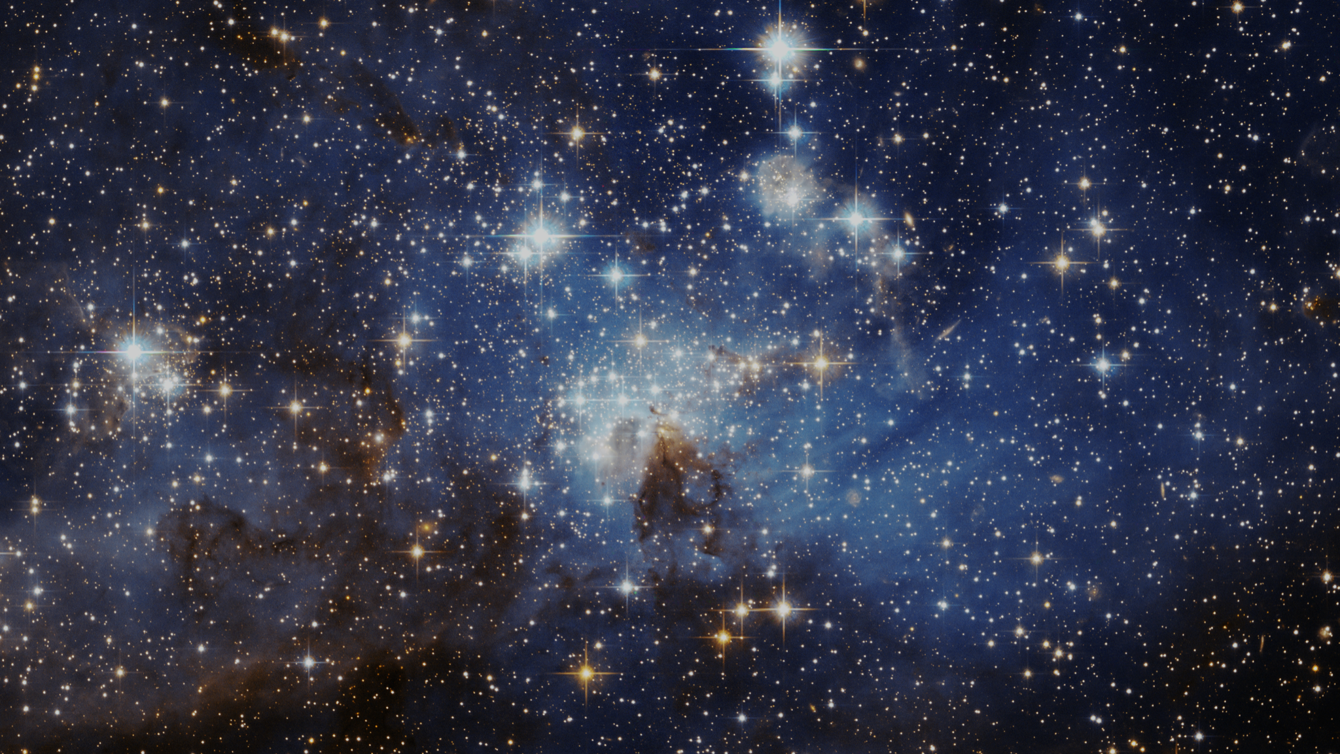
Stars vs. Planets –
Exoplanet Communications
There are many reasons why we can easily see stars in the night sky, but not their planets…
1
exoplanets.nasa.gov
Notes:
Planets vs Stars: Brightness, Size, and Weight ('Mass’) -- Audience: 4th Grade and older.
This slide illustrates why we can easily see stars in the night sky but not their planets. The slide incorporates a graphic comparison of Brightness, Size, and Weight.
User's notes: This slide is geared toward students in 4th grade; so it uses a concrete term ("weight") rather than an abstract one ("mass") since most young students are not yet familiar with physics concepts. Weight makes sense to all kids, it's something practical, something they can converse about it; the concept of "mass" only makes sense to kids familiar with physics concepts.
NOTE: This PowerPoint file has built-in interactive elements. To view them, you must be in "Slide Show" mode; you can then move to the next view either by clicking your mouse, the spacebar, or the arrow keys. This slide will not work in "regular viewing mode."
Animation:
Click 1: Transitions to next slide

Slide 2
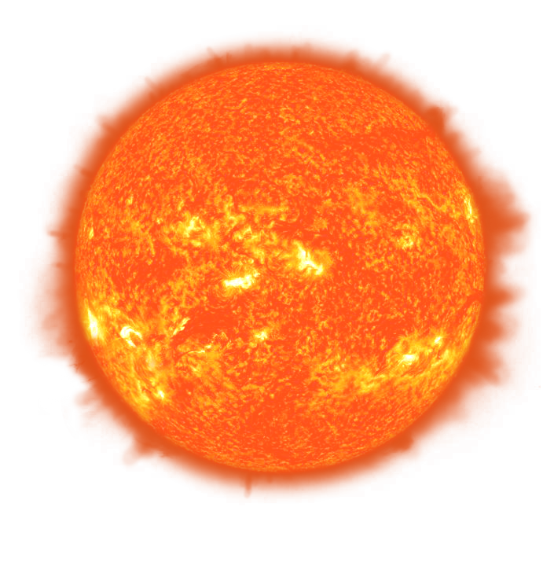
Stars vs. Planets – Brightness
Exoplanet Communications
Brightness:
The light reflected by a planet is extremely dim compared to the intense light from a star.
So, how many times brighter is the light emitted by the Sun…
…compared to the light reflected by Earth?
About 3,400,000,000 times brighter
(3.4 billion times brighter)
2
exoplanets.nasa.gov
Notes:
Animation: auto play of brightness statement
Click 1: question is displayed “how many times brighter?”
Click 2: answer is displayed “3.4 billion”
Click 3: transitions to next slide showing comparison (candle and lighthouses)

Slide 3
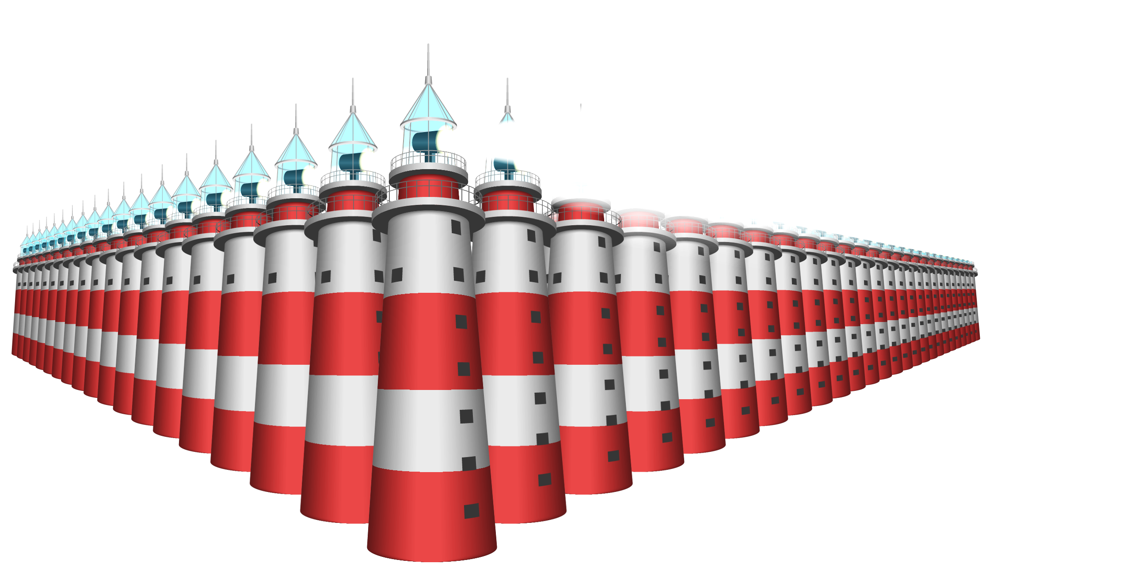
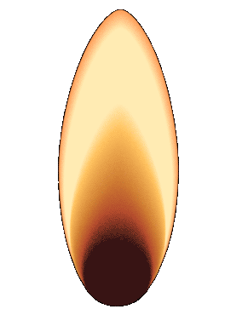
Stars vs. Planets – Brightness
Exoplanet Communications
It’s almost like comparing the tiny light from a candle…
…not with one single lighthouse…
But with the light from about
2,000 lighthouses!
3
exoplanets.nasa.gov
Notes:
Animation: auto play of candle comparison to 2000 lighthouses
Click 1: transitions to next slide

Slide 4
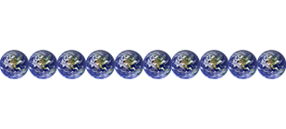
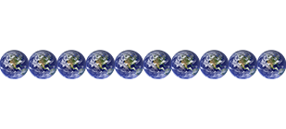
Stars vs. Planets – Size
Exoplanet Communications
?
Size:
110
Stars like the Sun are massive objects, far wider than planets such as Earth.
So, how many Earths would it take to equal the width of the Sun?
The Sun is 110 times wider than Earth.
4
exoplanets.nasa.gov
Notes:
Animation: auto play of size statement
Click 1: Sun scales down; question is posed, “how many Earth’s”?
Click 2: animation plays showing many tiny Earths extending across the Sun; answer is displayed (110 Earths)
Click 3: transitions to next slide where comparison animation plays (popcorn)

Slide 5
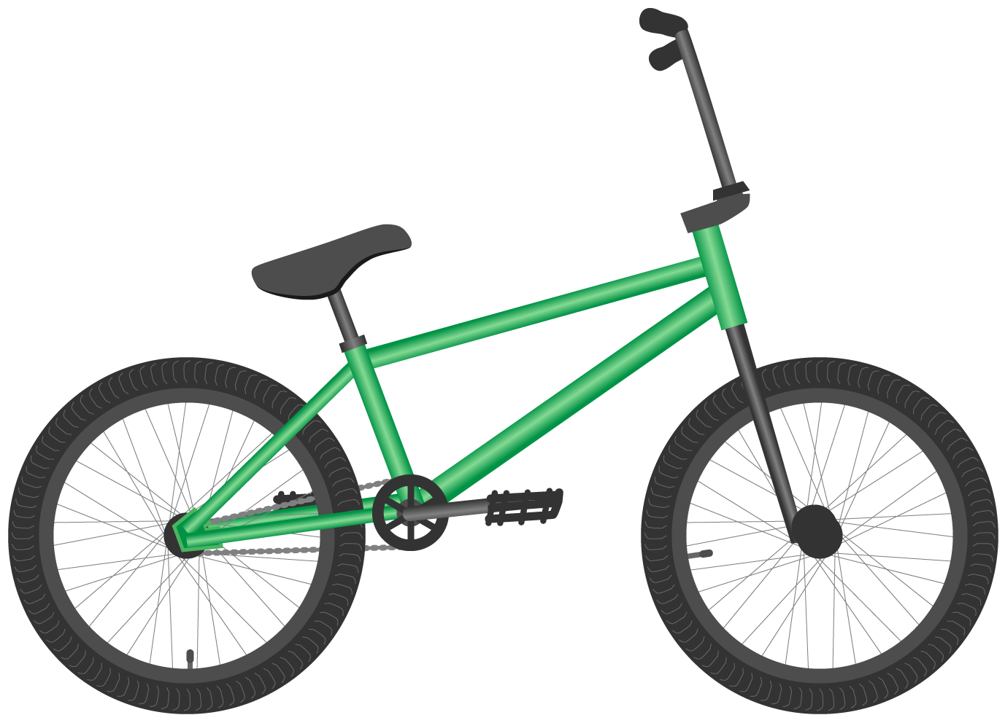
Stars vs. Planets – Size
Exoplanet Communications
It’s almost like comparing a piece of popcorn…
to a bicycle.
5
exoplanets.nasa.gov
Notes:
Animation: auto play of popcorn comparison to bicycle
Click 1: transitions to next slide

Slide 6
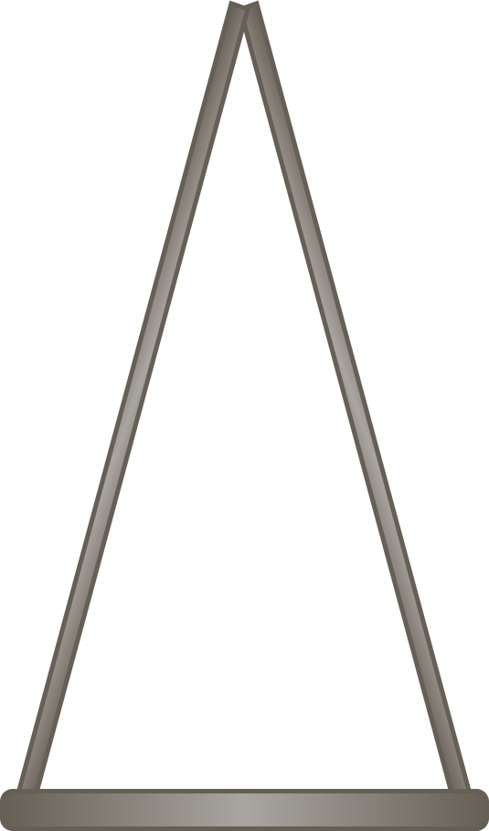
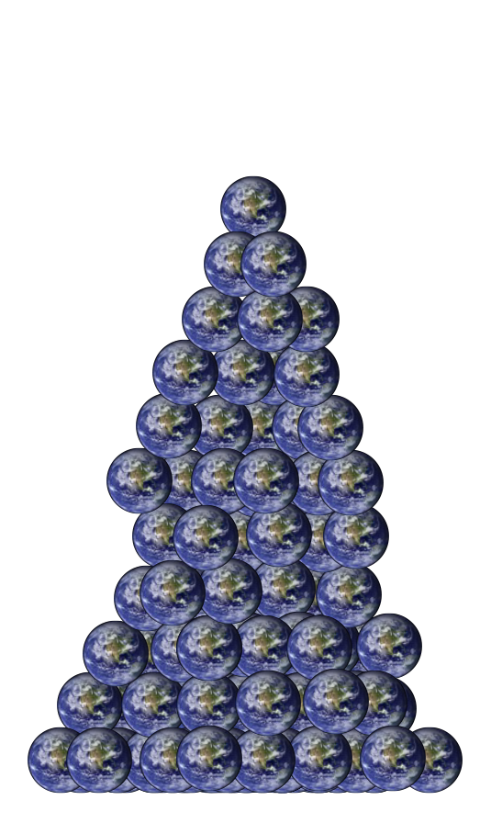
Stars vs. Planets – Weight (Mass)
Exoplanet Communications
So, how many Earths would it take to equal the weight of the Sun?
Weight:
Planets are much lighter than stars, which tend to be massive…
(Way too many to show here)
6
exoplanets.nasa.gov
Notes:
Animation: auto play of weight statement
Click 1: scale appears; questions is posed: “how many Earths would it take to equal the weight of the Sun?”
Click 2: animation plays showing many Earths stacking up on the balance scale
Click 3: transitions to next slide where answer to question appears “(333,000 Earths)”

Slide 7
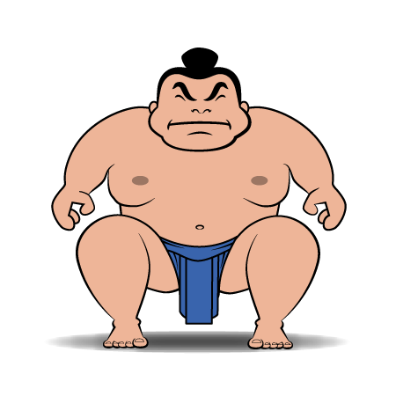
Stars vs. Planets – Weight (Mass)
Exoplanet Communications
About
333,000 Earths
It’s almost like comparing a paperclip…
equal the weight of the Sun.
to a sumo wrestler.
7
exoplanets.nasa.gov
Notes:
Planets vs Stars: Brightness, Size, and Weight (Mass) Audience: 4th Grade and older.
This slide illustrates why we can easily see stars in the night sky but not their planets. The slide incorporates a graphic discussion of Brightness, Size, and Weight.
User’s note: This slide uses a concrete term ("weight") rather than an abstract one ("mass") because in 4th grade students are not yet familiar with physics concepts. Weight makes sense to all kids, it's something practical, something they can converse about it; "mass" only makes sense to kids familiar with physics concepts.
Animation: auto play of answer (about 333,000 Earths)
Click 1: comparison animation plays (paperclip, etc.)
Click 2: transitions to next slide

