Slide 1
Exoplanet Biosignatures Workshop Without Walls
(aka ExoPAG SAG 16) Update
Organizers: Shawn Domagal-Goldman, Nancy Kiang, Niki Parenteau
Chapter leads: Eddie Schwieterman, Hillairy Hartnett, Victoria Meadows, Chris Reinhard, David Catling, Sara Walker, Bill Moore, Yuma Fujii

Slide 2
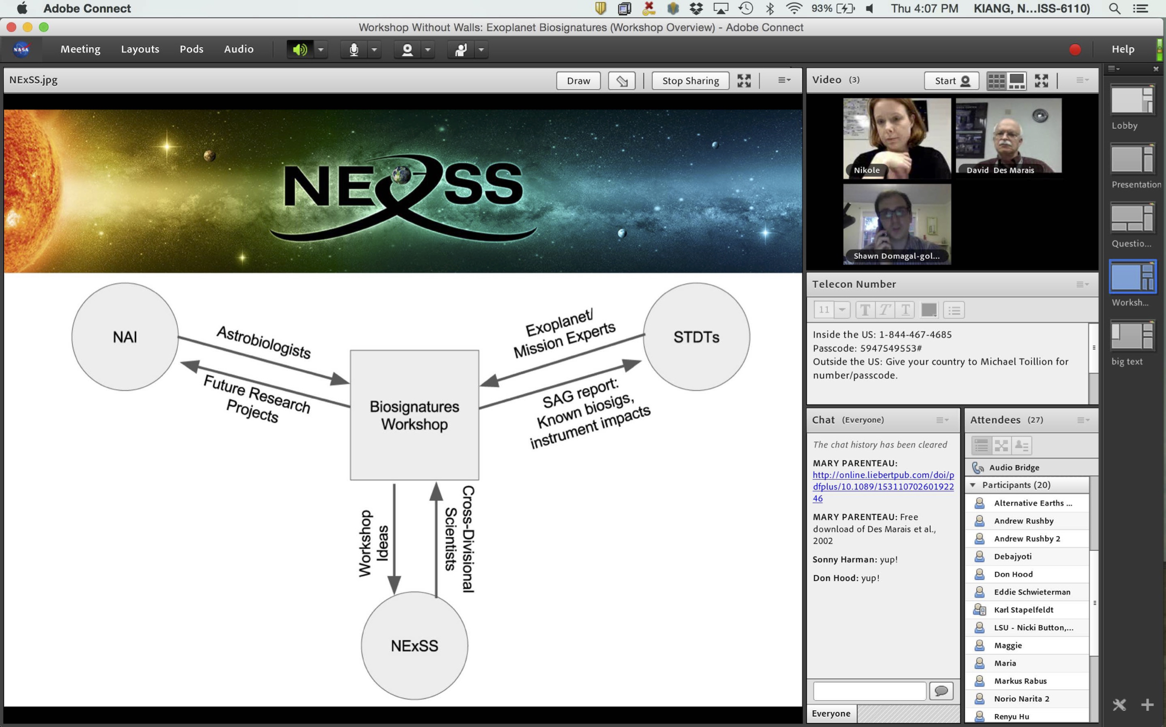

Slide 3
ExoPAG SAG16 has submitted 5 manuscripts for publication in Astrobiology:
EB I: Exoplanet Biosignatures: A Review of Remotely Detectable Signs of Life. Schwieterman et al.
Exoplanet Biosignatures: Understanding Oxygen as a Biosignature in the Context of Its Environment. Meadows et al.
Exoplanet Biosignatures: A Framework for Their Assessment. Catling et al.
Exoplanet Biosignatures: Future Directions. Walker et al.
Exoplanet Biosignatures: Observational Prospects. Fujii et al.
+1. Executive Summary of 1-5 above – draft complete, to be submitted soon
The SAG 16 report will consist of all of the above + an appenix outlining the SAG 16 process/meetings.
We are also submitting white papers to the NAS studies on astrobiology and exoplanets

Slide 4
Planetary Biosignatures Reviewed
e.g., O₂, O₃, CH₄, N₂O, DMS, DMDS, CH₃Cl, CH₃SH, CS₂, C₂H₆, organize haze, etc.
Atmospheric Gases
Surface Features
e.g., Vegetation Red Edge (VRE),
Other Reflectance features
Temporal Changes
e.g., Seasonal Change in Gas (e.g., “Keeling Curve”) or Pigments
Notes:
Recommendation to use this as the structure for the talk
We have to figure out which planets are most likely to harbor life, and determine how we will use observations available to us to choose the best targets. Then we have to determine how we would recognizethat they can support life.
Photometric, spectral or temporal features indicative of life’s global impact on a planetary environment.
Earth exhibits global-scale modification of its:
Atmosphere
Surface
Temporal behavior
These must be identified in context
Possible False Positives
Planetary processes that mimic the characteristics expected of a biosignature.
Possible “Antibiosignatures”

Slide 5
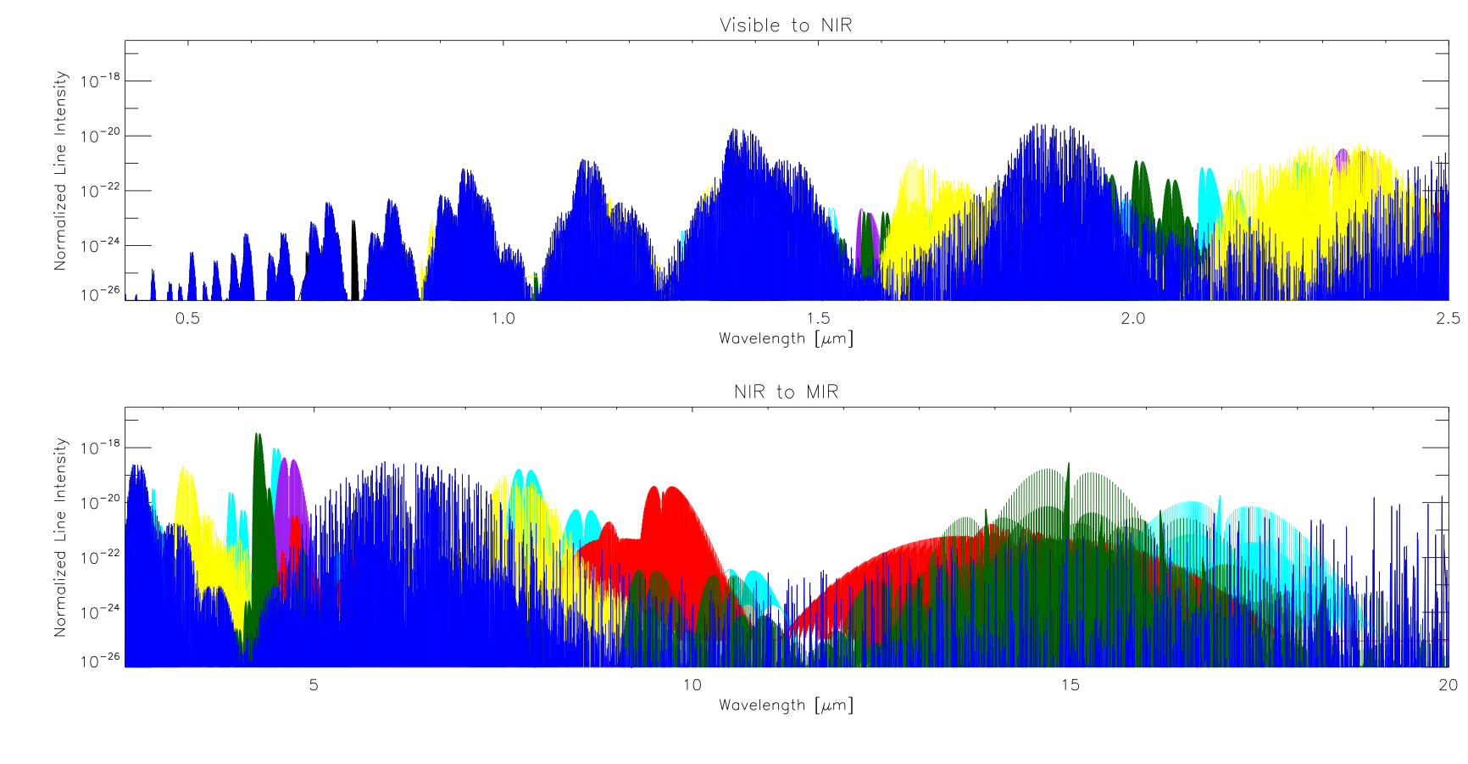
Line Intensities for Major Gases in Atmosphere
VIS to NIR: 0.4 – 2.5 μm
H₂O
CO₂
O₂
O₃
CH₄
CO
N₂O
0.5
1.0
2.0
2.5
NIR to MIR: 2.5 – 20 μm
More Absorption
5
10
15
20
Wavelength [μm]
Schwieterman, et al., submitted
Notes:
Figure 6 - Biosignature and habitability marker gas absorption lines. Line intensities (cm⁻¹/(molecule cm⁻²)) from HITRAN 2012 (Rothman et al. 2013) for the following gases: H₂O, CO₂, O₂, O₃, N₂O, CO, and CH₄. [Note: To be replace by individual panels for each biosignature gas (adding CH₃Cl, DMS, DMDS, CH₃SH, C₂H₆). CO₂ and H₂O will be split up and constitute Figure 3 with N₂.]
Figure 2.3. HITRAN 2012 (Richard et al. 2012) absorption line intensities (cm⁻¹/(moleculecm⁻²)) for each major absorbing gas in Earth’s atmosphere (0.4-20 μm): H₂O, CO₂, O₃, CH₄, N₂O, CO, and O₂. Includes isotopologues whose line intensities have been scaled by their natural abundance (on Earth).

Slide 6
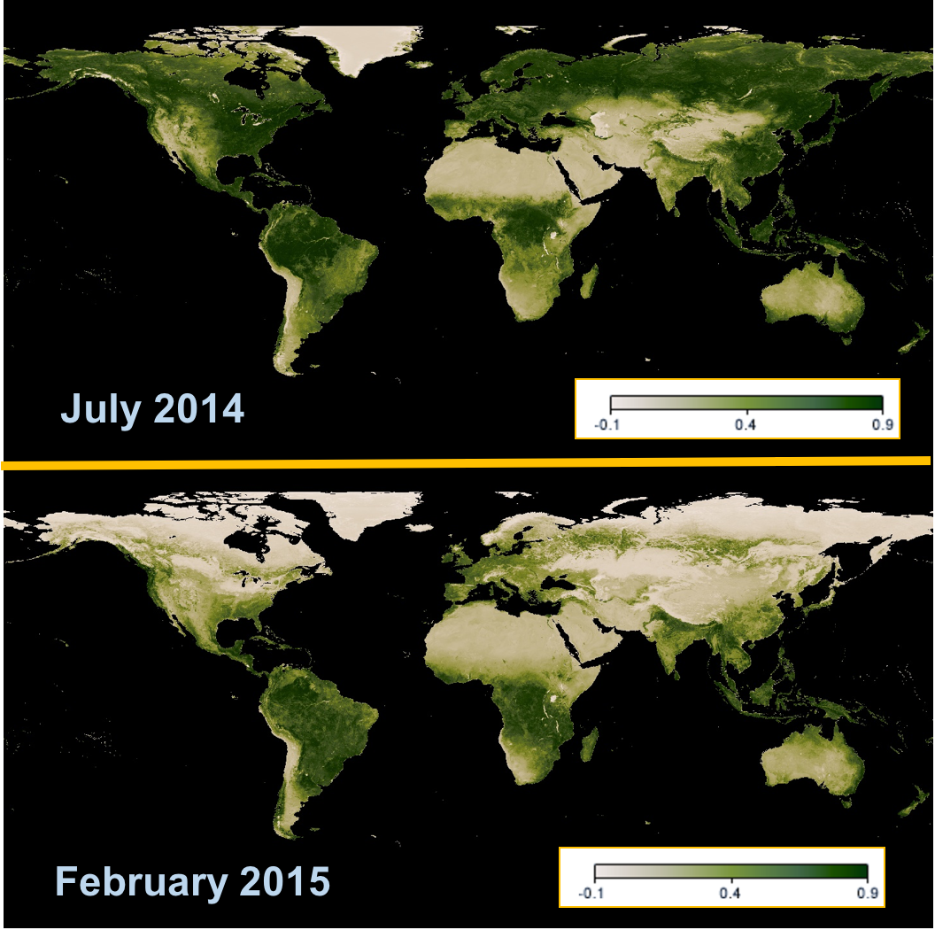
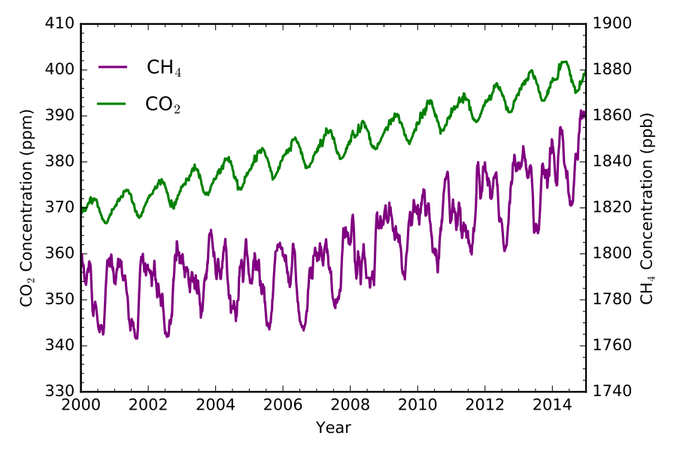
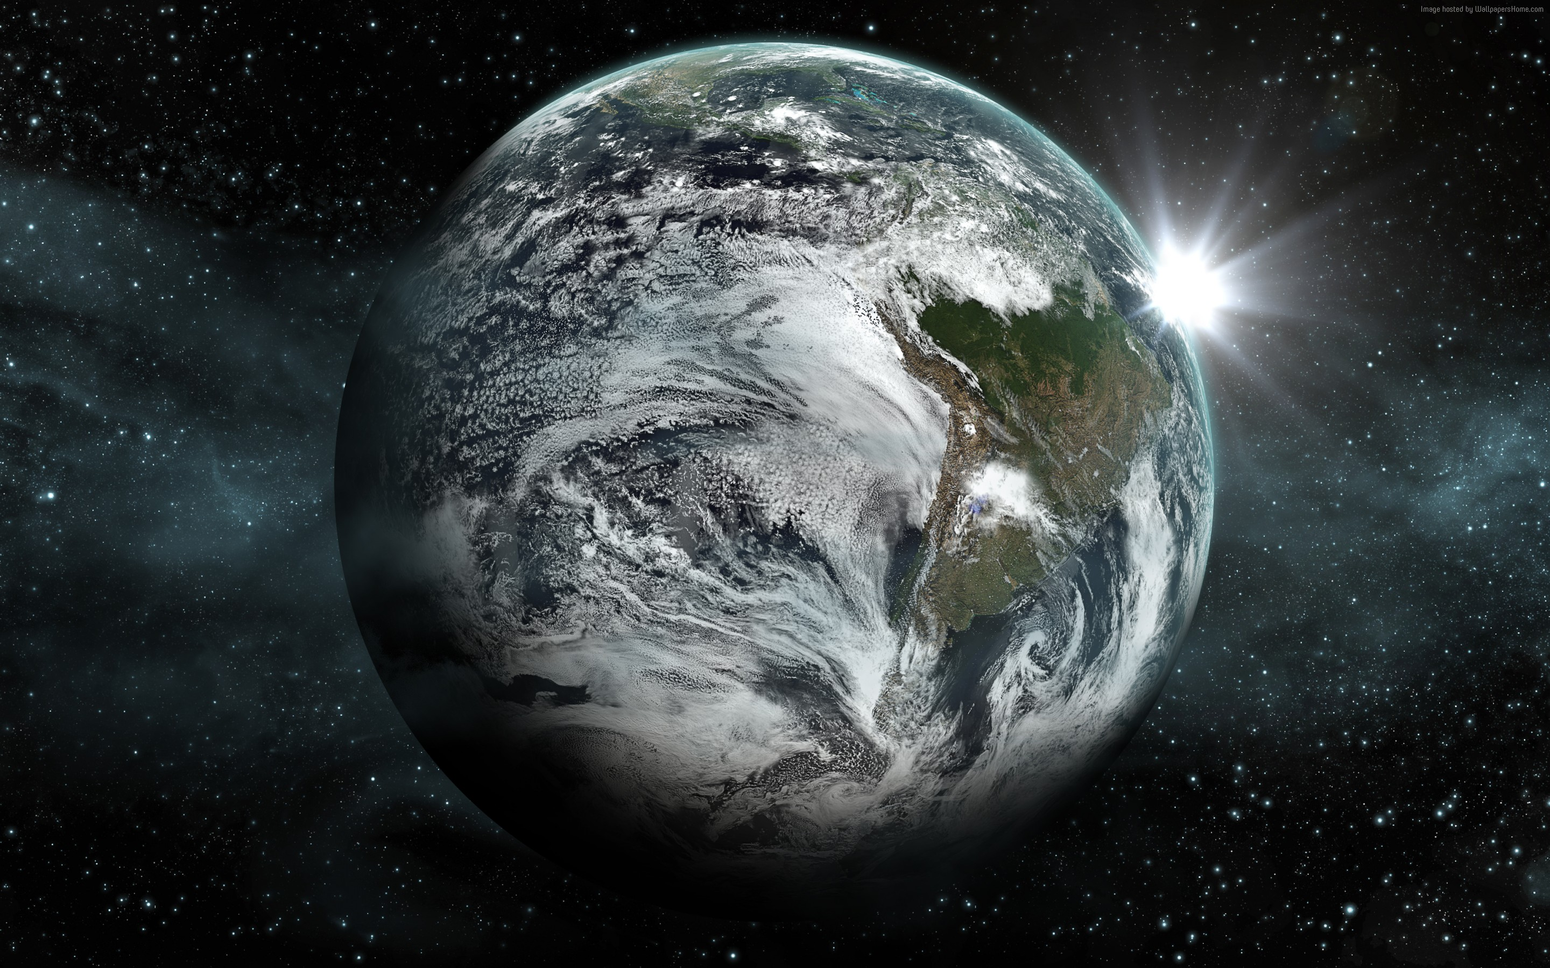
Gas abundance oscillations as a possible temporal biosignature
Seasonal change in global NDVI

Slide 7
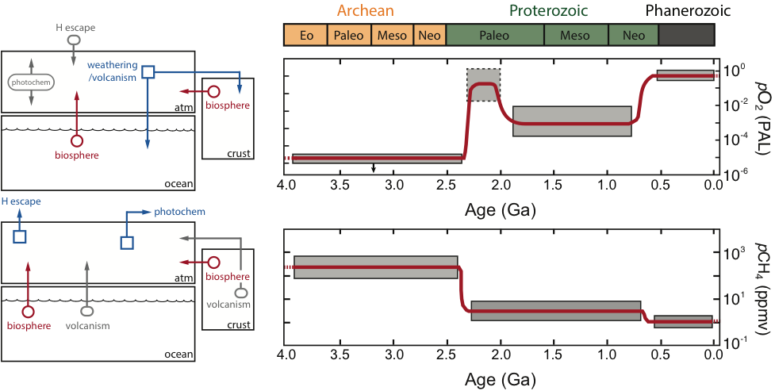
Meadows, et al., submitted

Slide 8
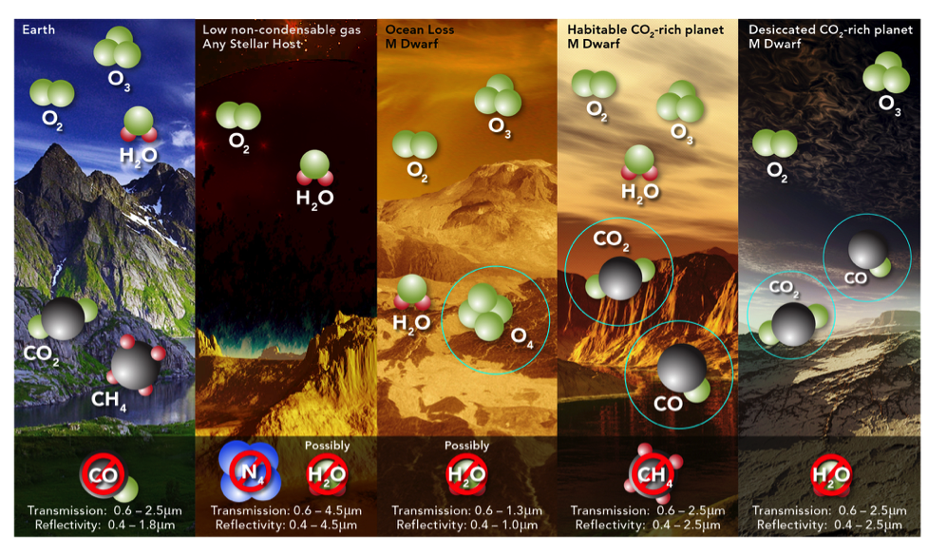
Meadows, et al., 2017

Slide 9
Catling, et al., submitted

Slide 10
A framework for exoplanet biosignature assessment
(Catling+ 2017,
Astrobiol, submitted.)
Observational astronomy
All of Astrobiology
Virtual Planetary Models
Catling, et al., submitted

Slide 12
Moving from product-based to process-based approaches
Questions in a process-based approach:
  What fundamental life processes underlie the chemistry we can detect on exoplanets?
  How do we detect these processes?
  And how can understanding the processes of life in turn inform new ways to identify and interpret the chemical signatures of life?

Slide 13
What remote biosignatures will work when environmental context and biology are different than Earth?
Image from Cronin & Walker Science 2016

Slide 15
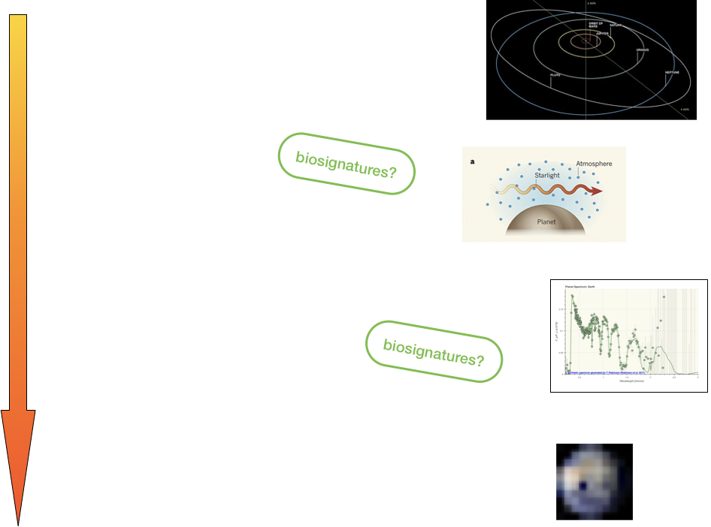
Fujii, et al., in prep

Slide 16
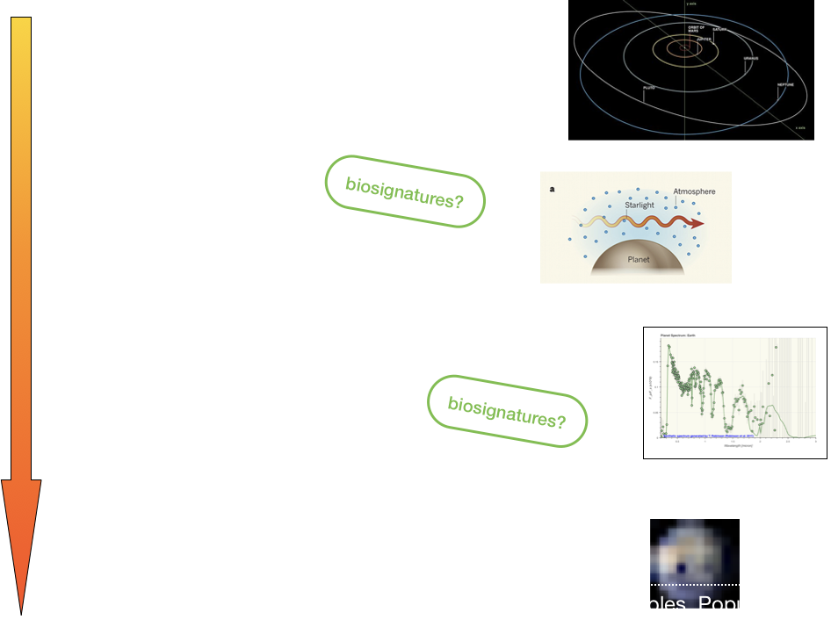
Fujii, et al., in prep

Slide 17
