Slide 1
Interactive PowerPoint Slides to be Used in Public Engagement
National Aeronautics and Space Administration
A set of slides designed to help teachers and Subject Matter Experts explain complex topics in a fun way.

Slide 2
Author:
Yasuhiro Hasegawa, Jet Propulsion Laboratory, California Institute of Technology
Slide design:
Richard Barkus, Jet Propulsion Laboratory, California Institute of Technology
Acknowledgement:
This work was carried out at the Jet Propulsion Laboratory, California Institute of Technology, under a contract with the National Aeronautics and Space Administration,
through funding from the NASA Exoplanet Exploration Program
All artwork made at JPL-Caltech.

Slide 3
INSTRUCTIONS:
These files have built-in interactive elements. To view them, PowerPoint must be in "Slide Show" mode; you can then move to the next slide or interactive event either by clicking your mouse, the spacebar, or the arrow keys.
These slides will not work in "regular viewing mode.”

Slide 4
List of slides
Astronomical Objects
Black Holes – Q&A
Black Holes – Three Kinds
Black Holes – What Are They?
Black Holes – Comparison with Planets
Exoplanet Detection – Gravitational Microlensing
Exoplanet Detection – Radial Velocity
Exoplanet Detection – Transit
Exoplanet Detection History
Space Telescope – Kepler vs TESS

Slide 5
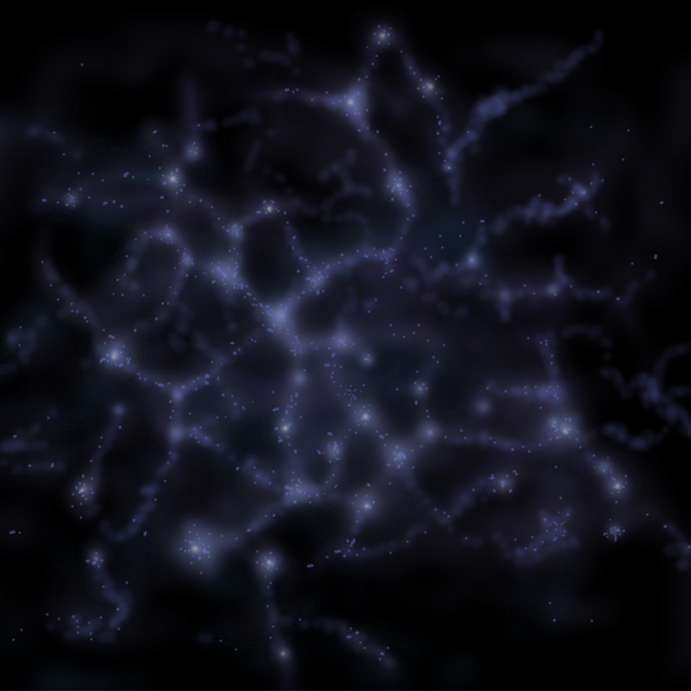
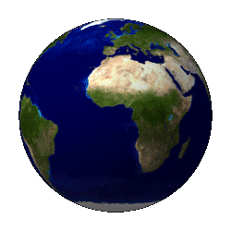
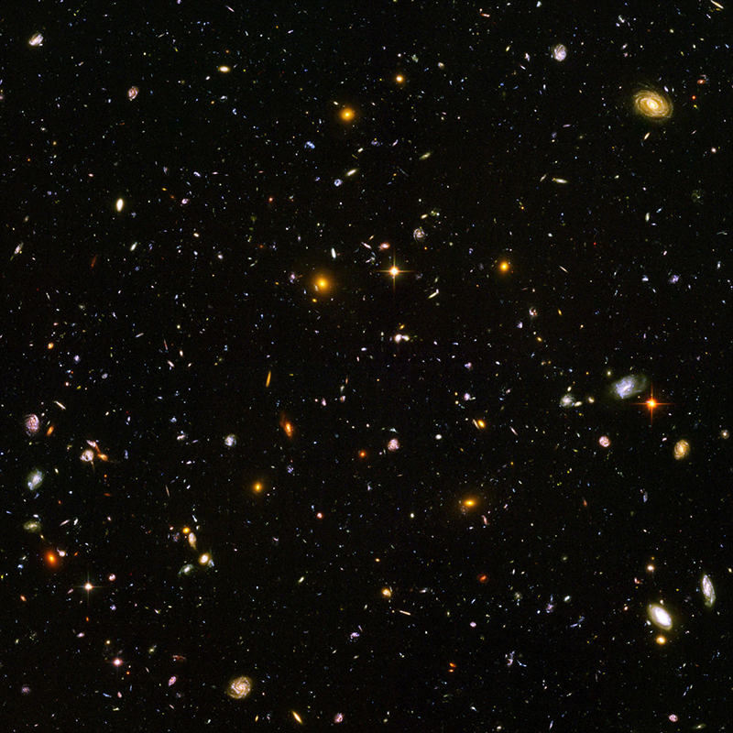
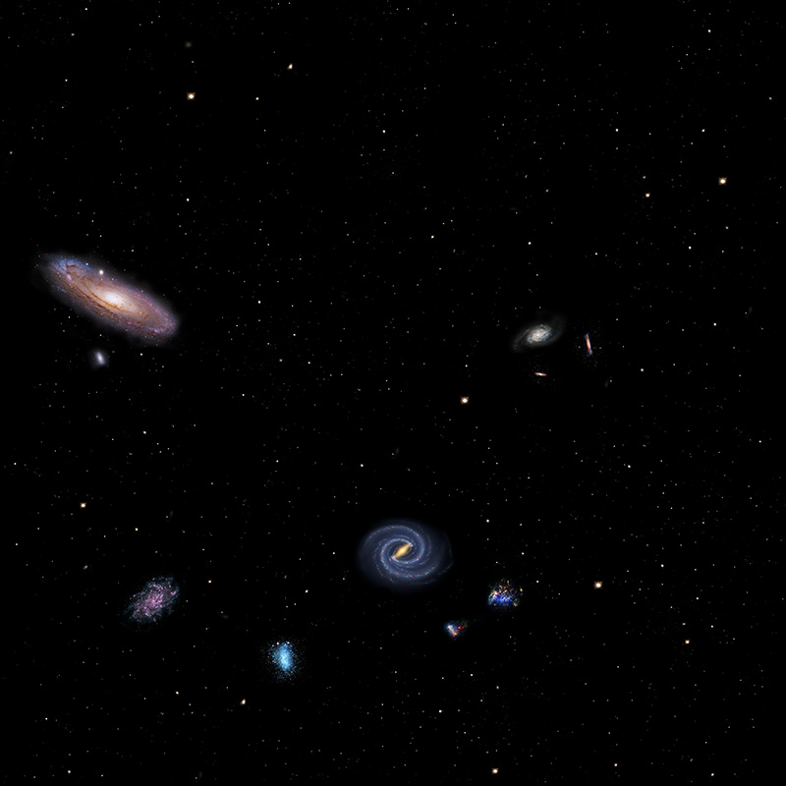
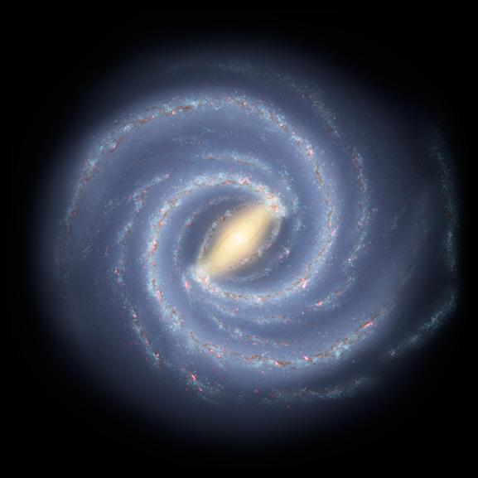
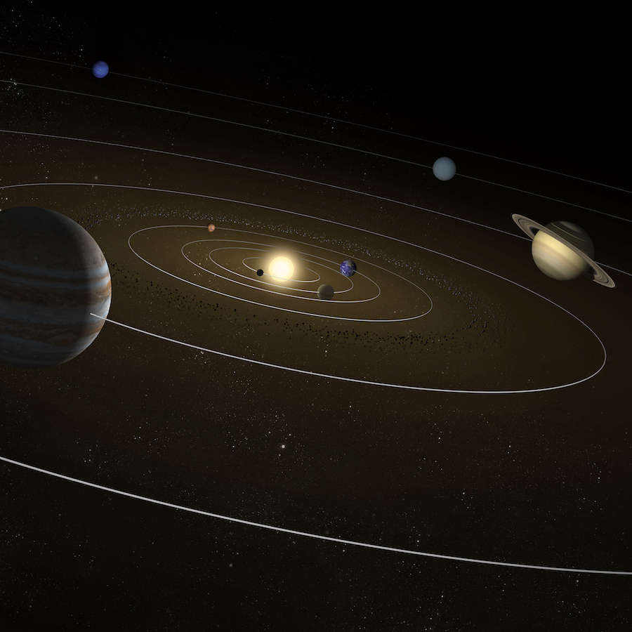
Astronomical Objects – From Earth to the Universe
Exoplanet Communications
The
Universe
The Local Supercluster
The
Local Group
The
Milky Way
The
Solar System
Age:
~13.8 billion years
Age:
~13.6 billion years
Size:
93 billion light years
Size:
~110 million light years
Age:
~13.6 billion years
Size:
~10 million light years
Age:
~13.6 billion years
Size:
~100 kilo light years
Age:
~4.6 billion years
Size:
~0.0005 light year (to Neptune)
Notes:
This slide requires 5 clicks:
Reveals the Solar System and details
Reveals the Milky Way and details
Reveals the Local Group and details
Reveals the Local Supercluster and details
Reveals the Universe and details
Audience:
9th Grade and older.
Description:
This slide explains and illustrates how small the solar system is in the universe (or how big the universe is) and the hierarchical structure of the universe and its constituents.
User's notes:
some visualizations (e.g., the milky way and the local group) are idealized, and numbers (i.e., the age and size) are approximate.
NOTE:
This PowerPoint file has built-in interactive elements.
To view them, you must be in "Slide Show" mode; you can then move to the next view either by clicking your mouse, the spacebar, or the arrow keys.
This slide will not work in "regular viewing mode."
Credit:
NASA/JPL-Caltech

Slide 6
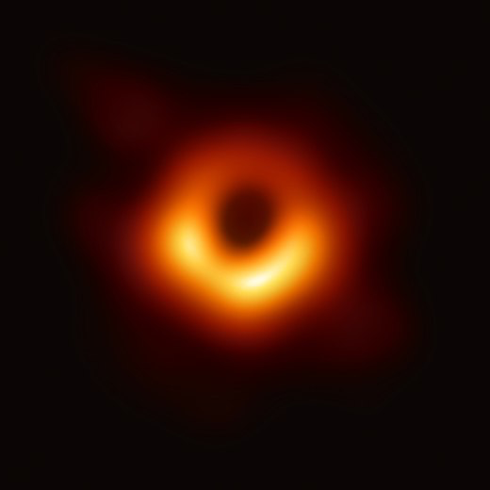
Black Holes – Q & A
Exoplanet Communications
Why does light become captured by a black hole although it has no mass?
A: Einstein proposed that gravity ”bends” spacetime. Light travels along
it, so light is captured by very massive bodies like black holes.
What observatories made recent, astonishing discoveries?
A: A black hole’s shadow was detected by the Event Horizon Telescope, and gravitational waves from collisions of black holes were detected by LIGO and VIRGO.
Are there any black holes present near our solar system and do they affect our lives?
A: Probably not, the nearest black hole currently known is about 1,500
light-year away from the Earth.
Can black holes eat up the entire galaxy?
A: It is possible, but very unlikely; when black holes “eat” nearby objects,
they “feedback” some of the energy, which prevents further eating.
exoplanets.nasa.gov
Notes:
Highlights question #1
Answers question #1
Highlights question #2
Answers question #2
Highlights question #3
Answers question #3
Highlights question #4
Answers question #4
Audience:
9th Grade and older.
Description:
This slide addresses the common questions about black holes raised by the audience.
User's notes:
The additional information can be available at e.g., https://www.nasa.gov/audience/forstudents/k-4/stories/nasa-knows/what-is-a-black-hole-k4.html,
https://eventhorizontelescope.org/press-release-april-10-2019-astronomers-capture-first-image-black-hole,
https://www.ligo.caltech.edu/page/gw-sources.
NOTE:
This PowerPoint file has built-in interactive elements.
To view them, you must be in "Slide Show" mode; you can then move to the next view either by clicking your mouse, the spacebar, or the arrow keys.
This slide will not work in "regular viewing mode."
Credit:
NASA/JPL-Caltech

Slide 7
Black Holes – Three Kinds
Exoplanet Communications
Mass: ~ 10 times the Sun
Size: ~ 30 km
Origins:
Form after the death of massive stars (supernovae)
Mass: ~ 1,000 times the Sun
Size: ~ 1000 km
Origins:
Still unknown...
May be the accumulation of surrounding materials and merging of stellar black holes and/or dark matter
Mass: between ~ 100,000 and 10 billion times the Sun
Size: ~ 100,000 km
(~ Jupiter’s diameter)
to ~3 billion km
(~ Uranus’ orbit)
Origins:
Still unknown...
May be the accumulation of surrounding materials and merging of stellar black holes and/or dark matter
Stellar black holes
Intermediate-mass black holes
Supermassive black holes
exoplanets.nasa.gov
Notes:
This slide requires 3 clicks:
Highlights topic #1 (stellar black holes)
Dims topic #1 and highlights topic #2 (intermediate-mass black holes)
Dims topic #2 and highlights topic #3 (supermassive black holes)
Audience:
9th Grade and older.
Description:
This slide addresses the common questions about black holes raised by the audience.
User's notes:
The additional information can be available at e.g., https://www.nasa.gov/audience/forstudents/k-4/stories/nasa-knows/what-is-a-black-hole-k4.html,
https://eventhorizontelescope.org/press-release-april-10-2019-astronomers-capture-first-image-black-hole,
https://www.ligo.caltech.edu/page/gw-sources.
NOTE:
This PowerPoint file has built-in interactive elements.
To view them, you must be in "Slide Show" mode; you can then move to the next view either by clicking your mouse, the spacebar, or the arrow keys.
This slide will not work in "regular viewing mode."
Credit:
NASA/JPL-Caltech

Slide 8
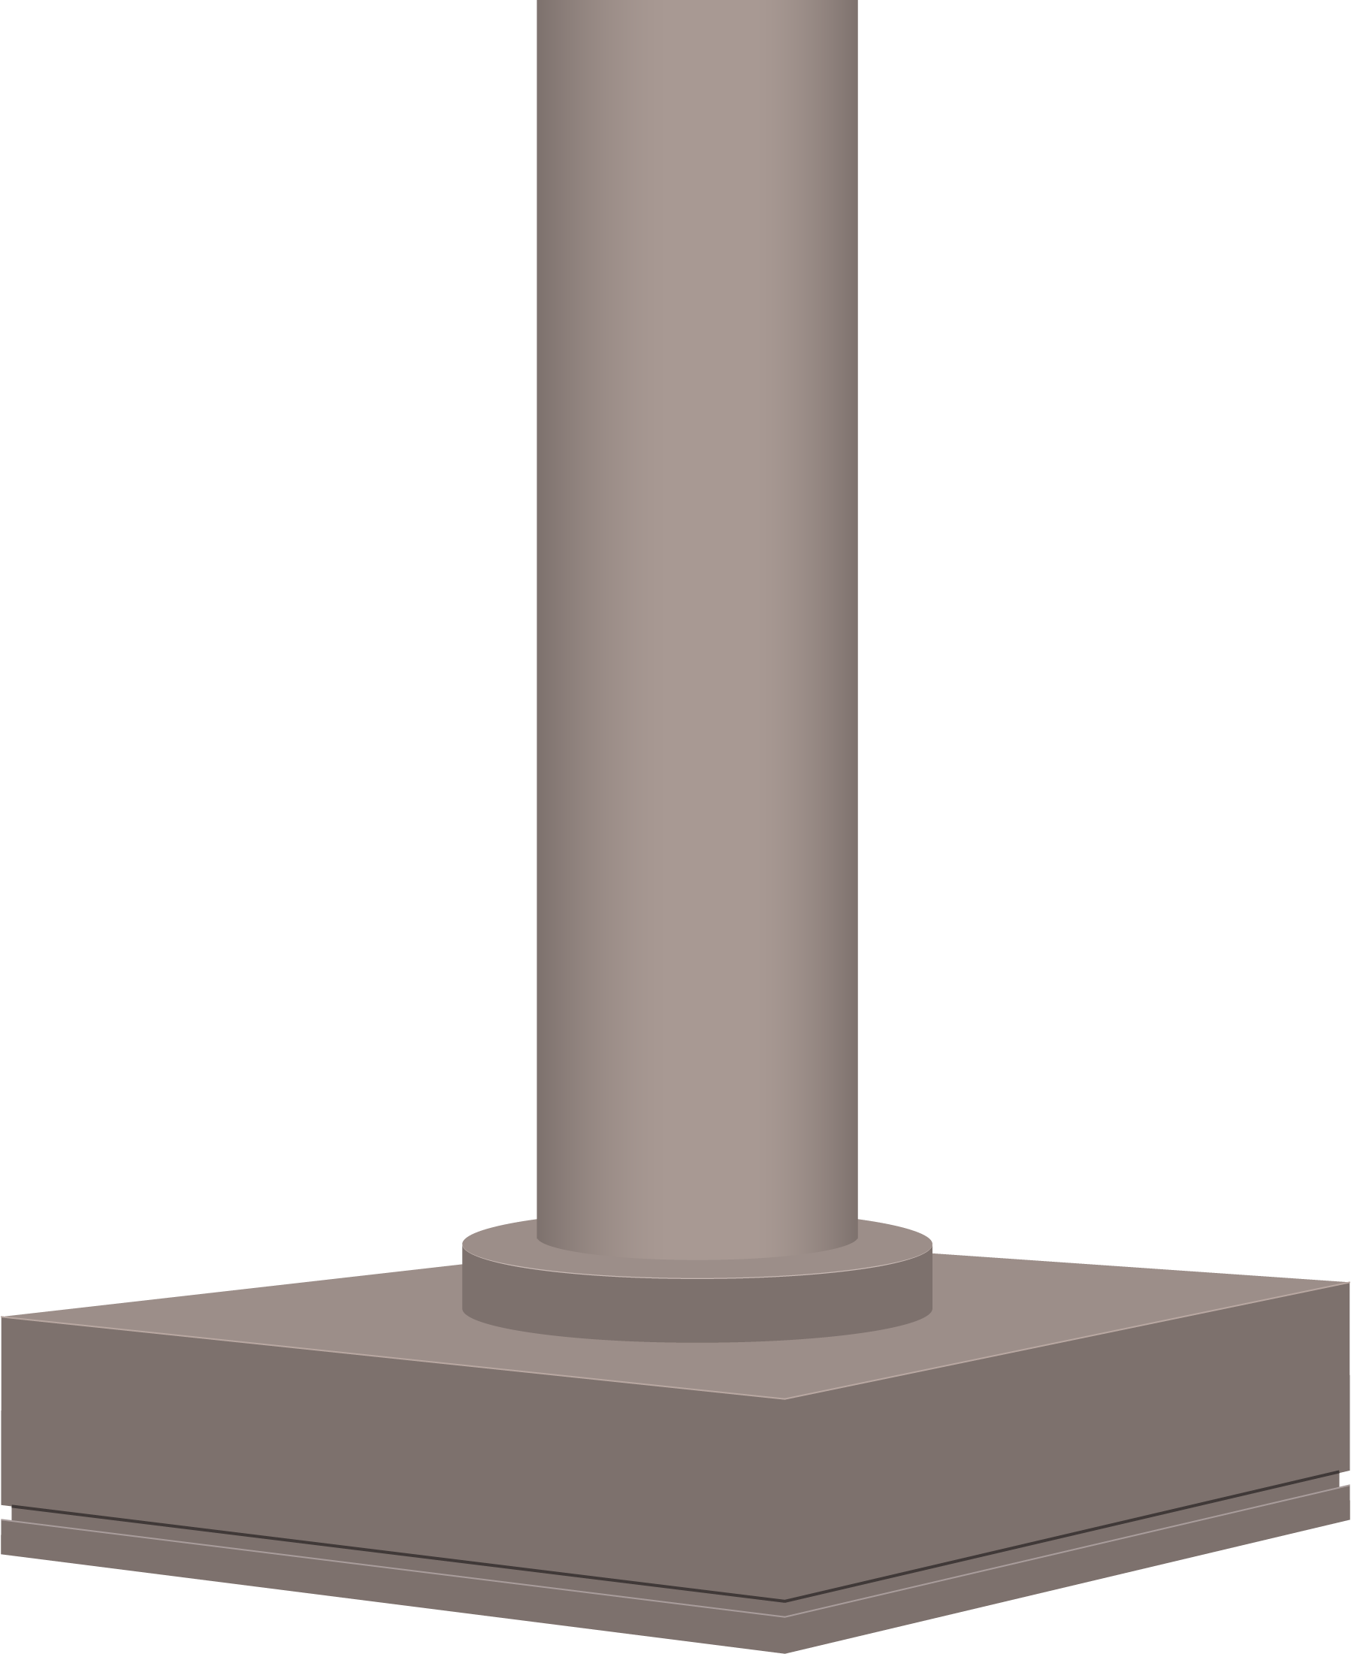
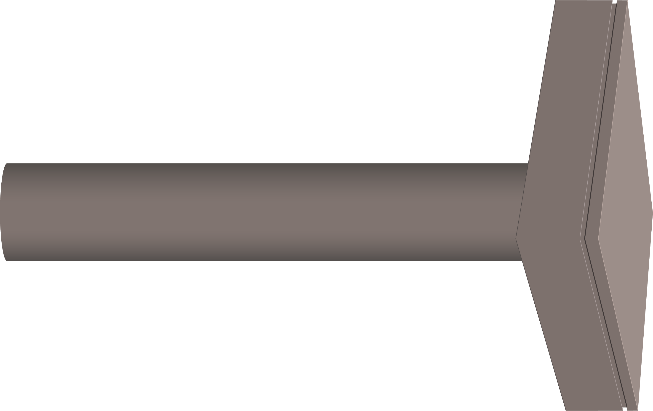
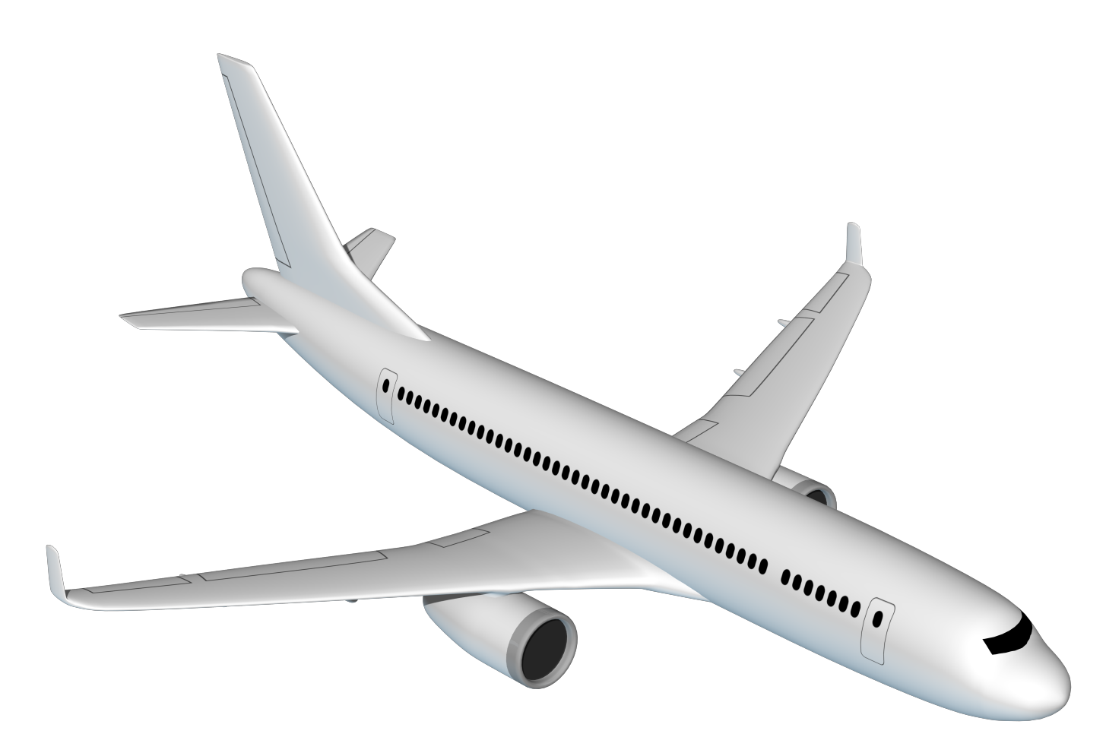
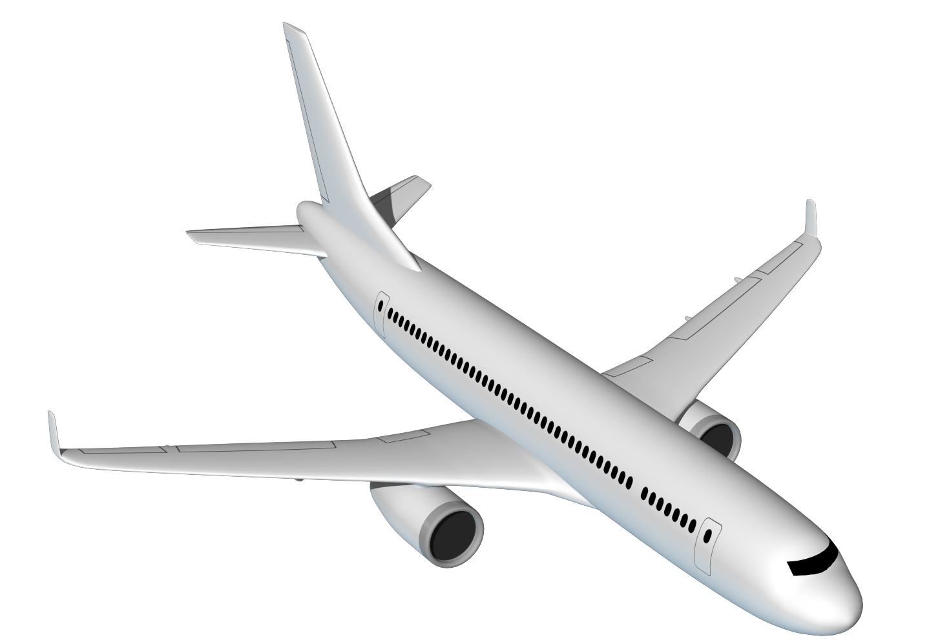
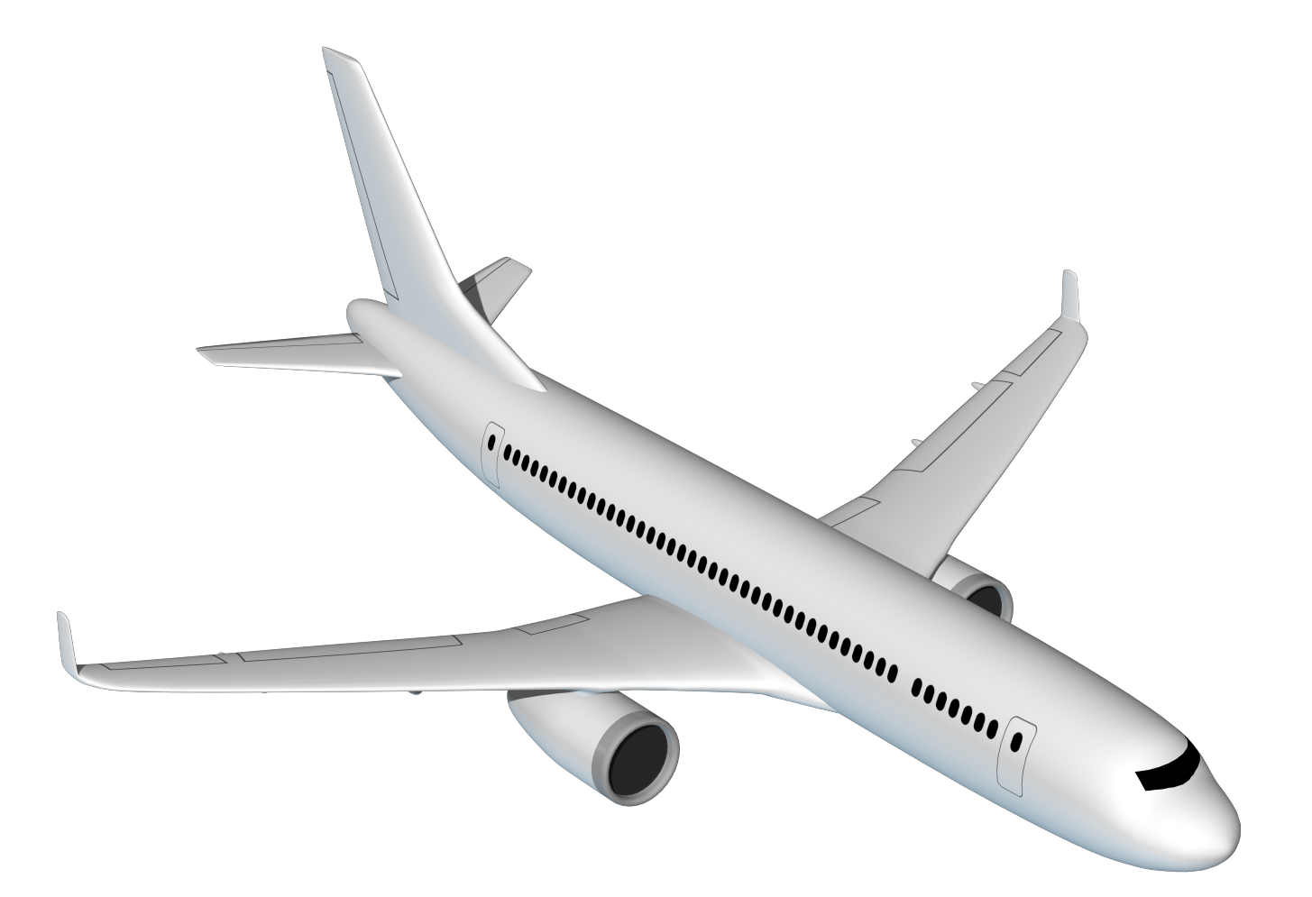
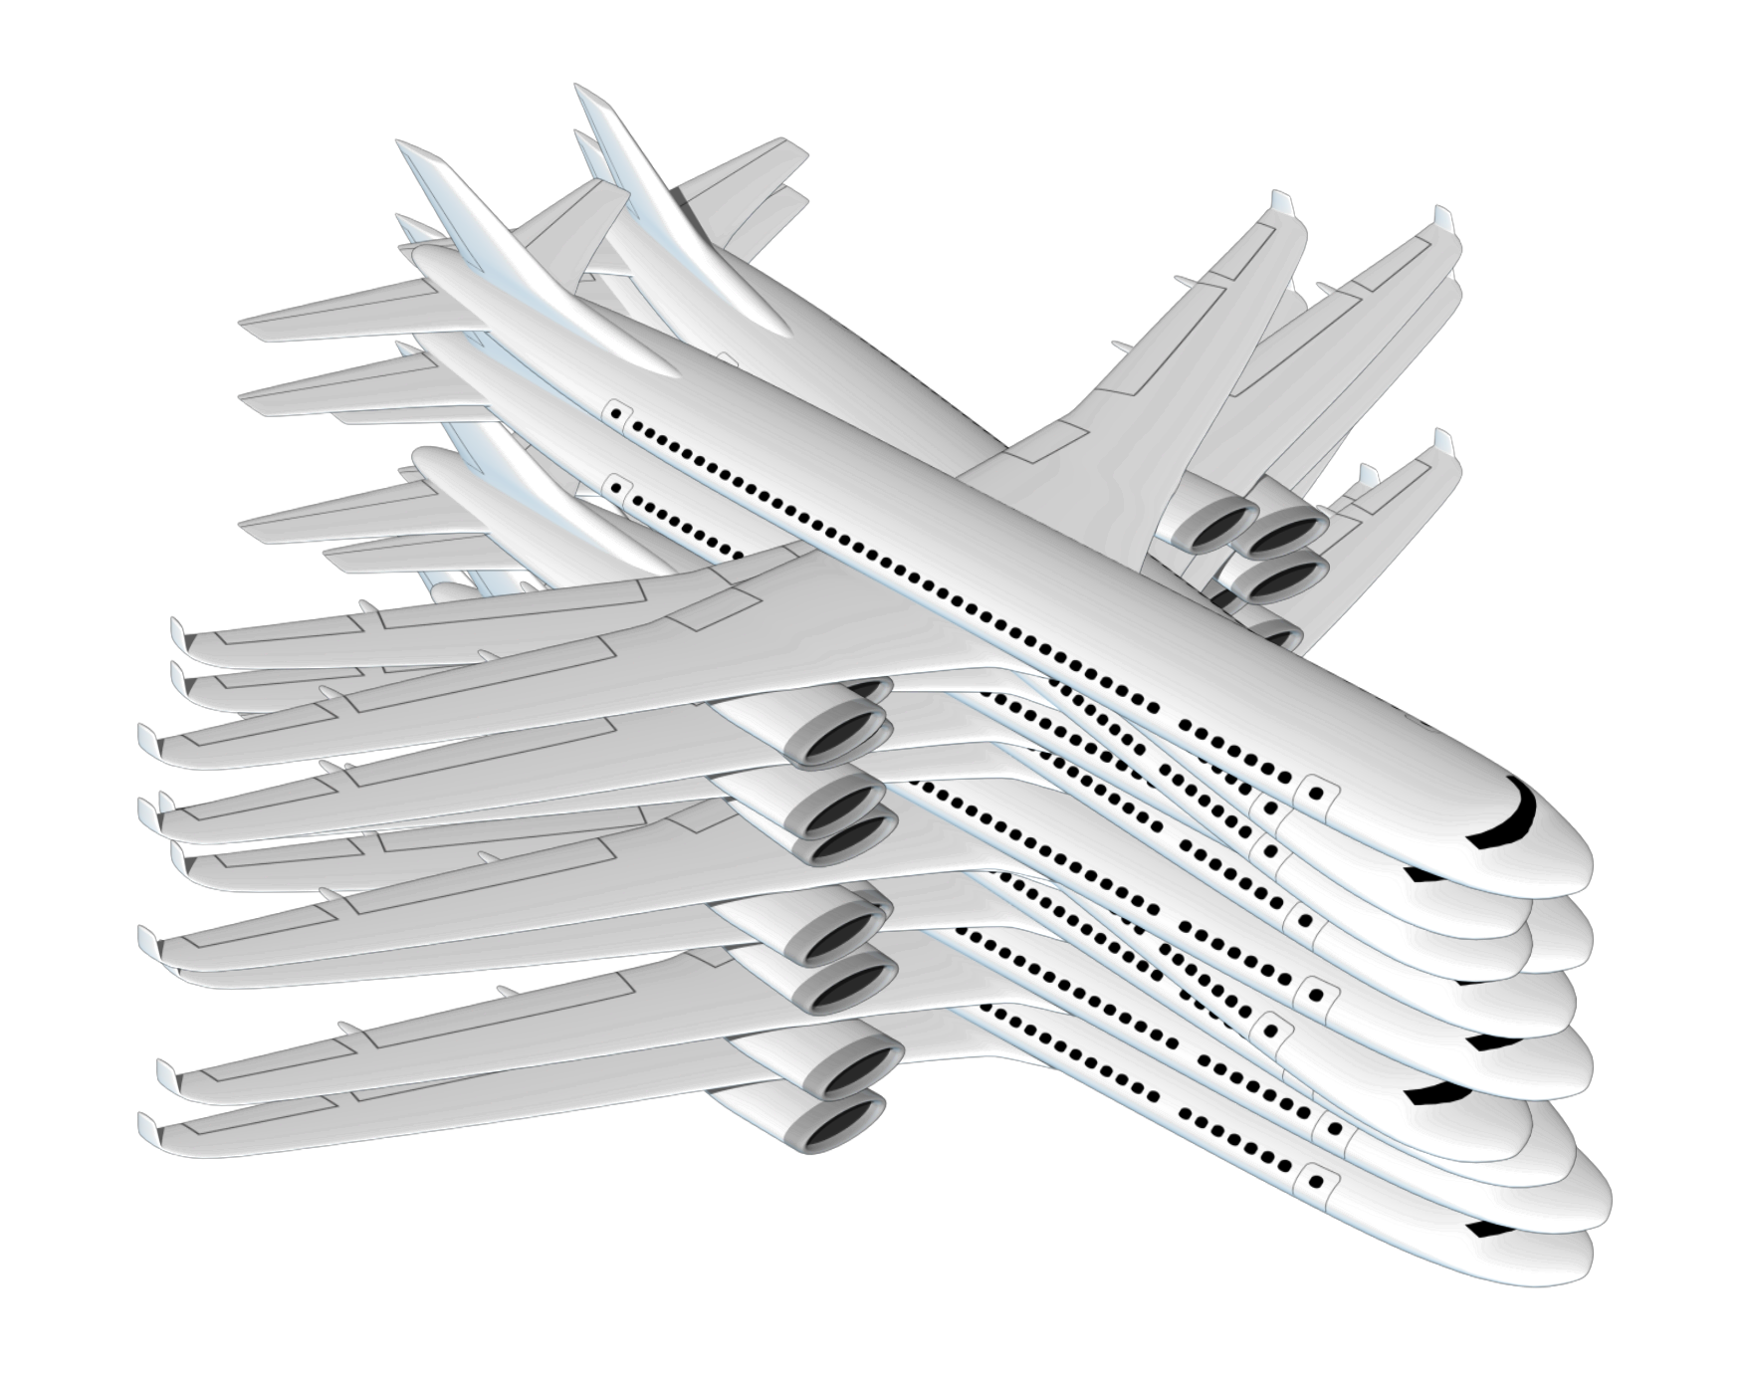
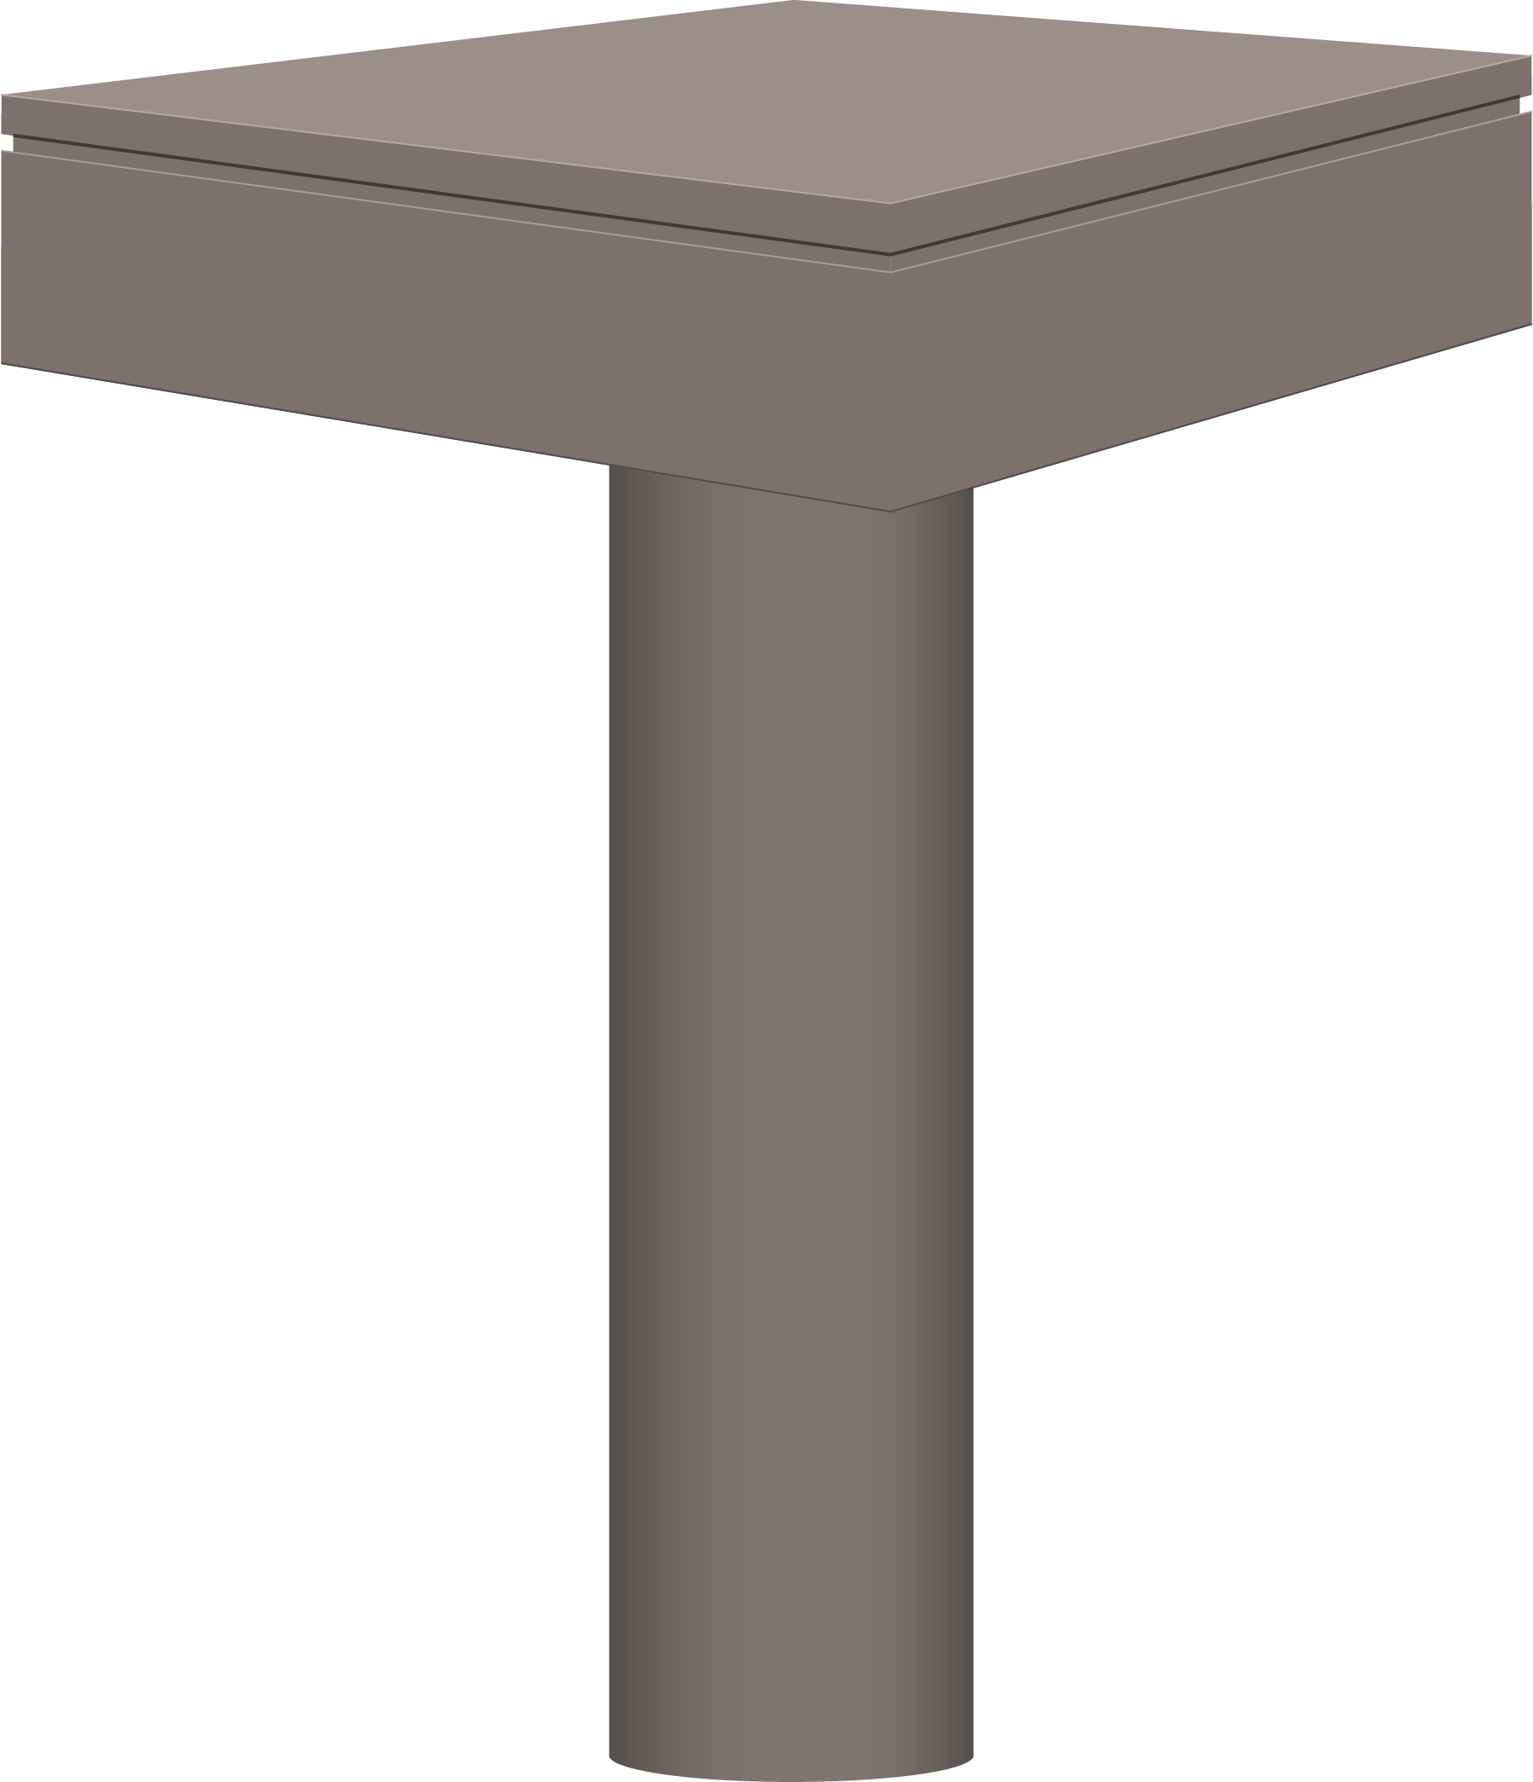
Black Holes – What are Black Holes?
Exoplanet Communications
It’s as if…
One description…
An astronomical object that is very, very massive, and yet whose mass is contained in a very, very small volume.
You had one commercial airliner,
then stacked nine more on top.
Until you were left with something the size of…
Compressed
them down…
a tiny single die.
Numbers…
Black holes are 1,000 times more massive than that of the Sun,
yet with about the size of Earth. (Applies to intermediate-mass black holes)
exoplanets.nasa.gov
Notes:
This sequence requires 3 clicks:
First click brings up a description of a black hole
Second click brings up numerical data
3) Third click initiates animation sequence (airliners, compression, magnifying glass)
Audience:
4th Grade and older.
Description:
This slide explains and illustrates how dense black holes are, using the animated example.
User's notes:
The additional information can be available at e.g., https://www.nasa.gov/audience/forstudents/k-4/stories/nasa-knows/what-is-a-black-hole-k4.html,
https://eventhorizontelescope.org/press-release-april-10-2019-astronomers-capture-first-image-black-hole,
https://www.ligo.caltech.edu/page/gw-sources.
NOTE:
This PowerPoint file has built-in interactive elements.
To view them, you must be in "Slide Show" mode; you can then move to the next view either by clicking your mouse, the spacebar, or the arrow keys.
This slide will not work in "regular viewing mode."
Credit:
NASA/JPL-Caltech

Slide 9
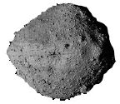
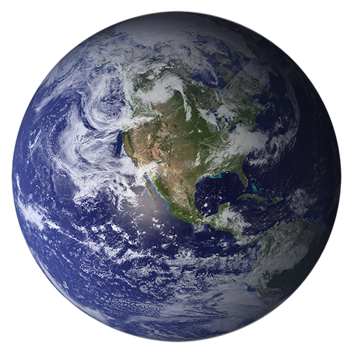
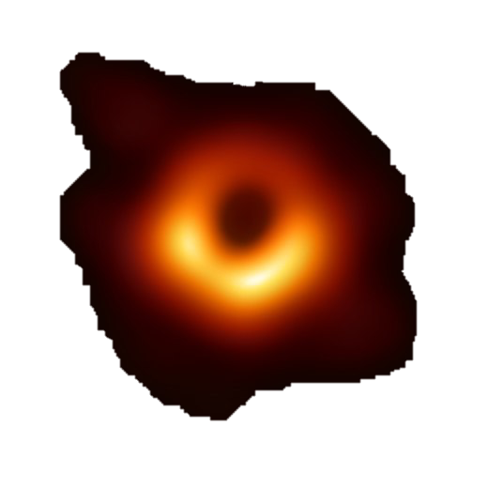
Black Holes – Black Holes vs. Planets
Exoplanet Communications
Planets
Asteroids
Black Holes
exoplanets.nasa.gov
Notes:
This slide is set to auto play
Click to advance to part two of Black Holes vs. Planets
Audience:
4th Grade and older.
Description:
This slide explains and illustrates how the gravity of astronomical objects changes the trajectory of asteroids.
User's notes:
The trajectory of asteroids is approximate;
Depending on the impact parameter (i.e., the nearest distance between the Earth and asteroids), the Earth can bend the trajectory of asteroids.
The additional information can be available at e.g., https://www.nasa.gov/audience/forstudents/k-4/stories/nasa-knows/what-is-a-black-hole-k4.html,
https://eventhorizontelescope.org/press-release-april-10-2019-astronomers-capture-first-image-black-hole,
https://www.ligo.caltech.edu/page/gw-sources.
NOTE:
This PowerPoint file has built-in interactive elements.
To view them, you must be in "Slide Show" mode; you can then move to the next view either by clicking your mouse, the spacebar, or the arrow keys.
This slide will not work in "regular viewing mode."
Credit:
NASA/JPL-Caltech

Slide 10
Black Holes – Black Holes vs. Planets
Exoplanet Communications
Planets
Starlight
Even light cannot escape a black hole
Black Holes
exoplanets.nasa.gov
Notes:
This slide is set to auto play
Click to advance to part three of Black Holes vs. Planets
Description:
This slide explains and illustrates how the gravity of astronomical objects changes the trajectory of light.
User's notes:
The trajectory of stellar light is approximate;
Depending on the impact parameter (i.e., the nearest distance between the Earth and light), the Earth can bend the trajectory of stellar light,
which is used to discover exoplanets, known as microlensing.

Slide 11
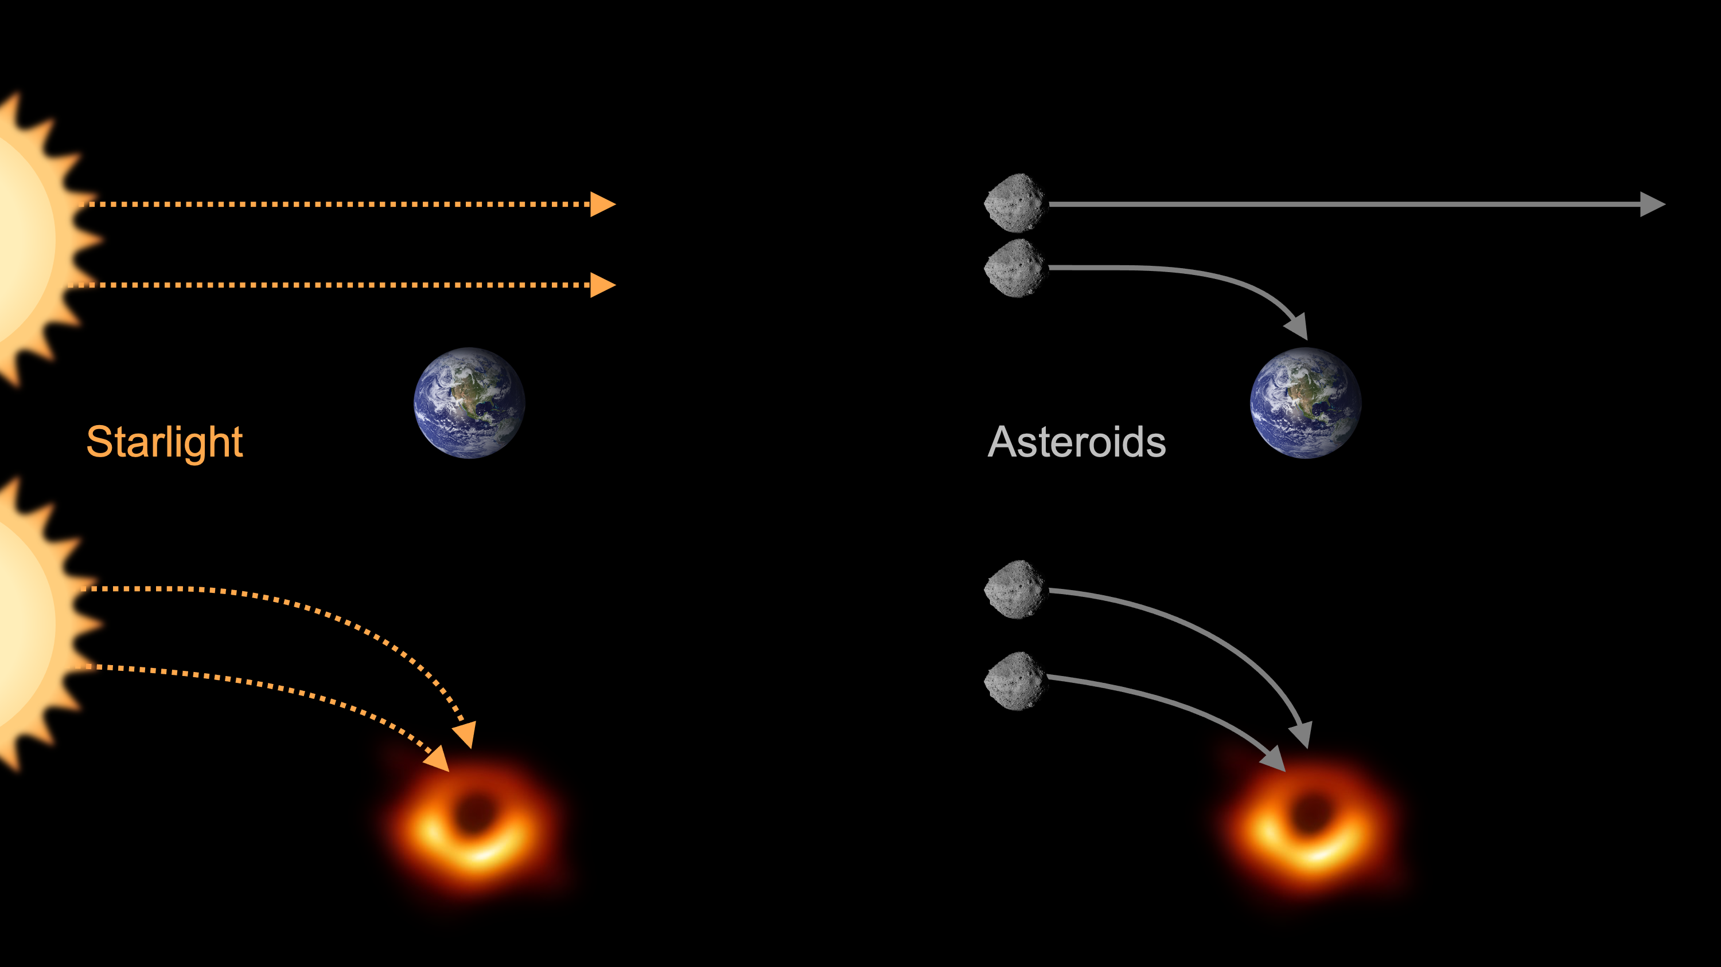
Black Holes – Black Holes vs. Planets
Exoplanet Communications
exoplanets.nasa.gov
Notes:
This slide does not contain any animated elements
Description:
This is the summary slide.

Slide 12
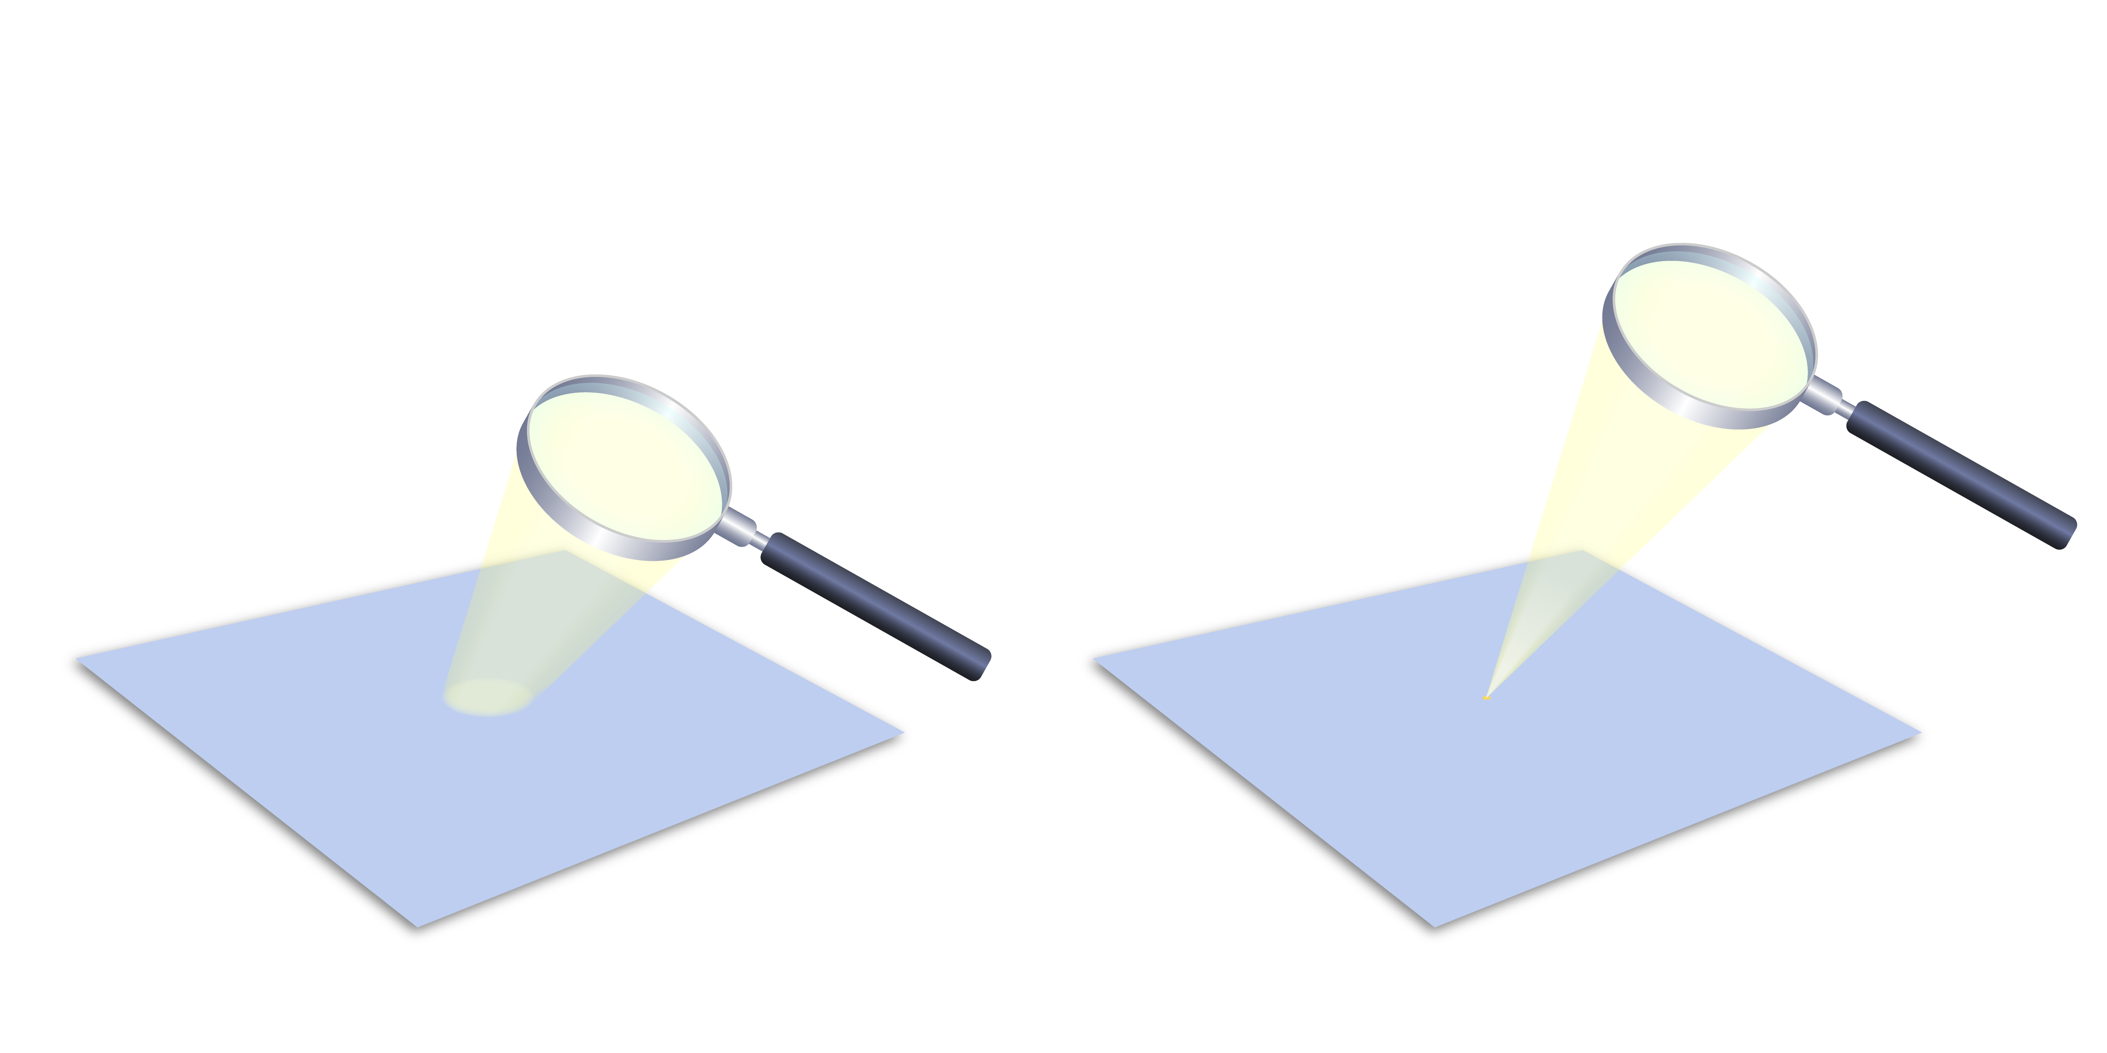
Exoplanet Detection – Microlensing Method
Exoplanet Communications
We know that a lens will focus light.
Notes:
This slide starts automatically, then requires 0 clicks:
The first click transitions to next slide
Audience:
9th Grade and older.
Description:
This slide explains and illustrates how a phenomenon called gravitational microlensing is used to detect exoplanets.
This is a commonplace analogy of gravitational microlensing.
User's notes:
The first cold (i.e., far from the host star) superEarth was discovered by this method (https://www.nature.com/articles/nature04441).
Roman space telescope will use this method to discover exoplanets.
The additional information can be available at e.g., https://exoplanets.nasa.gov/what-is-an-exoplanet/in-depth/
NOTE:
This PowerPoint file has built-in interactive elements.
To view them, you must be in "Slide Show" mode; you can then move to the next view either by clicking your mouse, the spacebar, or the arrow keys.
This slide will not work in "regular viewing mode."
Credit:
NASA/JPL-Caltech

Slide 13
Exoplanet Detection – Microlensing Method
Exoplanet Communications
Astronomers know that massive objects such as stars and planets can also focus light!
Notes:
This slide starts automatically, then requires 0 clicks:
The first click transitions to next slide

Slide 14
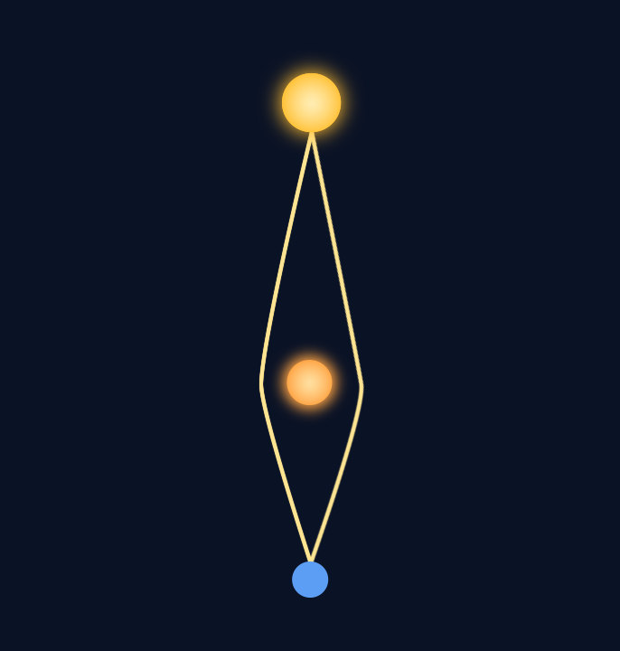
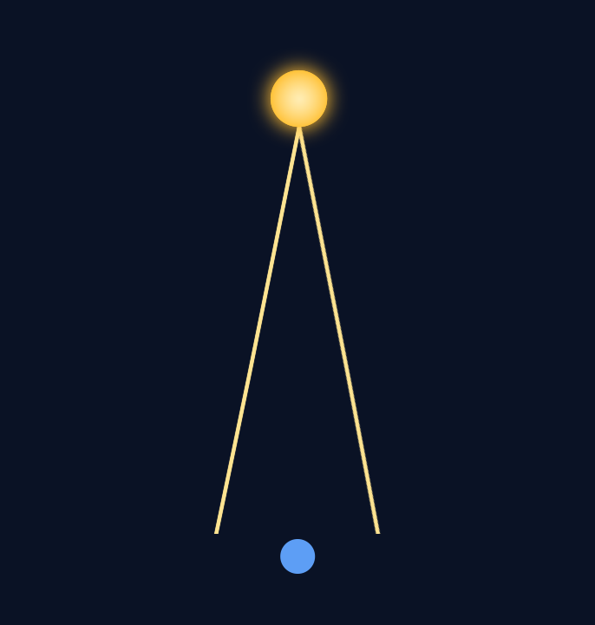
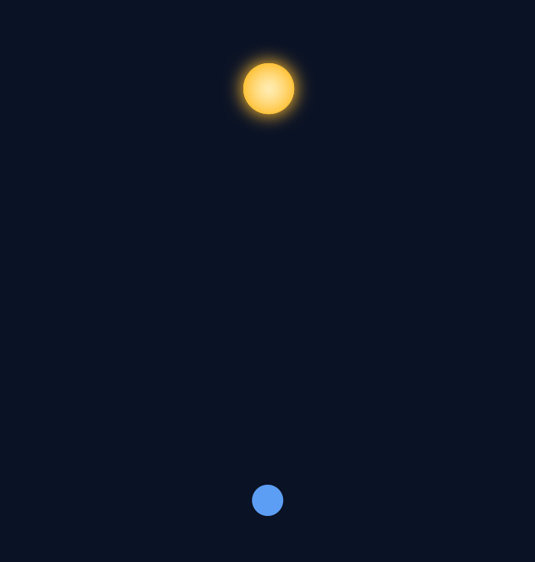
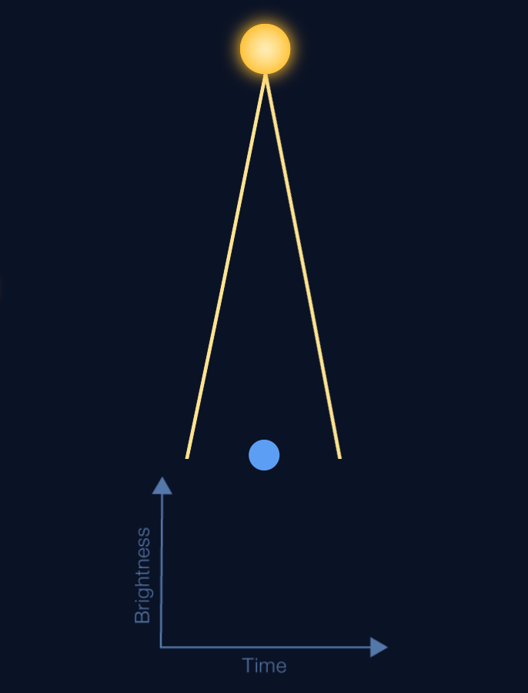
Exoplanet Detection – Microlensing Method
Exoplanet Communications
Background star
Image at 32%
When it reaches the midpoint, the power of its gravity bends the light rays of the background star, causing it to act like a “lens”.
Light from background star
Here is a star about to pass between Earth and the background star.
Earth (telescope location)
Notes:
This slide starts automatically, then requires 1 click:
First click – sends the star to a point between the background star and Earth
Second click – transitions to next slide
Description:
This slide explains and illustrates the situation where gravitational microlensing occurs.
User's notes:
As an example, two rays are only shown here;
Astronomers compute how the brightness curve will change with time, by tracing all the rays.

Slide 15
Exoplanet Detection – Microlensing Method
Exoplanet Communications
Image at 32%
Data from the observation is recorded in a “brightness curve.”
Notes:
This slide starts automatically and introduces the brightness curve
First click – transitions to next slide (which plays animation showing moving star and bending of light rays)
User's notes:
As an example, two rays are only shown here;
Astronomers compute how the brightness curve will change with time, by tracing all the rays.

Slide 16
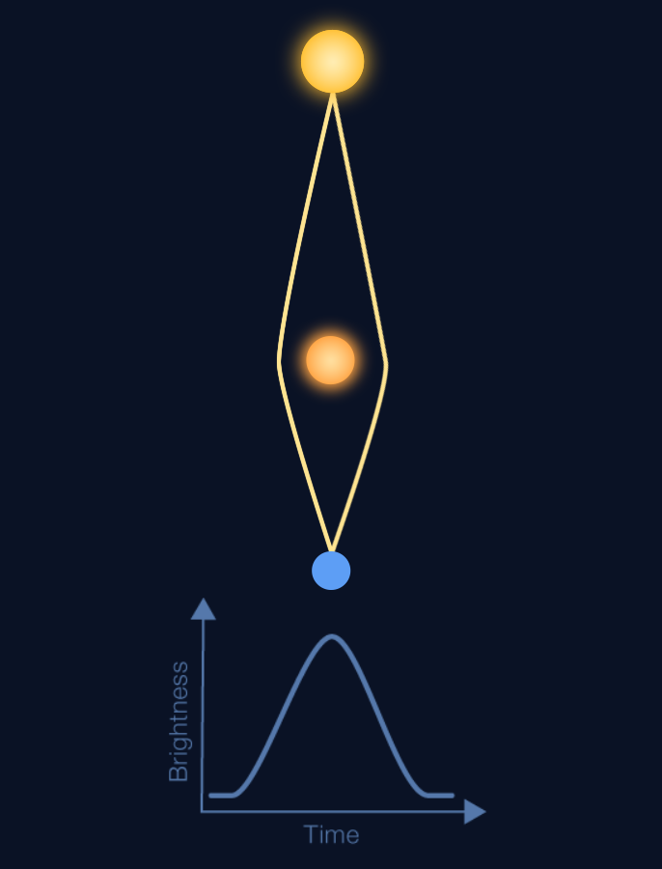
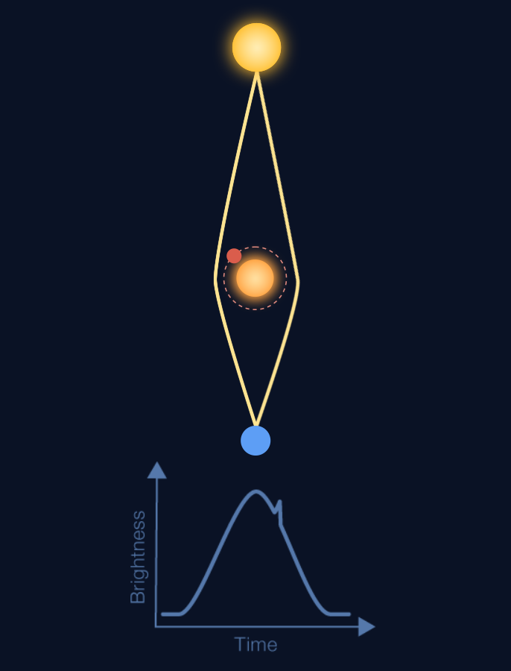
Exoplanet Detection – Microlensing Method
Exoplanet Communications
And if the “lens” star has a planet, the brightness curve will have two peaks!
If the “lens” star is moving, the brightness curve will show a peak.
Notes:
This slide starts automatically (plays animation showing bending of light rays, along with recording of brightness curve), then requires 1 click:
The first click brings up details about a lens star with an orbiting planet
Second click transitions to next slide
Description:
This slide explains and illustrates how astronomers use microlensing to discover exoplanets,
that is, how brightness curve changes with time due to the microlensing effect.
User's notes:
As an example, two rays are only shown here;
Astronomers compute how the brightness curve will change with time, by tracing all the rays.

Slide 17
Exoplanet Detection – Radial Velocity Method
Exoplanet Communications
An Everyday Example of the Doppler Effect
exoplanets.nasa.gov
Notes:
This slide begins automatically, then requires 0 clicks:
First click transitions to next slide
NOTE: clicking the left or up arrow on the keyboard, followed by the right or down arrow, will replay/restart the animation sequence
Audience:
9th Grade and older.
Description:
This slide explains and illustrates how a phenomenon called doppler effects is used to detect exoplanets.
This is a commonplace analogy of the doppler effect
User's notes:
The first exoplanet orbiting around a sun-like star was discovered by this method (https://www.nature.com/articles/378355a0).
Astronomers who made this discovery won the Nobel prize in 2019.
The additional information can be available at e.g., https://exoplanets.nasa.gov/what-is-an-exoplanet/in-depth/
NOTE:
This PowerPoint file has built-in interactive elements.
To view them, you must be in "Slide Show" mode; you can then move to the next view either by clicking your mouse, the spacebar, or the arrow keys.
This slide will not work in "regular viewing mode."
Credit:
NASA/JPL-Caltech

Slide 18
Exoplanet Detection – Radial Velocity Method
Exoplanet Communications
This star has no planets.
When we measure its velocity using data collected by our telescope, the value does not change over time.
That wobble changes the star’s velocity, and we can detect the change in the star’s light.
If the star did have a planet, however, it would cause the star to “wobble.”
exoplanets.nasa.gov
Notes:
This slide begins automatically, then requires 2 clicks:
First click = change to a star with 1 orbiting planet
Second click = measurements of the star with 1 orbiting planet
Third click transitions to next slide
Description:
This slide explains and illustrates how a phenomenon called doppler effects is used to detect exoplanets.

Slide 19
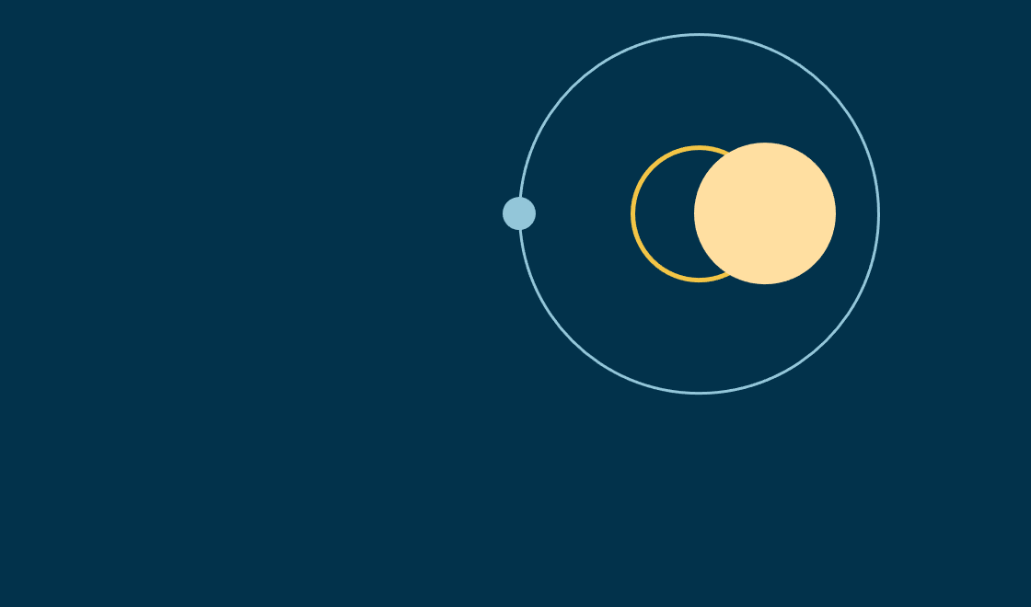
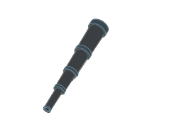
Exoplanet Detection – Radial Velocity Method
Exoplanet Communications
A star the mass of the Sun, with an orbiting planet of Jupiter’s mass and the Earth’s orbital period (1 year), would result in a radial velocity of 30 mph.
That’s about the speed of the fastest human.
The orbiting planet’s mass and orbital period determine the size of the star’s wobble and the resulting velocity.
The star’s resulting radial velocity would be an incredibly tiny 0.2 mph.
These extremely precise measurements create a huge challenge for astronomers!
However if the orbiting planet had the Earth’s mass and orbital period (1 year), the star’s wobble would be much smaller.
Babies crawl three times faster than that!!!
exoplanets.nasa.gov
Notes:
This slide starts automatically, then requires 6 clicks:
First click = animation of planet’s orbit and star’s wobble, followed by example of Jupiter-size planet
Second click = analogy to fastest human
Third click = example of Earth-size planet
Forth click = animation of the effect of Earth-size planet
Fifth click = analogy to baby’s crawl
Sixth click = challenge to astronomers
Seventh click transitions to next slide
Description:
This slide explains and illustrates how the mass and orbital period of exoplanets affect the radial velocity.

Slide 20
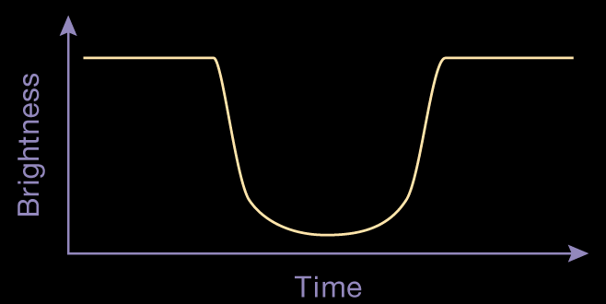
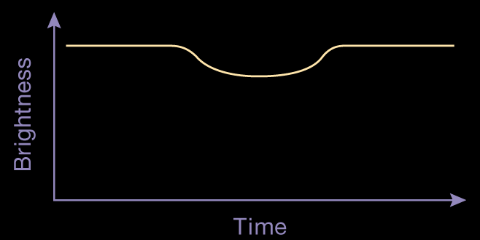
Exoplanet Detection – Transit Method
Exoplanet Communications
A car’s headlights on a dark street.
Astronomers use this same trick to discover exoplanets.
Any amount of decrease in the light’s brightness,
brought about by the passing object,
can be documented using a “light curve.”
Unseen objects may reveal themselves when passing in front of a light source.
The presence (and motion) of objects far too small to be seen can be revealed by observing changes in a star’s brightness.
exoplanets.nasa.gov
Notes:
This slide starts automatically, then requires 6 clicks:
First click = first appearance of the truck and bicycle
Second click = statement about light curves
Third click = example of light curve (empty)
Forth click = completion of light curve with example of truck
Fifth click = example of light curve with bicycle
Sixth click = statement regarding astronomers
Seventh click transitions to next slide
Audience:
4th Grade and older.
Description:
This slide explains and illustrates how a phenomenon called transit is used to detect exoplanets.
This is a commonplace analogy of transit
User's notes:
The shapes (and depths) of light curves for the truck and bicycle are approximate.
NASA Kepler space telescope and TESS use this method.
The additional information can be available at e.g., https://exoplanets.nasa.gov/what-is-an-exoplanet/in-depth/
NOTE:
This PowerPoint file has built-in interactive elements.
To view them, you must be in "Slide Show" mode; you can then move to the next view either by clicking your mouse, the spacebar, or the arrow keys.
This slide will not work in "regular viewing mode."
Credit:
NASA/JPL-Caltech

Slide 21
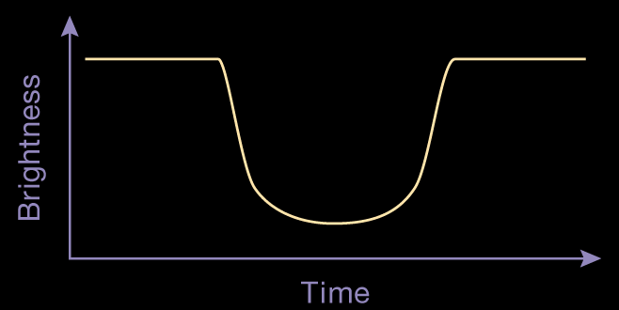
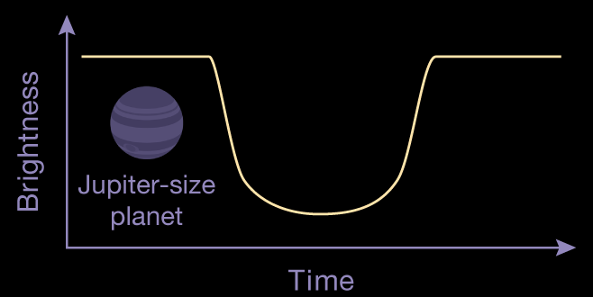
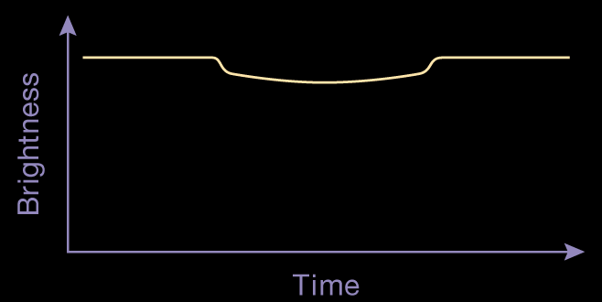
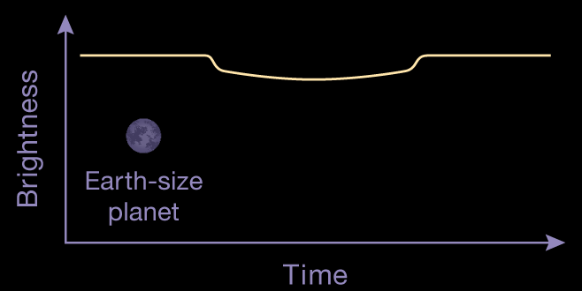
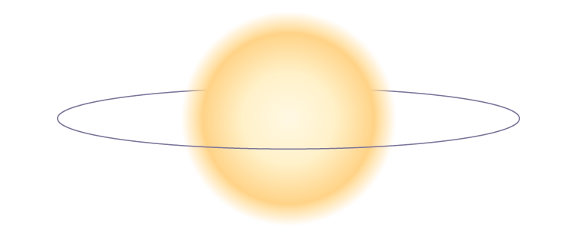
Exoplanet Detection – Transit Method
Exoplanet Communications
(Depth exaggerated for clarity)
(Depth exaggerated for clarity)
However, these observed changes to a star’s brightness are incredibly tiny, making the study of them very challenging.
Jupiter-size
planet
Earth-size
planet
exoplanets.nasa.gov
Notes:
This slide requires 3 clicks:
First click starts = demonstration of Jupiter-size planet light curve
Second click = demonstration of Earth-size planet light curve
Third click = discussion of the scale of light curves
Forth click transitions to next slide
Description:
This slide explains and illustrates how a phenomenon called transit is used to detect exoplanets.

Slide 22
Exoplanet Detection – Transit Method
Exoplanet Communications
Only a small 1% decrease in brightness
The depth of this curve
=
An incredibly tiny 0.01% decrease in brightness
The depth of this curve
=
exoplanets.nasa.gov
Notes:
This slide starts animation automatically after the slide change, then requires 1 click:
First click = discussion of the Earth-size planet light curve
Second click transitions to next slide

Slide 23
Exoplanet Detection – Transit Method
Exoplanet Communications
Imagine an impossibly large container of ice cream.
No, no, much larger.
1%
1% would be about equal to scooping
1cm deep.
That’s about the thickness of a cell phone.
Whereas 0.01% would be like scooping only the thickness of a postage stamp!
1 meter
(39 inches)
0.01%
exoplanets.nasa.gov
Notes:
This slide requires 3 clicks:
First click = starts a comparison between the light curve depths and the scooping of ice cream (stops at container dimensions)
Second click = continues comparison of light curve with scooping ice cream (stops after cell phone depth)
Third click = compares light curve depth of 0.01% to a postage stamp
Forth click transitions to next slide
Description:
This slide explains and illustrates how tiny transit depths are to discover exoplanets, using commonplace examples.

Slide 24
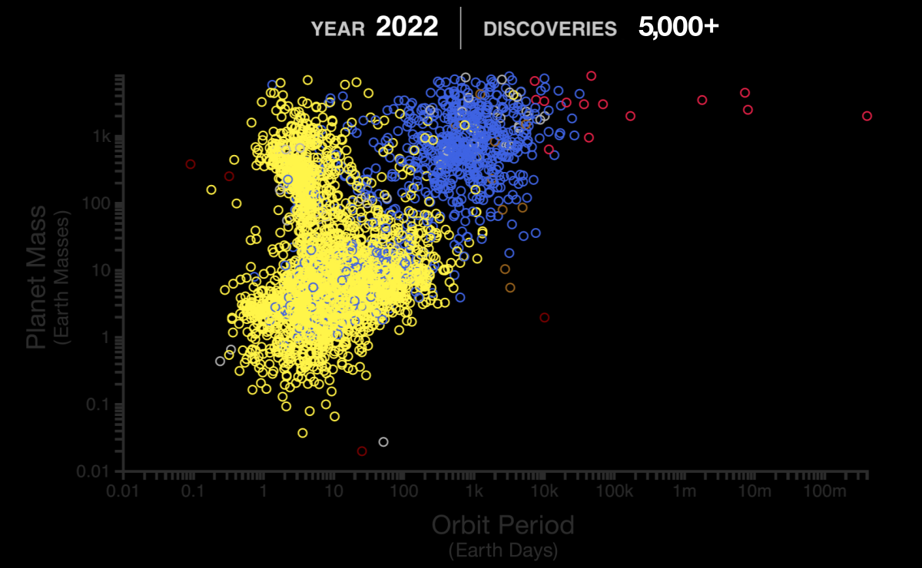
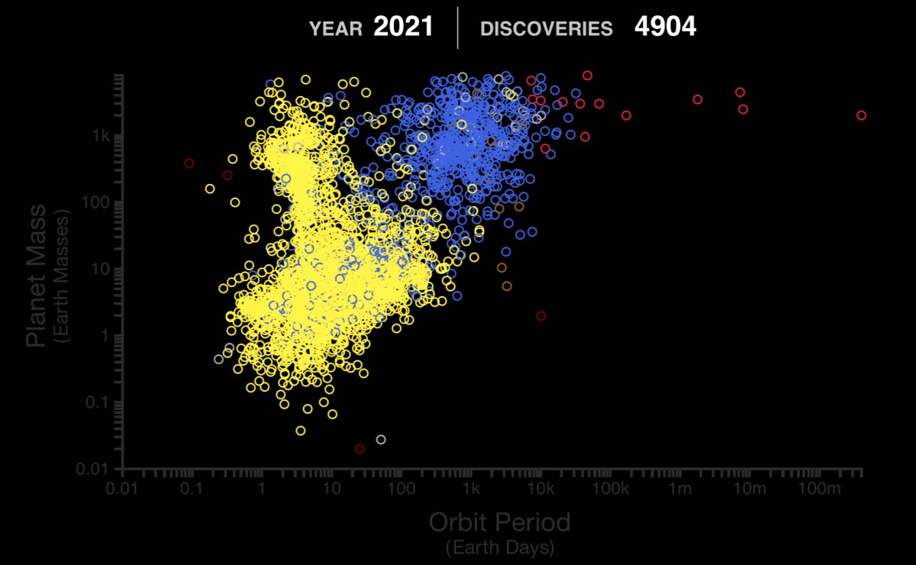
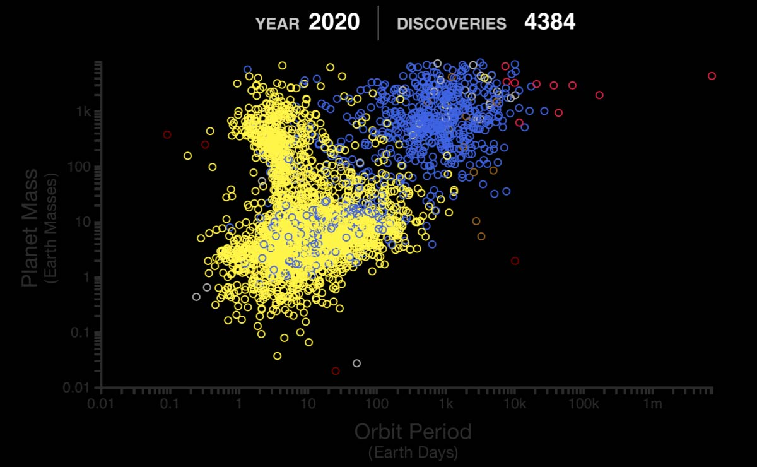
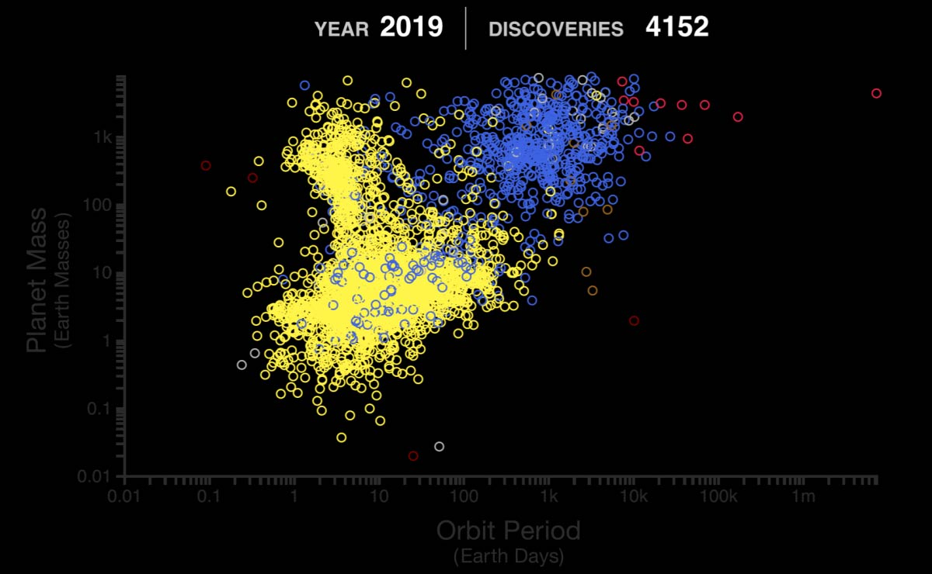
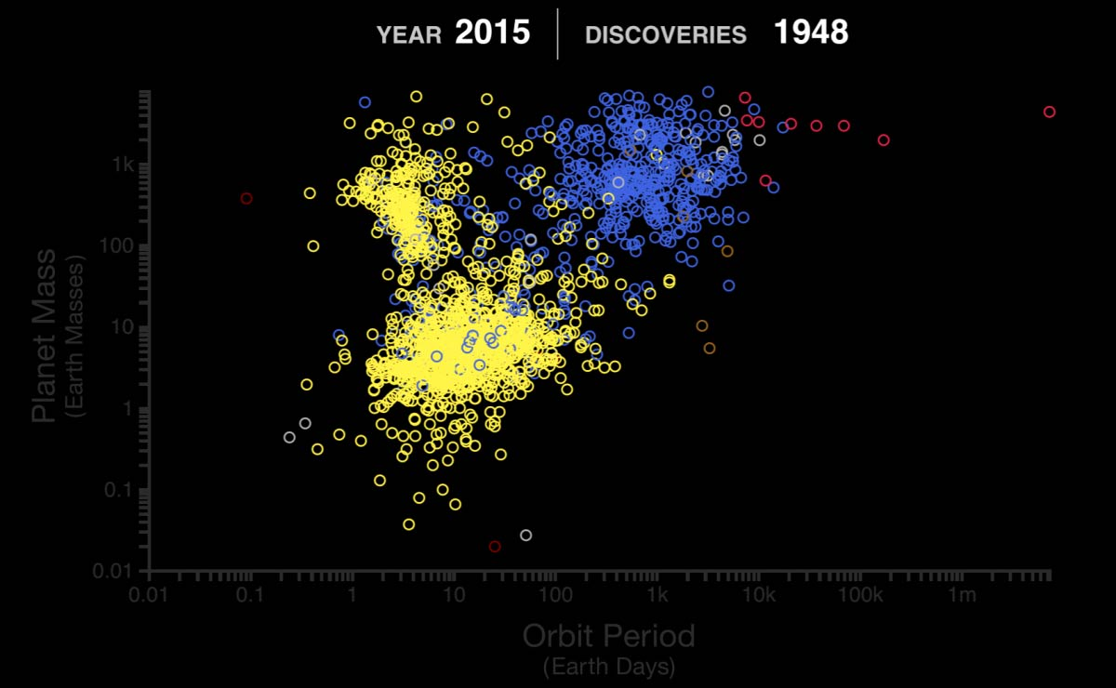
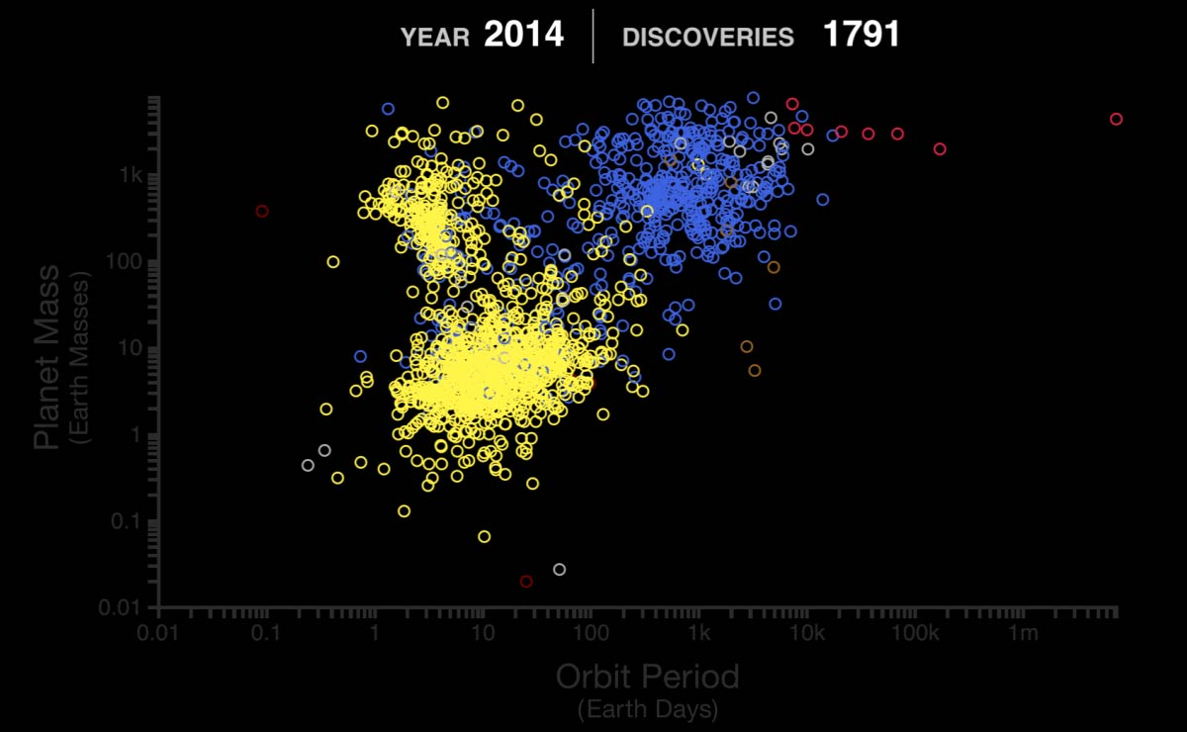
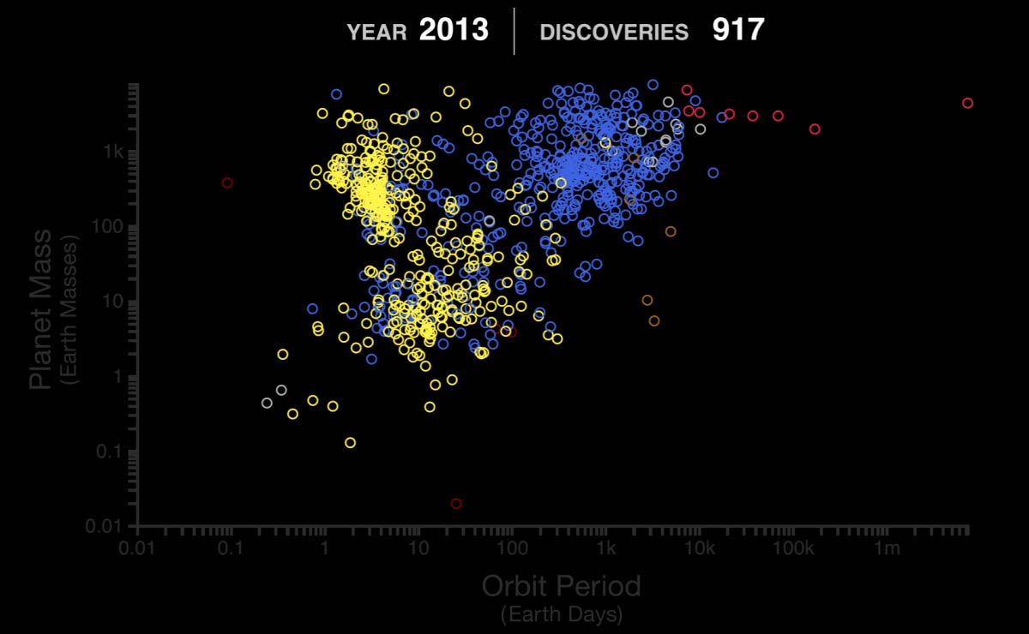
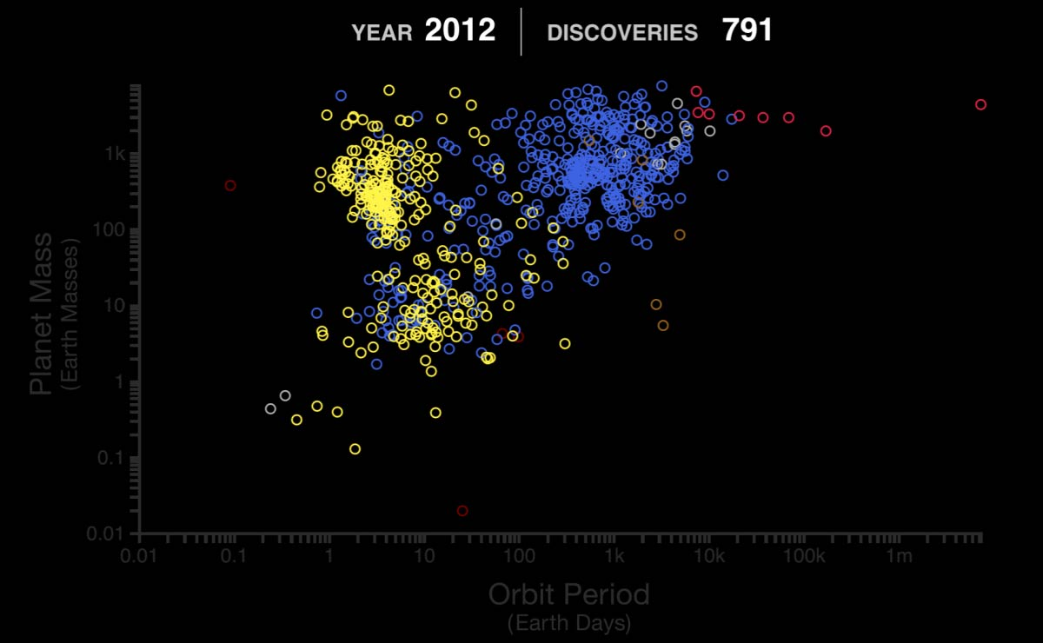
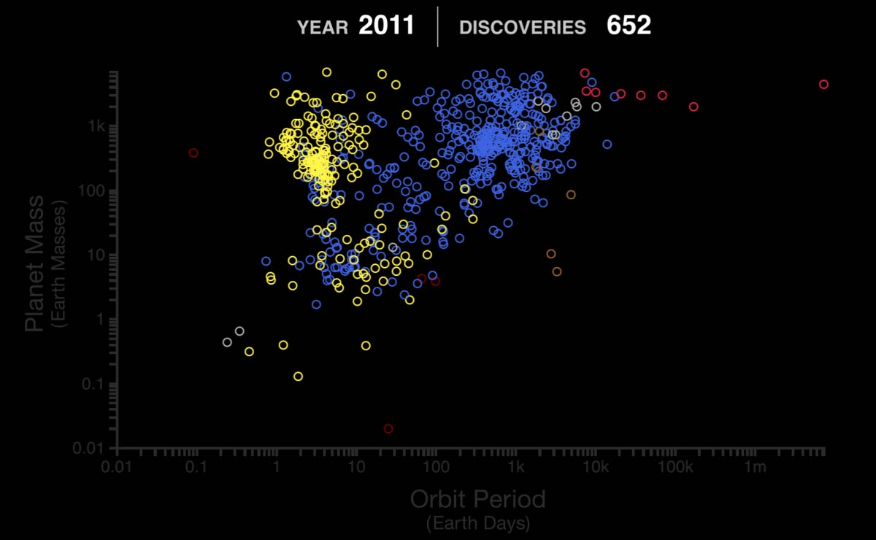
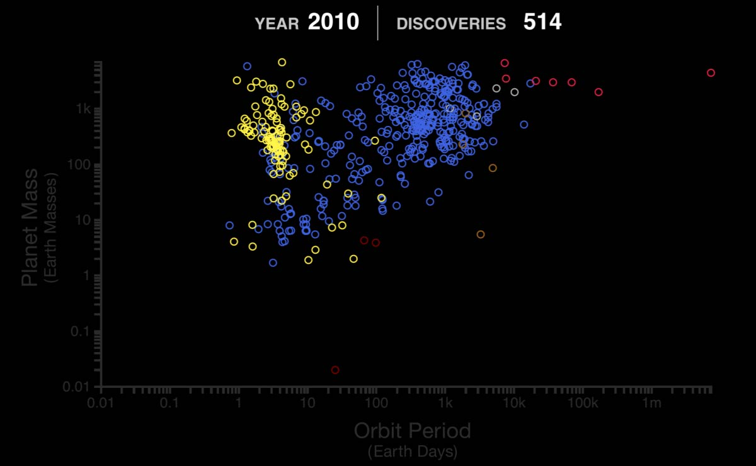
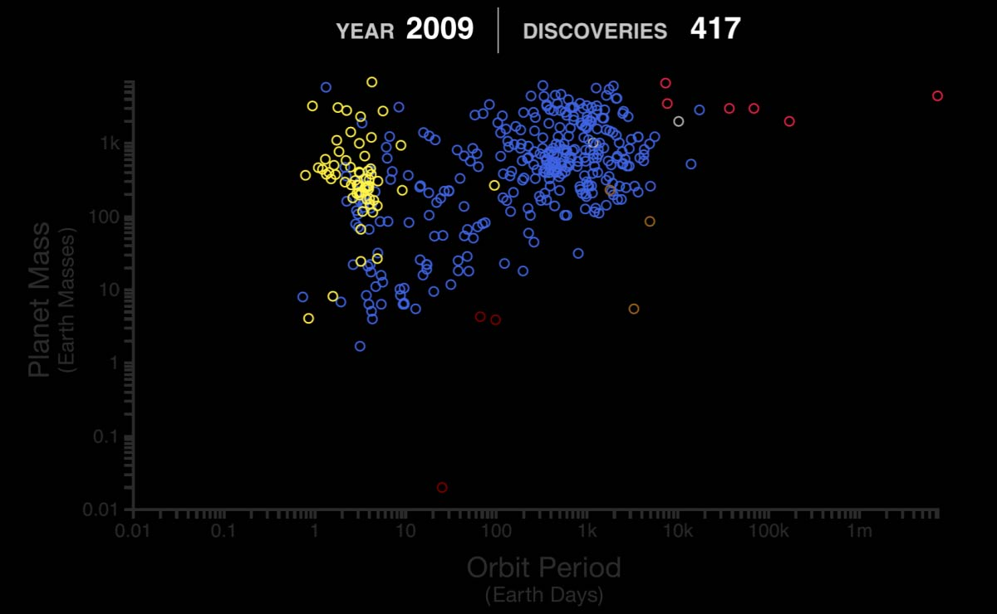
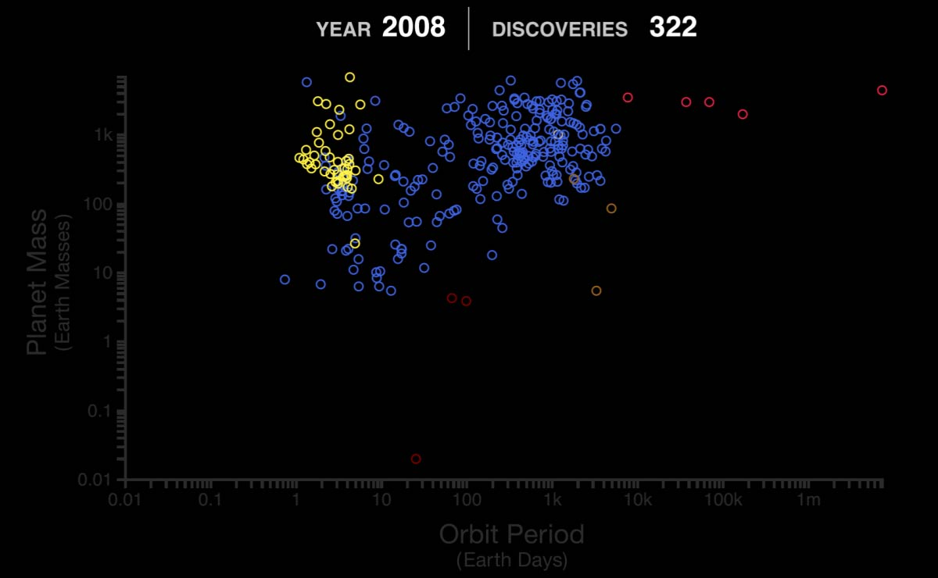
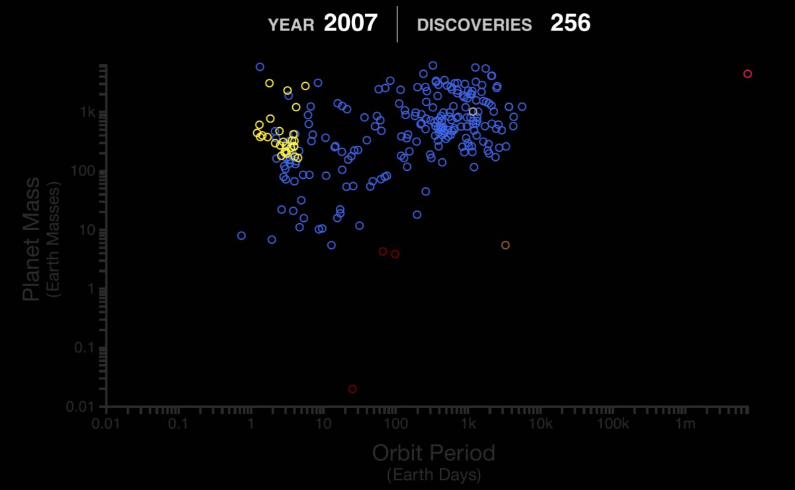
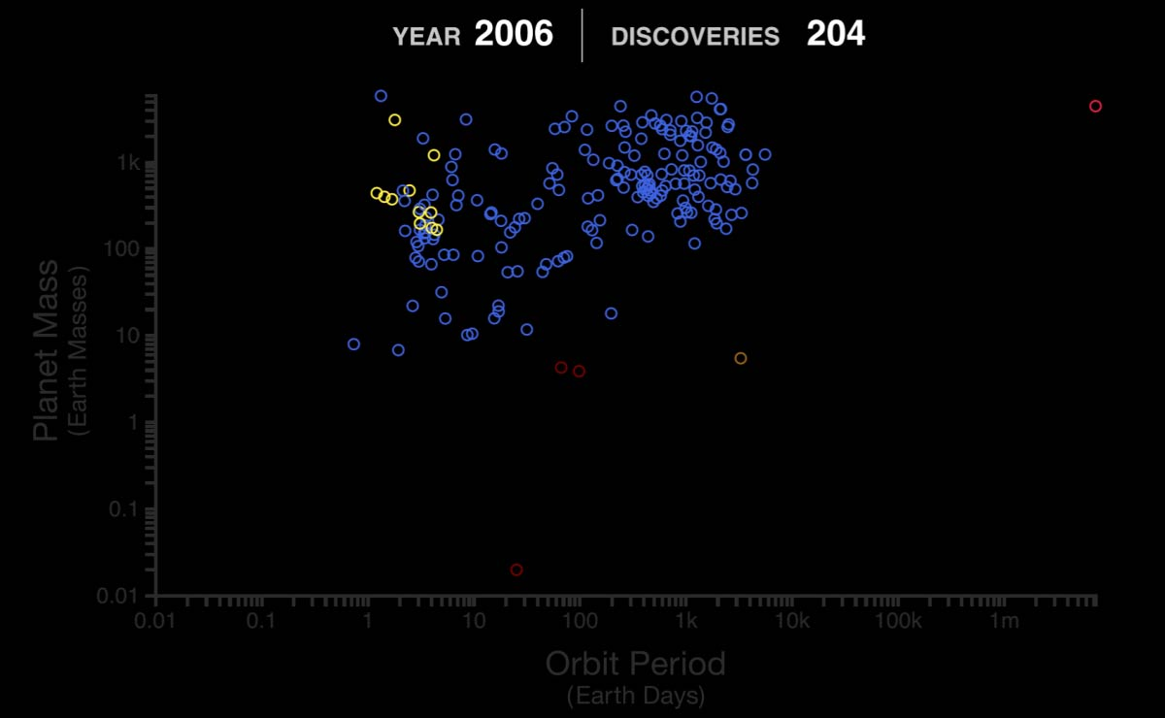
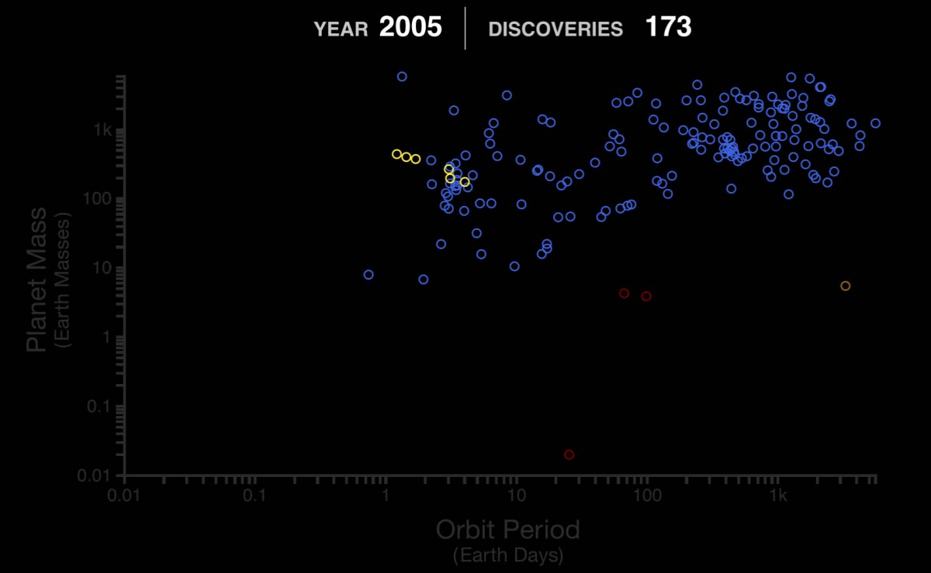
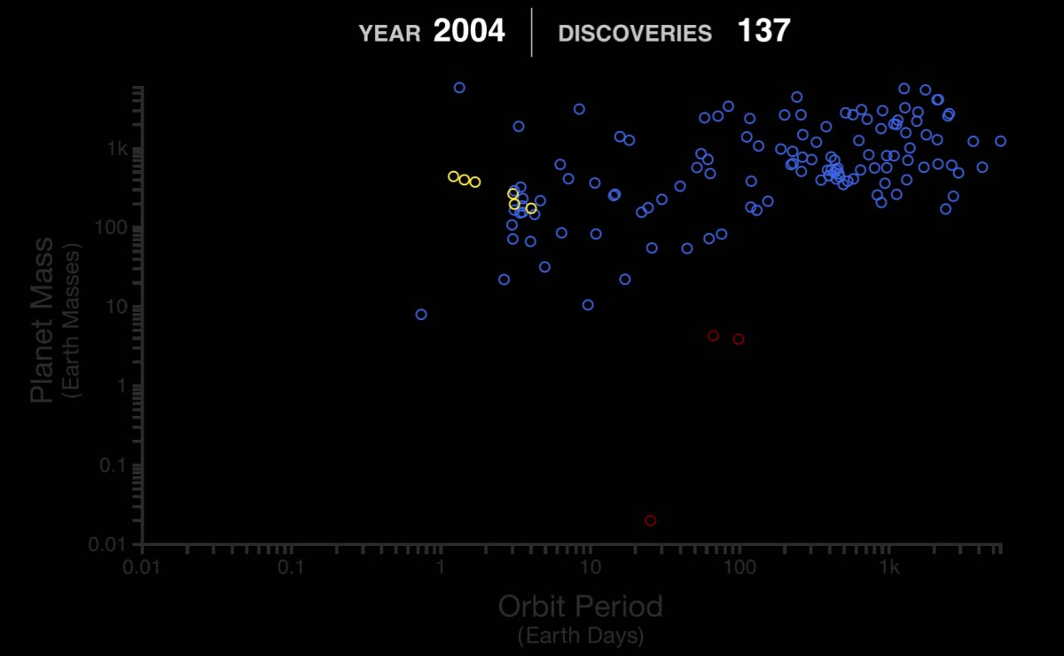
Exoplanet Discoveries – 30+ Years of History
Exoplanet Communications
exoplanets.nasa.gov
Notes:
First click: fills in discoveries by year
Second click: transitions to next slide
Audience:
4th Grade and older.
Description:
This slide explains and illustrates how rapidly exoplanets have been discovered.
User's notes:
The color od symbols denote detection methods:
Yellow = transit; blue = radial velocity; brown = microlensing; red = direct imagining; dark red = pulsar timing; gray = others
The additional information can be available at e.g., https://exoplanets.nasa.gov/what-is-an-exoplanet/in-depth/
NOTE:
This PowerPoint file has built-in interactive elements.
To view them, you must be in "Slide Show" mode; you can then move to the next view either by clicking your mouse, the spacebar, or the arrow keys.
This slide will not work in "regular viewing mode."
Credit:
NASA/JPL-Caltech

Slide 25
Exoplanet Discoveries – 30+ Years of History
Exoplanet Communications
5,000+
New Planets
the evolution of cell phones!
Such rapid progress is comparable to (or even faster than)…
Discovery Year
exoplanets.nasa.gov
Notes:
This slide requires 2 clicks:
First click transitions from the early years (1989-2000) to the full 30+ years of exoplanet discovery
Second click introduces a comparison with cell phone development of the last 30+ years
Third click transitions to next slide
Description:
This slide explains and illustrates how rapidly exoplanets have been discovered, using commonplace examples.
User's notes:
Adopted colors may not be color-blind friendly.
The mindful usage is highly recommended.

Slide 26
Kepler vs TESS – Comparison of Telescopes
Exoplanet Communications
3,000 light-years
⧫ | Goal | ◆
⧫ | Sky Coverage | ◆
300 light-years
All the sky
⧫ | Target Stars | ◆
200,000 stars
0.25% of the sky
⧫ | Mission Periods | ◆
April 2018 – the present (the original plan was 2-years)
2709 (as of May, 2022)
⧫ | Confirmed Planets | ◆
204 (as of May, 2022)
exoplanets.nasa.gov
Notes:
This slide requires 11 clicks:
First click – reveals goals for both Kepler and TESS
Second click – reveals sky coverage for both Kepler and TESS
Third click – hides TESS panel, preps for Kepler coverage animation
Forth click – plays animation describing Kepler sky coverage
Fifth click – returns TESS panel
Sixth click – hides Kepler panel, preps for TESS coverage animation
Seventh click – plays animation describing TESS sky coverage
Eighth click – returns Kepler panel
Ninth click – reveals "target stars" for both Kepler and TESS
Tenth click – reveals "mission periods" for both Kepler and TESS
Eleventh click – reveals "confirmed planets" for both Kepler and TESS
Twelfth click – transitions to next slide
Audience:
4th Grade and older.
Description:
This slide explains and illustrates how different Kepler and TESS telescopes are.
User's notes:
The additional information can be available at e.g., https://exoplanets.nasa.gov/what-is-an-exoplanet/in-depth/
NOTE:
This PowerPoint file has built-in interactive elements.
To view them, you must be in "Slide Show" mode; you can then move to the next view either by clicking your mouse, the spacebar, or the arrow keys.
This slide will not work in "regular viewing mode."
Credit:
NASA/JPL-Caltech

