Slide 1


ExEP Coronagraph Design Survey
Quad Chart Template
Rus Belikov (NASA Ames Research Center)
Chris Stark (NASA Goddard Space Flight Center)
Nick Siegler (Jet Propulsion Laboratory/California Institute of Technology)
© 2023 All rights reserved.
CL#23-2869

Slide 2
Name of Design or Technology
Name(s) of designer(s) and contact email
Basic description
Driving motivation(s) for this design
Key advantages, disadvantages, and distinguishing characteristics
Anything else you want to point out
Current maturity and TRL
Estimated TRL of components (see Technology Readiness Level Definitions)
Brief description of current lab performance (provide references, if any)
Anything else you’d like to point out
Optical layout diagram or technical description
Between the exit pupil of telescope and science plane
Can be very simple and unfolded – we are not considering details of packaging, relays, etc.
We will assume a standard baseline LOWFS, DMs, detector, etc. However, if one of those subsystems is special or unusual in your design, please include it.
If you wish to submit a coronagraph “technology” rather than complete “design”, CDS can provide a baseline design for you to pair with your technology
Risks and next steps
Narrative of next steps, including tall poles, risks, and long-lead items
Feasibility of getting to TRL 5 (if applicable), as well as any rough estimates about cost and time to TRL 5 (if available)

Slide 3
Definitions / Assumptions
What exactly do we mean by “design”?
  For now, the information on the previous quad chart (as much as you can fill out)
  Incomplete submissions are ok as a placeholder if you do not have all the information
  Over the next ~ 6 months, we will need additional information from you (and interested parties outside CDS) in order to fill out all the rows of the KT matrix. The format of that information is TBD, but will likely include
    Yield input package of simulated PSFs (Standardized Coronagraph Parameters for Input into Yield Calculations - 021219 )
    Inputs to assist evaluating sensitivities (format TBD)
    More detailed information about maturity and feasibility to TRL5
  We will work with you to provide the needed information.
Operating assumptions:
  Prefer designs that have a plausible TRL path in time for the Habitable Worlds Observatory
  Baseline aperture will be segmented off-axis, but others are allowed (if there is a good reason)
  Assume ~ 6 m inscribed diameter
  Telescope, but not necessarily the coronagraph, will have IR, V, and UV capabilities
  Robotic in-space servicing will be possible
  Scope of survey is about coronagraphs in the broadest possible sense

Slide 4
EXAMPLES OF FILLED-OUT QUAD CHARTS

Slide 5
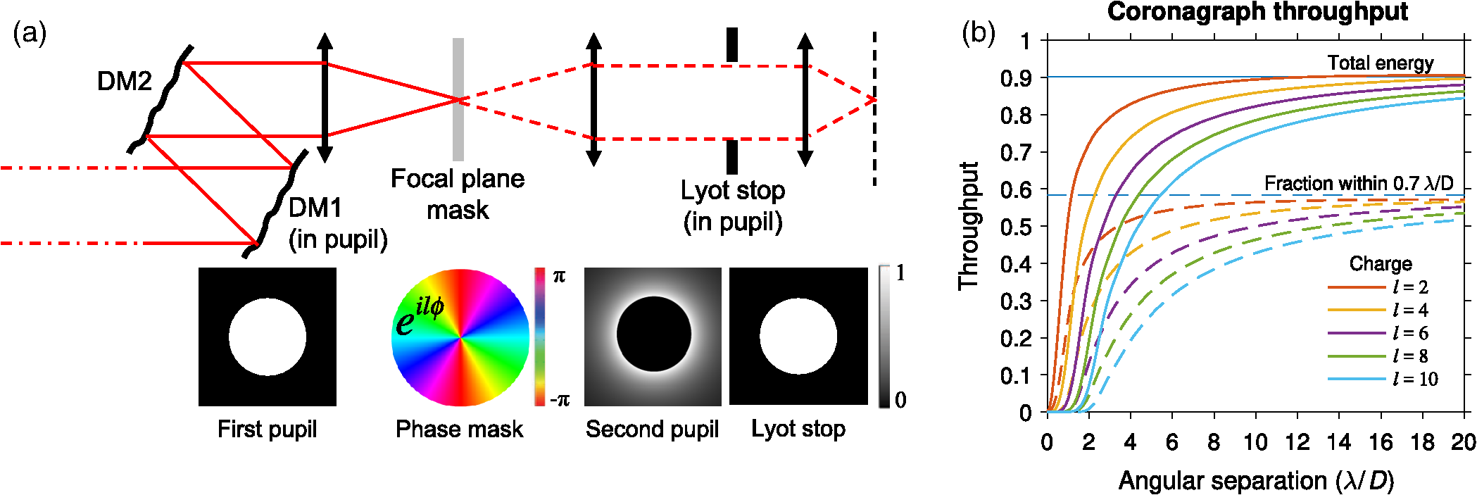
Vortex Coronagraphs
Garreth Ruane, Dimitri Mawet, Eugene Serabyn (garreth.ruane@jpl.nasa.gov)
Basic description
The vortex coronagraph applies a phase wrap to the stellar point spread function to redirect starlight out of the pupil.
Vortex coronagraphs rely on a focal plane phase mask, have relatively high throughput, small inner working angle, large field of view, low sensitivity to low-order aberrations and require small DM strokes.
Grayscale or DM-based pupil apodization is needed for segmented apertures.
A HWO mission could rely solely on VVC masks optimized for different wavelength ranges and inner working angles.
Current maturity and TRL
TRL: 3-4.
The most advanced (vector) vortex coronagraphs make use of liquid crystal polymer masks from Beam Co, Orlando, FL.
Best performance in 10% bandwidth (BW) is 1.6e-9 at 650nm (Ruane et al. 2022)
Scalar vortex phase masks are also being developed, but are currently less advanced
Segmented aperture demos in 10% BW:
      First DM-apodized demo: 5e-9 (Riggs et al 2022)
Grayscale apodized demo: 4e-8 (Llop-Sayson et al. 2020)
Optical layout diagram or technical description
The optical layout is the same as that of a Lyot coronagraph, making the two types of focal plane mask interchangeable.
The optical charge (integral phase wrap) is a free parameter that can alter the inner working angle and sensitivity to aberrations.
Risks and next steps
Near-ideal phase-mask manufacturing is challenging and long lead time.
Further HCIT testing planned under SAT (PI: Serabyn)
Potential to develop scalar vortex masks that would be polarization insensitive
Potential for dichroic coating to use out-of-band light for wavefront sensing in reflection.
Potential for integrated polarization filtering to increase bandwidth

Slide 6
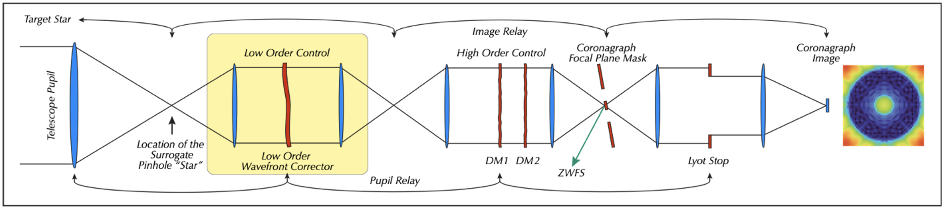
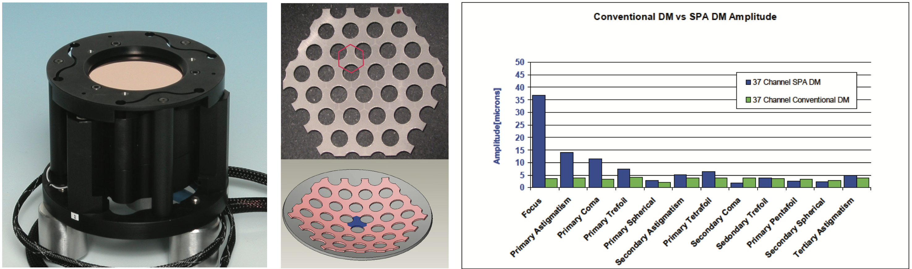
Integrated Dynamic Low-Order Wavefront Control
John Trauger (john.trauger@jpl.nasa.gov)
Basic description
A single integrated element located at an instrument pupil to provide dynamic low-order wavefront stabilization.
Surface parallel deformable mirror for correction of low order Zernike terms Z4-Z11 (focus, astigmatism, coma, …)
Flexure mounting for jitter control (Z2, Z3)
Anticipates closing the sensing and control loop with guidance from a Zernike wavefront sensor.
Stabilizes the dynamic elements of the wavefront with minimal disturbance to high-order wavefront stability.
Current maturity and TRL
Estimated TRL of components: 3
Development based on a selected 2022 SAT: “A low-order hardware implementation for sensing and control in exoplanet imaging”
Has not been demonstrated in the laboratory.
Optical layout diagram or technical description
Risks and next steps
Fabrication of surface parallel deformable mirror elements and laboratory demonstration are planned as part of a 2022 SAT (PI: J. Trauger).
Concept should be applicable to all coronagraph types.
For simplicity and model fidelity, the element will be demonstrated in the context of a hybrid Lyot coronagraph.
Integrated LOWFC element is highlighted. Hardware element and low-order response are illustrated at left.

Slide 8
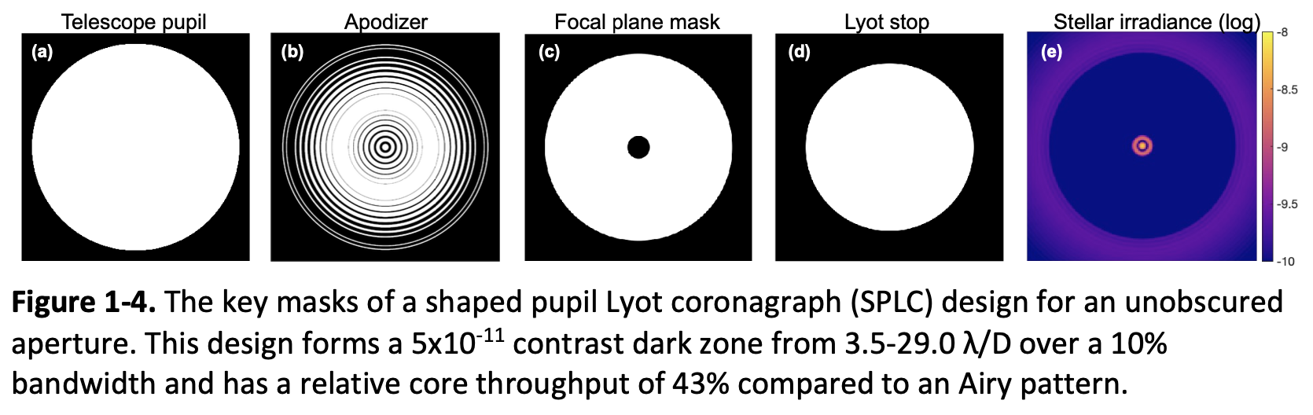
Shaped Pupil Lyot Coronagraphs (SPLCs)
AJ Riggs (aj.riggs@jpl.nasa.gov)
Basic description
SPLCs are a mature coronagraph type after years of development as part of Roman CGI.
SPLCs are robust, low risk, and moderate performance—they are most likely to provide exo-Earth spectra on HWO with currently tested manufacturing technologies.
SPLC masks can all be made accurately today. JPL’s MDL matured black silicon apodizer fabrication as part of the Roman CGI project. Occulters and Lyot stops are easy for vendors to make via e-beam lithography.
Current maturity and TRL of black silicon apodizers
TRL 5 at 4e-9 contrast in 10% BW in a static environment (Cady et al. 2017 SPIE 104000E, Marx et al. 2018 SPIE 106981E)
TRL 6 at 9e-9 contrast in 10% BW in a dynamic flight-like environment (Cady et al. 2017 SPIE 104000E)
TRL 3 (possibly 4) at 1e-10 contrast
The best to-date lab results of SPLCs were mainly limited by the Roman Space Telescope’s large pupil obscurations; less-obscured apertures will enable higher-throughput and higher contrast designs.
Optical layout diagram or technical description
Core pieces: apodizer mask, focal plane mask, Lyot stop, & field stop
NOTE: SPLCs are not APLCs. SPLCs use an outer FPM iris to block most of the starlight and make them very insensitive to misalignments and magnification errors. Modern APLCs mostly diffract light with the FPM and LS, making them more sensitive.
    Option 1 (available now): Circularly symmetric designs for monolithic apertures or segmented apertures if DMs are used to mitigate segment gaps
    Option 2 (later): Designs
    with apodizers accounting
    for segment gaps directly.
Risks and next steps
NASA recently selected our proposal 22-SAT22-0010 to design, model, and test SPLCs in the context of HWO.
Goals of that SAT are to demonstrate < 4e-10 contrast with SPLCs, make a testbed contrast error budget accurate to the 1e-11 contrast for each component, and model polarization induced by small mask features.
No SPLC-related major risks or long lead items.
Plan is to reach TRL 5 for HWO in 3 years.

Slide 9
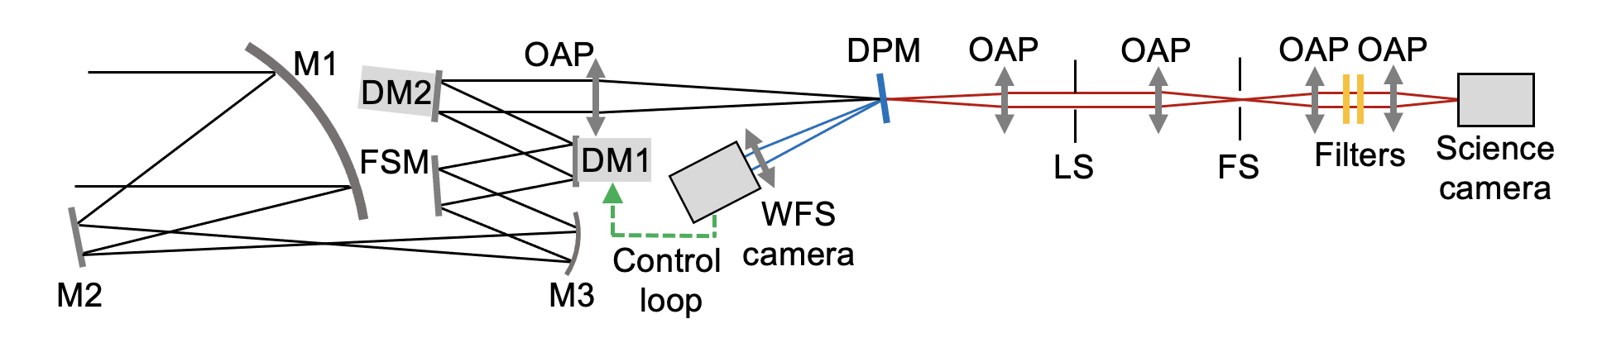
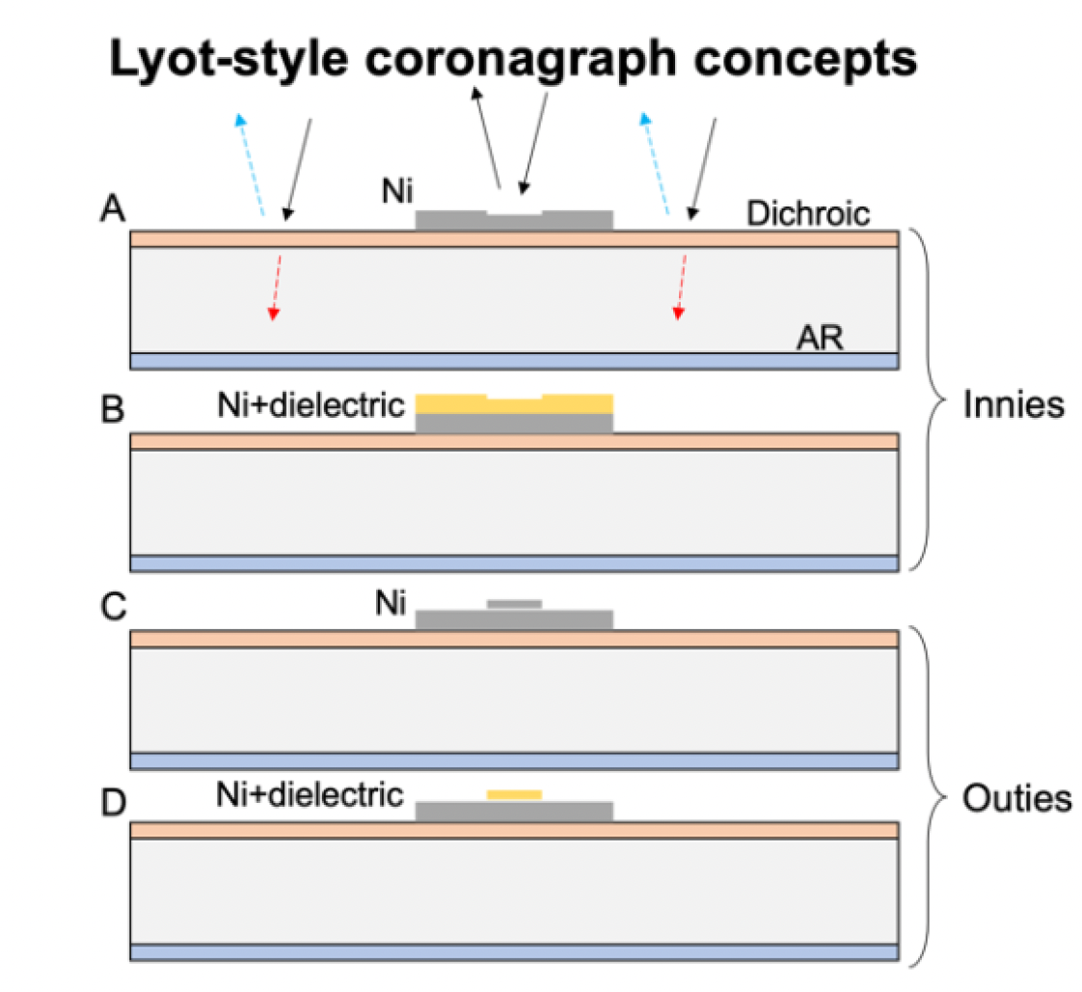
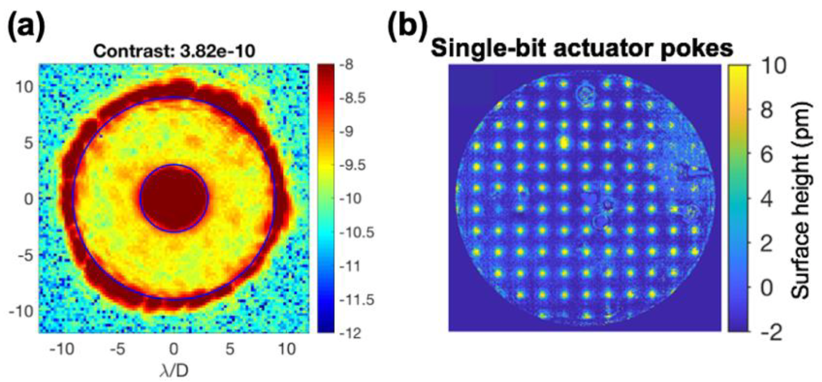
Dual Purpose Lyot Coronagraphs
Kent Wallace and Garreth Ruane (kwallace@jpl.nasa.gov, garreth.ruane@jpl.nasa.gov )
Basic description
Dual-Purpose Lyot Coronagraphs combine simple metal-on-glass Lyot coronagraphs with an out-of-band Zernike wavefront sensor (WFS).
DPLCs use the approach with the best demonstrated contrast performance with a high-order WFS capability.
A basic design consists of an occultor with phase dimples on/in the opaque metal disks (e.g. wedding cake shape focal plane masks) on a glass substrate with a dichroic coating.
Current maturity and TRL
Estimated TRL of components: 3
Individual functionalities demonstrated in
Seo et al. (2019) – 4e-10 in 10% BW on DST
Ruane et al. (2020) – pm sensitivity on DST
Simultaneous performance yet to be demonstrated.
Optical layout diagram or technical description
Risks and next steps
Simultaneous demonstration planned in HCIT under SAT (PI: Kent Wallace).
Lyot coronagraphs are generally more sensitive to aberrations than other coronagraph types.
Risk identified: coherence between reflecting regions.
Seo et al. (2019)
Ruane et al. (2020)

Slide 10
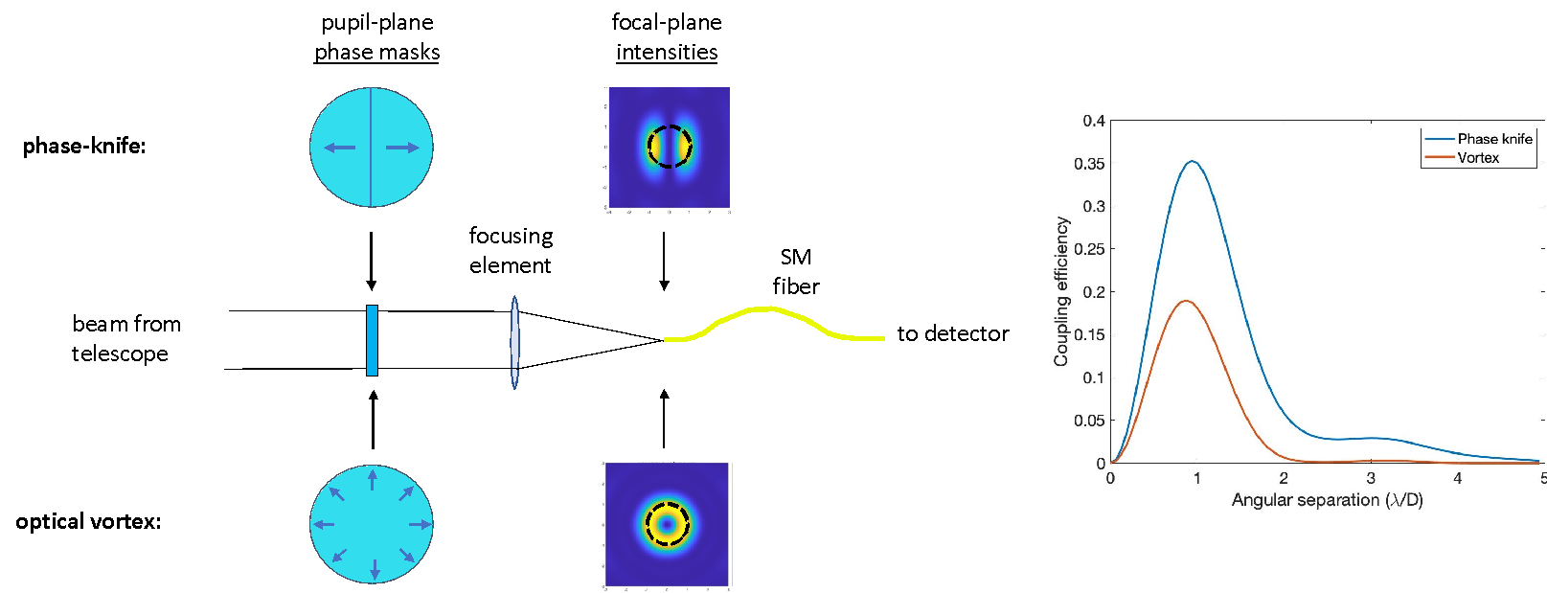
Single-mode fiber-nuller coronagraph
Eugene Serabyn, Garreth Ruane, Dimitri Mawet, Betrand Mennesson (eugene.serabyn@jpl.nasa.gov)
Basic description
A phase mask in a coronagraph’s pupil plane produces an asymmetric stellar focal plane field with an on-axis zero, which moves the starlight off-axis
The dark center of the field is coupled to a single-mode (SM) fiber that rejects the off-axis asymmetric starlight field
The HWO mission could use a single mode fiber nuller (SMFN) either to reach smaller angles than a coronagraph can reach, or longer wavelengths.
Current maturity and TRL
TRL: 3-4.
Various types of fiber nullers have so far demonstrated nulls in the 10⁻⁴ to 10⁻⁵ range for up to 10% bandwidth.
The Palomar Fiber Nuller (PFN) and Keck Vortex Fiber Nuller have provided on-sky system-level demonstrations, with the PFN reaching on-sky null-depth capabilities of a few 10⁻⁴
Optical layout diagram or technical description
A phase mask is inserted into a standard coronagraph’s pupil plane, after which the focused beam is coupled to a SM fiber
A SMFN can employ either an optical vortex mask to get a donut-shaped stellar point spread function (PSF) with equal sensitivities to exoplanets at all azimuths, or a phase-knife mask to get a double-lobed PSF which can be used to locate exoplanets
Risks and next steps
Need higher performance phase-knife and optical vortex phase masks
Need laboratory demonstrations of deeper nulls and broader bandwidths
The impact of SM fiber non-idealities need to be investigated
On-sky fiber-nulling very close companion observations underway at the Keck Observatory (PI: Mawet)

