Slide 1
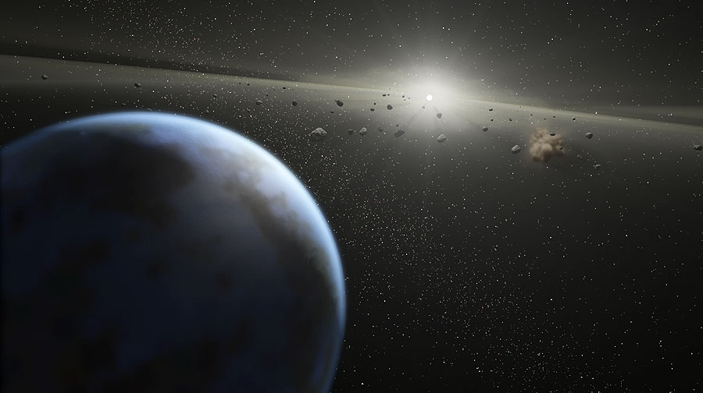

Potential for improving coronagraphic instrument on the Astro2020 flagship through continued technology innovation
Ruslan Belikov¹, Kevin Fogarty¹, Dan Sirbu¹,
Jeff Jewell², Olivier Guyon³, Christopher C. Stark⁴
¹NASA Ames Research Center
²Jet Propulsion Lab
³The University of Arizona
⁴Goddard Space Flight Center
ExoPAG, 6/11/2022

Slide 2
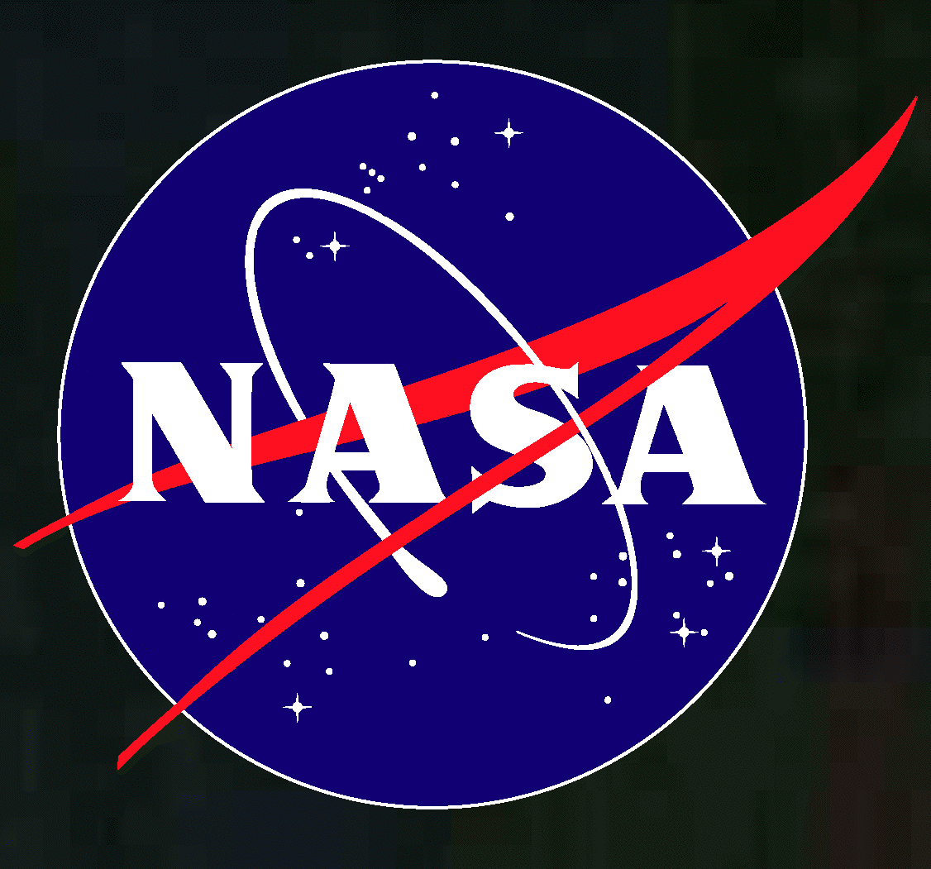
Outline
Motivation for continuing to improve coronagraphic instrument designs
How much improvement is possible (i.e. before we reach fundamental physics limits)?
What technologies can reach physics limits?
Example technology: PIAA-Vortex coronagraph (Kevin Fogarty)

Slide 3
Outline
Motivation for continuing to improve coronagraphic instrument designs
How much improvement is possible (i.e. before we reach fundamental physics limits)?
What technologies can reach physics limits?
Example technology: PIAA-Vortex coronagraph (Kevin Fogarty)

Slide 4
On a flagship, there is a strong motivation to improve instrument performance
Light from
Star, planets,
etc.
Telescope ($$$)
Instrument ($)
Aperture,
body jitter,
transmission
Information
limited by
telescope
Full information
about star system
Information limited by
telescope and instrument
Instruments are often performance bottlenecks
  unless they are physics-limited
Instrument technology research and development:
  small fraction of mission cost
  large impact on
    mission performance
    requirements relaxation
    risk reduction
  large, leveraged ROI (“better” is NOT the enemy of “good enough”)
    until physics limits are reached, or investment becomes a significant fraction of mission cost
On a flagship, should always aim for physics-limited instrument performance
  at least while development cost of an instrument is a small fraction of mission cost

Slide 5
More powerful instruments are necessary to guard against “yield erosion”
Mission | Originally expected/desired yield | Actual or currently expected yield
Kepler | ~25 Earth analogs (Borucki et al. 2003) | o(1)
Roman CGI | ~25 reflected light planets (circa 2013-2015) | o(1)
Astro2020 flagship | ~25 characterized potentially habitable planets | ?
There are more ways in which expected science yields can decrease than increase
So, yields they tend to get worse as a mission concept matures

Slide 6
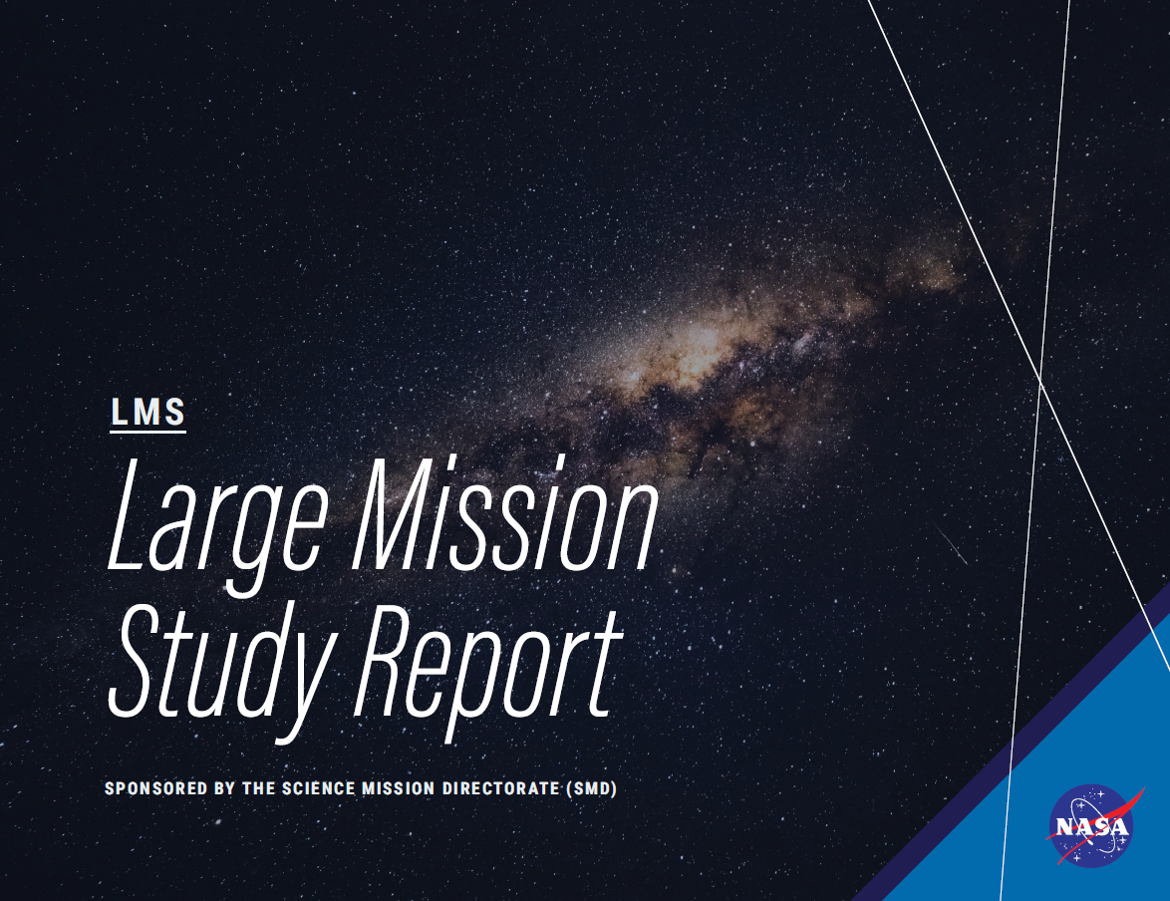
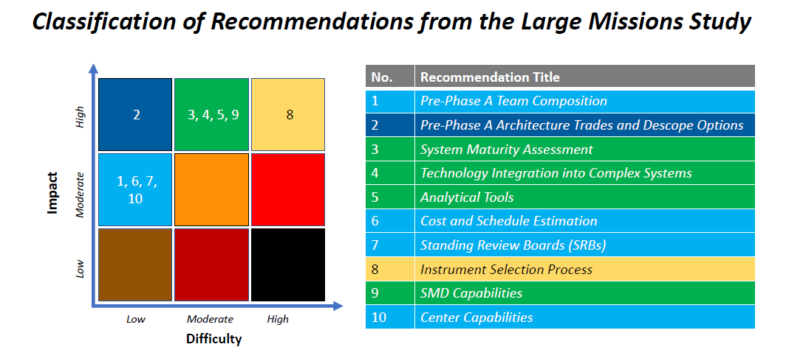
Large mission studies recommend thorough, early, well-funded trades and technology development
Finding: “During the Pre-Phase-A period, requirements development and architecture trades are often over-constrained, driving the mission unnecessarily toward very expensive solutions[…]”
Recommendation: “[…]Conduct requirements analyses and architecture trades during pre-phase-A that quantify science vs. cost, thereby preventing unnecessary adoption of very expensive solutions[…]”
  SMD’s large mission study report (https://science.nasa.gov/about-us/large-mission-study)
“Inadequate funding for concept studies, concept, and technology development”
  One of several common issues identified by the “Flagship Assessment Team” in 2013: National Aeronautics and Space Administration, “Cost and Schedule Growth in NASA Missions: Findings and Recommendations from the Explanation of Change Study and Flagship Mission Assessment,” Office of the Center Director, NASA Goddard Space Flight Center, 2013.
“annual funding [should be] provided in the early stages of development, to cover feasibility studies, technology developments and prototype development,”
  Bitten, R.E., Shinn, S. A., Emmons, D. L., “Challenges and Potential Solutions to Develop and Fund NASA Flagship Missions,” IEEE (2019).
(2020)

Slide 7
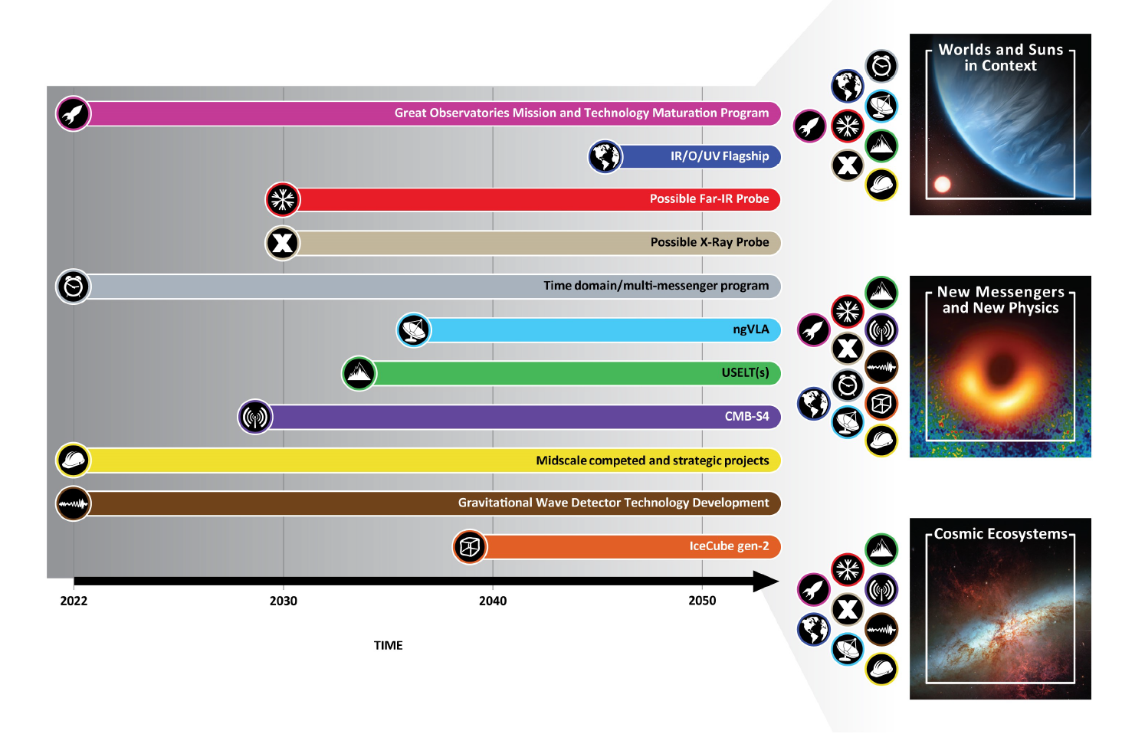
Astro2020 decadal survey recommendations for IR/O/UV flagship
Two of the top recommendations of Astro2020 decadal survey:
The decadal survey recommends a large (~6m diameter) Infrared/Optical/Ultraviolet space telescope with high-contrast imaging and spectroscopy as the first mission to enter the Great Observatories Mission and Technology Maturation Program. This is an ambitious mission with the goal of searching for biosignatures from habitable zone exoplanets and providing a powerful new facility for general astrophysics. If mission and technology maturation are successful, as determined by an independent review, implementation should start in the latter part of the decade with a target launch in the first half of the 2040’s.
Given the large costs and development timescales for the next generation of space telescopes, the decadal survey recommends that NASA create the Great Observatories Mission and Technology Maturation Program as a new approach for planning and implementing large missions. The program would provide early investment in technology development for multiple mission concepts to lower the risks and costs of projects before they become too complex, large, and costly. The first entrant for the maturation program should be a large Infrared/Optical/Ultraviolet space telescope. The second entrants should be strategic Far-Infrared and X-ray missions.
Astro2020 cost appraisal for GOMaP: $1.2B this decade
(FY2020$, see p. S-8, table S.5)
https://www.nationalacademies.org/our-work/decadal-survey-on-astronomy-and-astrophysics-2020-astro2020
Notes:
Bruce Macintosh: ~6m is very approximate
Scott Gaudi: most trades should be re-opened

Slide 8
Outline
Motivation for continuing to improve coronagraphic instrument designs
How much improvement is possible (i.e. before we reach fundamental physics limits)?
What technologies can reach physics limits?
Example technology: PIAA-Vortex coronagraph (Kevin Fogarty)

Slide 9
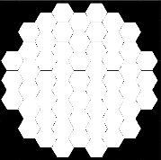
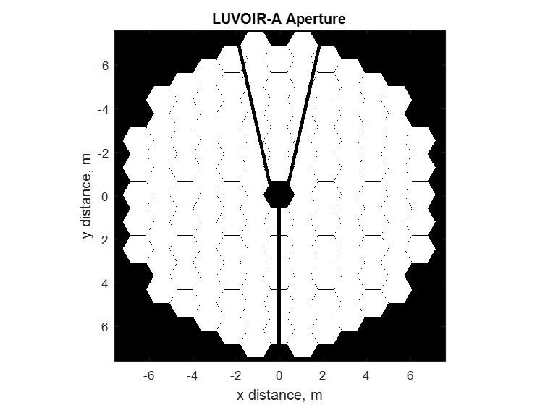
Expected ExoEarth candidate yields from current coronagraph designs
LUVOIR A
LUVOIR B
HabEx
Stark C., et al., 2019

Slide 10
Expected ExoEarth candidate yields from current coronagraph designs
Can we access
this region?
LUVOIR B
Stark C., et al., 2019
Notes:
Can we access this region?
How far is the ultimate physics limit for a given aperture?

Slide 11
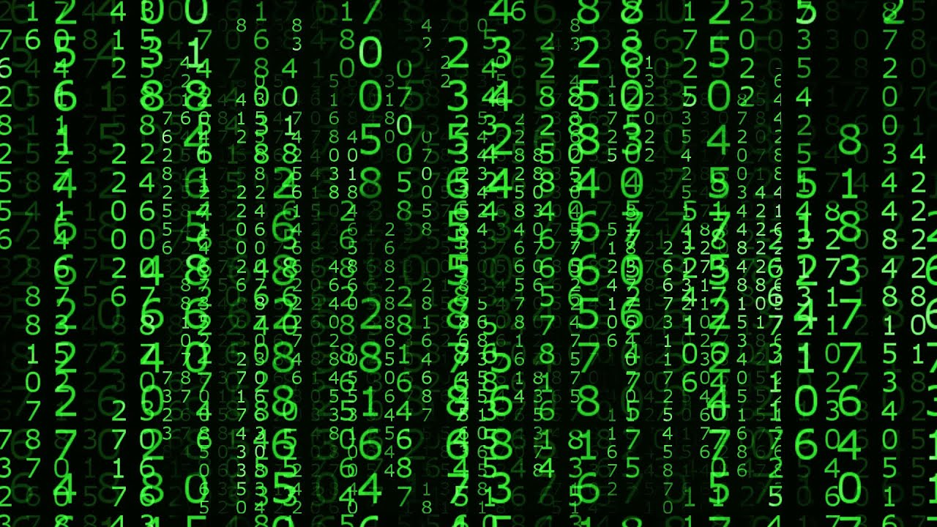
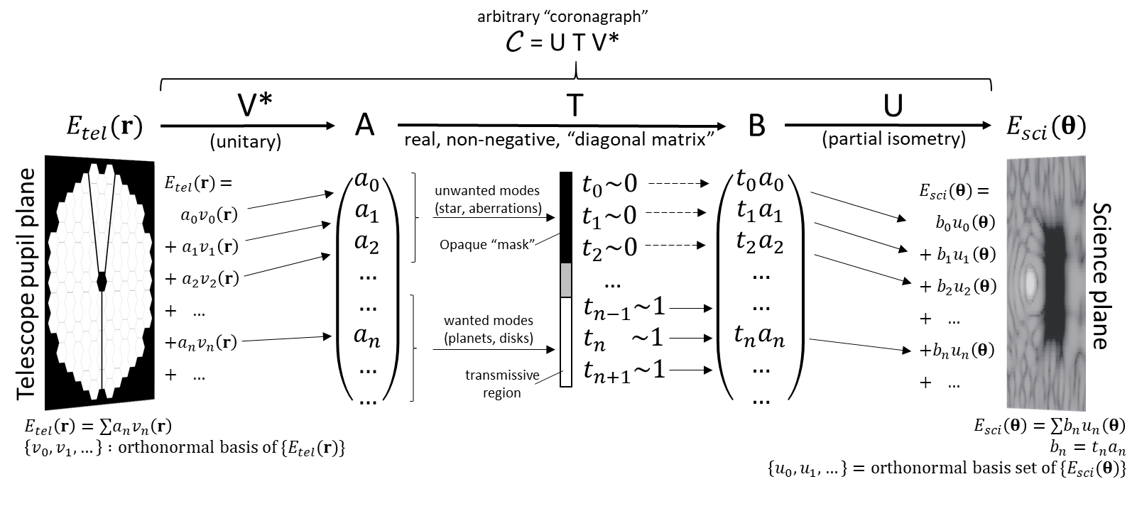
Abstract representation of coronagraphs as linear operators
C
(Linear Passive Operator)
Designing an abstract coronagraph:
Choose an orthonormal basis of pupil plane modes (identifying noise modes to be suppressed)
Choose desired attenuation for each mode (0 for noise modes and 1 for signal modes is best)
Choose an orthonormal basis of science plane modes onto which passed pupil plane modes are to be mapped (this will almost always be a simple imaging system for passed modes)
Belikov et al. 2021 (also see Guyon et al. 2006)
Notes:
SVD diagram
Action of a coronagraph:
Takeaway message: All coronagraphs can be thought of as a linear passive operator between the pupil plane and science plane
Motivated by the ideas in Guyon 2006, but formalizing, generalizing, it and extending it to obstructed apertures
Bring the power of Linear algebra, developed by countless mathematicians over centuries

Slide 12
Yield simulations of Exo-Earth candidates
Optimal coronagraphs
Optimal coronagraphs achieve 2-4 greater yield than currently baselined coronagraphs (for a fixed bandwidth and system QE)
Gap between obstructed and unobstructed apertures can be closed!
  Enabling larger aperture for the same cost, and/or risk reduction / cost savings
Caveats: optimal coronagraph yields
  Show where theoretical limits are, but not how to get there practically
  May or may not require exotic architectures
  Are partially based on IWA improvements, which may have other limitations
  Useful as a target, guide, and inspiration for coronagraph design
Yield enabled by continued improvements in coronagraph design
Baseline designs
Notes:
Gap between obstructed and unobstructed apertures can be closed
DMVC LUVOIR B yield of exoEarth candidates is 28 (expected value). Probably room to grow given the new robust design, especially if we can push to smaller IWA while maintaining robustness.
PIAA for LUVOIR B is 42. Probably room to grow as well as you know.

Slide 13
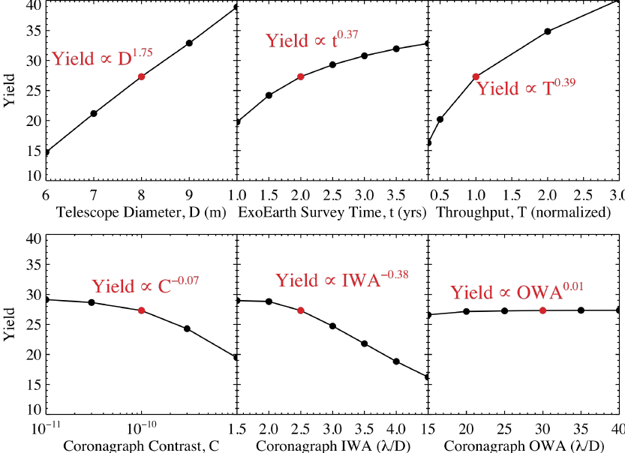
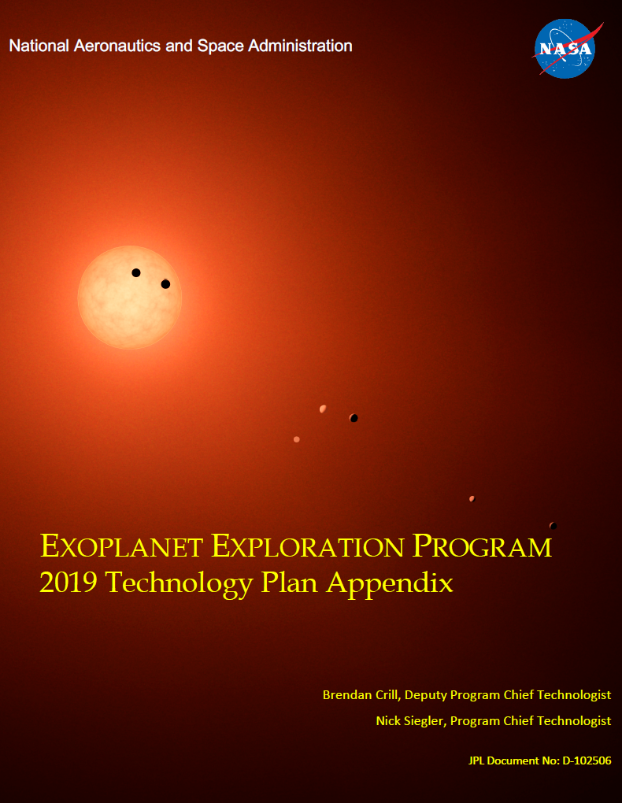
What coronagraph parameters should we focus on improving?
Technology gap list, ExEP
Stark et al. 2019
Coronagraph contrast is of course critical and challenging, but
  diminishing returns once o(1e-10) contrast is reached (because zodi / exozidi starts to dominate)
  is NOT fundamentally limited by coronagraph architecture (for point sources): requires primarily time and effort in the lab
Coronagraph “efficiency” (throughput, IWA, tolerance to stellar size, etc.) is also very critical
  IS fundamentally coronagraph architecture-limited: decisions made without a thorough trade can be very costly
  Requires continued innovation (TRL0-4)

Slide 14
Outline
Motivation for continuing to improve coronagraphic instrument designs
How much improvement is possible (i.e. before we reach fundamental physics limits)?
What technologies can reach physics limits?
Example technology: PIAA-Vortex coronagraph (Kevin Fogarty)

Slide 15
Which technologies may reach physics limits?
We want to be here
physics-limited performance
Current technology gap
?
Coronagraph expected yield
(at current level of maturity)
Maturing
Architectures
(<TRL5)
Currently mature
coronagraph
Technologies
(~TRL5+)
?
Theoretically optimal
coronagraph technologies
(e.g. photonic chips)
time (or $ spent)
now
2030
    Blue and green probably require churning through ~20+ technologies/architectures (because many may fail)
      an order of magnitude more effort than what can be supported by current ROSES calls
      Still a tiny fraction of mission cost
    Should not be afraid of <TRL3 technologies: “In Exoplanets, 4 years is a lifetime” – Eric Mamajek
Notes:
Blue and green require an order of magnitude more effort than what can be supported by current ROSES calls
“In the Exoplanets field, 4 years is a lifetime – Eric Mamajek”

Slide 16
(Jeff Jewel, JPL)

Slide 17
Outline
Motivation for continuing to improve coronagraphic instrument designs
How much improvement is possible (i.e. before we reach fundamental physics limits)?
What technologies can reach physics limits?
Example technology: PIAA-Vortex coronagraph (Kevin Fogarty)

Slide 18
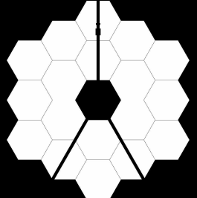
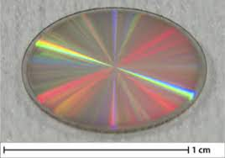
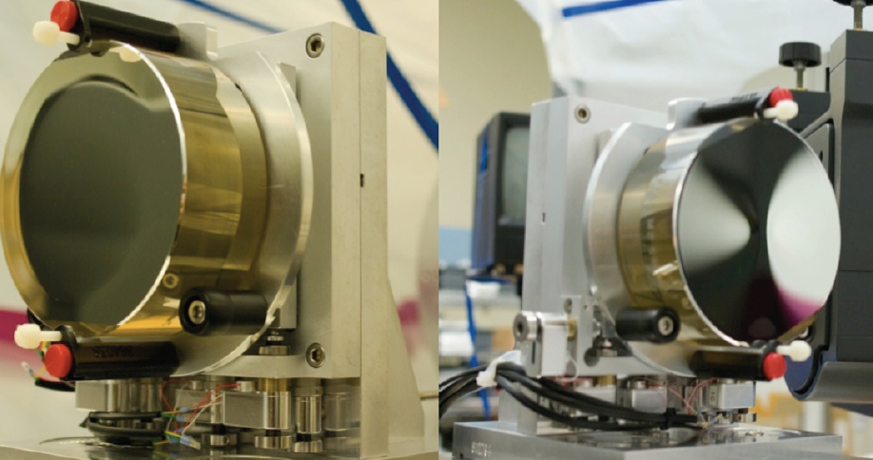
PIAA-Vortex Coronagraph: High Performance on Obstructed Pupils
Enables an obstructed aperture version of Astro2020 flagship, with yields potentially comparable to unobstructed apertures.
  Mitigates several key mission risks
  Access to on-axis trade space may improve science performance
Based on high-maturity components, but requires more design optimization and system-level testing.
Addresses the trade-off between throughput, sensitivity, and IWA that limits on-axis performance.
Absil et al. 2017
Belikov et al. 2010

Slide 19
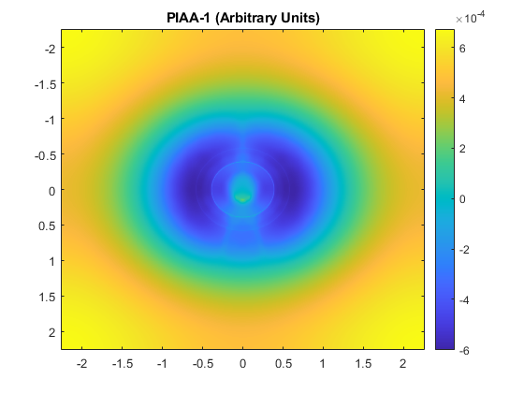
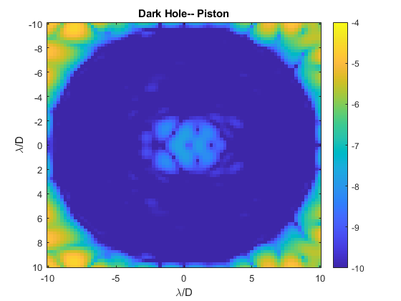

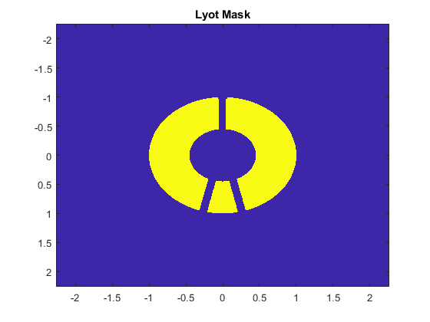



PIAA-Vortex combines the advantages of PIAA and Vortex coronagraphs
PIAA Mirror 1
$$H_{1}(x,y)$$
PIAA Mirror 2
$$H_{2}(\tilde{x},\tilde{y})$$
(A)
FT
(B)
FT
(C)
FT
(D)
PIAA-Apodized Pupil Plane
$$A(\tilde{x},\tilde{y})$$
Vortex
Lyot Stop
Image

Slide 20
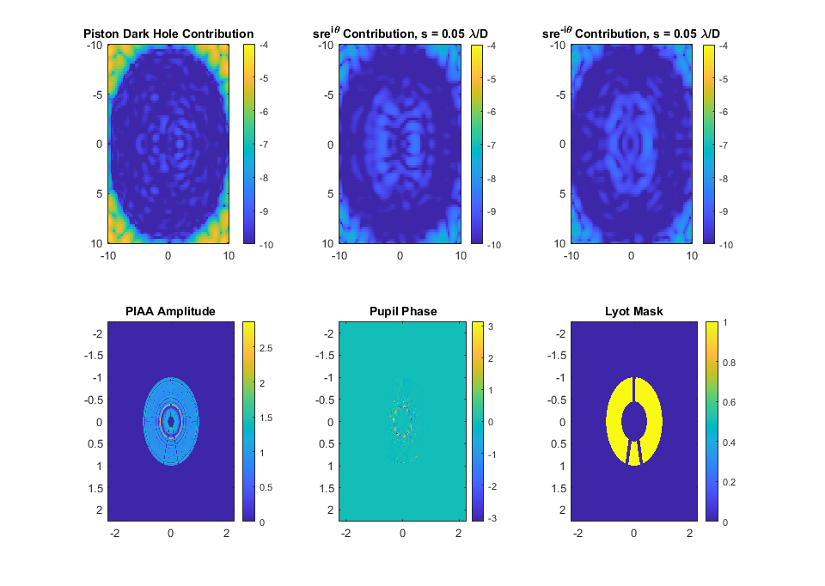
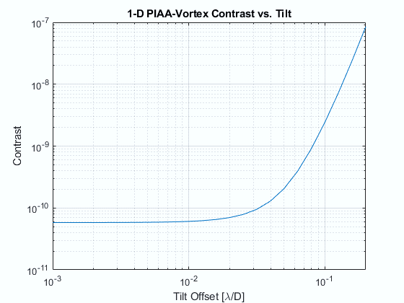
PIAA-Vortex enables robustness to tip/tilt errors and stellar angular size

Slide 21
PIAA-Vortex aims to improve yields and lower Astro2020 risk.
We expect an on-axis yield improvement over existing designs of a factor of > 1.6
  Parametric extrapolation of yield from apodized vortex (accounting for better throughput, etc.) with obstruction, but ignoring struts and segments for now…
Relaxation of requirements on tip/tilt and stellar angular size by factor of ~10.
Stay tuned for more in-depth presentation of results at SPIE Montreal.

Slide 22
There are other technologies improve Astro2020 flagship CGI performance
Several other promising coronagraph architectures
Spectral bandwidth
  No fundamental limit (can be “brute-forced” by many narrowband CGIs in parallel)
Binary star suppression
More efficient wavefront control methods
  Pogorelyuk et al. 2020
  Fogarty et al.
  etc.
Better quantum efficiency of CGI components (coatings, cameras, etc.)
Post-processing and DRM improvements
…

Slide 23
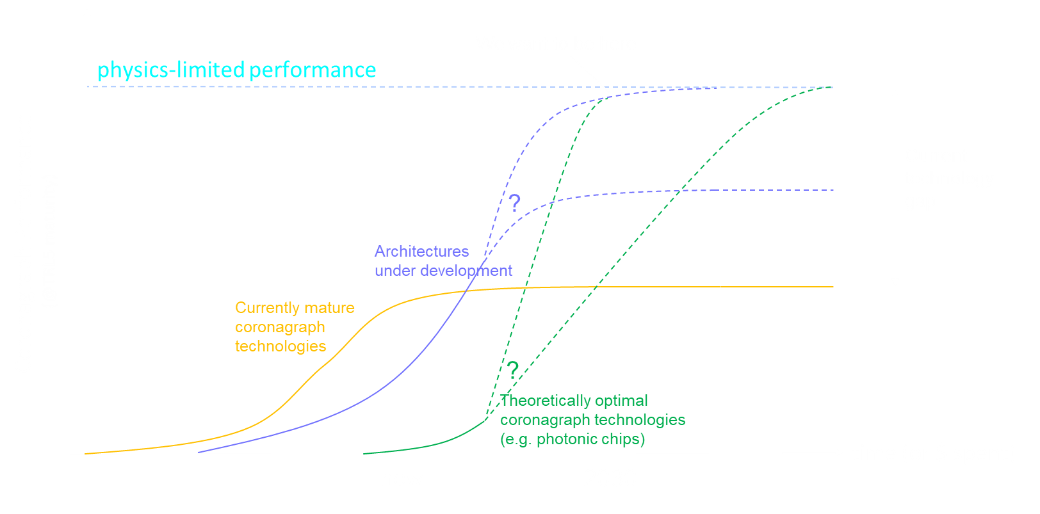
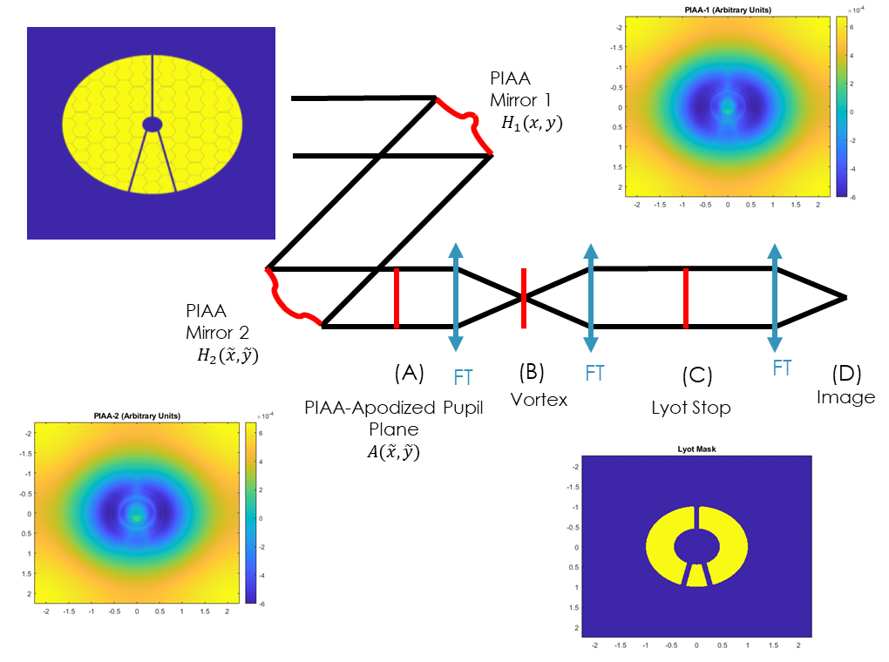
Conclusions
On a flagship, there is very high value in improving instruments (all the way to physics limits)
  Instrument is a small fraction of mission cost, but high impact on performance
  A more powerful instrument can also significantly relax mission requirements and reduce risk
Coronagraphic state of the art is still far from physics limits
  2-4x exoEarth yield improvement still possible, simply by improving coronagraph efficiency
  Additional improvements are possible from bandwidth, WFC, QE, etc.
There are many technologies can result in a breakthrough in performance:
  Existing coronagraph architectures still have plenty of mileage left (but unclear whether they can reach physics limits)
  Emerging technologies such as photonic chips are on the horizon, may be possible to raise to TRL6 by 2030 (especially by interdisciplinary engagement with telecommunications engineers)
Need to accelerate technology innovation for Astro2020 mission
  A coordinated effort, rather than independent groups
  Taking full advantage of this opportunity probably requires pursuing dozens of technologies -- an order of magnitude greater effort than current ROSES opportunities can support

