Slide 1


Exoplanet Watch
A Citizen Science Project To Observe Transiting Exoplanets
Dr. Rob Zellem
© 2021. California Institute of Technology.
Government sponsorship acknowledged.

Slide 2
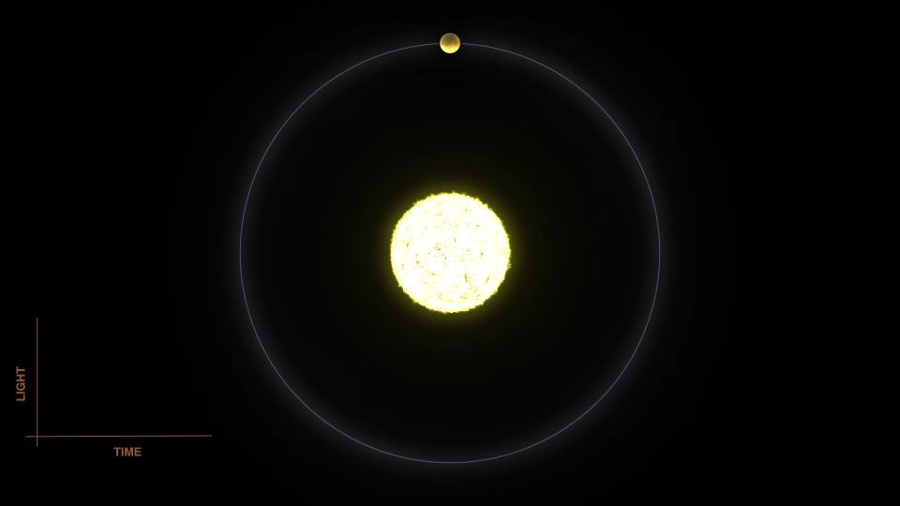
Transits
Measures the change in brightness as the planet passes in front of or behind its host star
  At best, the dip in brightness is 1%
Gives us the planet-to-star radius ratio
Also allow us to study a planet’s atmosphere
Method used to discover ~3000 (~75%) currently-known exoplanets
NASA

Slide 3
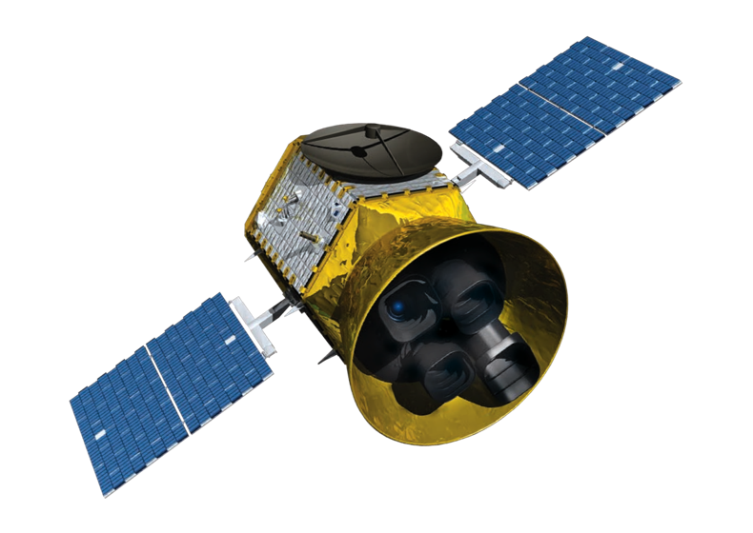
TESS will discover thousands of transiting exoplanets
All-sky survey predicted to find potentially 10,000 new transiting exoplanets
  (Barclay et al. 2018)
NASA/MIT

Slide 4
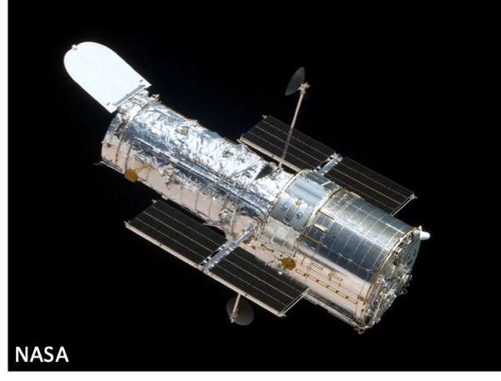
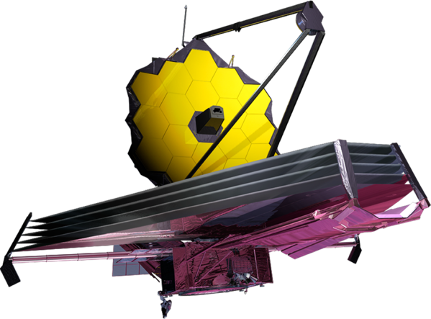
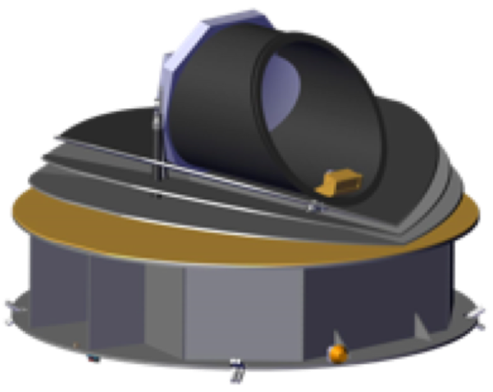
Transits
Hubble – tens of planets
JWST – tens to hundreds of planets
ARIEL – hundreds to a thousand planets
NASA Astro2020 mission – will potentially use the transit method to look for biosignatures
JWST - NASA/Goddard
ARIEL - ESA

Slide 5
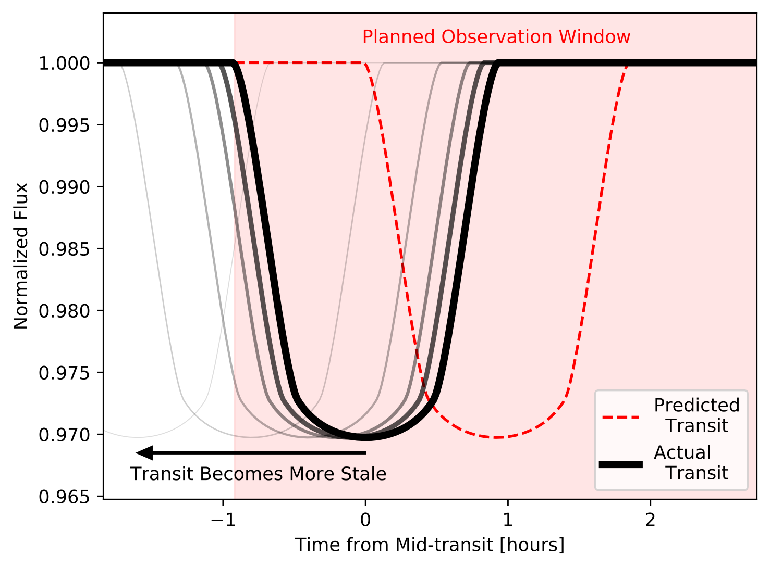
Need to keep things fresh
Zellem et al. 2020

Slide 6
The Power of Small Telescopes
A single 6-inch (15.24-cm) telescope is capable of high-precision transit photometry
  MicroObservatory in Tucson, AZ
HAT-P-32b
  Hot Jupiter orbiting a relatively-dim star (V-mag = 11.289)
mid-transit uncertainty of 1.28 min
transit depth uncertainty of 0.096%
  25σ significance
Zellem et al. 2020

Slide 7
The power of Small Telescopes
Zellem et al. 2020

Slide 8
Small Telescopes are the Answer
Zellem et al. 2020

Slide 9
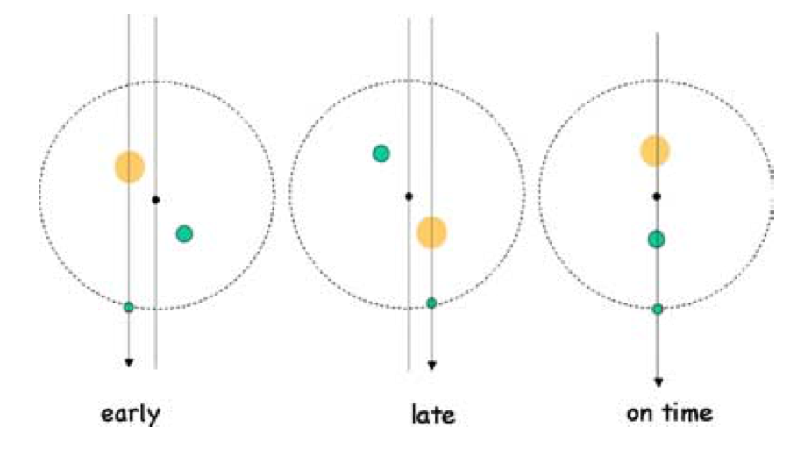
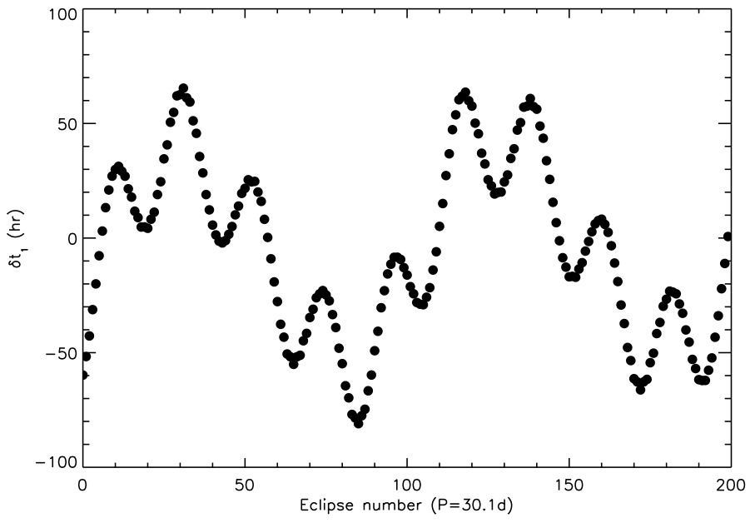
Transit Timing Variations (TTVs)
Gravitational perturbation of a planet by another planet
  Early/late measured transit times
Can allow for the discovery of new planets
Enables measurement of planetary masses
Agol et al. 2005

Slide 10
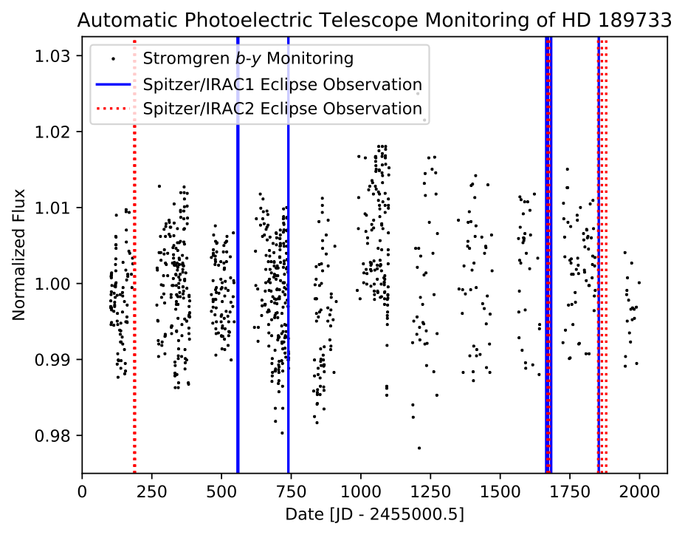
Monitor for Stellar Variability
Kilpatrick et al. (2019)

Slide 11
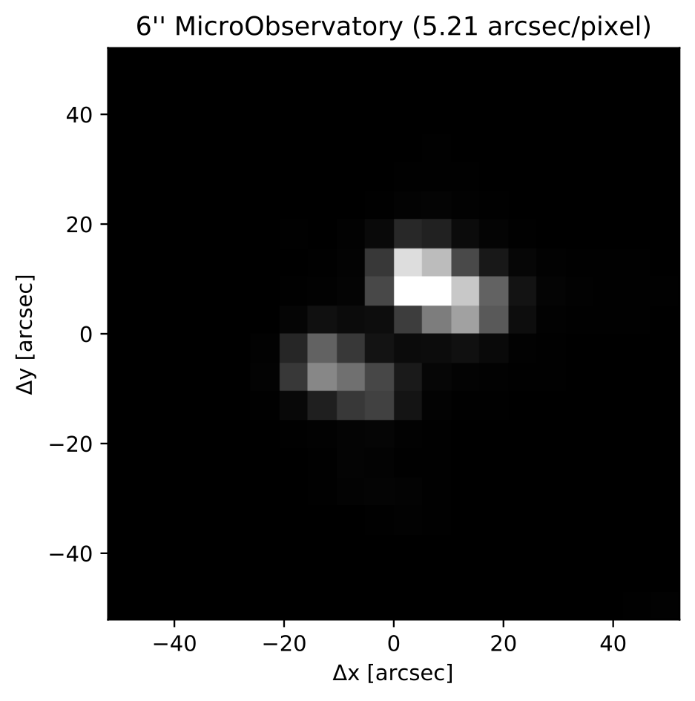
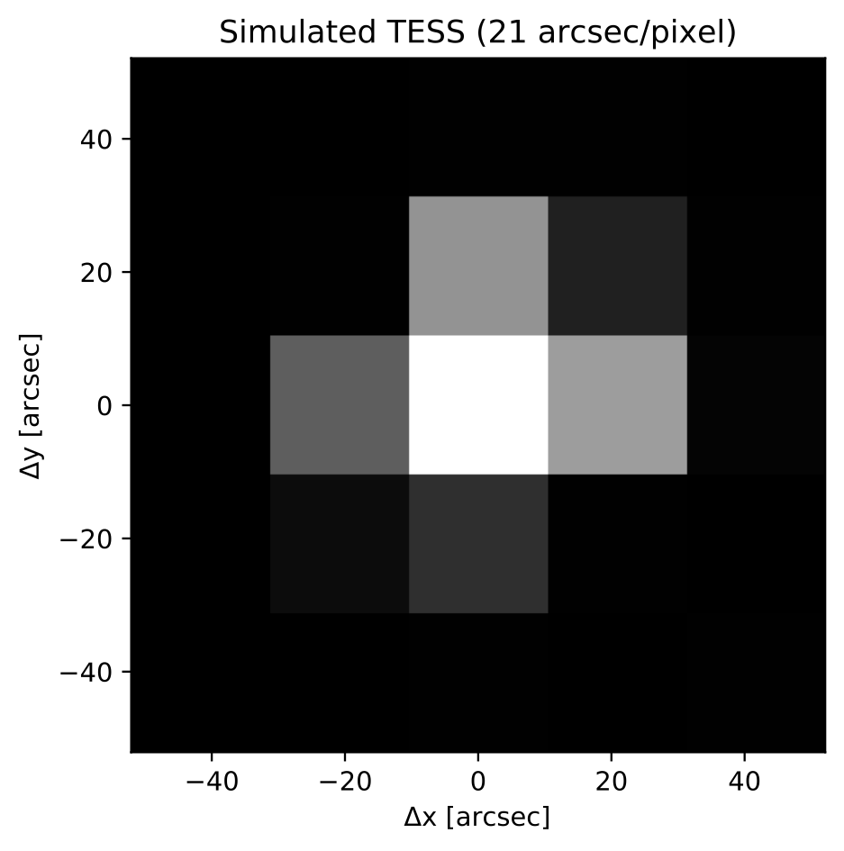
Blended Pairs
Zellem et al. 2020

Slide 12
Exoplanet Watch
A campaign aimed at citizen scientists to routinely observe high-priority transiting exoplanets to keep their mid-transit times and orbital periods precise
Collaborative effort to complement existing surveys
  e.g., open collaboration with ExoClock
Data will be immediately public to entire community
Opportunity for community feedback and target requests
Observers will be listed as co-authors on any published results
Part of NASA’s Universe of Learning

Slide 13
Goals
Education goals: to engage the public in exoplanet citizen science and increase their confidence about their ability to do science
Science goals: to ensure efficient use of large telescopes; discover new exoplanets; search for blended pairs; monitor stellar variability; confirm new exoplanets

Slide 14

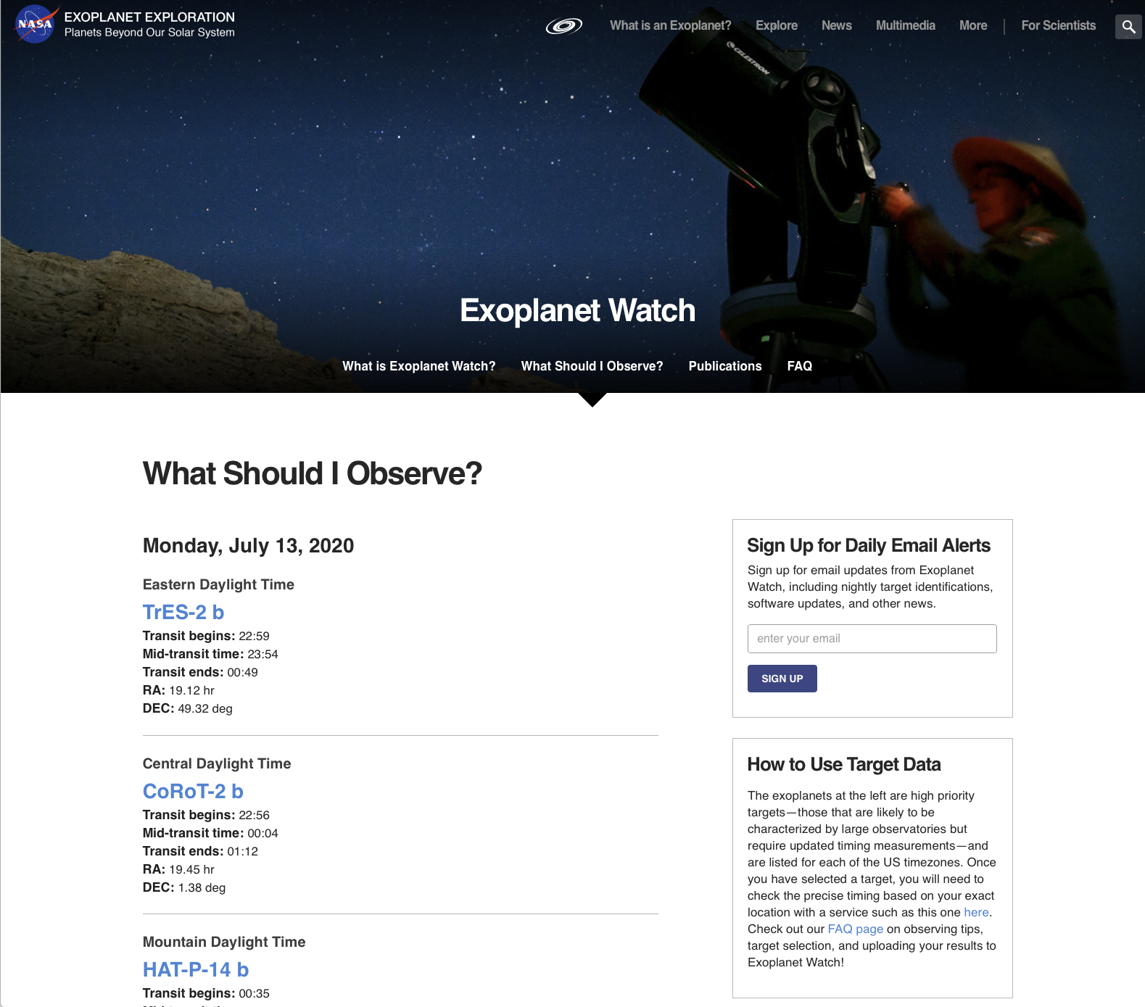
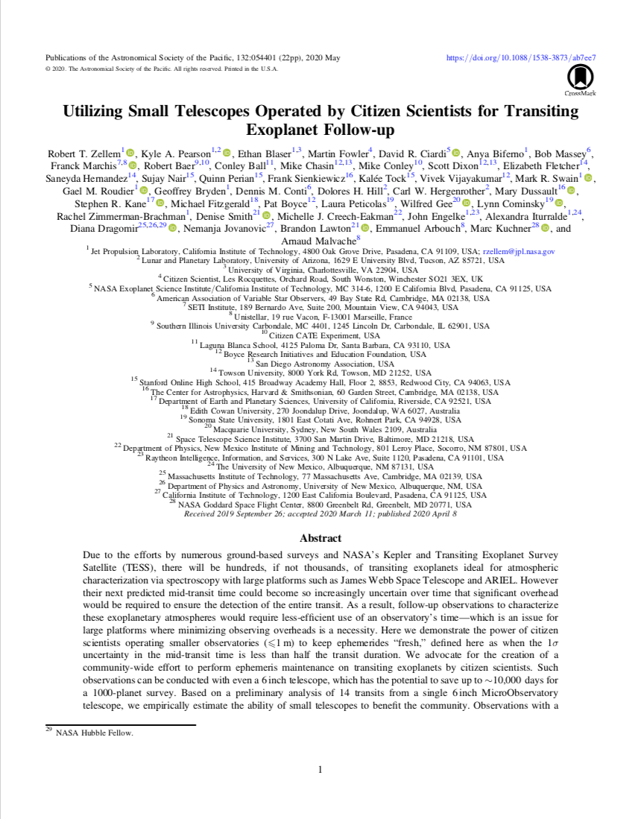

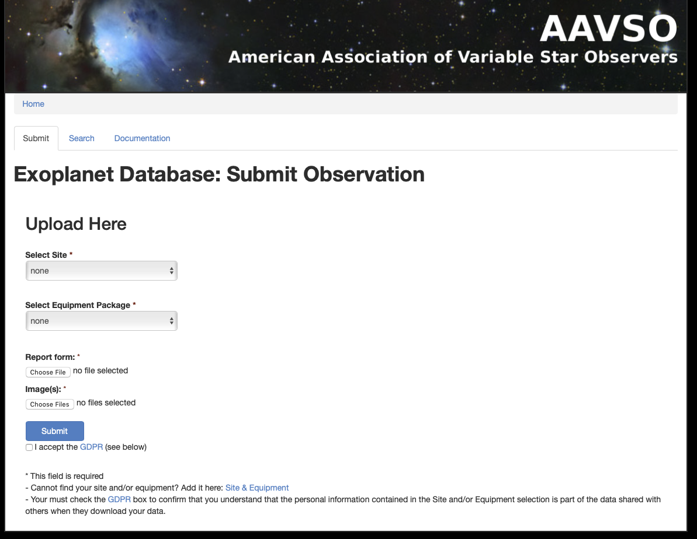
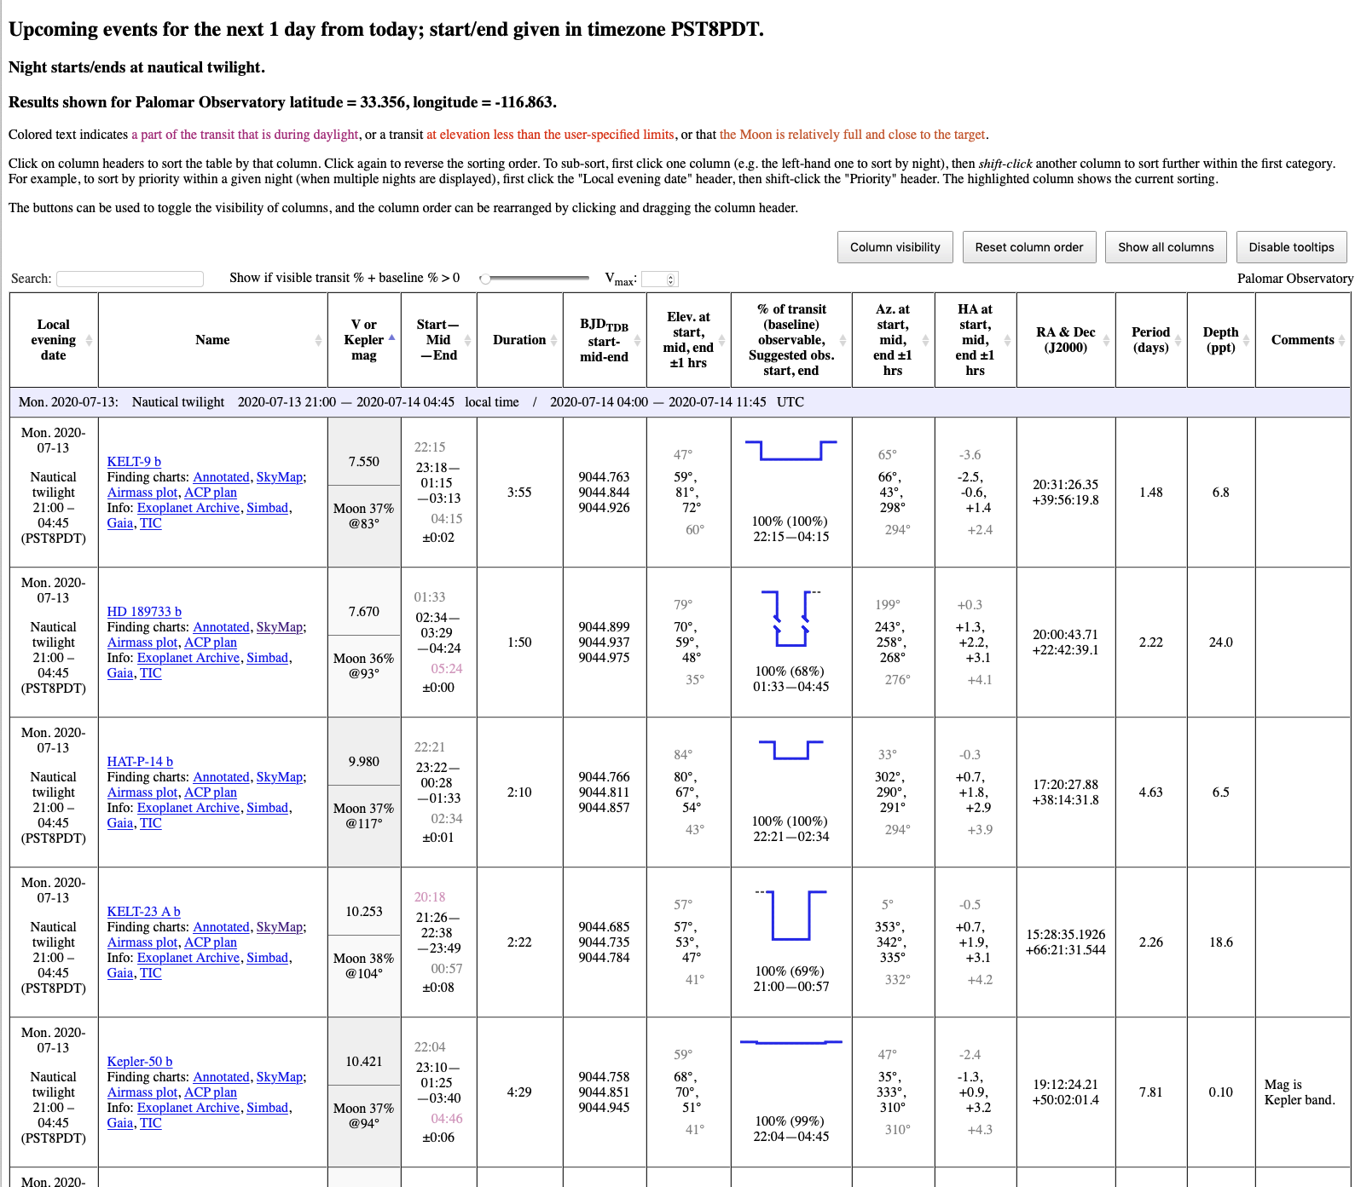
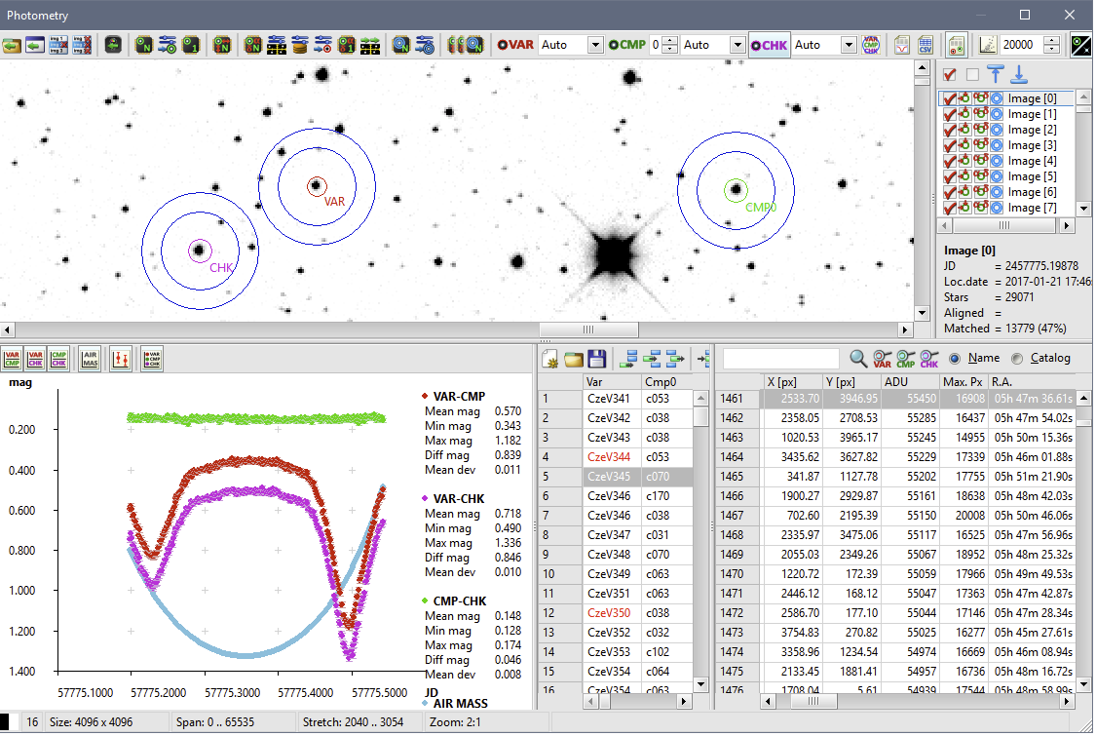
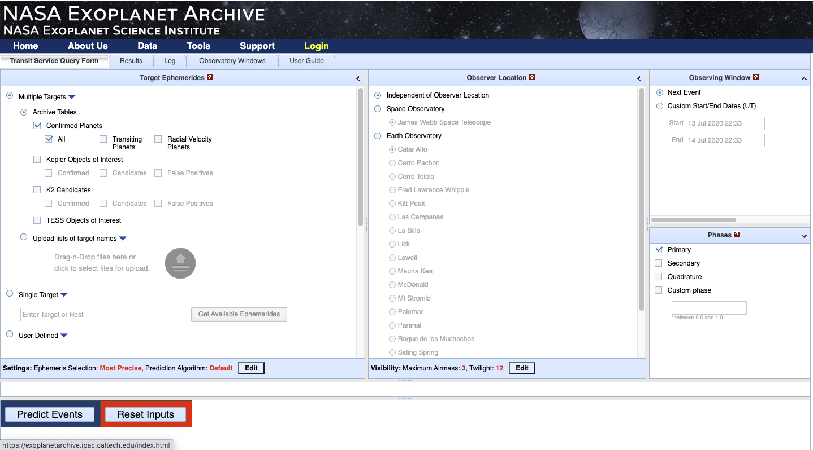
User Experience
AstroImageJ
Doug Lalla
Doug Lalla
1. Plan
2. Observe
3. Reduce
4. Upload
5. Publish

Slide 15
User Experience
AstroImageJ
Doug Lalla
Doug Lalla
1. Plan
2. Observe
3. Reduce
4. Upload
5. Publish

Slide 16
User Experience
AstroImageJ
Doug Lalla
Doug Lalla
1. Plan
2. Observe
3. Reduce
4. Upload
5. Publish

Slide 17
User Experience
AstroImageJ
Doug Lalla
Doug Lalla
1. Plan
2. Observe
3. Reduce
4. Upload
5. Publish

Slide 18
User Experience
AstroImageJ
Doug Lalla
Doug Lalla
1. Plan
2. Observe
3. Reduce
4. Upload
5. Publish

Slide 19
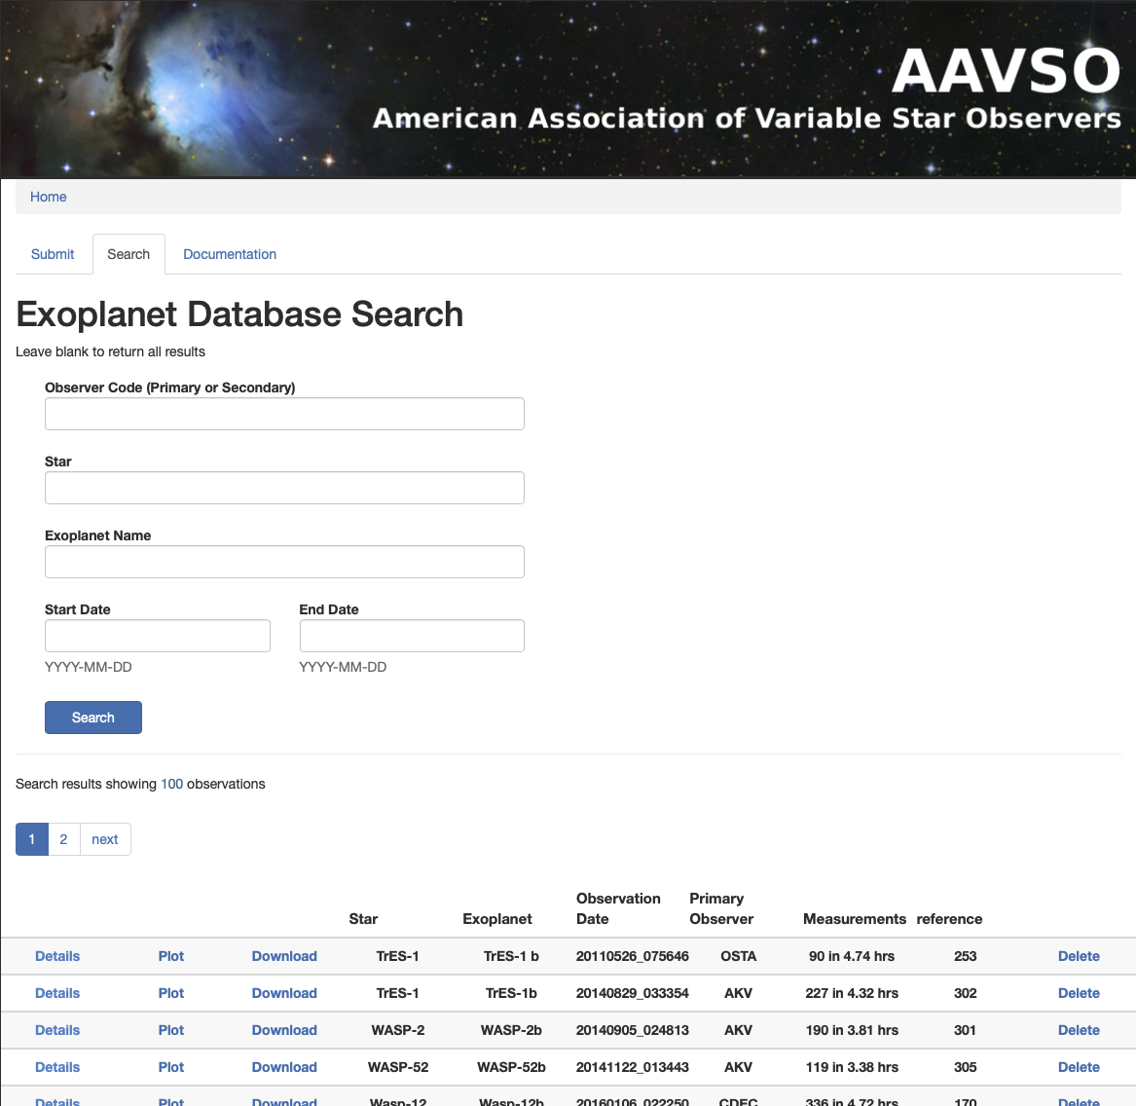


CITISENS Pipeline
1. Scrape
2. Process
3. Publish
Notes:
Citizen Initiated Transit Information Survey Enabling NASA Science

Slide 20
CITISENS Pipeline
1. Scrape
2. Process
3. Publish
Notes:
Citizen Initiated Transit Information Survey Enabling NASA Science

Slide 21
CITISENS Pipeline
1. Scrape
2. Process
3. Publish
Notes:
Citizen Initiated Transit Information Survey Enabling NASA Science

Slide 22
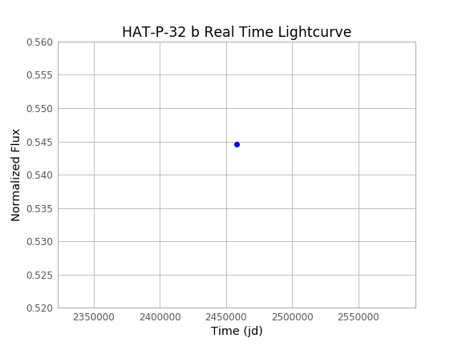
EXOplanet Transit Interpretation Code
Python transit reduction tool
    Reduces raw fits files or pre-reduced data
    Produces final lightcurves
    Fits lightcurves with transit model
    Automatically scrapes all parameters needed to produce model lightcurve
    Produces text file in AAVSO database format and pdfs in article-ready format
    Working successfully on multiple telescopes
    Comes with sample transit data
    https://github.com/rzellem/EXOTIC
Zellem et al. 2020

Slide 23
Exoplanet Watch
Contact us: exoplanetwatch@jpl.nasa.gov
Visit our website: www.exoplanets.nasa.gov/exoplanet-watch

