Slide 1
ATA Starshade Presentation
Starshade Science Industry Partnership Forum
Jet Propulsion Laboratory
9/18/19
Laura Hoffman, George Antoun, Cory Rupp, Trish Sur

Slide 2
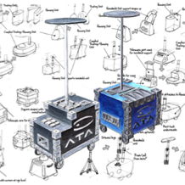
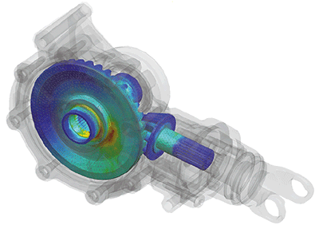
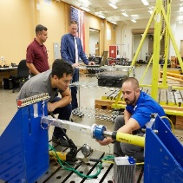
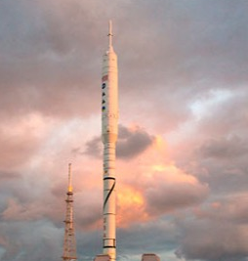
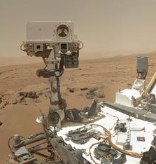

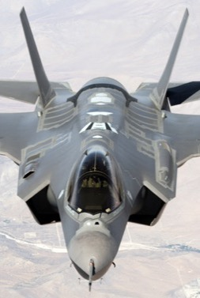


Who is ATA?
ATA Engineering provides high-value engineering services help solve the most challenging design and analysis problems
From initial concept development to detailed structural design
Comprehensive structural, fluid, acoustic, and thermal analysis services
Industry-leading structural test services for extreme loading environments
Design
Analysis
Test
Aerospace
Robotics & Controls
Themed
Entertainment
Industrial & Mining Equipment
Consumer Products
Defense
Notes:
ATA Engineering provides engineering services in the realms of Design, Analysis, and Test in a variety of fields from defense and aerospace to themed entertainment.

Slide 3
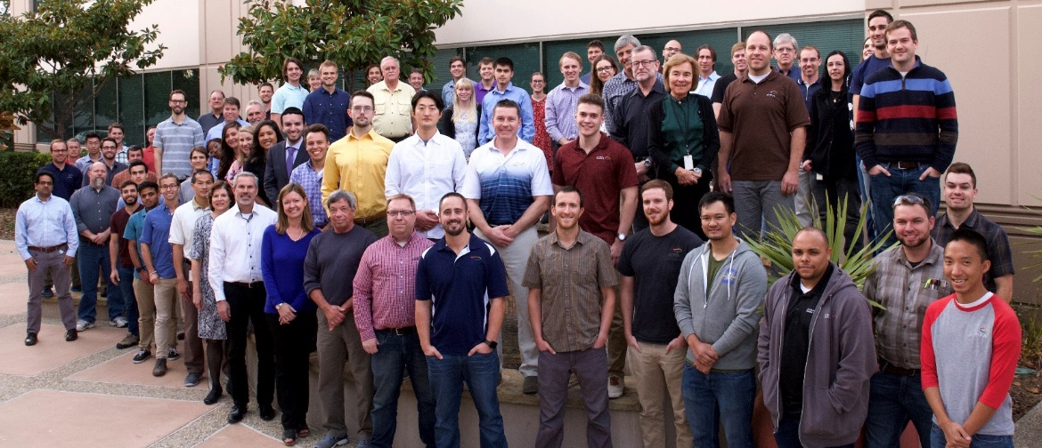
Who We Are
We are an employee-owned small business with a full-time staff of over 155, more than 130 of whom are degreed engineers
Bay Area
Denver
Washington, D.C.
Los Angeles
Albuquerque
Huntsville
28
Ph.D.
San Diego
76
M.S.
14
Registered Professional Engineers
14
Average years of experience
Subject matter experts as recognized by AIAA, IMAC and NAE
26
B.S.
Notes:
We are an employee owned small business with 155 full time employees, 130 of which are degreed engineers. We have a good mix of bachelors, masters and PhDs. We are one company in several locations, with our headquarters in San Diego. All of us supporting the Starshade contract are located in the Denver office.

Slide 4
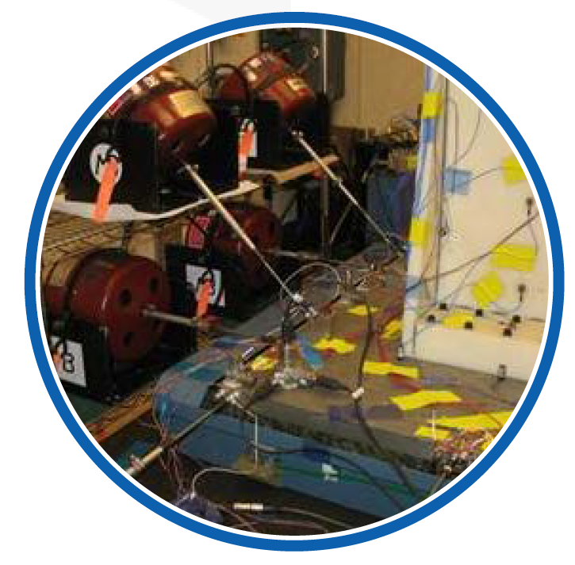
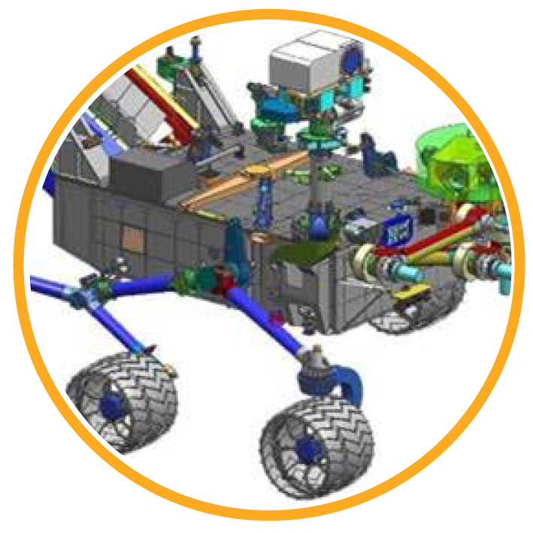

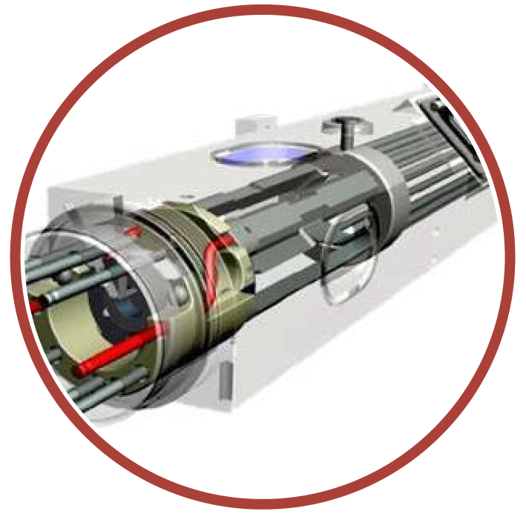
ATA Has Provided 68+ Staff-Years of Support to JPL programs
Resulted in new tools and methods development
Mars Science Laboratory & Mars2020
Space Interferometry Mission
Deep Space Atomic Clock
Space Optics
Fixed base modes from flight interface excitation of delicate flight hardware
Statistical loads for EDL; flexible multibody simulations; maximum VM stress
Nano modeling, thermal distortion, and thermal mapping
Brazed joint stress triaxiality; coil dynamics
Other programs include: AMD, Juno, DAWN, Aquarius, JWST (MIRI), ATEC, SMAP, Fast ,FINESSE, MSS, InSight, PRISM, ASTERIA, MSPI, ECCO, APX, SMMS, RapidScat, ISLAND, BLUE, SWOT, HERMeS, NuStar
Notes:
For over thirty years, ATA and JPL have championed common values and implemented aligned methods to jointly attain technical excellence and scientific achievements. We have also been heavily involved with projects at other NASA centers, like James Webb Space Telescope and the WB-57 with NASA JSC.

Slide 5
Our Commitment to Excellence
We have been recognized by numerous organizations for our outstanding customer support and work environment
2012 George M. Low awardee as JPL’s small business services nominee
NASA
NASA JPL
NASA JPL
NRO
George M. Low Award
Thomas H. May Legacy of Excellence
Small Business Subcontractor of the Year
Commander Commemoration
Wall Street Journal
NCEO
SDBJ
Top 15 Small Workplaces
Innovations in Employee Ownership
San Diego’s Fastest Growing Companies
Notes:
In recognition of the high quality of ATA’s support to JPL for MSL, NASA conferred upon ATA the George M. Low award in 2012. Previously, ATA’s performance as a subcontractor also led to our selection for JPL’s Small Business Contractor of the Year award and the Thomas H. May Legacy of Excellence award by JPL in 2010.

Slide 6
Tools and Methods to Support Robotics, Deployment of Large Space Structures
Select simulation framework for application to get design guidance early in design process
ADAMS
General multibody dynamics modeling & solutions
Scripting
Rapid processing of many cases
Support of statistical loads
Relatively fast
ABAQUS
General advanced nonlinear FEA
Advanced contact
Highly flexible multibody dynamics including nonlinear interaction
Very general component interactions
Longer solve times
ATA Tool based on Modelica (RAPID)
General system modeling
Open capability to specialize for large deployable structures
Very fast to model
Very fast to solve
Brings simulation results (forces and deflections) earlier in the design process
Used with Matlab to get statistical loads for MSL/Mars2020 EDL
Notes:
ATA regularly uses and develops software tools to aid in analyzing and designing deployable structures such as Starshade, including many component systems with geometric, material, and contact nonlinearities.

Slide 7
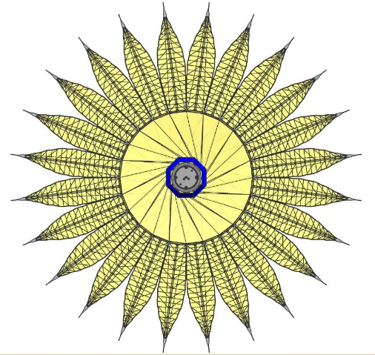
ATA’s Role on Starshade Technology Maturation
ATA has experience modeling highly nonlinear multibody dynamics and deployable structures
Capabilities ATA brings
  Extensive experience with both dedicated multibody dynamic (MBD) tools (Adams) and FE-based approaches for flexible MBD problems (Abaqus)
  A uniquely capable toolset for nonlinear deployment simulation
    RAPID (Rapid Analysis and Parametric Integrated Design)
Value ATA brings
  Evaluate structural analysis methodologies and software and assess the benefits of the approaches using petal and truss deployment as case studies

Slide 8
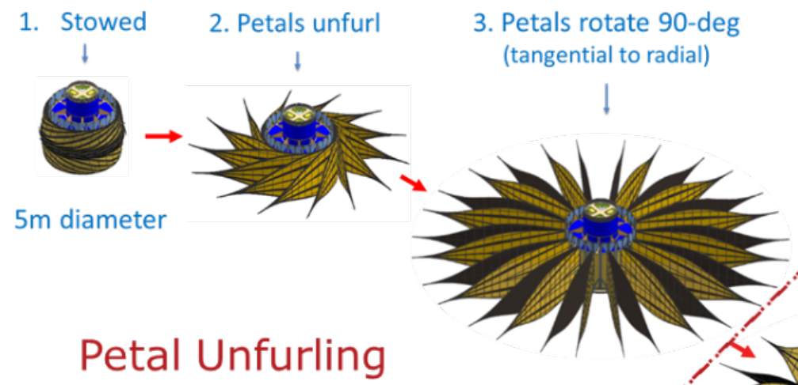
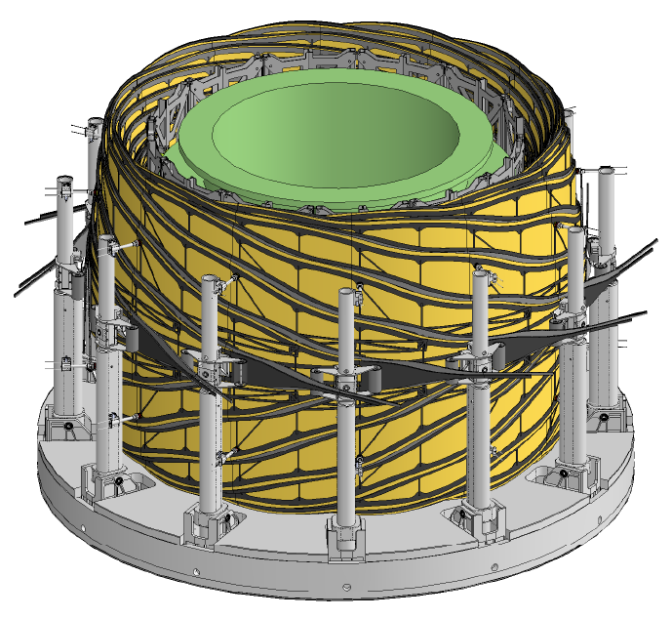
Task 1: PLUS Deployment Simulations
Task: Evaluate modeling the PLUS deployment with the goal of providing a simulation workflow that makes this problem tractable for simulation of the full set of petals in a quasi-static manner
Will work in step with testing progress, doing pre-test analysis and correlating models to test
Why use Abaqus?
  Key feature: General component flexibility and contact are critical features of this deployment, which are strengths of Abaqus

Slide 9
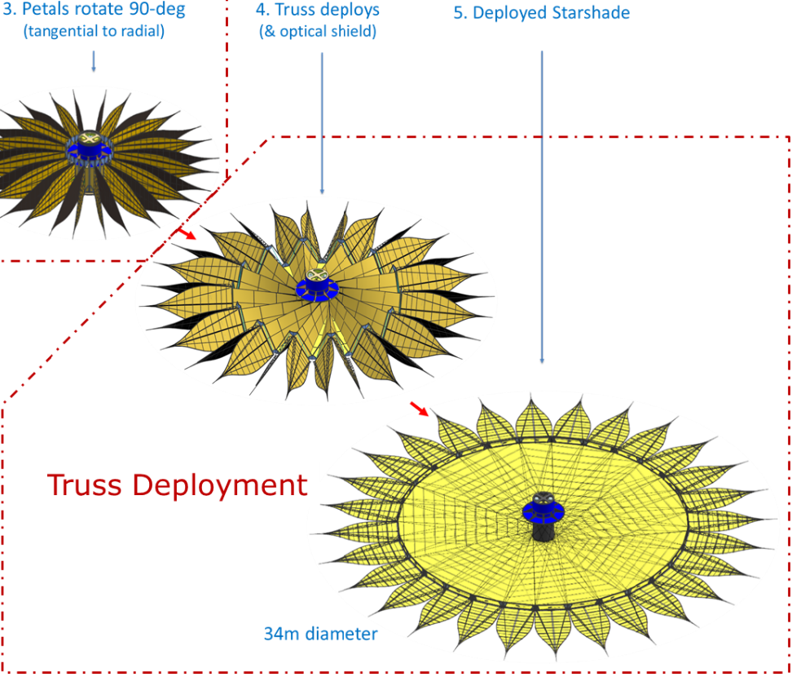
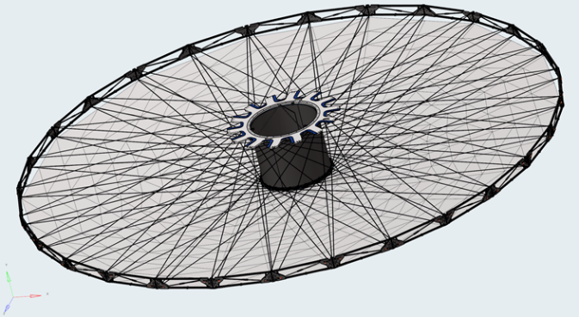
Task 2: IDS Deployment Simulations
Build an Abaqus and RAPID deployment model of the hub shield and truss
  Monitor deployment forces between the hub, shield, and truss
    Force results will help understand the loads on the shield and whether there may be structural issues that arise
  Explore 0g unconstrained deployment behavior
  Produce XYZ positions of the petal as a function of deployment as well as loads through system and interfaces between systems, e.g. hub, shield, truss.

Slide 10
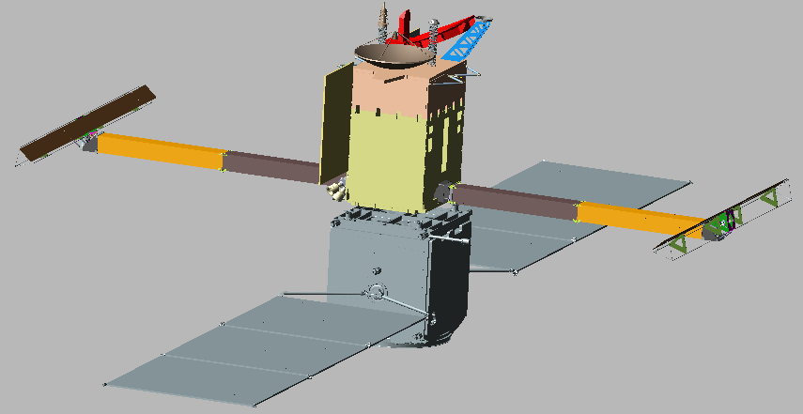
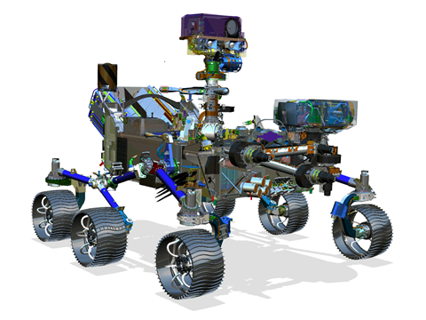
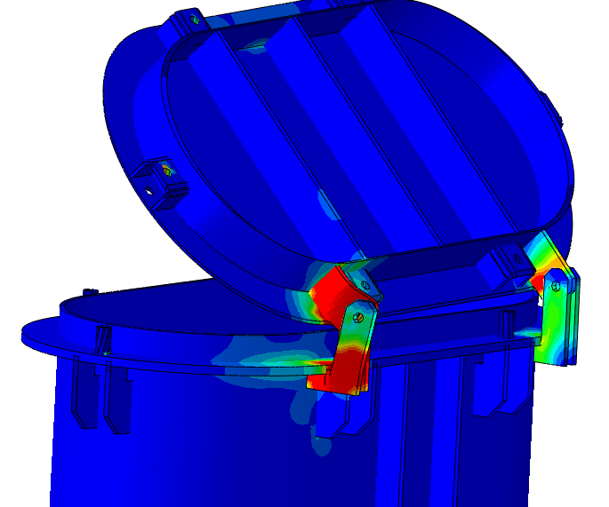
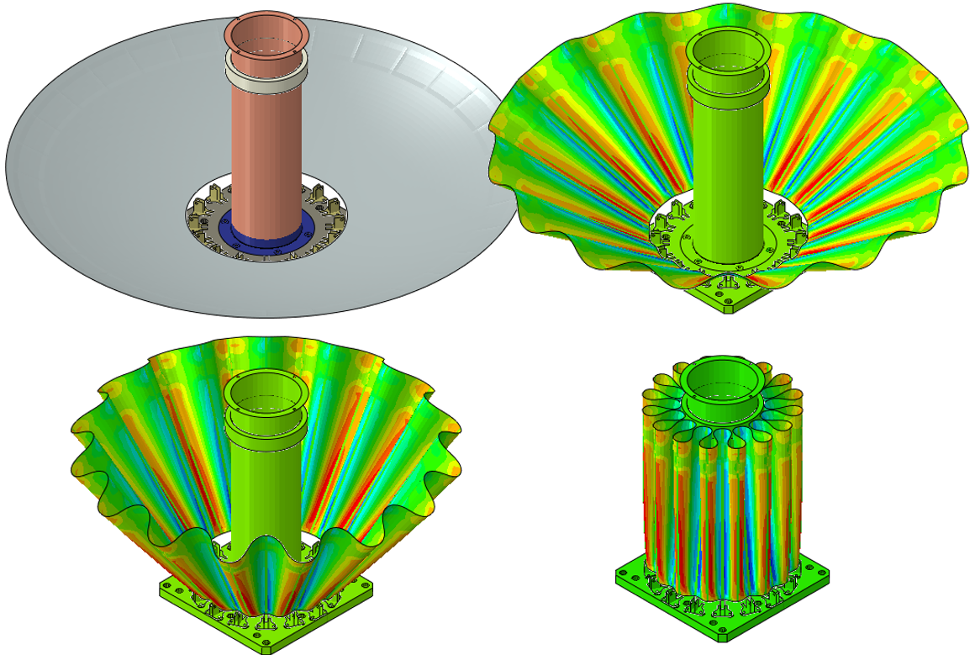
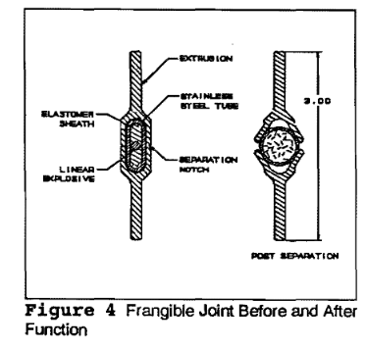
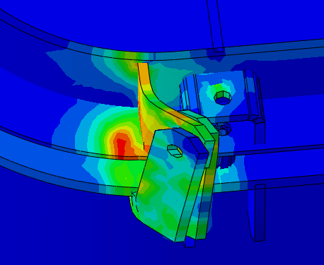
Relevant ADAMS and Abaqus Experience
Heavily involved with JPL team modeling and validating
MSL, Mars 2020, and SWOT in ADAMS (>6000 hrs)
  Deep understanding of strength and limitations
  of ADAMS
  Familiar with JPL’s processes and usage of ADAMS
Recent IRAD work to couple ADAMS with
NL FE codes (Abaqus and MSC Nastran SOL 400)
Long history of using Abaqus for non-standard applications
  Deployable reflectors, gas-inflating frangible joint, Navy mechanisms with damage
Courtesy of CTD – Approved for Public Release
Notes:
Key idea about JPL-ADAMS work: We know JPL’s past processes and needs from deployment models, have very strong understanding of strengths and limits of ADAMS that is JPL’s primary MBD tool. Have provided over 6,000 hours of support on MBD and deployment modeling for MSL, M2020, and SWOT over past 10 years (George)
Abaqus experience: Note that we can’t talk about many specific projects of customers. Use Abaqus to solve problems that don’t fit neatly in MBD or NL FE alone. One key to get across in this slides is that we don’t just use software for the intended uses, but look at types of problems that have elements of both MBD and NL FE and have found that Abaqus is well suited to solve some of these problems. During ATA introduction section would be good to mention that ATA is a methods-development company (as Mary likes to say) since this feeds into the second bullet.
Frangible joint image: Detonation cord inside of a firehose stuffed into annular region of a joint. Gas inflation causes increase in pressure in hose, causes rivets to fail, pushes two halves of fairing apart. Independent variable for simulation was gas inflator mass flow rate, simulated virtual orifices, fasteners failure, and separating fairing halves in Abaqus (without CFD) for comparison to test.
Reflector image: Simulated stowing of a reflector for Composite Technology Development and subsequent launch loads analysis.
Navy Hatch: Awarded SBIR Phase I and II to help Navy develop analytical methods to determine operational effectiveness of hatch mechanisms after sustaining damage: don’t care about yielding specifically but want to know if the hatch will still open.

Slide 11
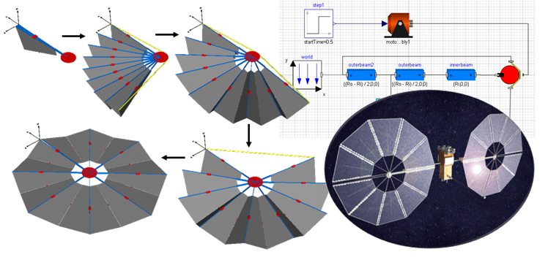
What is RAPID?
Efficient simulation for design exploration
Technology Explanation
  RAPID is an ATA developed toolset for nonlinear simulation (transient deployment, random vibration, modal analysis)
  Modular models simplify the modeling process
  Akin to multi-body analysis tools such as ADAMS, but far more powerful, extensible, and efficient
Benefits
  Uses a library of parameterized structural and mechanism modeling elements typical for deployable systems
  FEA superelement import and connection capability with CAD and FE mesh visualization
  A fabric modeling capability to predict the response of tensioned fabric structures
Notes:
RAPID value in a nutshell: Modeling time is on the order of building an Adams model; however with it’s parametrized, equation-based structure, sizing and topology of RAPID models can be updated nearly instantaneously, and solve times are an order of magnitude faster for similar fidelity, enabling low-cost sensitivity studies and design space exploration of these complex structures.

Slide 12
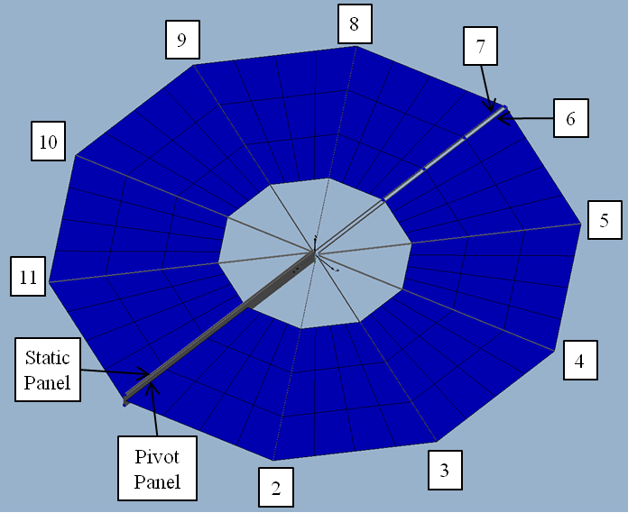
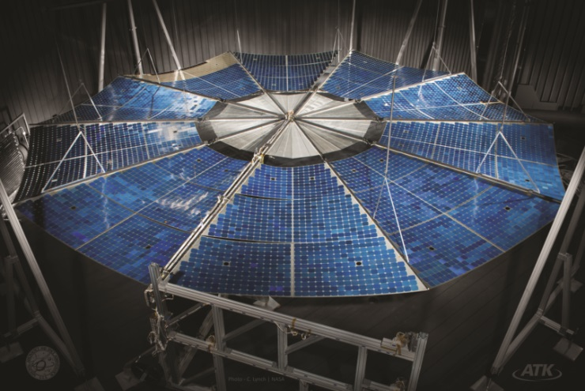
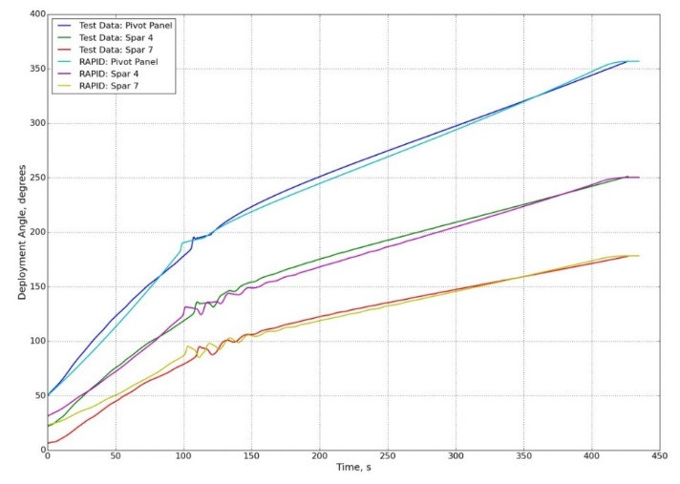
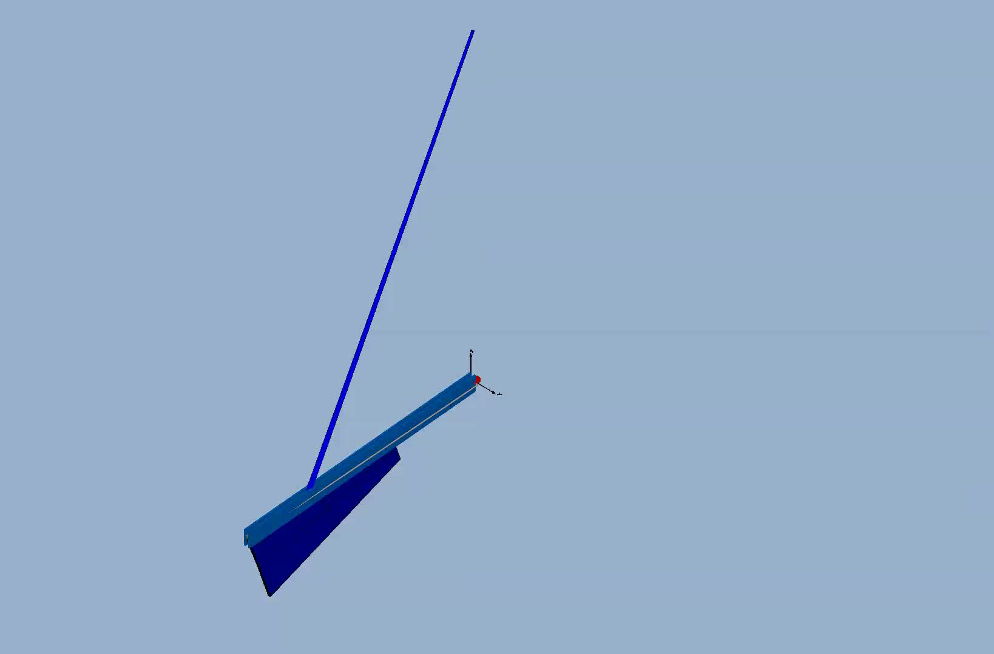
How has RAPID been verified?
ATA partnered with OATK during our Phase II NASA SBIR to support ground testing of their MegaFlex array design
ATA developed a MegaFlex model in RAPID to simulate deployment and validate against test data
  Angular position of array spars was tracked over time
  Excellent agreement between RAPID simulation and test data
    Angular position
    Timing and magnitude of dynamic event after 100 sec.
  Good shape and frequency agreement between RAPID and OATK analysis with minimal correlation effort
    OATK analysis used typical nonlinear finite elements
    In-plane mode: -0.8% frequency difference
    Torsion: -11.0%
    Out of plane: 2.6%

Slide 13
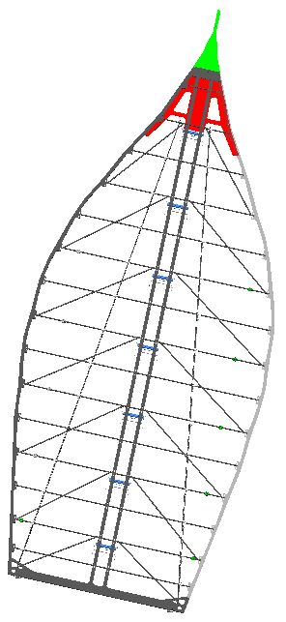
Task 1: PLUS Deployment Simulations
Current Status
Start with single petal deployment
  Petal prototype (4m)
  Force vs. deflection analysis, validate with test data. Model the stowing and deployment of a single petal (no rib) – including force to stow (from above)
Expand to multiple petal deployment
  6m petal, inner and outer. Validate with test data. Do the same with a pair of petals.
    This would include the carts and snubbers.
  Single petal with a rib, stow and deploy
  Pair of petals with ribs, stow and deploy

Slide 14
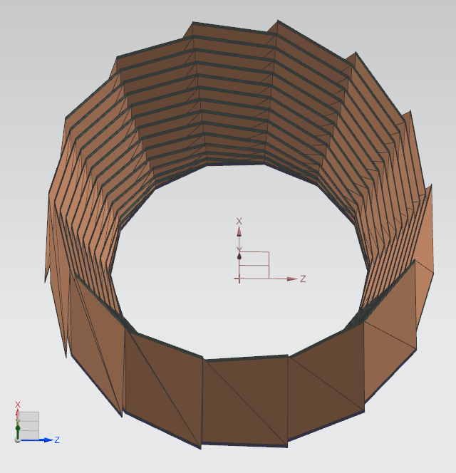
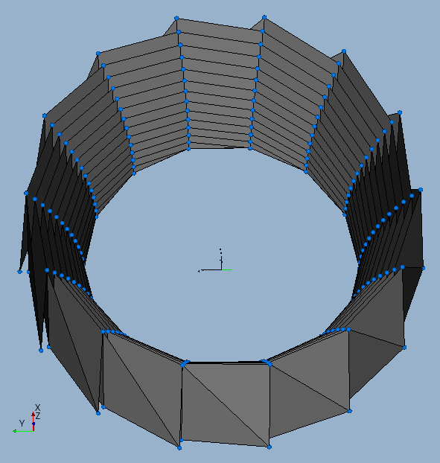
Task 2: IDS Deployment (Hub Shield)
Current Status (1 of 2)
Starting building RAPID model
  IDS shield built, currently adding truss and hub
  Currently using roughly estimated material properties and origami shape parameters
CAD
RAPID

Slide 15
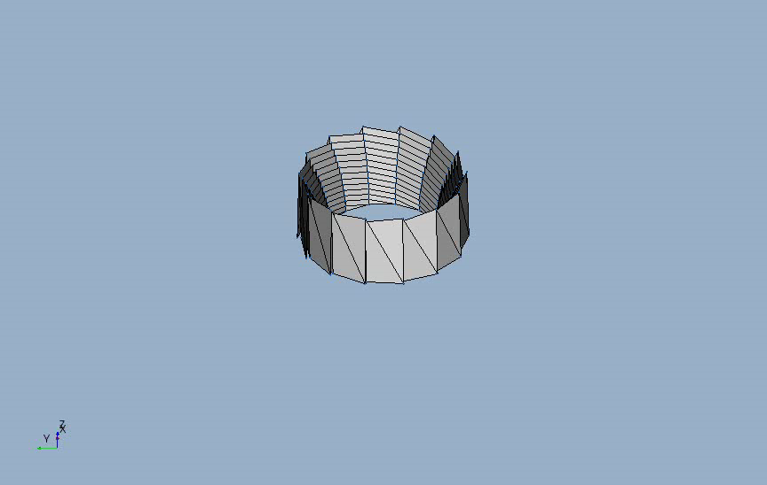
Task 2: IDS Deployment (Hub Shield)
Current Status (2 of 2)
RAPID deployment simulation of origami shield
  Forces pull radially and tangentially on outer panels, fixed at hub
  Origami parameters not quite correct since the final shape is not conical
  Tangential overextension causes shield to fold back up in new pattern
  Deploy speed is high and introduces some dynamics

Slide 16
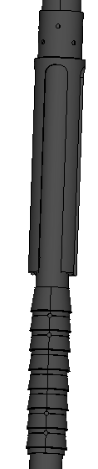
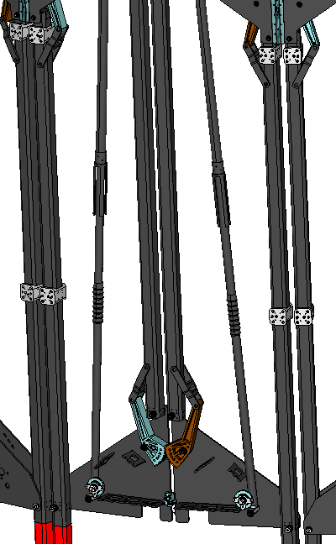
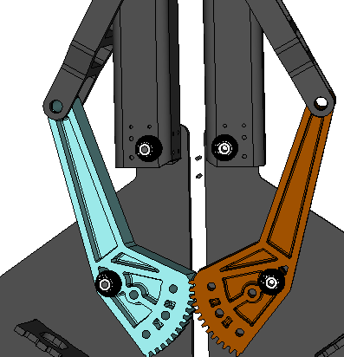
Task 2: IDS Deployment (Abaqus)
Current Status (1/2)
Goal is to develop Abaqus model of entire IDS deployment
Have developed simple, efficient modeling approaches for mechanisms with connectors (2-node elements)
  Synchronizers: 2 connectors (no detailed mesh or contact)
  Cable/pulley system: 1 connector per cable span
  Linear ratchet: 9 connectors for each ratchet system
3
2
1
Notes:
JPL/ATA team collectively decided that Abaqus is right tool to model IDS deployment because of general component flexibility and contact.
1.) Synchronizers: Gears that require symmetric deployment and disengagement after certain rotation angle. Developed method to represent this kinematic behavior with 2 connector elements (no detailed mesh, no contact).
2.) Cable/pulley system: Explored connector-based representation of cable that allows material flow between connectors and include friction loss across pulleys
3.) Linear ratchet: Developed connector-element based model to represent ratcheting behavior, requires about 5 connectors per linear ratchet system.

Slide 17
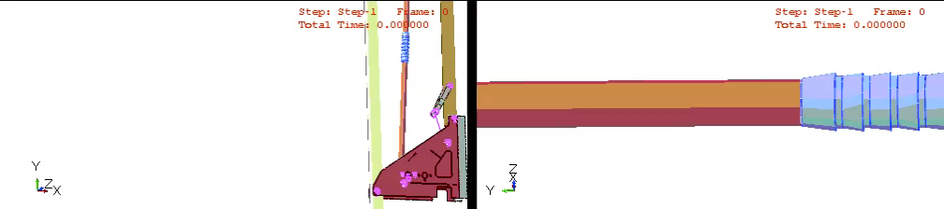
Task 2: IDS Deployment (Abaqus)
Current Status (2/2)
Analysis plan:
  Methodically developing/verifying truss FEM in stowed config
    Minimal strain energy in truss when stowed
    Exercising model of single bay to verify desired behavior
    Will instantiate single bay to make entire truss
  Will model shield in deployed config, simulate stowing to capture strain energy
  Couple two components for deployment analysis
Arms and barbs for display only
Notes:
Just getting started with truss FEM, this animation is just a snapshot of where we are after ~2 days of building the truss FEM. Next will add adjacent bay and test out synchronizers and cable. Then instantiate entire thing for entire truss.
Ratchet arms and barbs are for display only, behavior is controlled by several connector elements.
Simulation sequence: gravity down to engage ratchet, then gravity up to engage stops. Bounces because there’s no damping in system. Barbs on the ratchets do provide resistance to downward motion of arms, then stops prevent arms from backing up. Can independently tune force to bend arms around barbs (resistance to forward motion) and force to back up arms.

Slide 18
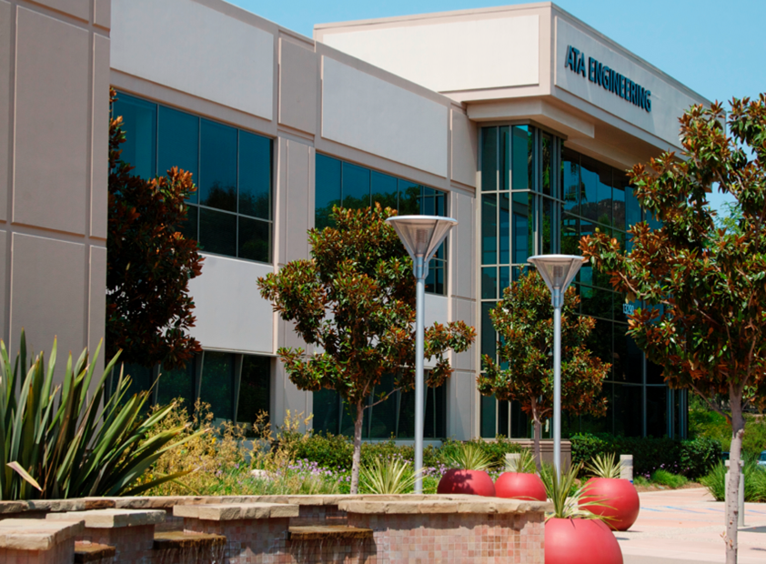
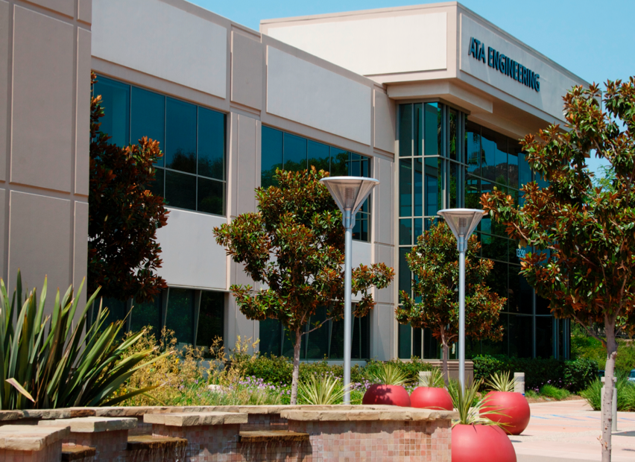
13290 Evening Creek Drive
Suite 250, San Diego, CA 92128
(858) 480-2000
sales@ata-e.com
www.ata-e.com
www.ata-plmsoftware.com
@ATAEngineering
ata-engineering

