Slide 1
S5 Error Budget and Allocations
a High Level Discussion
at the SIP Workshop
Doug Lisman
JPL, Caltech
September 18, 2019

Slide 2
Agenda
Error budget overview
Margins
Origin of top level specifications (planet contrast sensitivity and instrument contrast)
Identify potential topics for further discussion in breakout sessions

Slide 3
S5 Top Level Error Budget
WFIRST-Starshade Rendezvous at 1.52 λ/D IWA
Science investigations
Study metallicity of Gas Giants
Detect & Characterize Earth 2.0
Planet/star flux ratio ≤ 4 x 10⁻¹¹
Study Circumstellar Disks
Limit photometric noise at IWA to ≤ 2-20X planet
Calibrate systematic noise to ≤ 1-10%
Background
Starshade
Telescope
Time Variant
KPP 3
Other stars
(galactic and extra-galactic)
V > 30
Solar Zodi
V > 29
per PSF at 760 nm
Exo-Zodi
V > 28
per PSF at 1.5X solar density
Reflected
bright bodies
V > 30
V> 32 99% of time
Solar Edge Scatter
V > 25 mags
in 2 lobes at IWA
Instrument Contrast
1 x 10⁻¹⁰
Sunlight thru micrometeoroid holes
V > 31
(after multi-bounces)
Sunlight leakage thru optical shield flaps
V > 32
Detector Noise
Read Noise:
Dark Current:
Cosmic Rays:
KPP 1
Verify in lab at subscale
(no hidden physics)
Model validation accuracy ≤ 25%
2 x 10⁻¹¹
KPP 2
HabEx reserve at 1.36 λ/D IWA
0.4 x 10⁻¹¹
Flight dev. margin ≥100% margin
4 x 10⁻¹¹
Allocated Instrument Contrast
3.6 x 10⁻¹¹
KPP 4
Starlight thru micrometeoroid holes
0.1 x 10⁻¹¹
Nominal specified shape
0.4 x 10⁻¹¹
Mechanical Shape Error
2.1 x 10⁻¹¹
Lateral Formation Control ≤ ± 1m
1 x 10⁻¹¹
Lateral Formation Sensing ≤ ± 30 cm
Petal Shape
1.8 x 10⁻¹¹
Launch, cruise & non-thermal stability
0.1 x 10⁻¹¹
Petal Position
0.2 x 10⁻¹¹
KPP 5
KPP 6
KPP 7
KPP 8
Pre-launch (Mfr., AI&T & storage)
≤ ± 70 µm
1 x 10⁻¹¹
On-orbit thermal stability
≤ ± 80 µm
0.8 x 10⁻¹¹
KPP
Threshold Values
Pre-launch (Mfr., AI&T & storage)
≤ ± 300 µm
0.1 x 10⁻¹¹
On-orbit thermal stability
≤ ± 200 µm
0.1 x 10⁻¹¹
41%
100%
Margin
41%
100%
≤ ± 50 µm
≤ ± 40 µm
KPP Goals
≤ ± 212 µm
≤ ± 100 µm
25%
100%
Contingency or MUFs
25%
100%
≤ ± 40 µm
≤ ± 20 µm
Nominal CBE Values
≤ ± 170 µm
≤ ± 50 µm
TDEM-09 measurements
Unvalidated models
Basis of estimate
TDEM-10 measurements
Unvalidated models

Slide 4
Instrument Contrast Sub-allocations with Margins
Total Instrument Contrast of 1 x 10⁻¹⁰ is sub-allocated with substantial margins (allocated and unallocated) to cover S5 challenges (technical, cost and schedule) and also leave margin for a flight development
HabEx reserve is for operating at 1.36 λ/D IWA vs. 1.5 λ/D baseline, with greater shape error sensitivity

Slide 5
Planet Contrast Sensitivity
Planet contrast sensitivity (PCS) of 4 x 10⁻¹¹ is specified for a good Earth 2.0 detection probability
  Found on TPF-C and Exo-S studies, with large target lists, to provide optimal HZ search space per unit time
  Corresponds to Earth 2.0, with Lambertian phase function, at outer HZ with quadrature illumination at L=1 star
We might alternatively consider limiting planet brightness to provide SNR with respect to Exo-Zodi
  Key questions are, how accurately can we calibrate Exo-Zodi and other noise sources
We might also consider evaluating performance for a distribution of rocky planet sizes
1
Exo-Zodi
Planet
Calibrate to
10% ?
IWA
0.4
Telescope
SNR ≥ 4 ?
0.1
Residual
Exo-Zodi
C = iaR²/r²

Slide 6
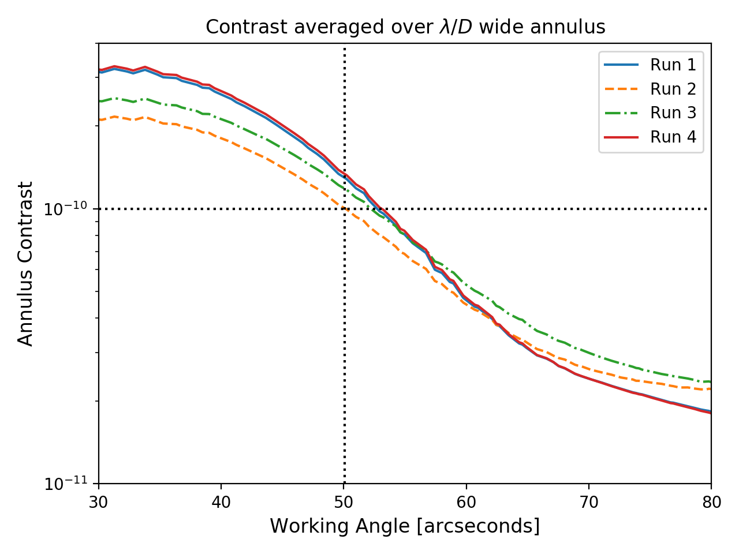
Instrument Contrast
Ratio of residual starlight at any point in focal plane to starlight without the starshade, at the tips
  Improves at larger working angles (see figure to left)
Provides SNR of 4 with respect to 4 x 10⁻¹¹ planet contrast, after calibration to 10% accuracy
  See figure to right
Limits contribution to integration times to not be a driver (see next slide)
Also, turns out to be consistent with a small scale testbed at Princeton, in air
Instrument Contrast
1 x 10⁻¹⁰
Planet Contrast
Calibrate to
10% accuracy
4 x 10⁻¹¹
Tips
SNR ≥ 4
1 x 10⁻¹¹
Residual
Suggests planet flux ≥ exo-zodi flux

Slide 7
Integration Time
Total integration time = (SNR²/F_{p}²) [F_{p}(1 + C_{i}/C_{p}) + F_{LZ}(1 + 2Z) + F_{read-noise} + F_{dark-current}], where:
  F_{p} is planet flux, F_{LZ} is local zodi flux, Z is exo-zodi density relative to local-zodi, C_{i} is instrument contrast and C_{p} is planet contrast
Ratio of instrument contrast to exo-zodi time = (F_{p} / F_{EZ}) (C_{i} / C_{p})
  Further constrains planet contrast
  For example, if both instrument contrast and planet contrast are 1 x 10⁻¹⁰, then the integration time attributed to instrument contrast is 40%, per a planet 4X brighter than exo-zodi calibrated to 10%

