Slide 1

Deployable Spacecraft Structures
SIP Forum #1 Presentation, 9/18/2019
Thomas Murphey, PhD
tmurphey@opterusrd.com
(505) 250-3006
Patrick Rodriguez
patrick@opterusrd.com
(505) 795-3896

Slide 2
Introduction
About Opterus
Representative Related Activities
  PMACs SBIR P1:
  HSC STTR P1:
Starshade to TRL5 (S5) Activities
  Patrick Rodriguez

Slide 3
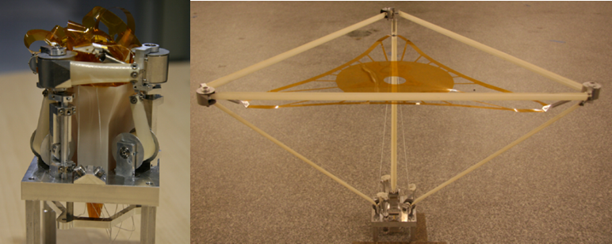

Deployable Spacecraft Structures
1U CubeSat
(10cm cube)
100 cm Diffractive Telescope (AFRL/USAFA FalconSat/DARPA Moire Co-Program)

Slide 4
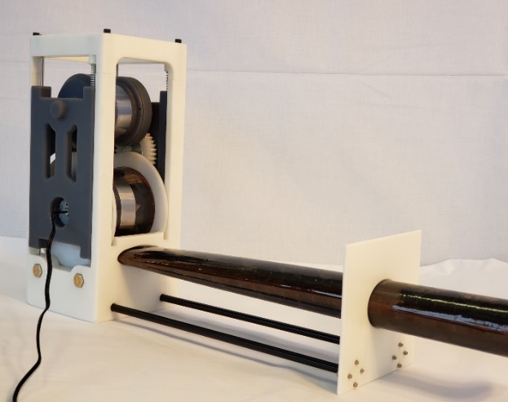
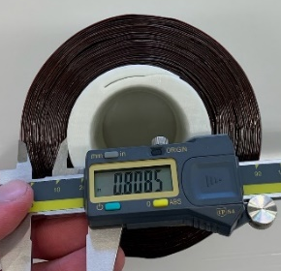
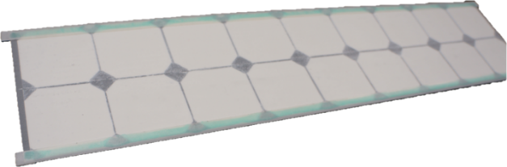
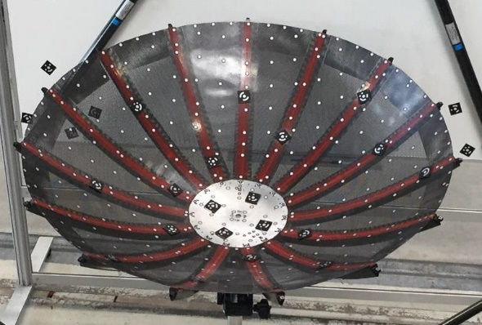
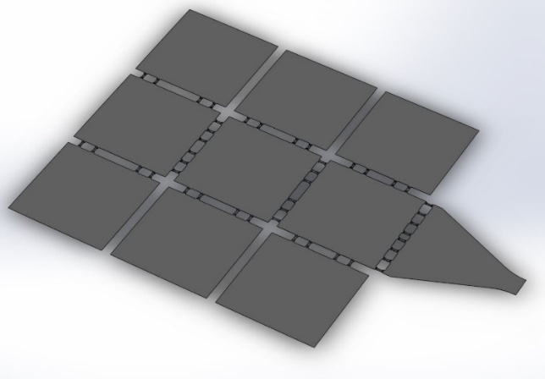
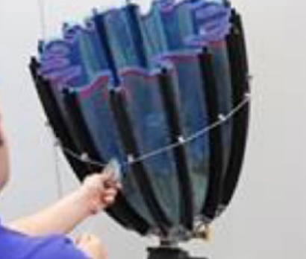
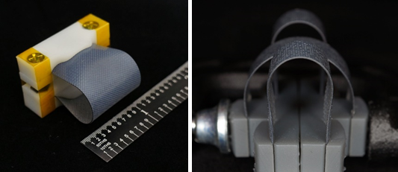
Core Technology Areas
Booms and Hinges
Solar Array Structures
Antennas, Phased Arrays and Reflectors
Not OPTERUS Tech
Not OPTERUS Tech
TRL 5-9
Flight Heritage
100% Success
TRL 4-5
Key partnerships established
TRL 2-4
Key features demonstrated
Multiple patents in process

Slide 5
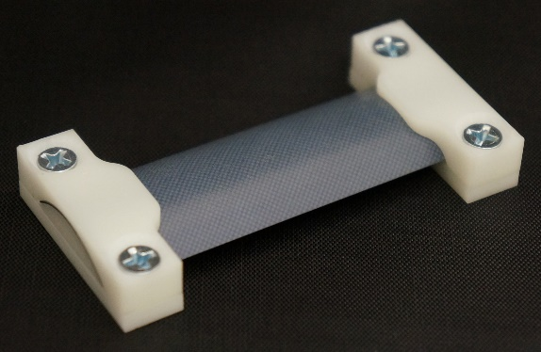
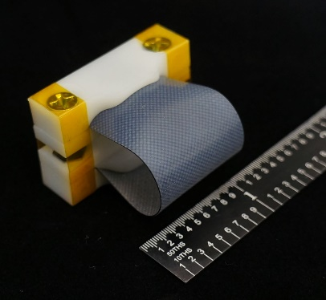
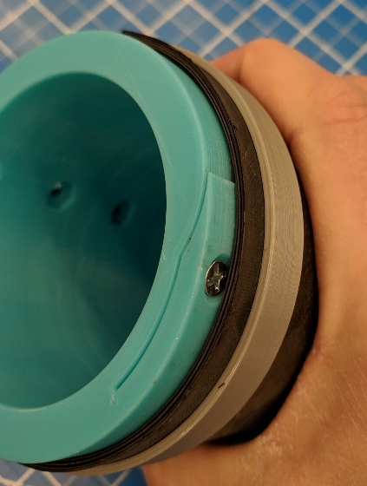
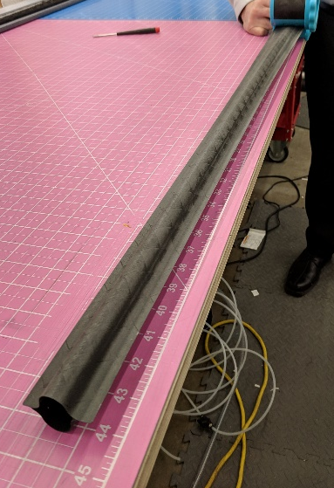
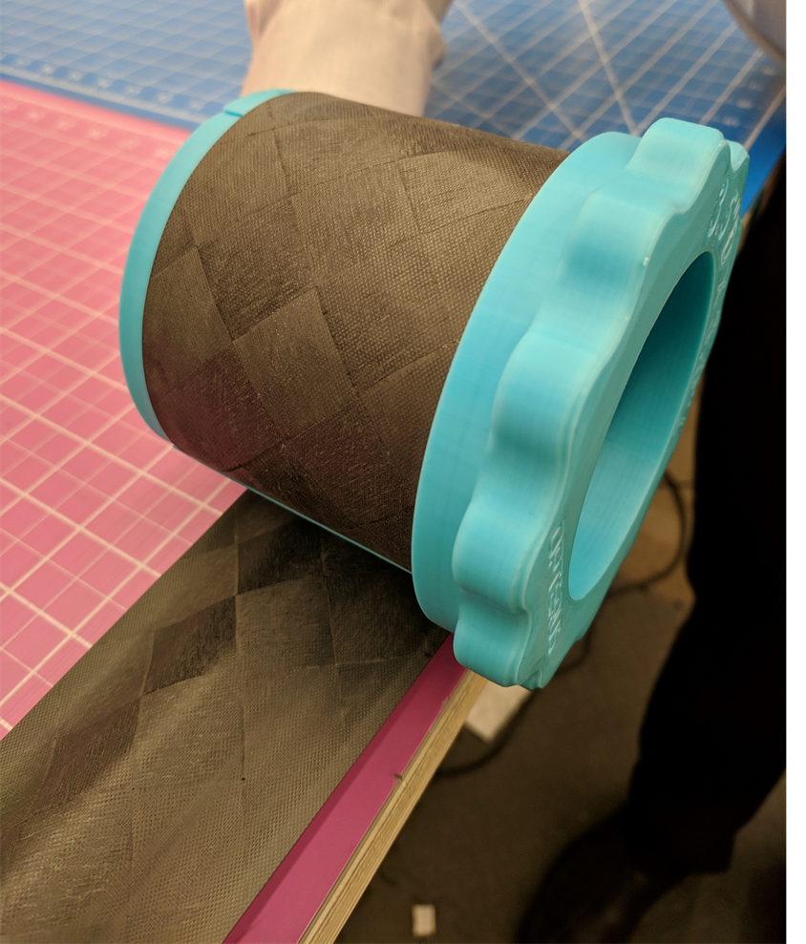
Core Material Innovation: HSC (high strain composites)
Panel Hinges
2x stronger
8x stiffer
5x lighter weight
20x more stable
Industry leading source for
HSC technologies
CTM Boom
Notes:
CTM pictures aren’t great.

Slide 6
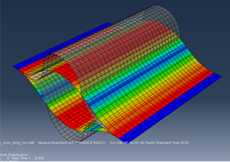
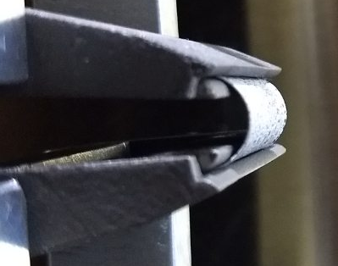
Capabilities
Composite design, manufacturing and testing capabilities
  Specialize in High Strain Composite manufacturing methods
Deployable spacecraft structures and mechanical systems
  Conception > Design > Analysis/Simulation > Fabrication
Simulation and Analysis
  Deployment simulations
  Finite Element Analysis
  Structural architecture development

Slide 7
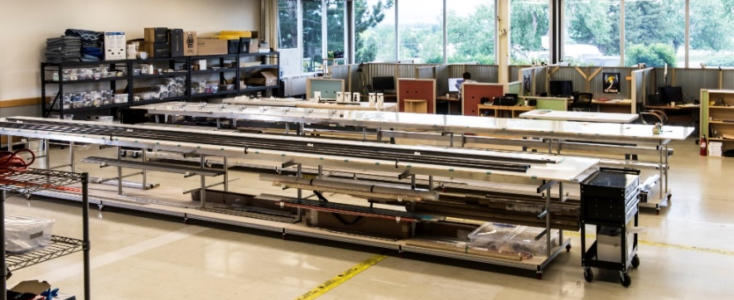
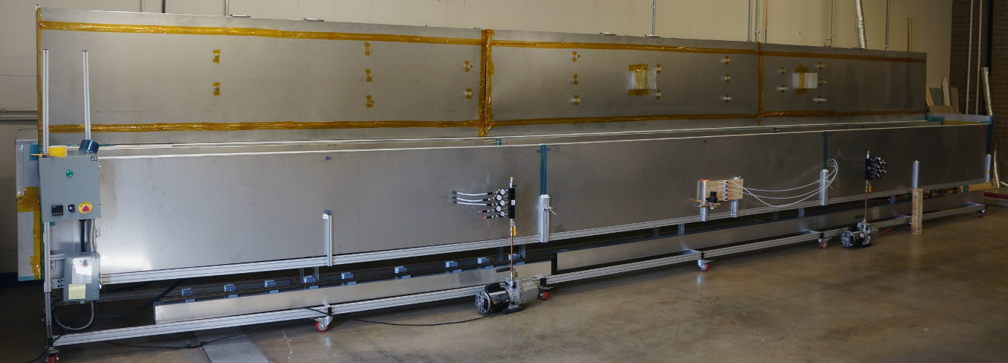
Facilities
In-house composites fabrication
  30 ft modular oven (expands in 10 ft increments)
  2 x 30 ft modular lay-up tables
Structural testing facility in development
Loveland, CO (1 hour north of Denver)
  4,500 ft² , expanding to 8,000 ft²
  50,000 ft² contiguous space available for future expansion

Slide 8
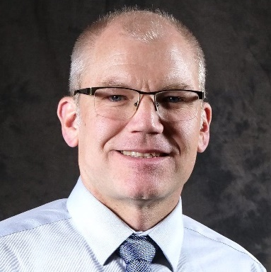
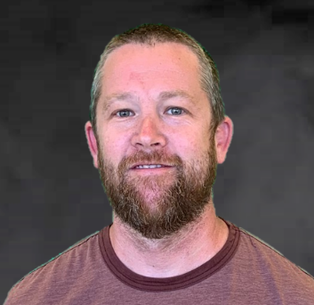


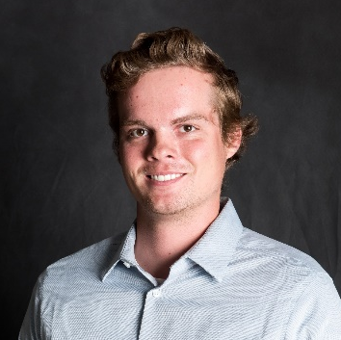


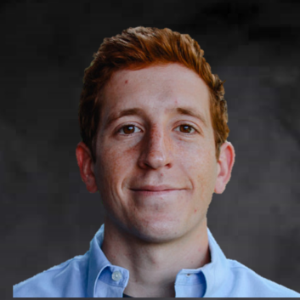
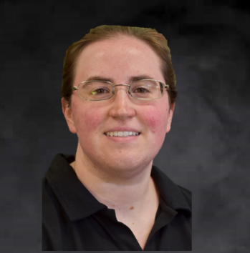
Our Team
Dr. Thomas Murphey
CEO, CTO
Shane Stamm
Chief Engineer
Todd Whitaker
COO
Supporting Team
Jeremy Kellog
Composites Production
Erik Pranckh
Engineer
Levi Nicholson
Engineer
Sebastian Mettes
Engineer
Patrick Rodriguez
Engineer II
Gina Olson
Consultant
Tiffany Dailey
Controller

Slide 9
PMACs SBIR P1
Precision Multifunction Autonomous Connections

Slide 10
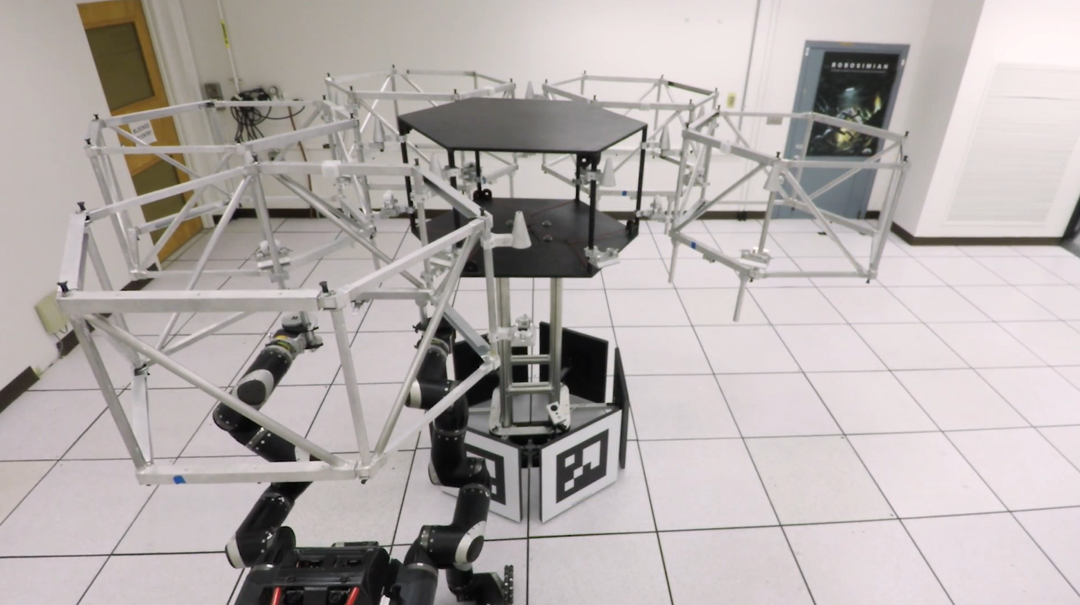
Robotic Assembly of Hybrid Deployable Structure
Mukherjee, R. et al., “In-space Telescope Assembly Robotics Risk Reduction,” JPL, 2017

Slide 11
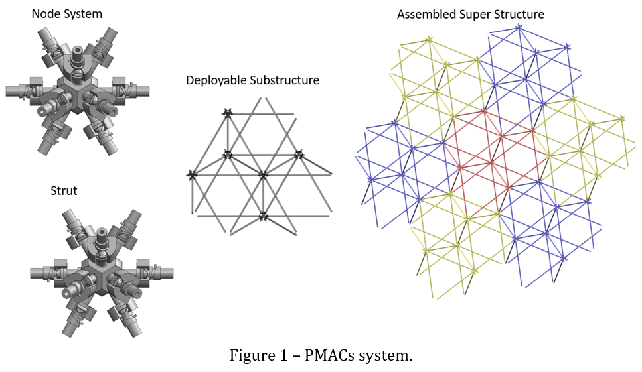
Precision Multifunction Autonomous Connections

Slide 12
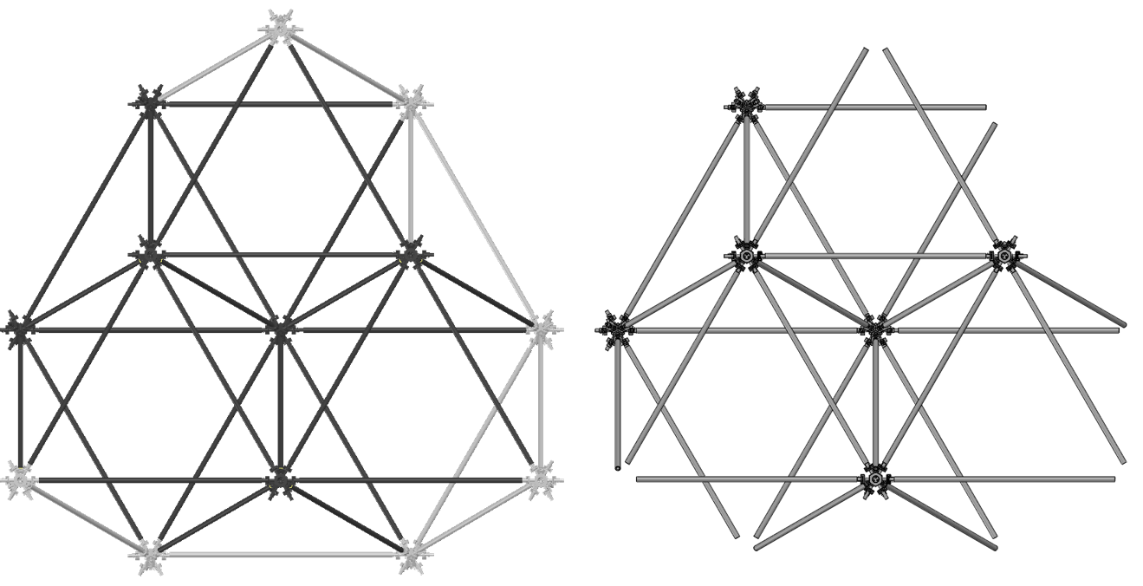
Proposed Subassemblies

Slide 13
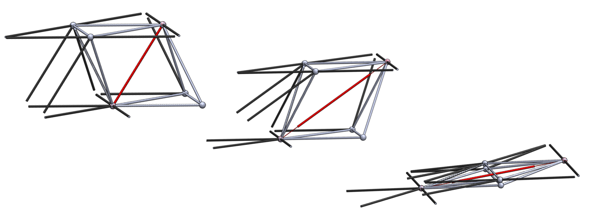
Proposed Subassembly Packaging

Slide 14
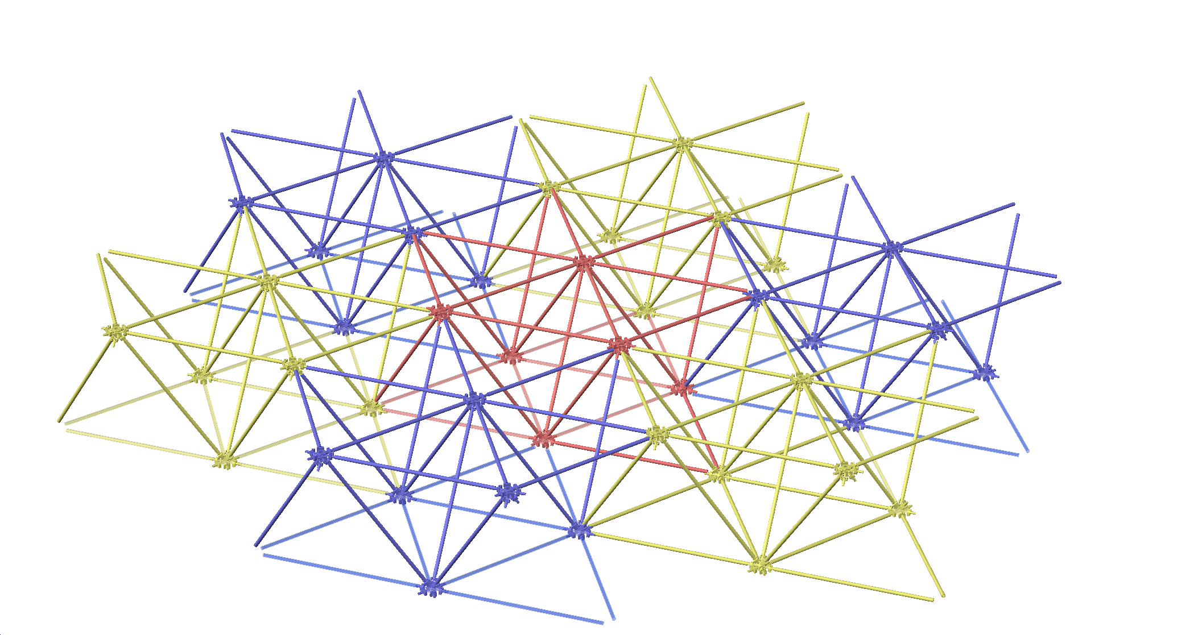
Proposed Assembly of Subassemblies

Slide 15
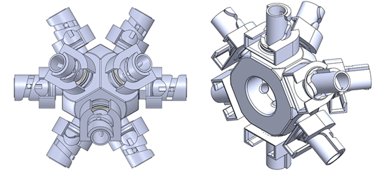
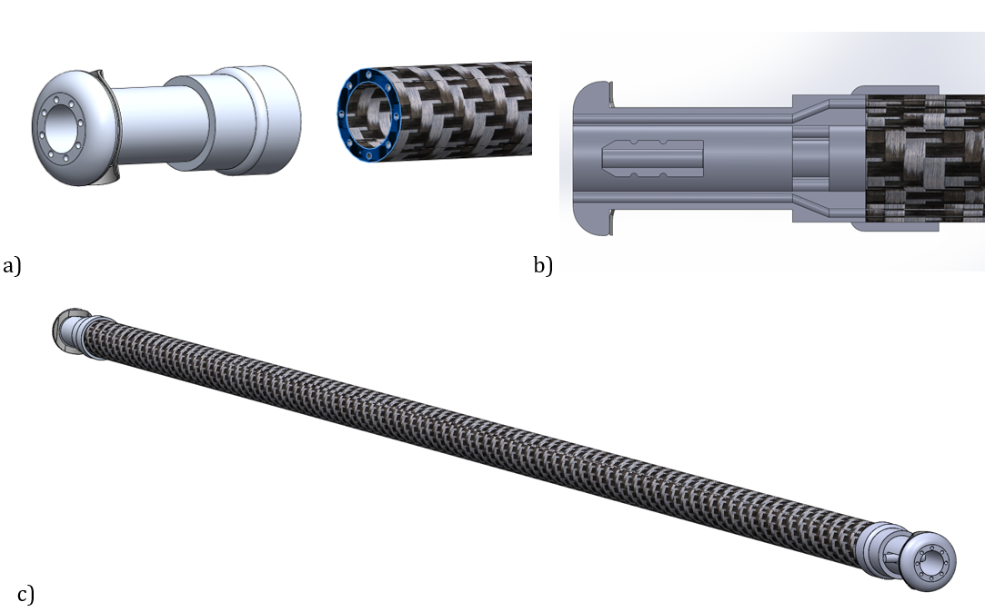
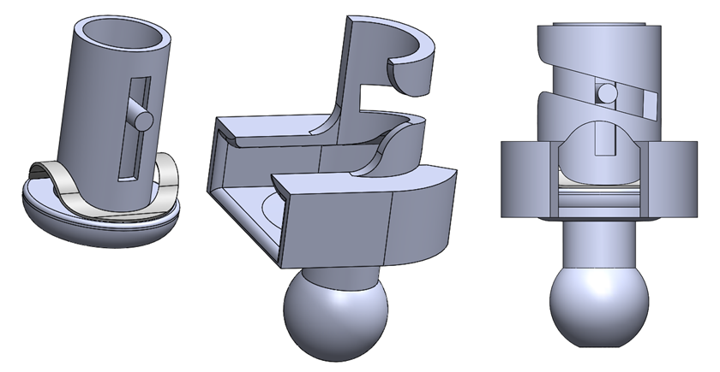
Proposed Node

Slide 16
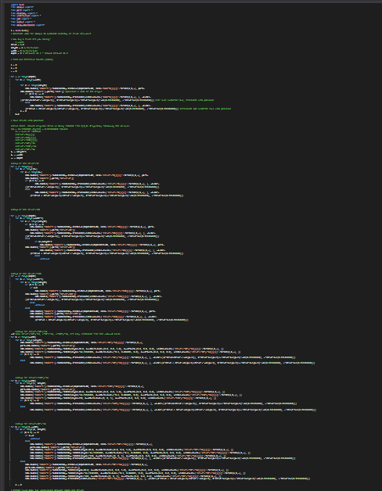
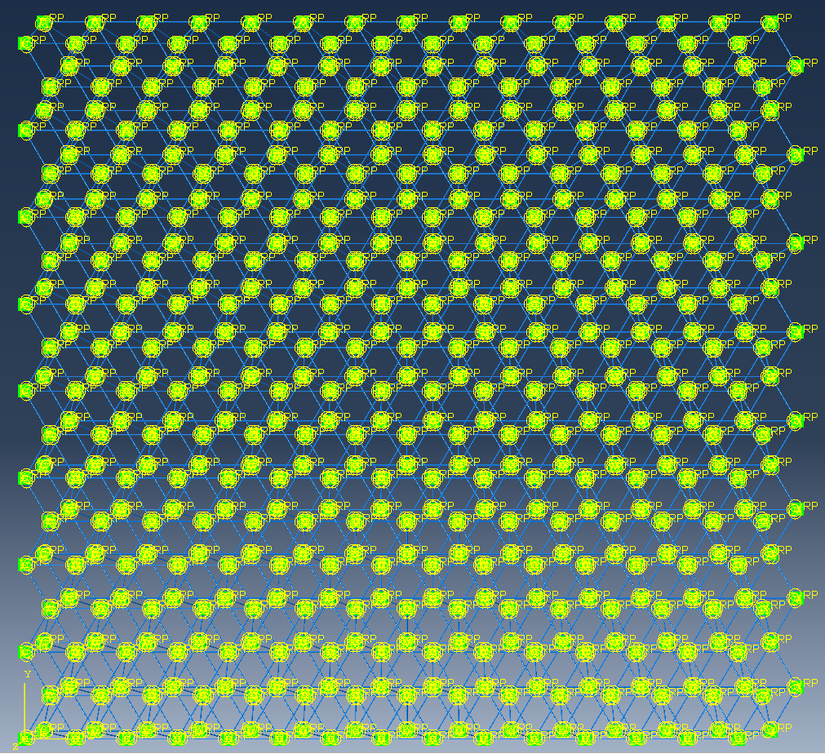
Automated Analysis
Python Abaqus Scripts
Abaqus Simulations

Slide 17
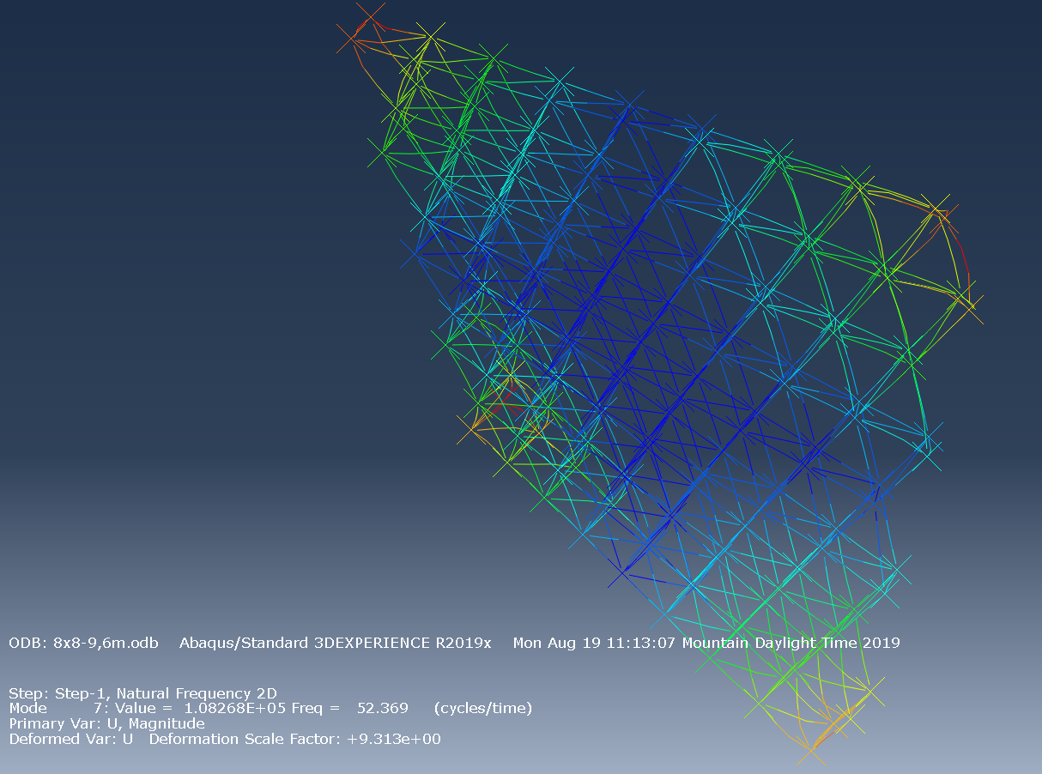
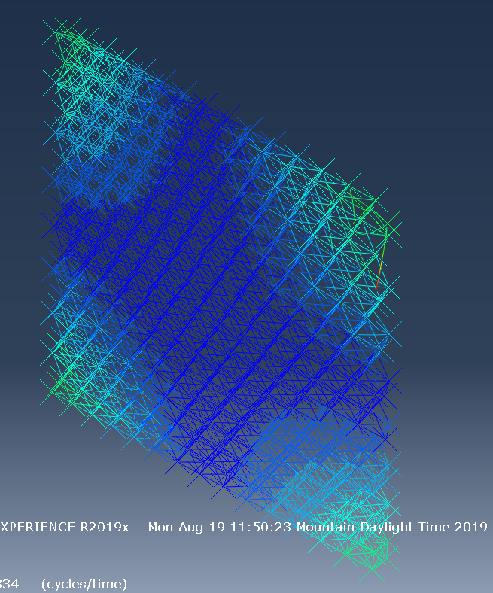
Modal Analysis Results

Slide 18
HSC STTR P1

Slide 19
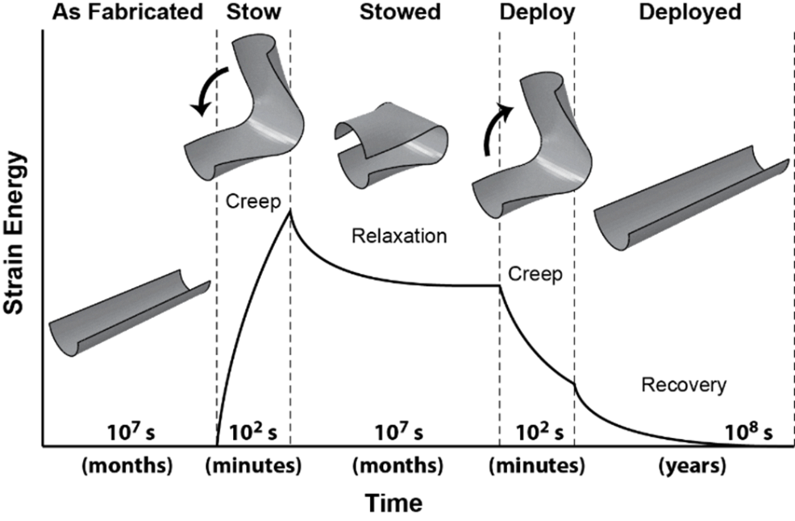
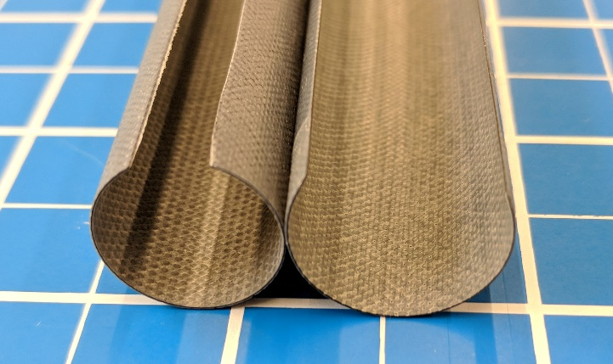
Viscoelastic Response of High Strain Composites

Slide 20
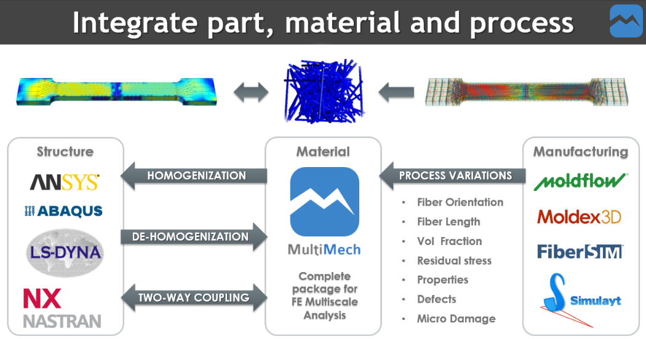
MultiMechanics Multi-scale Analysis

Slide 21
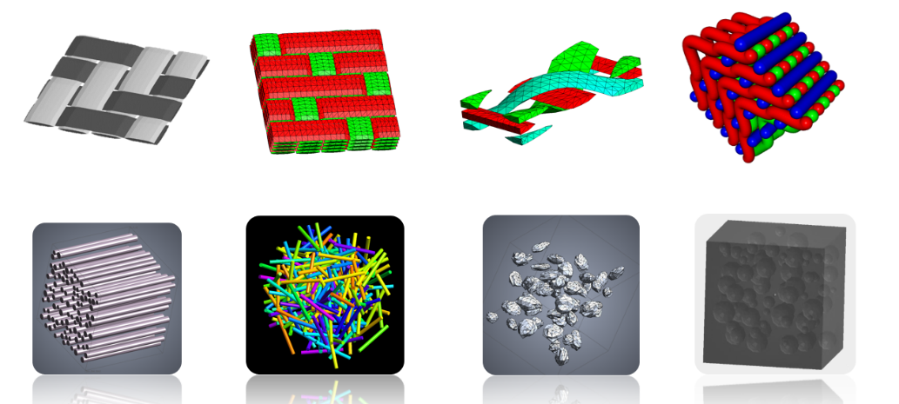
Composites RVEs

Slide 22
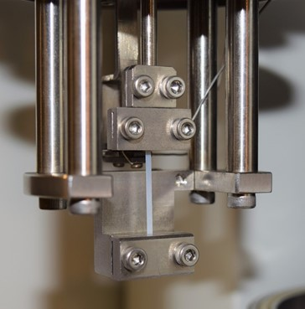
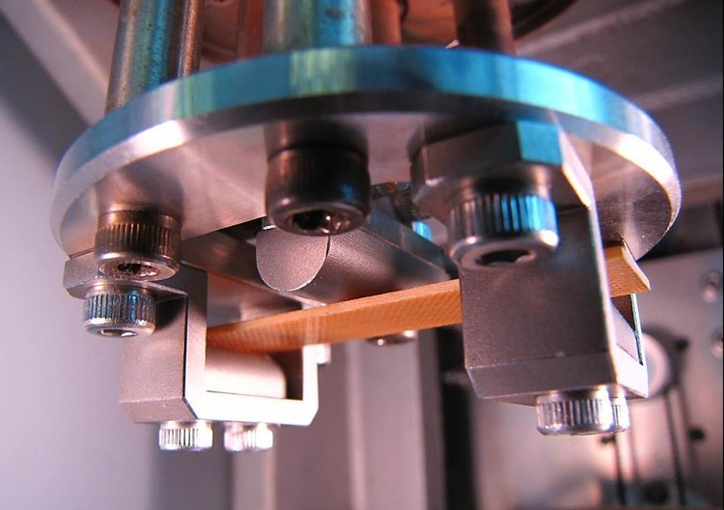
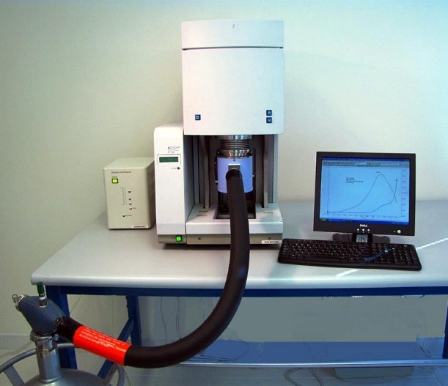

Thermal Dynamic Mechanical Testing
High strain tensile testing of neat resins for viscoelastic response and residual strains

Slide 23
Resin Varieties
# | Resin Identifier | Resin Description | Nanosilicate | Toughener
1 | F7C | Pure epoxy | No | No
2 | F7 | Epoxy with toughener | No | Yes
3 | Epoxy (38% NS) | Epoxy with nano-silicates, no toughener | 38% | No
4 | F7 (10% NS) | Epoxy with toughener and nano-silicates | 10% | Yes
5 | F6 | Cyanate ester | N/A | N/A
Effect of tougheners

Slide 24
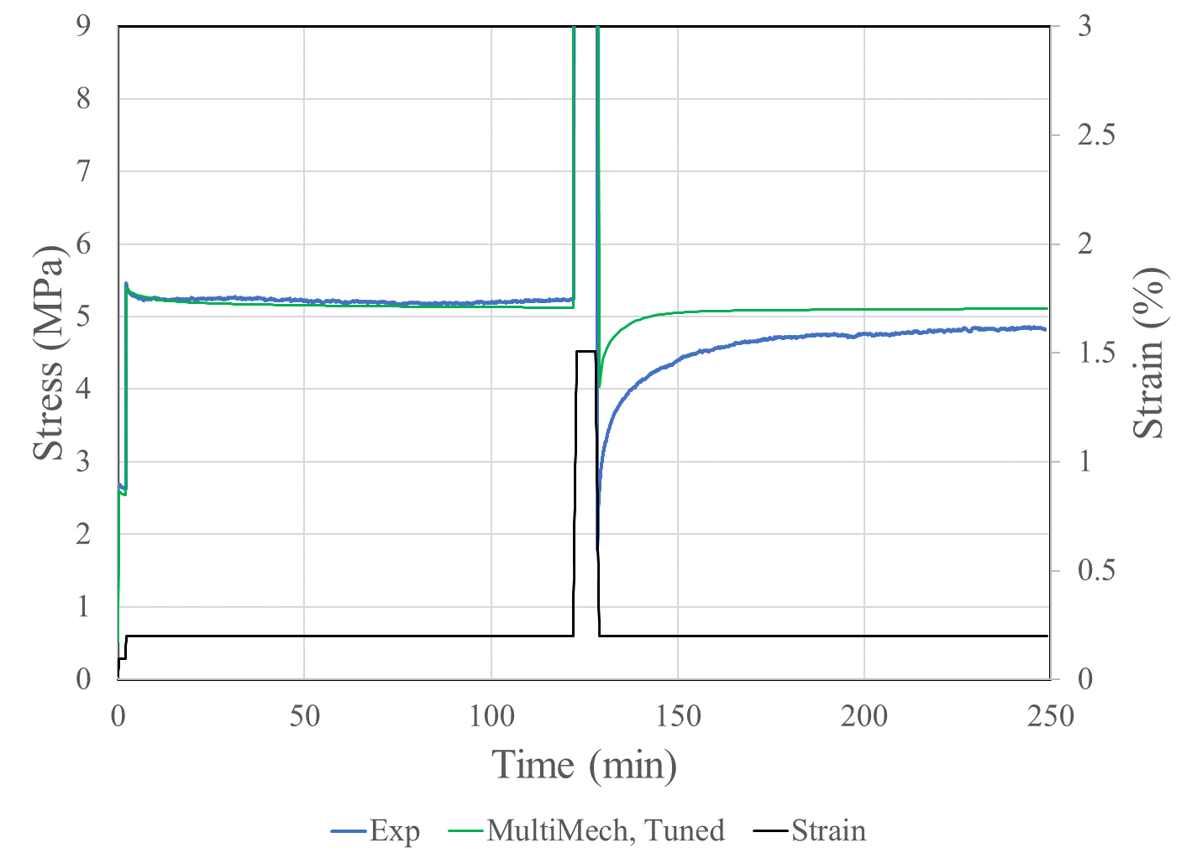
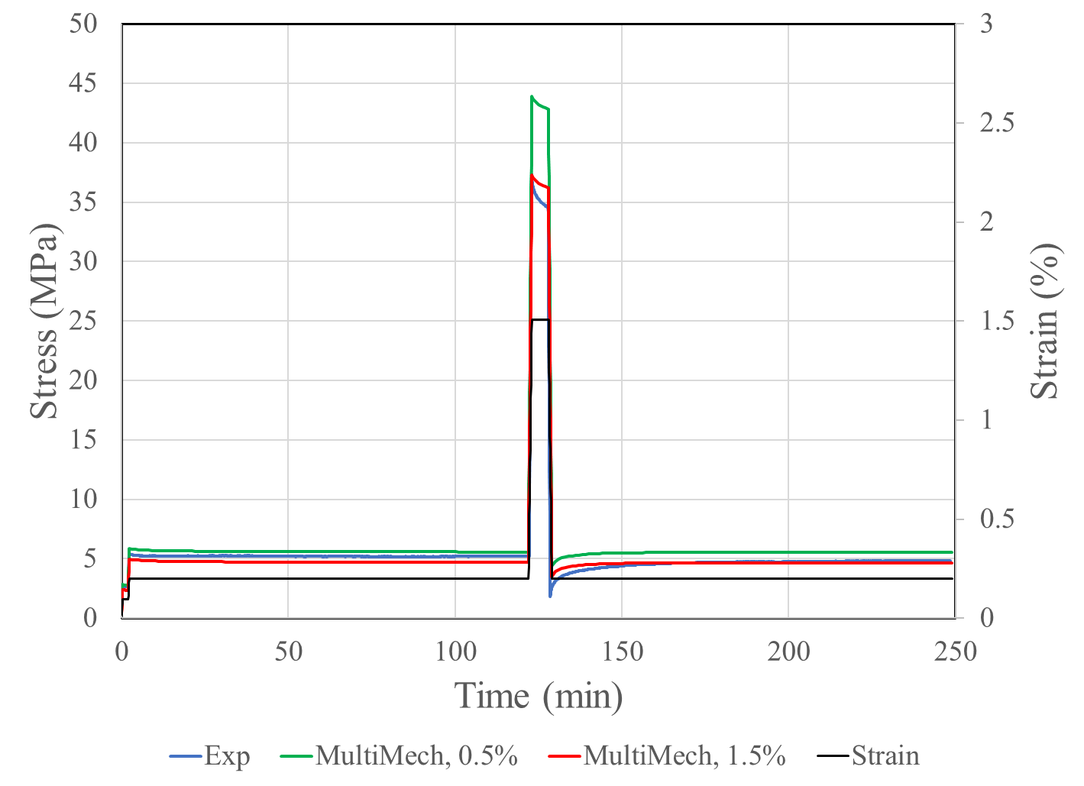
Results
Prony series models are effective for simple load cases. Errors with complex load time histories (load-unload cycles)
All systems creep fast and creep a lot. Significant creep in seconds to minutes
Significant residual (unrecovered plastic) strains

Slide 25
Starshade to TRL5 (S5)

Slide 26
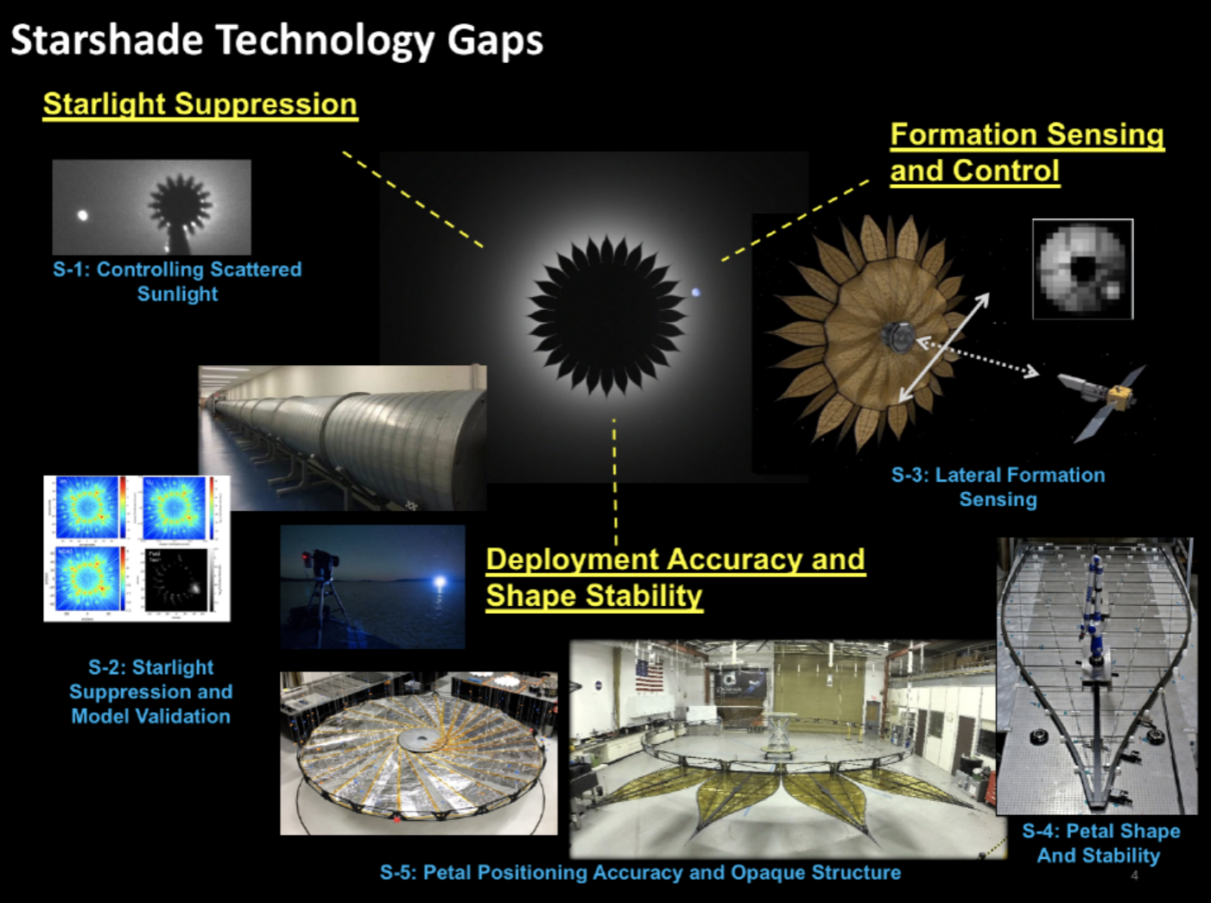
Addressing Key Technology Gaps
Opterus will address Deployment Accuracy and Shape Stability
  Combined test/ analysis approach proposed
  Targeting estimates on short/ long term Starshade Petal dimensional stability
  Petal dimensional stability tied to composite material stability (edge, battens & longerons)
* From Starshade to TRL5 (S5) TDP

Slide 27
Error Budget Reduction
This work addresses Starshade error budget items in light blue
  Petal Shape
    KPP 5 (≤ ± 70 µm)
    KPP 6 (≤ ± 80 µm)
Pre-launch/ on-orbit shape stability are relevant
* From Starshade to TRL5 (S5) TDP

Slide 28
Work Scope – Guiding Material Selection
The proposed work will support materials selection for the Petal subsystem prior to full-scale fabrication
Multiple resin variants will be evaluated relative to Petal dimensional stability under stowed-stress/ on-orbit thermal conditions via:
  Preliminary, comparative Petal edge analyses
  Coupon-level resin testing
  Full Petal analyses using test validated resin properties

Slide 29
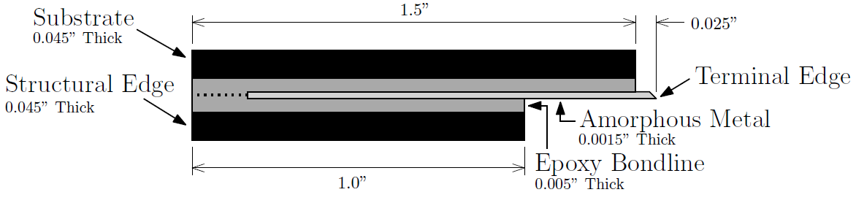
Preliminary Petal Edge Analyses
Targeting initial analytical comparison of creep deformations under stow/ bending loads
Five resin variants for comparison:
  Pure epoxy
  Epoxy w/ toughener
  Epoxy w/ nano-silicates
  Epoxy w/ toughener and nano-silicates
  Cyanate Ester
Petal Edge Assembly (Prototype)
* From 2019 Optical Edge SPIE Paper
Notes:
Be sure to emphasize why these material variations are relevant! Prior work shows that all resins show measurable viscoelasticity, but they don’t necessarily creep/ recover/ relax/ recover to the same magnitude or at the same rates

Slide 30
Coupon Level Resin Testing
Coupon level tests required to assess resin dimensional stability
  Thermal
  Hygroscopic
  Physical aging
Coupons exposed to controlled environments, subjected to relevant stow/ bending loads
Coupons will be modeled to predict behavior
Constitutive model parameters adjusted to match test data

Slide 31
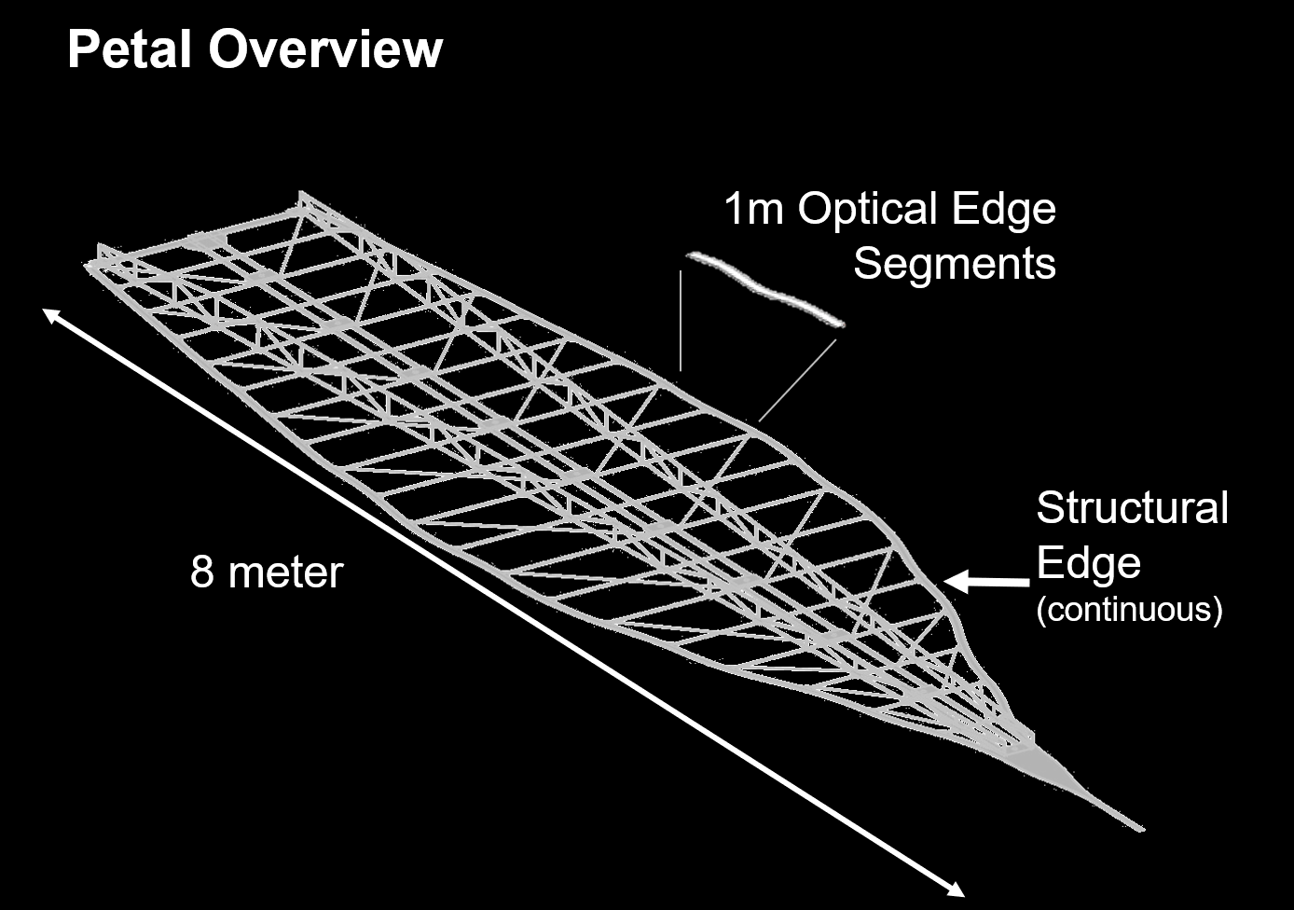
Full Petal Analyses
Targeting predictions of viscoelastic deformations in composite/ bonded elements
  Petal edge, Petal width battens and full Petal
  Incorporating discretely modeled fiber/ matrix materials
  Leveraging test validated material properties
Factors impacting dimensional stability
  Long term roll stowage
  Hygroscopic deformations
  Thermal deformations
* From 2019 Optical Edge SPIE presentation

Slide 32
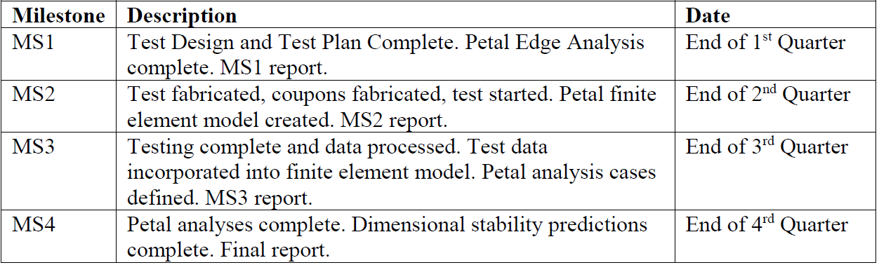
Milestone Development

Slide 33
Deployable
Spacecraft Structures
Big Gains for Small Spacecraft TM
Thomas Murphey, PhD
tmurphey@opterusrd.com
(505) 250-3006
Patrick Rodriguez
patrick@opterusrd.com
(505) 795-3896

