Slide 1
Tendeg SIP Program Plan
Gregg Freebury - Tendeg
19 Sept 2019

Slide 2
Tendeg Summary
Mission/focus: Precision deployable structures
17 Employees
Louisville, CO
  23,000 SF new building
  Thermal chambers
  Laser scanners
    Leica laser tracker with laser scanner
    Faro Arm
  Clean rooms
Software
  Design (Solidworks, NX)
  Analysis (FEMAP, NX NASTRAN, ABAQUS, Matlab)
  RF analysis (GRASP, custom program)

Slide 3
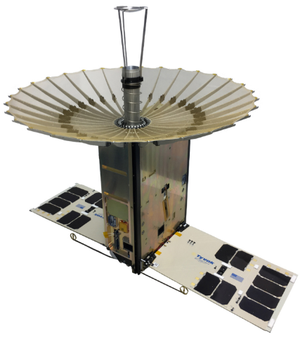
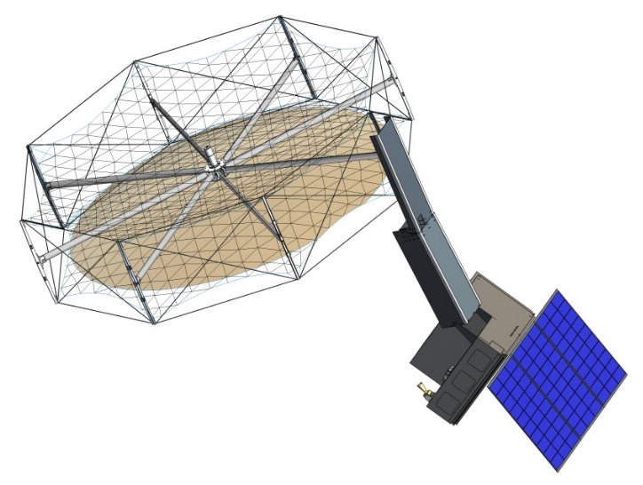
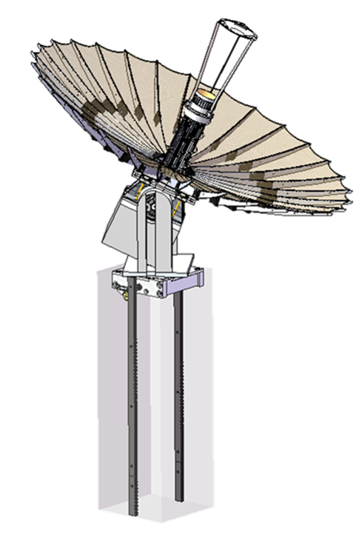
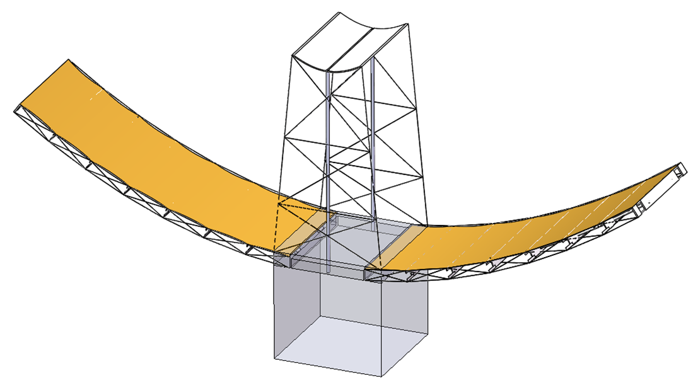
Antenna Products
KaPDA
KaTENna
KaPDA Gimbal
SAR

Slide 4
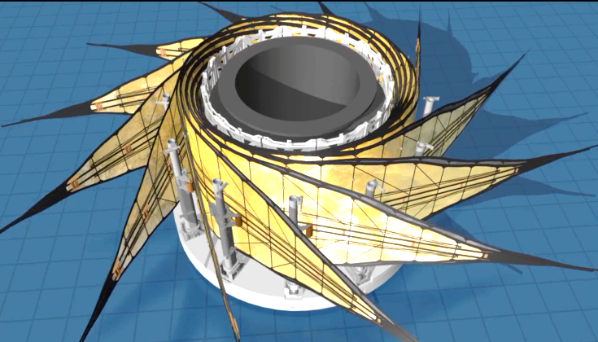
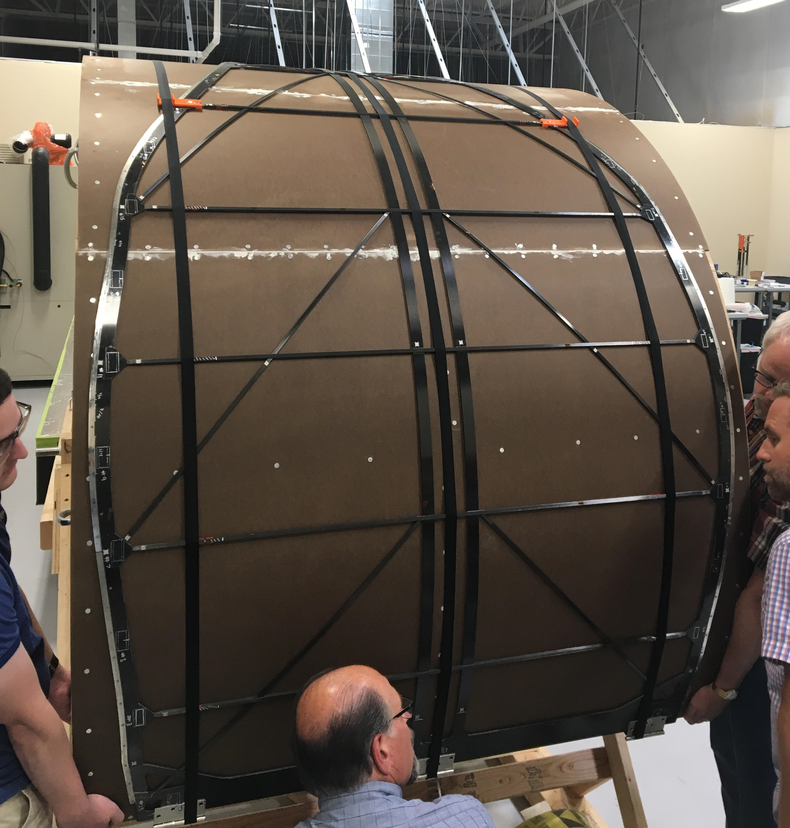
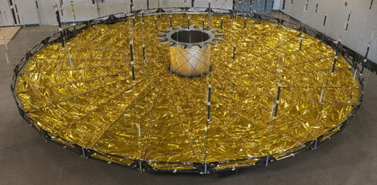
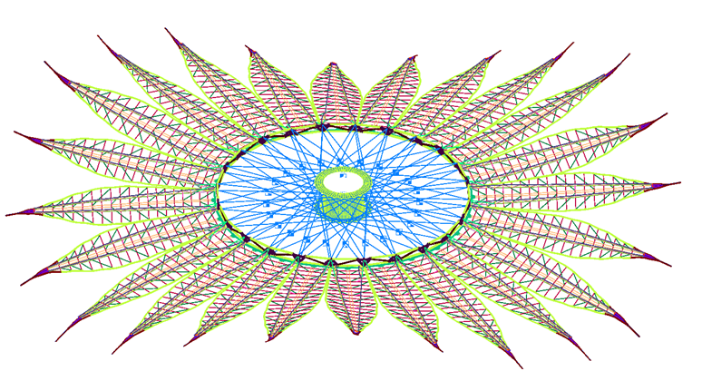
Starshade Support
PLUS
Petal
Inner Disk Assembly
System Design and Analysis

Slide 5
SIP Program Plan
SIP plan is focused on characterizing mechanical shape errors
  AI&T (petal furling and launch preloading)
  Petal storage effects (viscoelastic/creep effects)
  Unfurling does not damage petal or edges

Slide 6
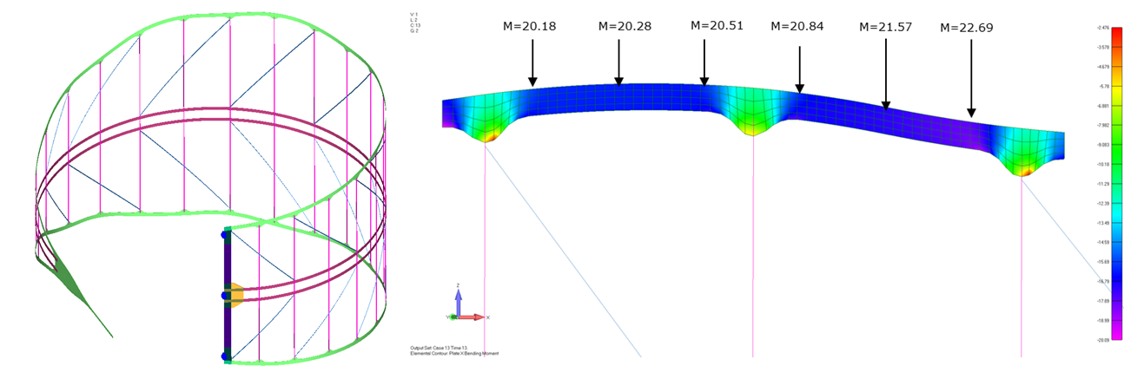
SIP Program Plan
Single petal deployment simulation
  Planar petal (outer) with PLUS (Petal Launch restraint and Unfurling System), cart and batten snubber interfaces
  Add fidelity of pop up ribs and root hinge
Single petal deployment testing with correlation analysis
  Include 1G and offloading effects

Slide 7
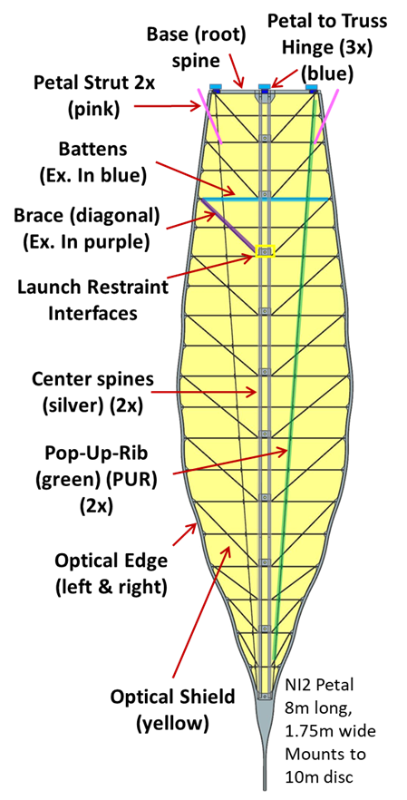
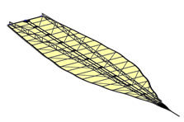
SIP Program Plan
Model inner petal assembly
  Analyze petal pair interactions and account for contact and friction effects
Petal pair deployment testing with correlation analysis

Slide 8
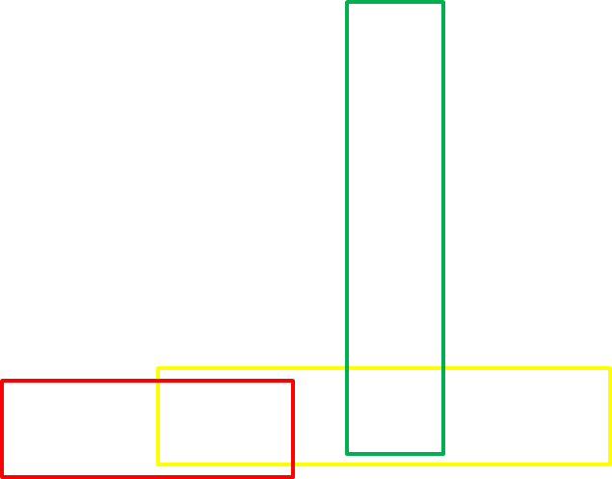
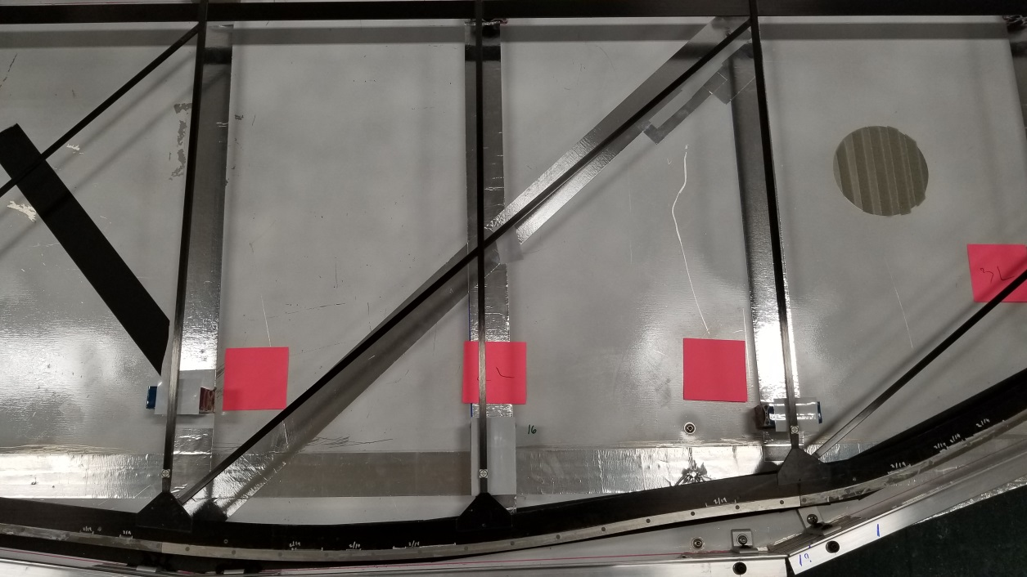
SIP Program Plan
Petal viscoelastic/creep testing
  Fabricate petal edge segments
    Center section, butt joint segment, batten to edge joint
  Load segments per petal FEM results
  Test at defined environment and duration
  Measure initial shape and shape after recovery
  FEA to correlate to initial distorted shape
Yellow = center section, Red = butt joint section, Green = batten assembly

Slide 9
SIP Program Plan
SIP program builds on SBIR Petal Phase II-E
  PLUS, petal carts, petal snubbers, unfurling tests
  Identified shortcoming of existing PLUS Testbed petal offloading
  Redesign and rebuild offloader
SIP activities will commence Q4 2019

