Slide 1
Starshade Science and Industry Partnership
Telecon #6
NASA Exoplanet Exploration Program
Gary Blackwood and Renyu Hu
August 8, 2019
© 2019 All rights reserved
CL # 19-1960

Slide 2
Telecon Agenda
SIP Updates - Gary Blackwood and Renyu Hu
Starshade Technology Introduction / Context – Phil Willems
Error budget and Risk Matrix of the Starshade Technology Development Plan – Doug Lisman
Review of the agenda of the Starshade Forum #1 – Renyu Hu and Simone D’Amico
Logistics of the Starshade Forum #1 – Jennifer Gregory
Comments/Discussion by TSWG Chair, Open Floor for Discussion

Slide 3
Motivation for Starshade Science and
Industry Partnership
The purpose of the Starshade SIP is to maximize the
technology readiness level of starshades to
enable potential future exoplanet science missions.
Starshades (or External Occulters) are one of the starlight suppression technologies for high contrast imaging of exoplanets and are baselined for large- and probe-class mission concept studies funded by the NASA Astrophysics Division for submission to the Astro2020 Decadal Survey.
Recently the Astrophysics Division authorized the Exoplanet Exploration Program (ExEP) to execute a directed technology development activity to advance starshades to Technology Readiness Level (TRL) 5.
The Starshade Technology Development Activity to TRL5, or S5, follows an approved Technology Development Plan with technology milestones that respond to documented mission performance requirements.
The ExEP recognizes that robust and impactful technology maturation requires ongoing consideration of new technology approaches and new mission concept drivers.
Notes:
Acknowledge current partners

Slide 4
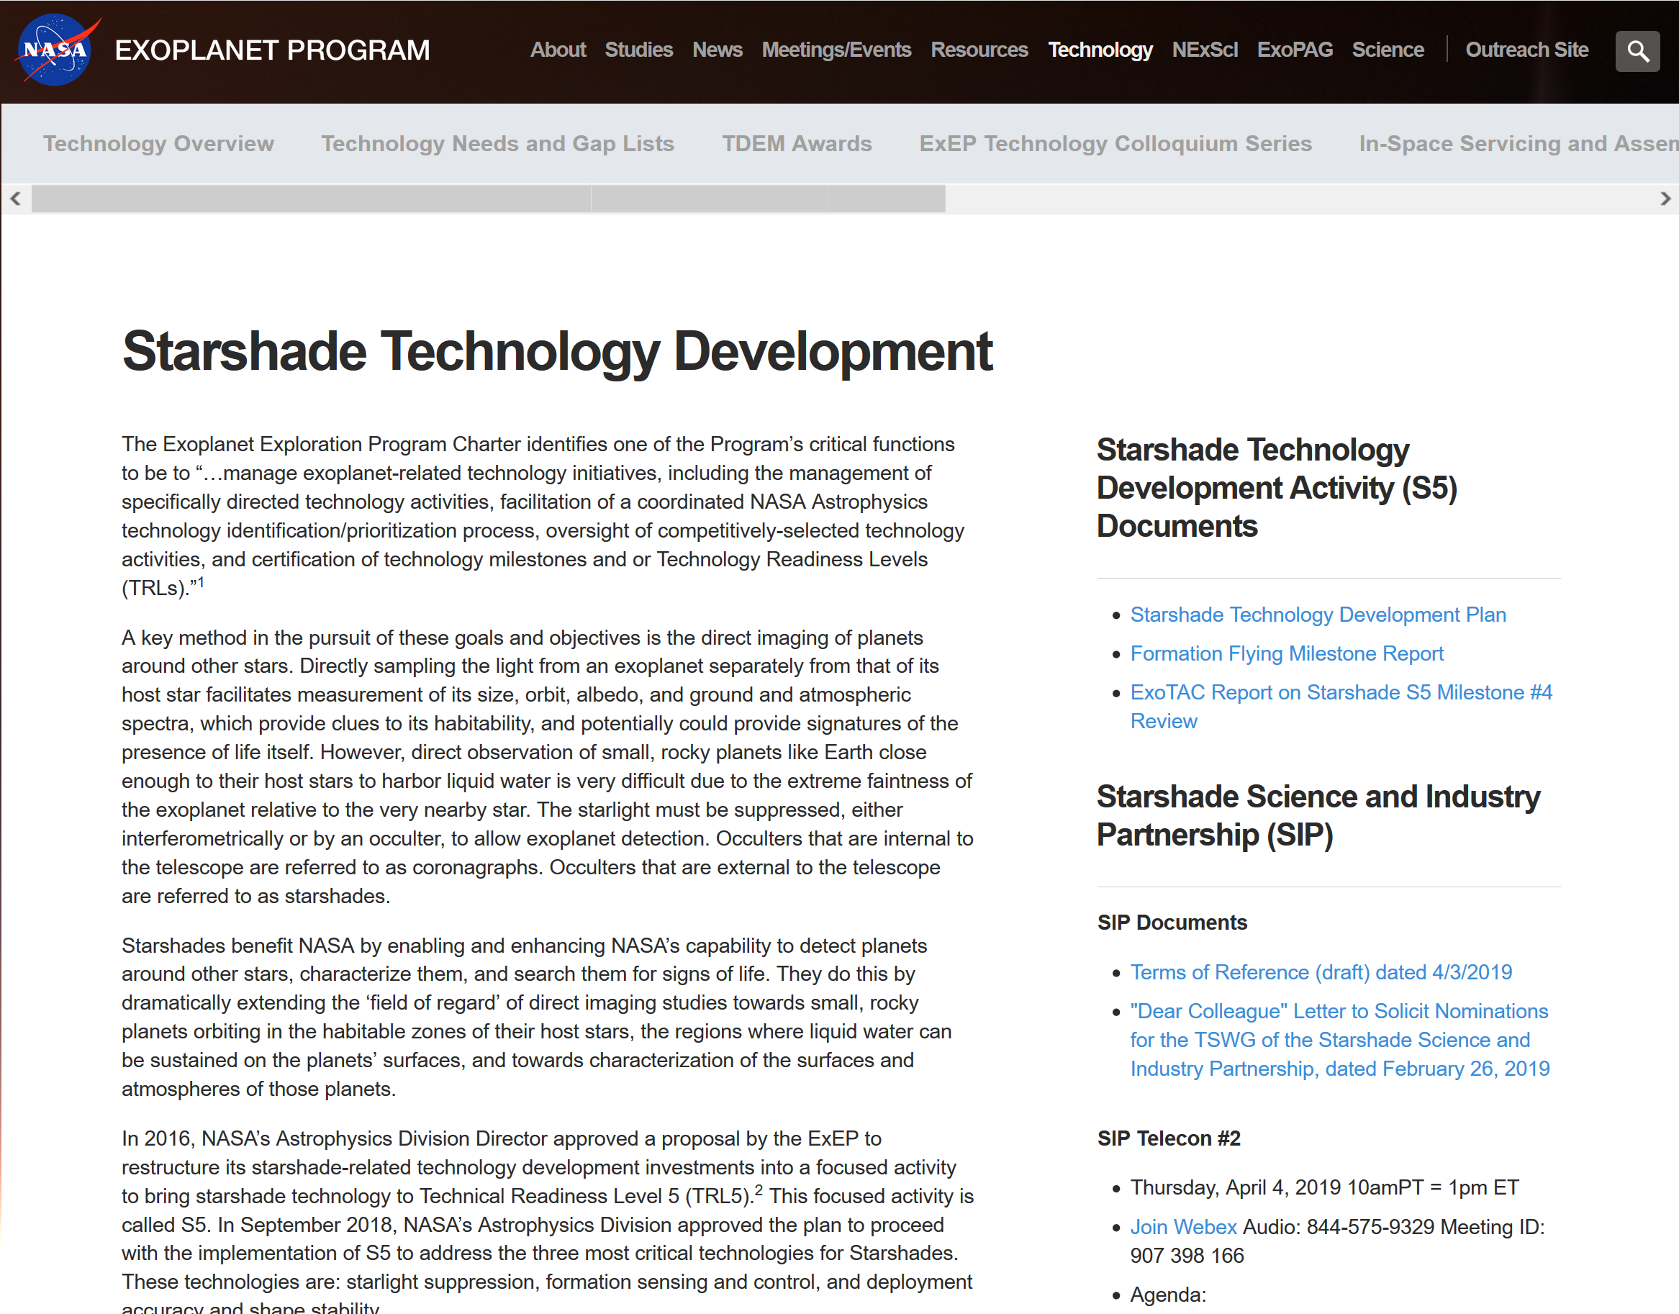
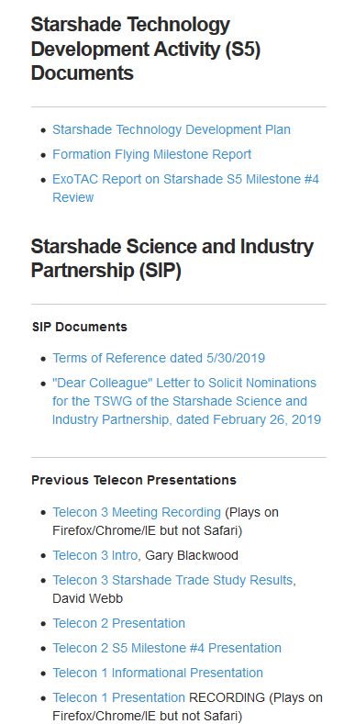
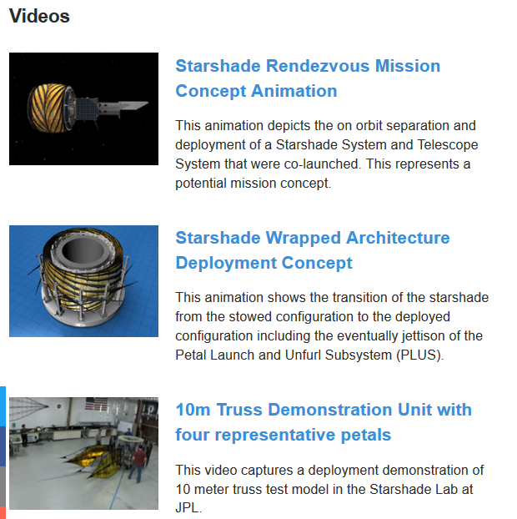
https://exoplanets.nasa.gov/exep/technology/starshade/

Slide 5
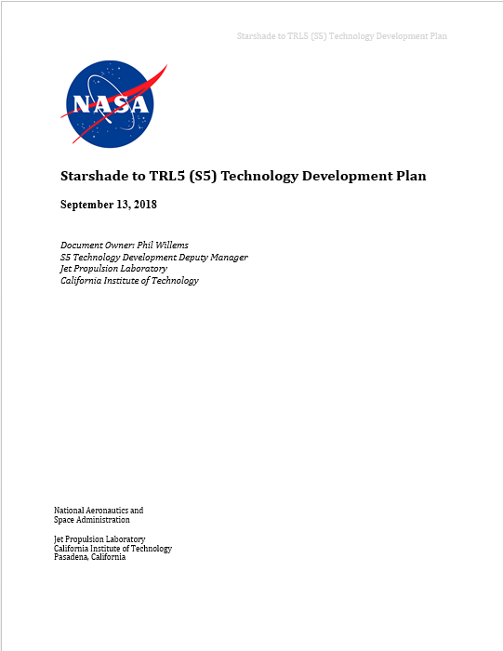
Technology Development Plan
Signed and posted on S5 website.
Contains in-depth description of technology baseline, performance parameters, development and test plans.
Highlights:
  The comprehensive error budget based on the mission key performance parameters
  The specific milestones defined as necessary to meet TRL 5

Slide 6
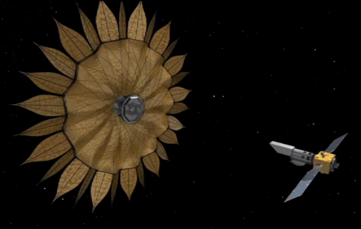
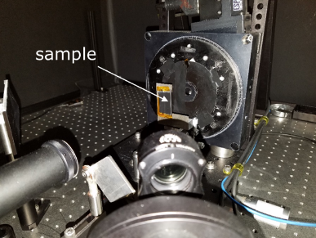
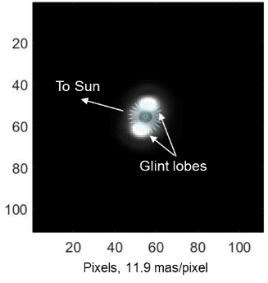
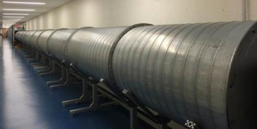
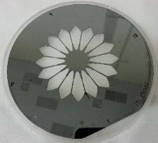
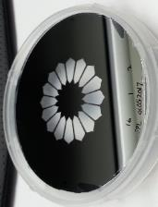
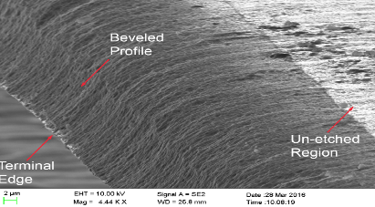
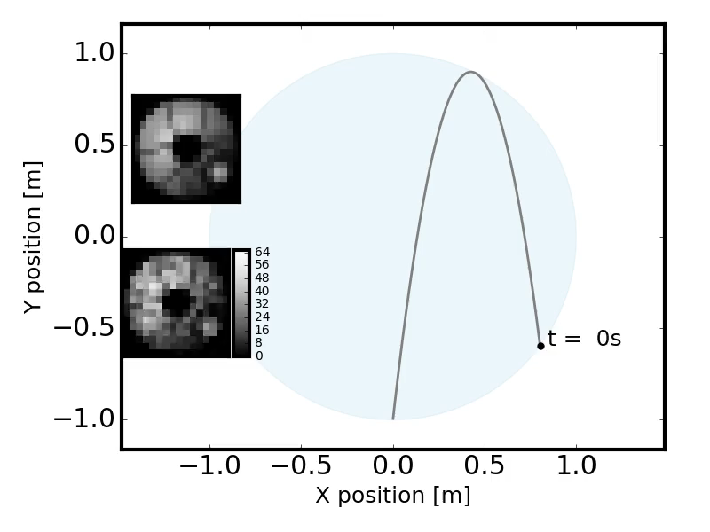
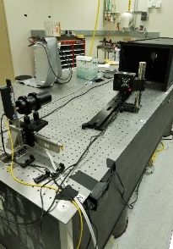
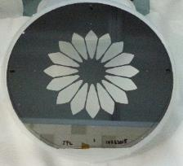
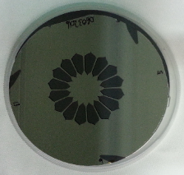

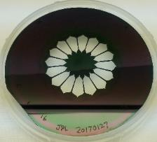
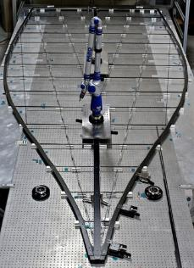
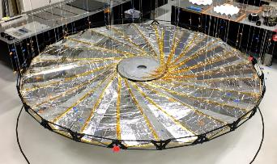
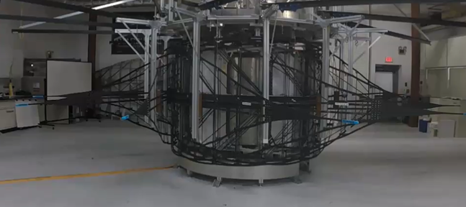
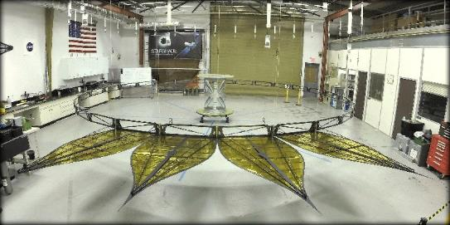
Starshade Technology Development Activity
Formation Flying
Starlight Suppression
Scattered Sunlight
Testbed validated model of sensing accuracy; simulated control performance under flight-like conditions.
Subscale demonstration of 1e-10 contrast at both narrow and broadband; optical model validation to 25% accuracy.
+/- 30 cm sensing accuracy
+/- 1 m control
Amorphous Metal
TGL S-2
Scatterometer measurements of half-scale petal edge segments show scattered sunlight less than Vmag 25 in image simulations.
TGL S-3
TGL S-1
Petal Shape and Position Accuracy
Petal Shape and Position Stability
Fabricate petals shape to a pre-launch accuracy of +/- 70um and demonstrate by analysis an on-orbit shape stability of +/- 80um
Perform petal deployment to a position accuracy of +/- 300um and demonstrate by analysis an on-orbit position stability to +/- 200 um
TGL S-4
TGL S-5
TGL S-# is the ExEP Technology Gap List reference number

Slide 7
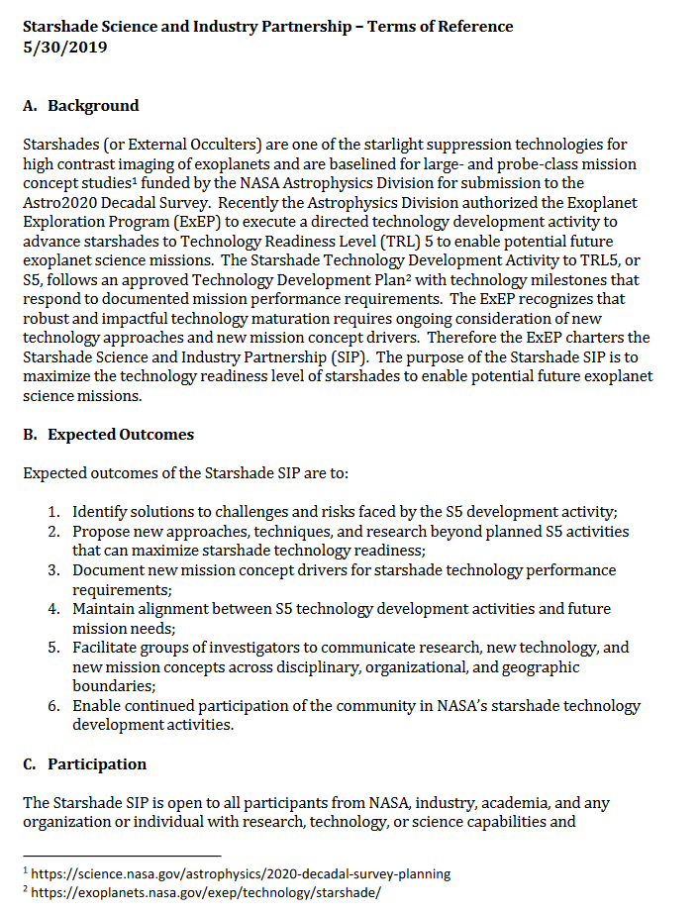
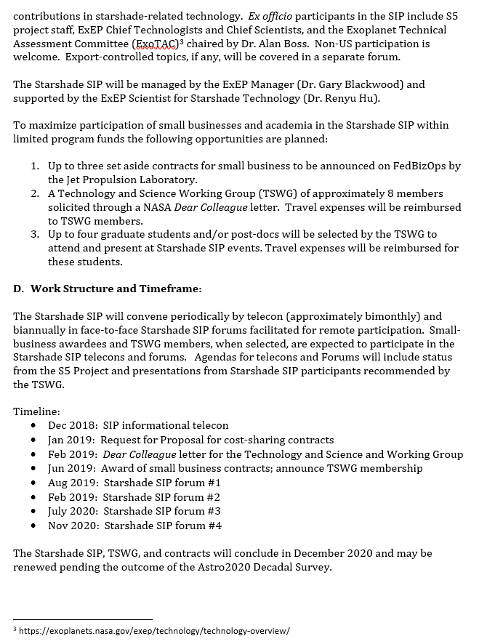
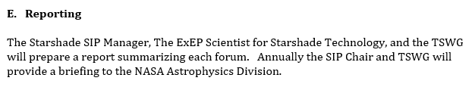
Starshade SIP – Terms of Reference

Slide 8
Expected Outcomes of the Starshade SIP
Identify solutions to challenges faced by the S5 development activity;
Propose new approaches, techniques, and research beyond planned S5 activities that can maximize starshade technology readiness;
Document new mission concept drivers for starshade technology performance requirements;
Maintain alignment between S5 technology development activities and future mission needs;
Facilitate groups of investigators to communicate research, new technology, and new mission concepts across disciplinary, organizational, and geographic boundaries;
Enable continued participation of the community in NASA’s starshade technology development activities.

Slide 10
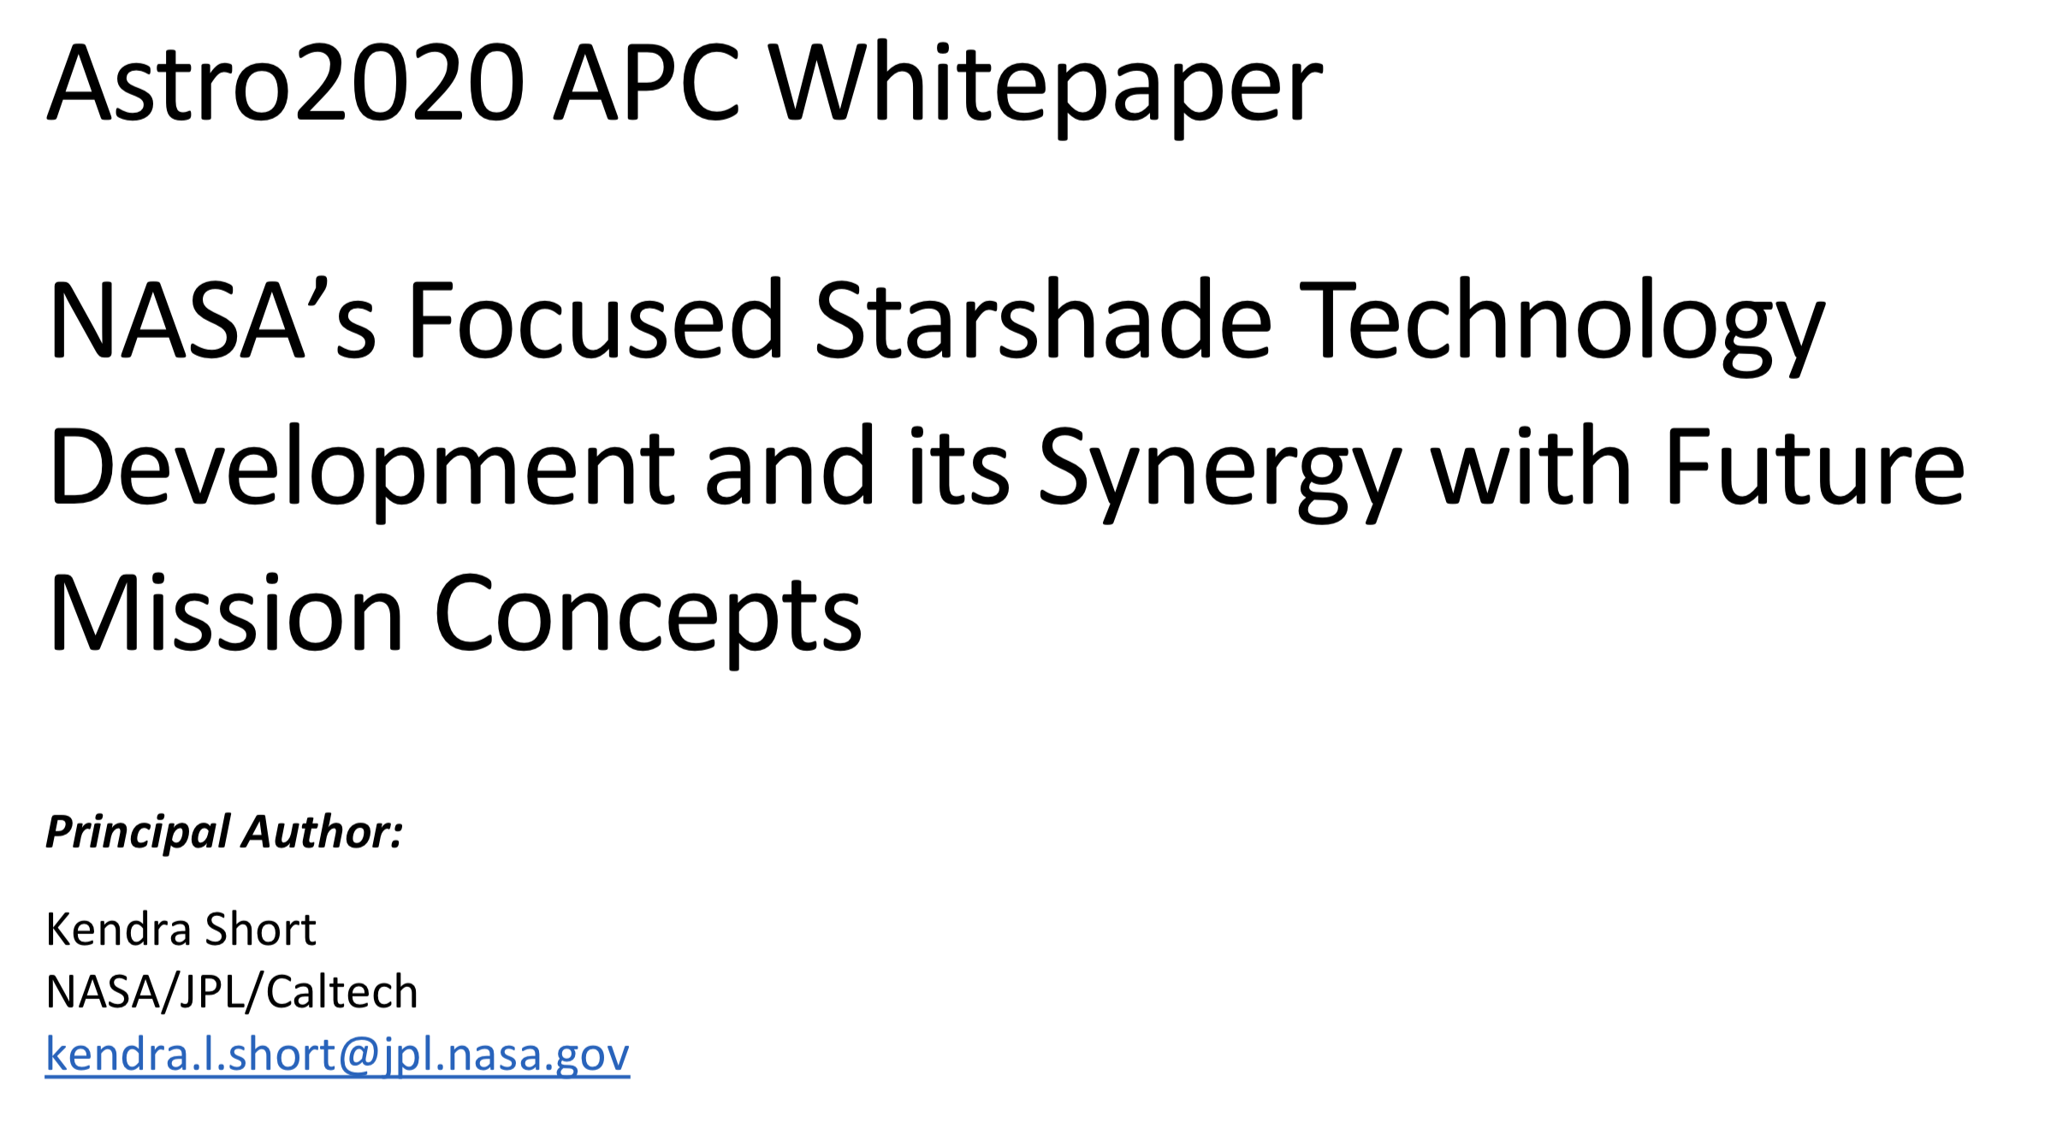
Status Since July 9th Telecon
Astro2020 APC Whitepaper submitted
http://surveygizmoresponseuploads.s3.amazonaws.com/fileuploads/623127/5043187/254-7069abdebe4bb83fcdc0a00b804840f6_ShortKendraL.pdf
Scattered sunlight experiments completed
  Finalizing the analysis and ready to write the milestone report
Notes:
APC = Activities, Projects, or State of the Profession Consideration

Slide 11
Telecon Agenda
SIP Updates - Gary Blackwood and Renyu Hu
Starshade Technology Introduction / Context – Phil Willems
Error budget and Risk Matrix of the Starshade Technology Development Plan – Doug Lisman
Review of the agenda of the Starshade Forum #1 – Renyu Hu and Simone D’Amico
Logistics of the Starshade Forum #1 – Jennifer Gregory
Comments/Discussion by TSWG Chair, Open Floor for Discussion

Slide 12
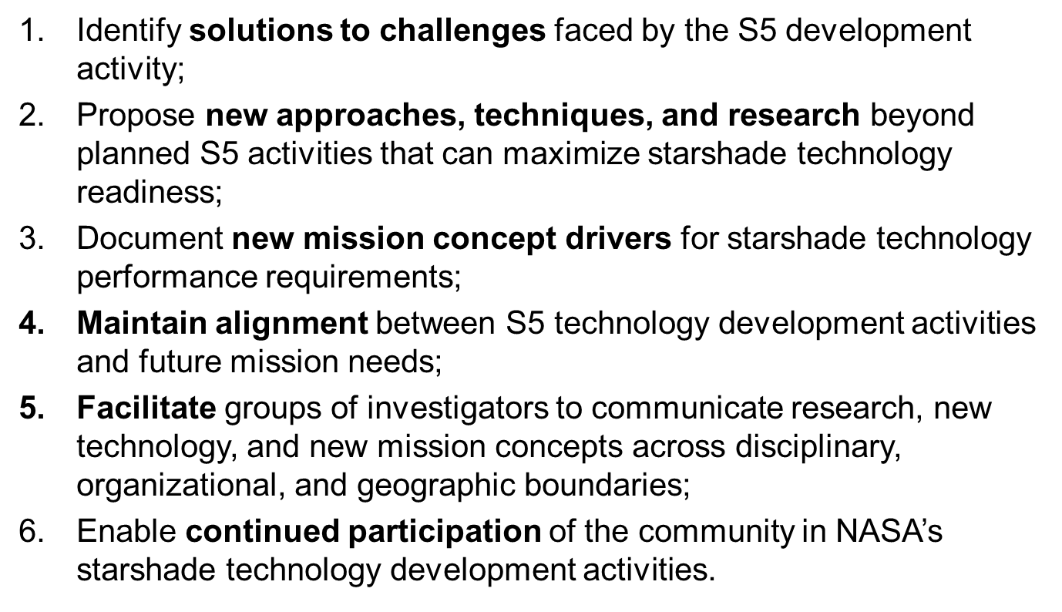
Agenda (draft) for F2F#1
JPL, Pasadena CA, September 18-19 2019
Day 1
Morning
  S5: Status from project; progress and challenges Chair: Willems
  Starshade Lab Tours
Afternoon
  Small business contract awardees: work scope Chair: Short
  Working Group Breakout, organized by Chair: Hu
    Outcomes 1-3, Outcomes 4-6
Day 2
Morning
  TSWG presentations Chair: d’Amico
  Presentations by any SIP member Chair: Hu
Afternoon
  Presentations by any SIP member, continued
  Breakout Groups report back / capture next steps Chair: Blackwood

Slide 13
Agenda (draft) for F2F#1
JPL, Pasadena CA, September 18-19 2019
Agenda Item - Day 1 Sept 18 | Presenter | Start | Duration | End
Introduction and Overview | Blackwood | 8:30 | 0:20 | 8:50
Exoplanet Science with Starshade | Hu | 8:50 | 0:20 | 9:10
Session 1: S5 Progress and Challenges. Chair: Phil Willems
Error Budget and Risk Matrix | Lisman | 9:10 | 0:20 | 9:30
Formation Flying Technology Updates | Thibolt | 9:30 | 0:20 | 9:50
Starshade Mechenical Architecture and Technolopgy Updates | Webb | 9:50 | 0:20 | 10:10
Optical Edge Technology Updates | Hilgemann | 10:10 | 0:20 | 10:30
Starshade lab Tour | Short | 10:30 | 1:00 | 11:30
Lunch |  | 11:30 | 1:00 | 12:30
Session 2: Small Business Work Scope Chair: Kendra Short
ATA |  | 12:30 | 0:30 | 13:00
Zecoat |  | 13:00 | 0:30 | 13:30
Opterus |  | 13:30 | 0:30 | 14:00
Tendeg |  | 14:00 | 0:30 | 14:30
Breakout Groups on Outcomes 1-2, 3-4, 5-6, and report to Paul: Chair: Renyu Hu |  | 14:30 | 2:30 | 17:00
 | End | 17:00

Slide 14
Agenda (draft) for F2F#1
JPL, Pasadena CA, September 18-19 2019
Agenda Item - Day 2 Sept 19 | Presenter | Start | Duration | End
Session 3: TSWG Chair: Simone D'Amico
Miniaturized Distributed Occulter/Telescope (mDOT) | Bruce Macintosh | 8:00 | 0:30 | 8:30
Orbiting starshade | John Mather | 8:30 | 0:30 | 9:00
Challenges to implementation of the starshade and alternative deployment approaches | Jon Arenberg | 9:00 | 0:30 | 9:30
Starshade Optical Testing: Current Status and Future Challenges | Anthony Harness | 9:30 | 0:30 | 10:00
Science that could be achieved with different size telescope apertures and starshades | Andrew Romero-Wolf | 10:00 | 0:30 | 10:30
Reserve |  | 10:30 | 0:30 | 11:00
Lunch |  | 11:00 | 1:00 | 12:00
Session 4: Presentations by any SIP members Chair: Renyu Hu
In-space assembly of a starshade | Rudranarayan Mukherjee | 12:00 | 0:30 | 12:30
Reserve |  | 12:30 | 0:30 | 13:00
Breakout Groups Report Out from Day 1 Chair: Gary Blackwood |  | 13:00 | 2:00 | 15:00
Summary and capture next steps |  | 15:00 | 0:30 | 15:30
 | End | 15:30

Slide 15
Telecon Agenda
SIP Updates - Gary Blackwood and Renyu Hu
Starshade Technology Introduction / Context – Phil Willems
Error budget and Risk Matrix of the Starshade Technology Development Plan – Doug Lisman
Review of the agenda of the Starshade Forum #1 – Renyu Hu and Simone D’Amico
Logistics of the Starshade Forum #1 – Jennifer Gregory
Comments/Discussion by TSWG Chair, Open Floor for Discussion

Slide 16
Closing
Future agenda, future forum,
Starshade SIP mailing list: Follow instructions at https://exoplanets.nasa.gov/exep/technology/starshade/
Suggest Forum agenda topics to:
  Gary Blackwood and Renyu Hu
Starshade Forum #1: Sept 18-19 at JPL in Pasadena CA.
  Register by Sept 11 for US citizens and by Sept 4 for foreign nationals, by sending an email to sip_travel@list.jpl.nasa.gov
  Remote participation available.
Open the floor for further discussion
Notes:
FAQ: location of first forum, length = 1.5 days, CM on driving requirements

Slide 17
Copyright 2019 California Institute of Technology. Government sponsorship acknowledged.

Slide 18
Acknowledgements
This work was carried out at the Jet Propulsion Laboratory, California Institute of Technology under contract with the National Aeronautics and Space Administration. © 2019 All rights reserved.

Slide 19
Contact Information
Starshade Science and Industry Partnership
Gary Blackwood, NASA ExEP Manager, Starshade SIP Chair
  Gary.blackwood@jpl.nasa.gov
  W: 818 354 6263
  M: 818 458 0507
Yuriy Tsurkan, Subcontract Manager
  Yuriy.Tsurkan@jpl.nasa.gov
  W: 818 393-8052
  M: 747 261-8928
Renyu Hu, ExEP Starshade Scientist
  Renyu.Hu@jpl.nasa.gov
  W: 818 354 6090
  M: 818 281-9459
Kendra Short, S5 acting Manager, NASA ExEP Deputy Manager
  Kendra.Short@jpl.nasa.gov
  W: 818 354 9286
  M: 818 634 3918

Slide 20
Program Office – Key Participants
NASA Exoplanet Exploration Program (ExEP)
Science and Industry Partnership
Gary Blackwood, NASA ExEP Manager, Starshade SIP Chair
Yuriy Tsurkan, Subcontract Manager
Renyu Hu, ExEP Scientist for Starshade Technology
Starshade Technology Development Activity (S5)
Kendra Short, acting Manager of S5, NASA ExEP Deputy Manager,
Phil Willems, acting Deputy Manager of S5, LBTI Project Manager

Slide 21
NASA Headquarters Leadership
Astrophysics Division
Shahid Habib, Program Executive for ExEP
Douglas Hudgins, Program Scientist for ExEP
Martin Still, Deputy Program Scientist for ExEP
Nasser Barghouty, Division Technology Lead
Jeff Volosin, Deputy Division Director
Paul Hertz, Division Director

Slide 22
Small Business Set Aside Subcontracts
Proposals solicited only from small businesses and any resulting award will be made to a small business
Up to three cost-sharing contracts are planned by the Jet Propulsion Laboratory
Contract type is cost type
Procurement Schedule Milestones:
  RFI release in FedBizOpps 7/25/2018 Complete
  RFI responses due 9/05/2018 Complete
  RFP release in FedBizOpps 1/31/2019 Complete
  Proposals due 2/28/2019 Complete
  Target Award Date 6/17/2019
Only responsive, responsible proposers will be considered for award

