Slide 1
Starshade Science and Industry Partnership
Telecon #4
NASA Exoplanet Exploration Program
Gary Blackwood
June 6, 2019
© 2019 All rights reserved
CL # 19-1960

Slide 2
Telecon Agenda
SIP Updates - Gary Blackwood
Starshade Technology Introduction / Context – Phil Willems
S5 Milestone #1, High Contrast Experiments –
Anthony Harness
Starshade Optical Edge and Solar Glint - Stefan Martin
Future Telecons / Next Steps
Open Floor for Discussion

Slide 3
Motivation for Starshade Science and
Industry Partnership
The purpose of the Starshade SIP is to maximize the
technology readiness level of starshades to
enable potential future exoplanet science missions.
Starshades (or External Occulters) are one of the starlight suppression technologies for high contrast imaging of exoplanets and are baselined for large- and probe-class mission concept studies funded by the NASA Astrophysics Division for submission to the Astro2020 Decadal Survey.
Recently the Astrophysics Division authorized the Exoplanet Exploration Program (ExEP) to execute a directed technology development activity to advance starshades to Technology Readiness Level (TRL) 5.
The Starshade Technology Development Activity to TRL5, or S5, follows an approved Technology Development Plan with technology milestones that respond to documented mission performance requirements.
The ExEP recognizes that robust and impactful technology maturation requires ongoing consideration of new technology approaches and new mission concept drivers.
Notes:
Acknowledge current partners

Slide 4
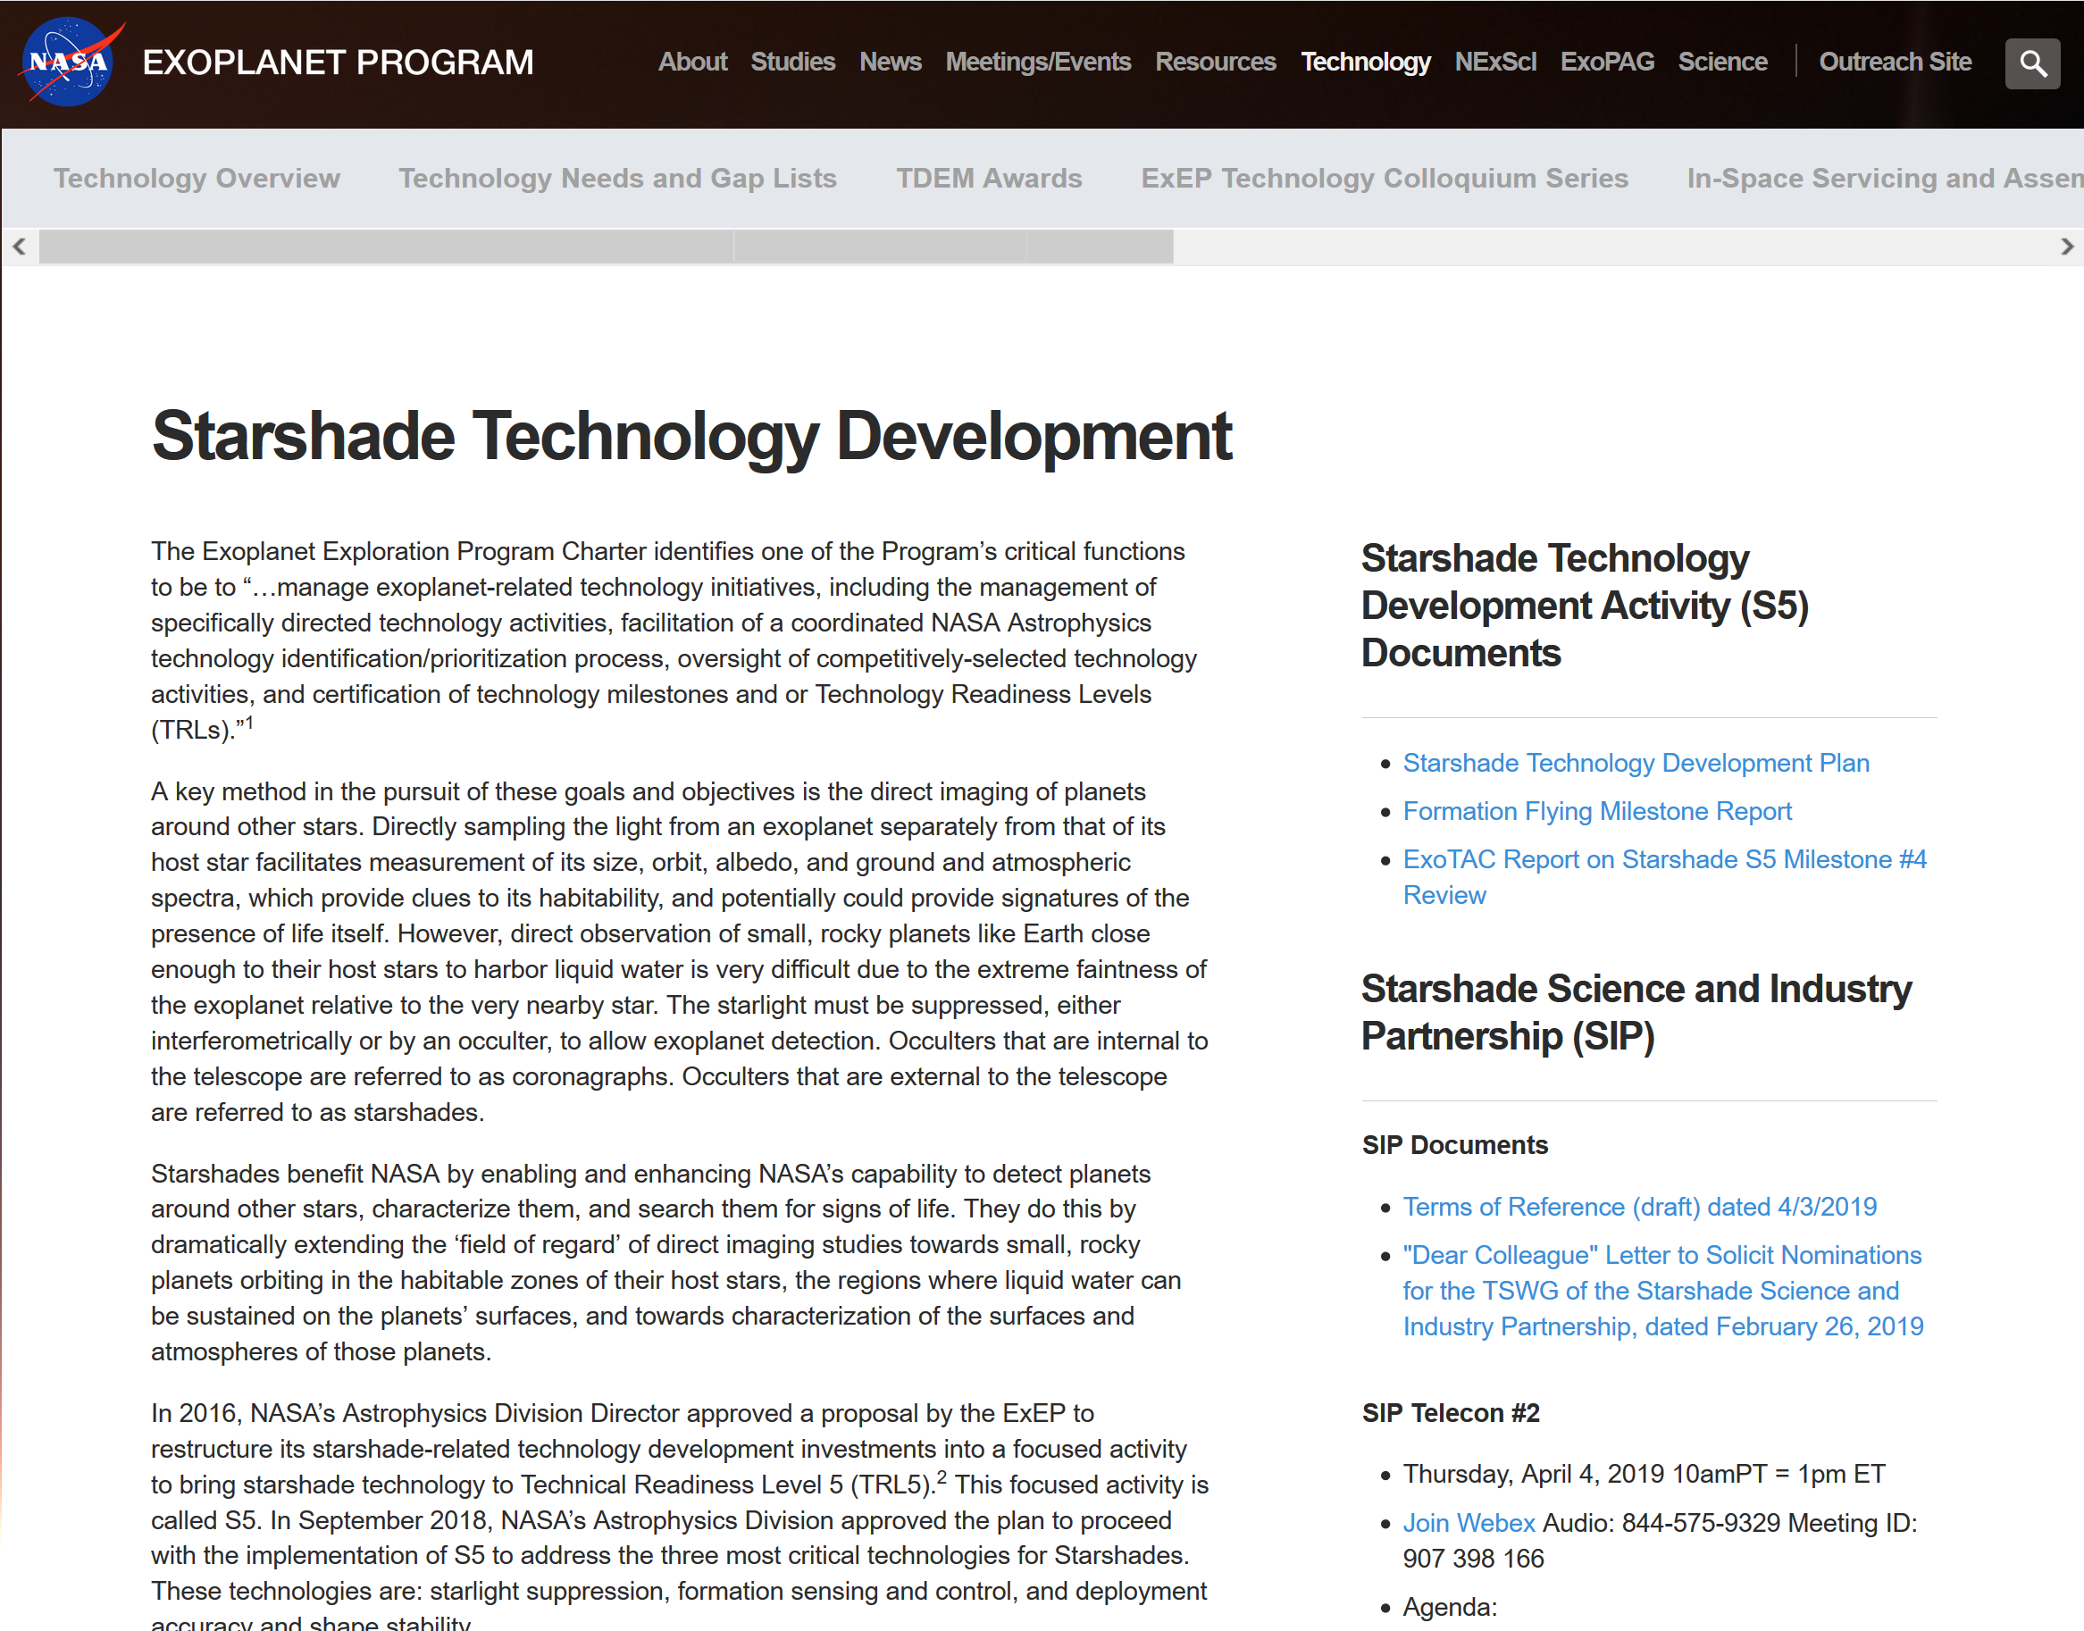
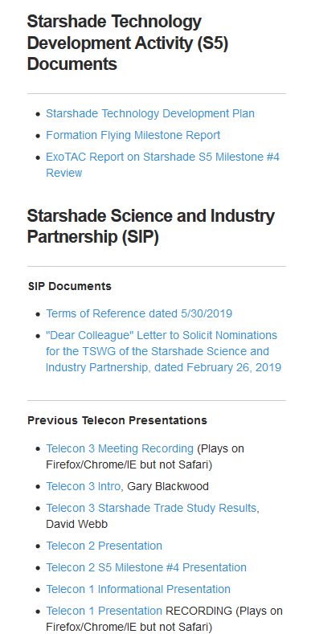
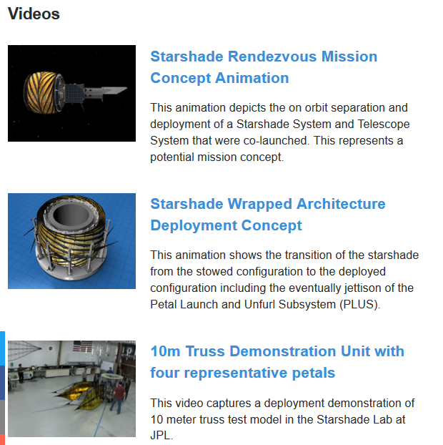
https://exoplanets.nasa.gov/exep/technology/starshade/

Slide 5
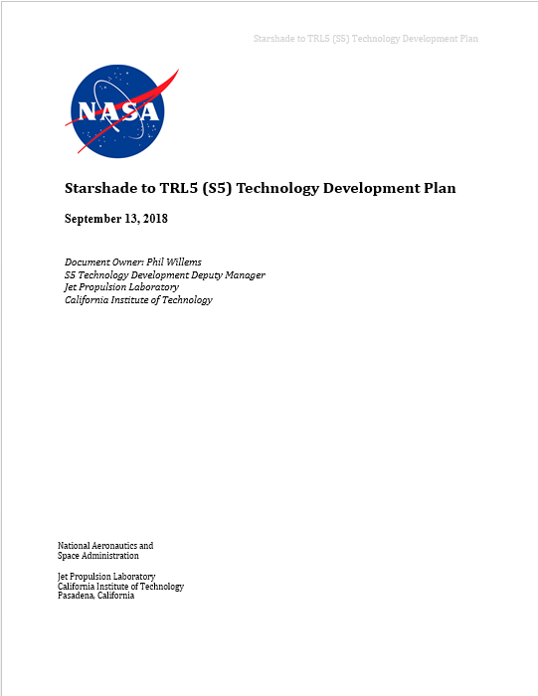
Technology Development Plan
Signed and posted on S5 website.
Contains in-depth description of technology baseline, performance parameters, development and test plans.
Highlights:
  The comprehensive error budget based on the mission key performance parameters
  The specific milestones defined as necessary to meet TRL 5

Slide 6
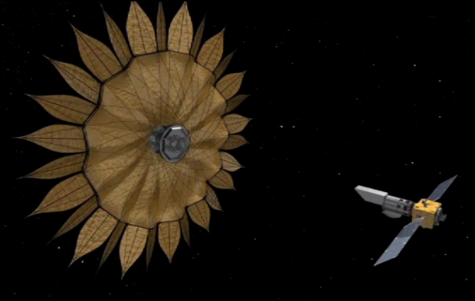
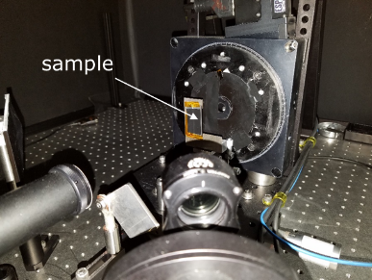
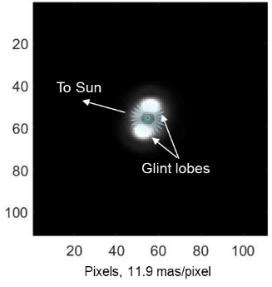
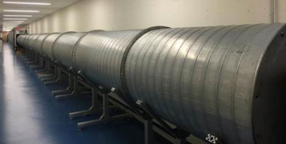
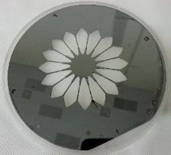
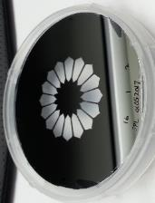
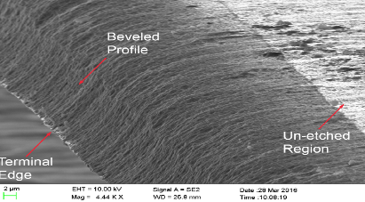
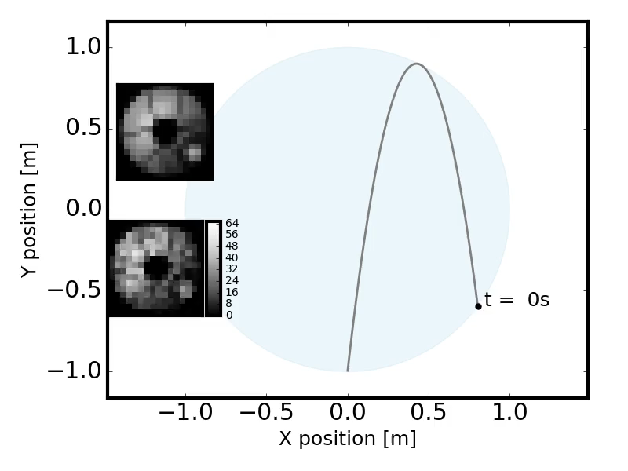
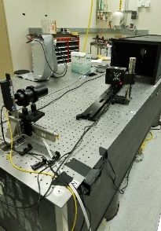
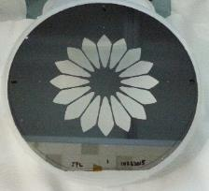
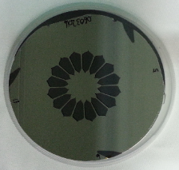

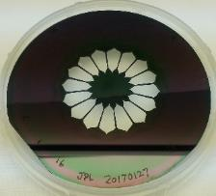
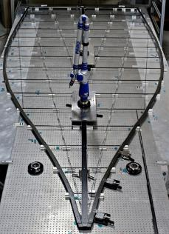
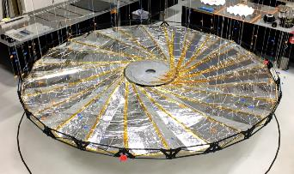
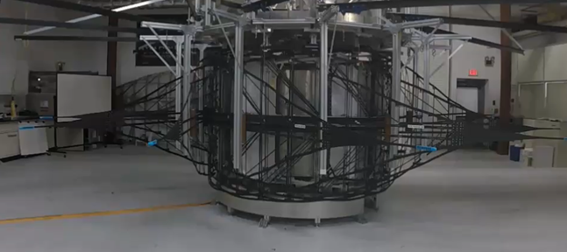
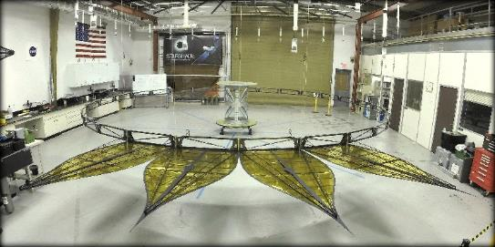
Starshade Technology Development Activity
Formation Flying
Starlight Suppression
Scattered Sunlight
Testbed validated model of sensing accuracy; simulated control performance under flight-like conditions.
Subscale demonstration of 1e-10 contrast at both narrow and broadband; optical model validation to 25% accuracy.
+/- 30 cm sensing accuracy
+/- 1 m control
Amorphous Metal
TGL S-2
Scatterometer measurements of half-scale petal edge segments show scattered sunlight less than Vmag 25 in image simulations.
TGL S-3
TGL S-1
Petal Shape and Position Accuracy
Petal Shape and Position Stability
Fabricate petals shape to a pre-launch accuracy of +/- 70um and demonstrate by analysis an on-orbit shape stability of +/- 80um
Perform petal deployment to a position accuracy of +/- 300um and demonstrate by analysis an on-orbit position stability to +/- 200 um
TGL S-4
TGL S-5
TGL S-# is the ExEP Technology Gap List reference number

Slide 7
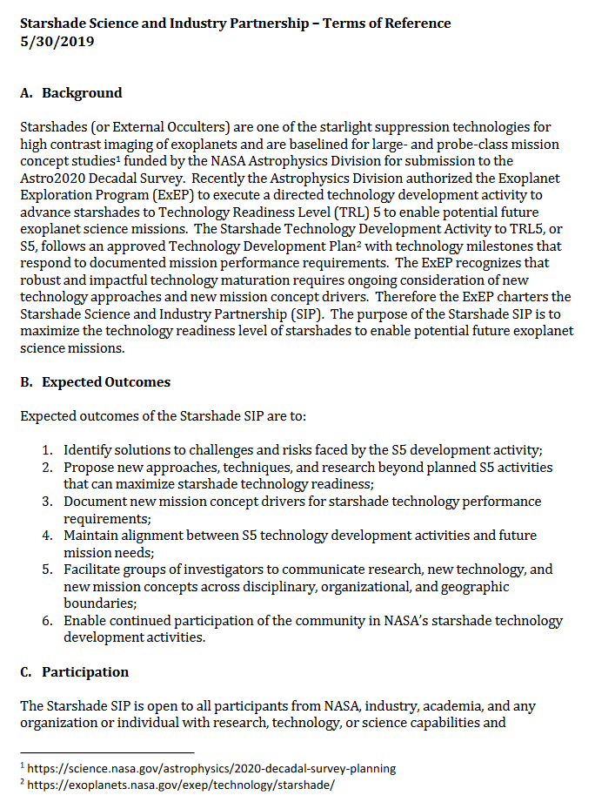
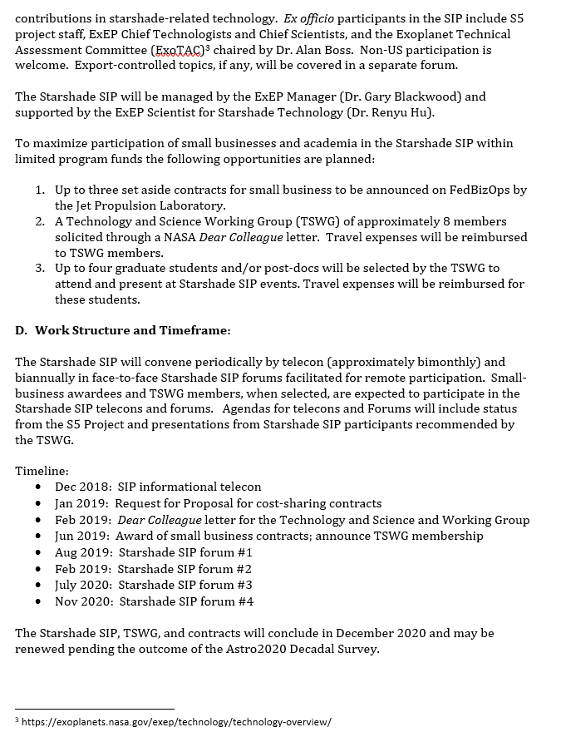
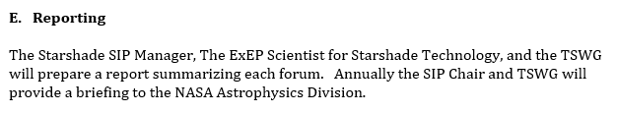
Starshade SIP – Terms of Reference
Now Signed

Slide 8
Expected Outcomes of the Starshade SIP
Identify solutions to challenges faced by the S5 development activity;
Propose new approaches, techniques, and research beyond planned S5 activities that can maximize starshade technology readiness;
Document new mission concept drivers for starshade technology performance requirements;
Maintain alignment between S5 technology development activities and future mission needs;
Facilitate groups of investigators to communicate research, new technology, and new mission concepts across disciplinary, organizational, and geographic boundaries;
Enable continued participation of the community in NASA’s starshade technology development activities.

Slide 9
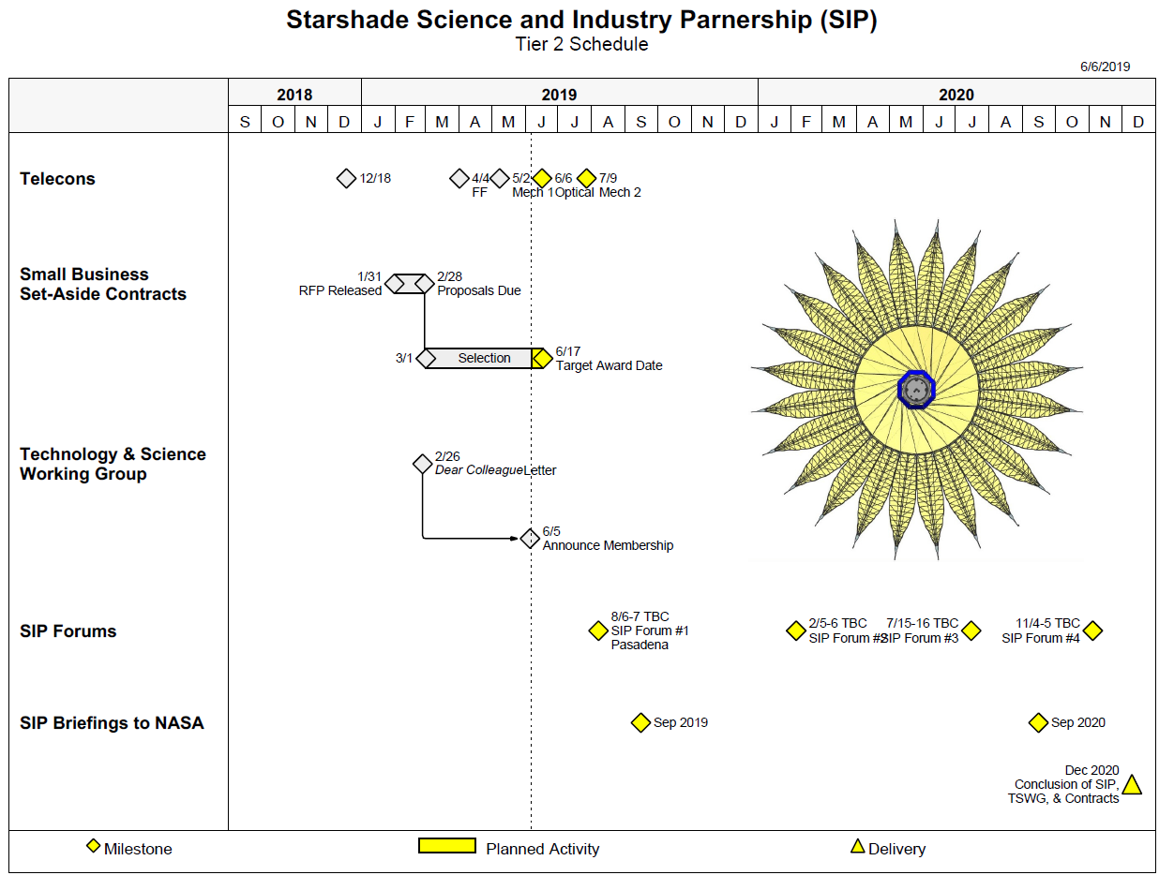

Slide 10
Status Since May 2nd Telecon
Remote Occulter (Mather, Peretz)
  GSFC Workshop 5/14-15
  JPL Team X study week of 5/21-23
Plans for whitepapers:
  ExEP Search for Life Technology APC whitepaper July 10 2019
  Starshade Tech APC whitepaper on July 10 (Short)
  S5 Tech assessment, alongside flagship & probe reports Aug 23 (Willems)
Technology and Science Working Group (TSWG) appointed

Slide 11
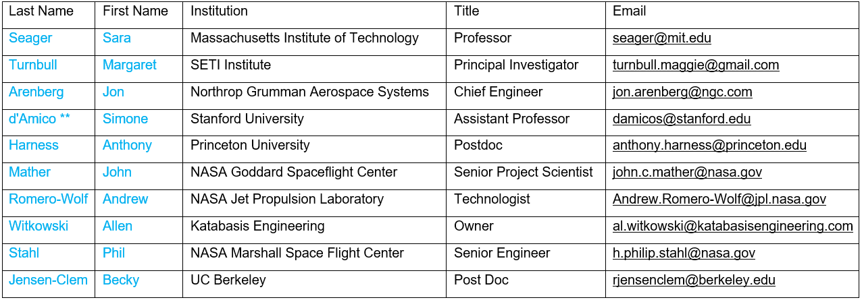
Technology and Science Working Group
Congratulations and Welcome!
** Chair

Slide 12
Technology and Science Working Group
Context:
  TSWG is a steering group for the SIP
  The SIP will help S5 achieve its milestones, and, help NASA understand if S5 has the right milestones
TSWG members will:
  Identify solutions to challenges faced by the S5 development activity
  Propose new approaches, techniques, and research beyond planned S5 activities that can maximize starshade technology readiness
  Document new mission concept drivers for starshade technology performance requirements
  Maintain alignment between S5 technology development activities and future mission needs
  Document findings in annual Starshade SIP reports to NASA APD
The TSWG will select up to four graduate students and postdocs to attend and present at each SIP forum (travel expenses reimbursed), starting with forum #2

Slide 13
Telecon Agenda
SIP Updates - Gary Blackwood
Starshade Technology Introduction / Context – Phil Willems
S5 Milestone #1, High Contrast Experiments –
Anthony Harness
Starshade Optical Edge and Solar Glint - Stefan Martin
Future Telecons / Next Steps
Open Floor for Discussion

Slide 14
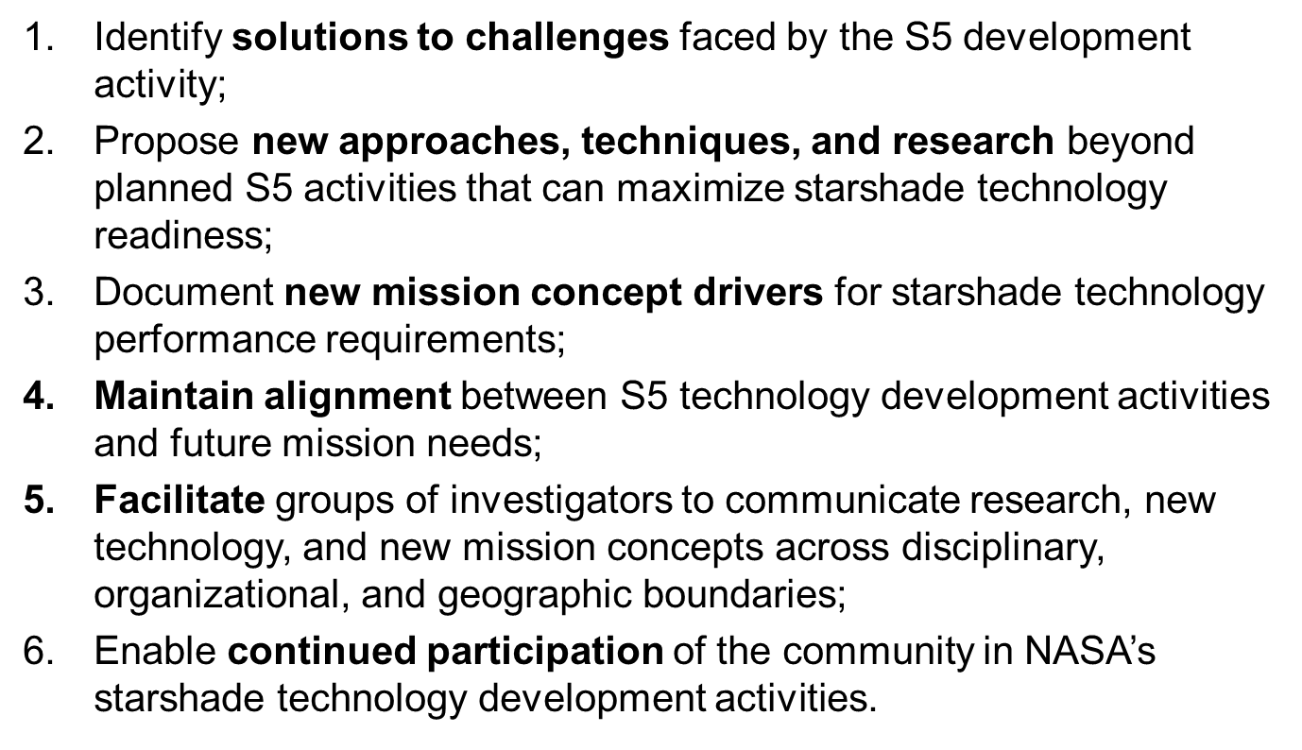
Agenda (draft) for F2F#1
JPL, Pasadena CA, August 6-7 2019, 8-5 PT
Day 1
Morning
  S5: Status from project; progress and challenges Chair: Willems
  Starshade Lab Tours
Afternoon
  Small business contract awardees: work scope Chair: Short
  Working Group Breakout, organized by Chair: Hu
    Outcomes 1-3, Outcomes 4-6
Day 2
Morning
  TSWG presentations Chair: d’Amico
  Presentations by any SIP member Chair: Hu
Afternoon
  Presentations by any SIP member, continued
  Breakout Groups report back / capture next steps Chair: Blackwood

Slide 15
Closing
Future agenda, future forum,
Starshade SIP mailing list: Follow instructions at https://exoplanets.nasa.gov/exep/technology/starshade/
Suggest future telecon (or Forum) agenda topics to:
  Gary Blackwood and Renyu Hu
Starshade Forum #1: 8/6-7 at JPL in Pasadena CA. Remote participation available.
Open the floor for further discussion
Notes:
FAQ: location of first forum, length = 1.5 days, CM on driving requirements

Slide 16
Copyright 2019 California Institute of Technology. Government sponsorship acknowledged.

Slide 17
Acknowledgements
This work was carried out at the Jet Propulsion Laboratory, California Institute of Technology under contract with the National Aeronautics and Space Administration. © 2019 All rights reserved.

Slide 18
Contact Information
Starshade Science and Industry Partnership
Gary Blackwood, NASA ExEP Manager, Starshade SIP Chair
  Gary.blackwood@jpl.nasa.gov
  W: 818 354 6263
  M: 818 458 0507
Yuriy Tsurkan, Subcontract Manager
  Yuriy.Tsurkan@jpl.nasa.gov
  W: 818 393-8052
  M: 747 261-8928
Renyu Hu, ExEP Starshade Scientist
  Renyu.Hu@jpl.nasa.gov
  W: 818 354 6090
  M: 818 281-9459
Kendra Short, S5 acting Manager, NASA ExEP Deputy Manager
  Kendra.Short@jpl.nasa.gov
  W: 818 354 9286
  M: 818 634 3918

Slide 19
Program Office – Key Participants
NASA Exoplanet Exploration Program (ExEP)
Science and Industry Partnership
Gary Blackwood, NASA ExEP Manager, Starshade SIP Chair
Yuriy Tsurkan, Subcontract Manager
Renyu Hu, ExEP Scientist for Starshade Technology
Starshade Technology Development Activity (S5)
Kendra Short, acting Manager of S5, NASA ExEP Deputy Manager,
Phil Willems, acting Deputy Manager of S5, LBTI Project Manager

Slide 20
NASA Headquarters Leadership
Astrophysics Division
Shahid Habib, Program Executive for ExEP
Douglas Hudgins, Program Scientist for ExEP
Martin Still, Deputy Program Scientist for ExEP
Nasser Barghouty, Division Technology Lead
Jeff Volosin, Deputy Division Director
Paul Hertz, Division Director

Slide 21
Small Business Set Aside Subcontracts
Proposals solicited only from small businesses and any resulting award will be made to a small business
Up to three cost-sharing contracts are planned by the Jet Propulsion Laboratory
Contract type is cost type
Procurement Schedule Milestones:
  RFI release in FedBizOpps 7/25/2018 Complete
  RFI responses due 9/05/2018 Complete
  RFP release in FedBizOpps 1/31/2019 Complete
  Proposals due 2/28/2019 Complete
  Target Award Date 6/17/2019
Only responsive, responsible proposers will be considered for award

