Slide 1
AFTA Coronagraph Recommendation Process
Gary Blackwood, Exoplanet Exploration Program Manager
Jet Propulsion Laboratory, California Institute of Technology
EXOPLANET EXPLORATION PROGRAM ANALYSIS GROUP #8, Denver CO
October 5, 2013
Copyright 2013 California Institute of Technology. Government sponsorship acknowledged

Slide 2
AFTA Coronagraph Recommendation
Why: In response to NASA Administrator’s guidance, and Astrophysics Director’s Implementation plan, AFTA must produce a compelling and viable mission concept including coronagraph within guideline budget and schedule for
2015 Mid-decadal review
FY17 potential new mission start
What:
Use limited funds to focus design and technology investments
Technology funds for AFTA will be directed not competed
Choose primary and backup coronagraph technology
AFTA = Astrophysics-Focused Telescope Asset

Slide 3
Background
January 6 2013: ExoPAG#7 endorses coronagraph for AFTA
May: Steering Group formed by Program Office to anticipate possible follow-up actions to Administrator briefing
May 30: NASA Administrator gives permission for AFTA pre-formulation activities including a coronagraph
June 20: AFTA Coronagraph Working Group (ACWG) Charter signed by NASA Headquarters, identifying Members.
July 23-25: AFTA Coronagraph Workshop (ACW)#1 held in Princeton
Aug-September: Instrument Team builds analysis tools for comparative analysis. Advocates produce designs
September 9,10: AFTA Science Definition Team (SDT) meeting
September 16: Initial briefing by Program and Study Office to Technology Analysis Committee (TAC)
September 25-27: ACW#2 held at JPL
  Preliminary science requirements and evaluation criteria established
October 5: Briefing to ExoPAG#8 on AFTA Coronagraph by Program Office

Slide 4
Approach to Recommendation
Objective: Recommend a primary and backup coronagraph architecture to focus design and technology development leading to mid-decadal review and new mission start
Recommendation by ExEPO and ASO based on inputs from
  SDT: Sets the science requirements
  ACWG: Delivers technical FOMs and technology plans
  > Aim for the positive: a consensus product
  > SDT delivers science FOMs
  TAC: Analysis of technical FOM, TRL readiness
  plans, and risks
ExEPO and ASO recommendation to APD Director
based on:
  Technical and Programmatic
  Musts (Requirements), Wants (Goals), and Risks
  Distinguish description from evaluation
APD Director will make the decision
ACWG = representatives of ExEPO, ASO, SDT, Community
TAC:
Alan Boss (Carnegie Mellon)
Joe Pitman (EXSCI)
Steve Ridgway (NOAO)
Lisa Poyneer (LLNL)
Ben Oppenheimer (AMNH)
How do we define a successful outcome?
FOM = Figure of Merit

Slide 5
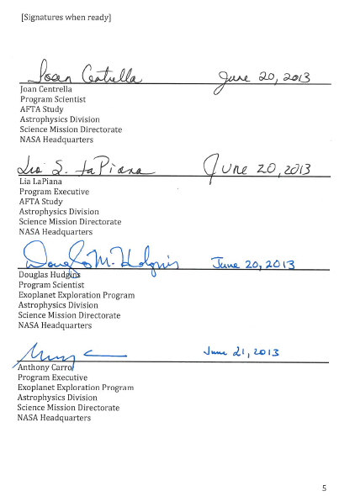
ACWG Membership
These represent Program, Study Office, SDT, and Community:
Additional consultants participate at
request of Steering Group
Charter
Workshop Organizers:
Gary Blackwood (NASA JPL)
Kevin Grady (NASA GSFC)
Peter Lawson (NASA JPL)
Steering Group:
Scott Gaudi (OSU)
Neil Gehrels (NASA GSFC)
Dave Spergel (Princeton U)
Tom Greene (NASA ARC)
Chas Beichman (NExScI)
Jeff Kruk (NASA GSFC)
Karl Stapelfeldt (NASA GSFC)
Wes Traub (NASA JPL)
Bruce MacIntosh (LLNL)
Members:
Jeremy Kasdin (Princeton U)
Mark Marley (NASA ARC)
Marc Clampin (NASA GSFC)
Olivier Guyon (UofA)
Gene Serabyn (NASA JPL)
Stuart Shaklan (NASA JPL)
Remi Soummer (STScI)
John Trauger (NASA JPL)
Marshall Perrin (STScI)
Feng Zhao (NASA JPL)
Rick Lyon (NASA GSFC)
Dave Content (NASA GSFC)
Mark Melton (NASA GSFC)
Cliff Jackson (NASA GSFC)
John Ruffa (NASA GSFC)
Jennifer Dooley (NASA JPL)
Mike Shao (NASA JPL)

Slide 6
Recommendation Criteria:
Defining a Successful Outcome
MUSTS (Requirements): Go/No_Go
Science: Does the proposed architecture meet the baseline science drivers?
Interfaces: For the baseline science, does the architecture meet telescope and spacecraft requirements of the observatory as specified by the AFTA project (DCIL¹)
Technology Readiness Level (TRL) Gates: For baseline science, is there a credible plan to be at TRL5 at the start of FY17 and at TRL6 at the start of FY19 within available resources?
Is the option ready in time for this selection process?
WANTS (Goals): Relative to each other, for those that pass the Musts:
Science: Relative strength of science beyond the baseline
Technical: Relative technical criteria
- See details
Programmatic: Relative cost of plan to meet TRL Gates
RISKS and OPPORTUNITIES
- See details
¹DCL = Dave Content Interface List

Slide 7
Option Space
Six architectures being considered:
  Shaped Pupil Kasdin
  PIAACMC Guyon/Belikov
  Hybrid Lyot Trauger
  Vector Vortex Serabyn
  Visible Nuller – DAVINCI Shao
  Visible Nuller Coronagraph– Phase-Occulted Lyon
Some hybrids may emerge through the design process – in order to best satisfy the success criteria

Slide 8
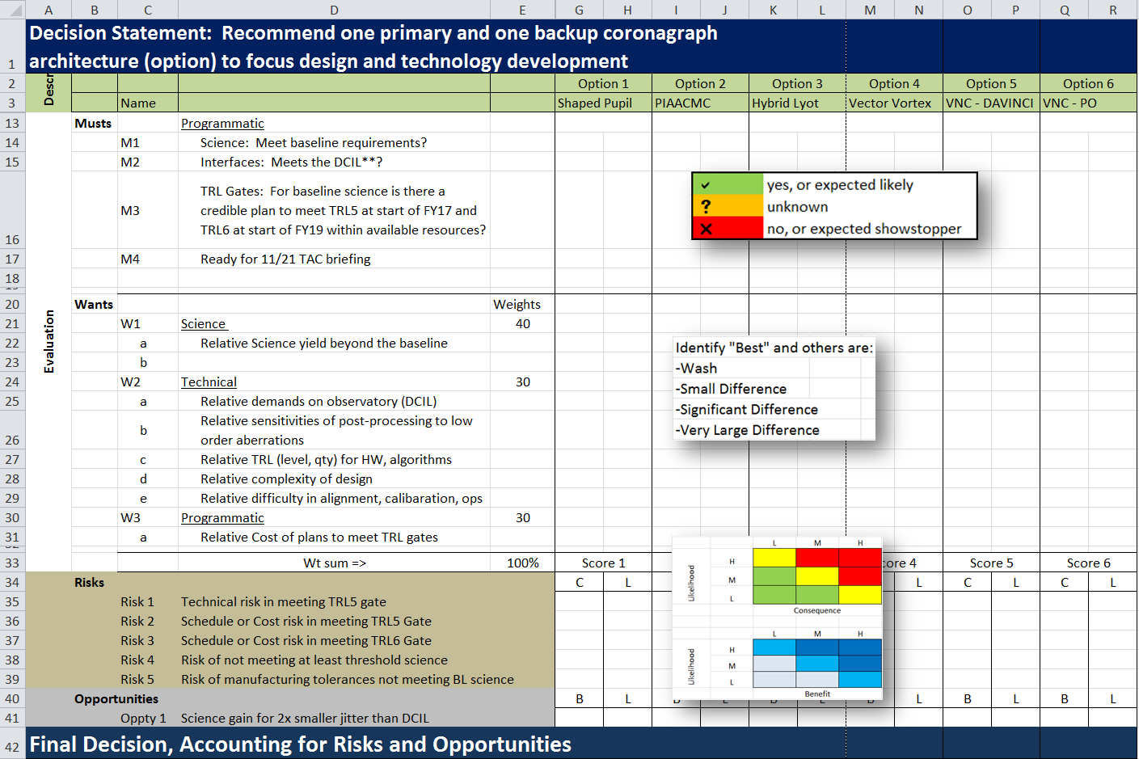
Evaluation Criteria

Slide 9


Product of ACWG:
Comparative Analysis
Science Baseline Requirements
SDT
Optical Model
Coronagraph
Advocates
ASO Coronagraph Instrument Team
Technical
FOM
SDT
Science
FOM
Designs
TAC
Recommendation
Analysis
APD DD
Technology
Description
ExEPO
ASO
Technology
Plans
Sensitivities / Other
ExEPO Chief Technologist
TRL Assessment
Decision
Technology Manager
Plan Viability
FOM = Figure of Merit
ASO = AFTA Study Office
ExEPO = Exoplanet Exploration Program Office
You Are Here

Slide 10
Top-Level Schedule

Slide 11
Acknowledgements
This work was carried out at the Jet Propulsion Laboratory, California Institute of Technology, under a contract with the National Aeronautics and Space Administration.
© 2013. All rights reserved.

Slide 12
BACKUP

Slide 13
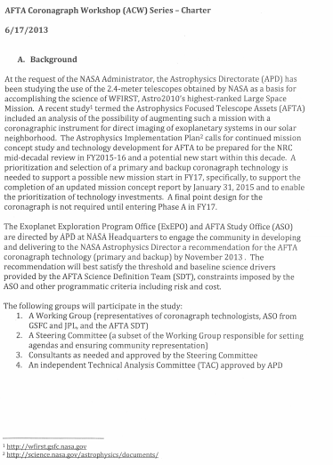
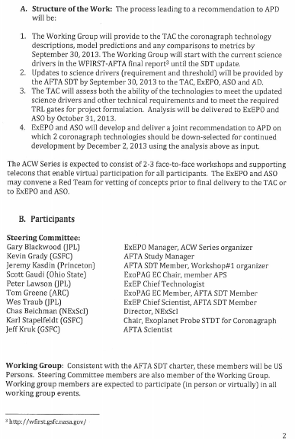
AFTA Coronagraph Workshop (ACW) Series Charter

Slide 14
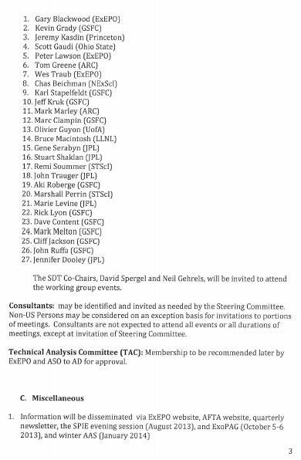
AFTA Coronagraph Workshop (ACW) Series Charter

