Slide 1
Kepler Estimate #3: An Analysis and Implications of Kepler’s Photometric Uncertainties
Wesley A. Traub
ExoPAG-8, Denver CO
6 October 2013
© 2013 California Institute of Technology. Government sponsorship acknowledged.

Slide 2
Goal: Understand the limits of Kepler observations
Photometric uncertainty prevents Kepler from being able to detect small planets, with long periods, as they transit faint stars
This paper aims to quantify this effect
With the “missing” data quantified, we have a better chance of modeling the distributions of planets, with radius and period, and thereby extrapolating to estimate eta-sub-Earth

Slide 3
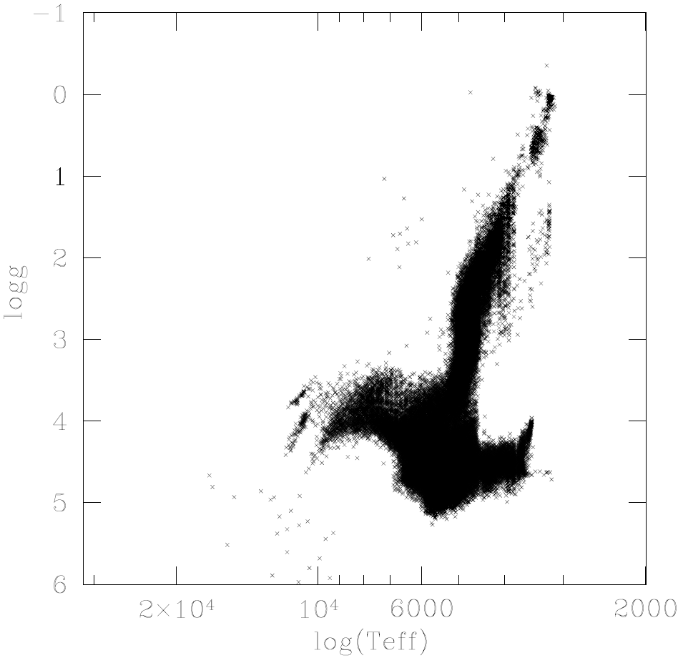
Select 3200-7000K, log g > 4.0
tgr_0_291 4/15/2012

Slide 4
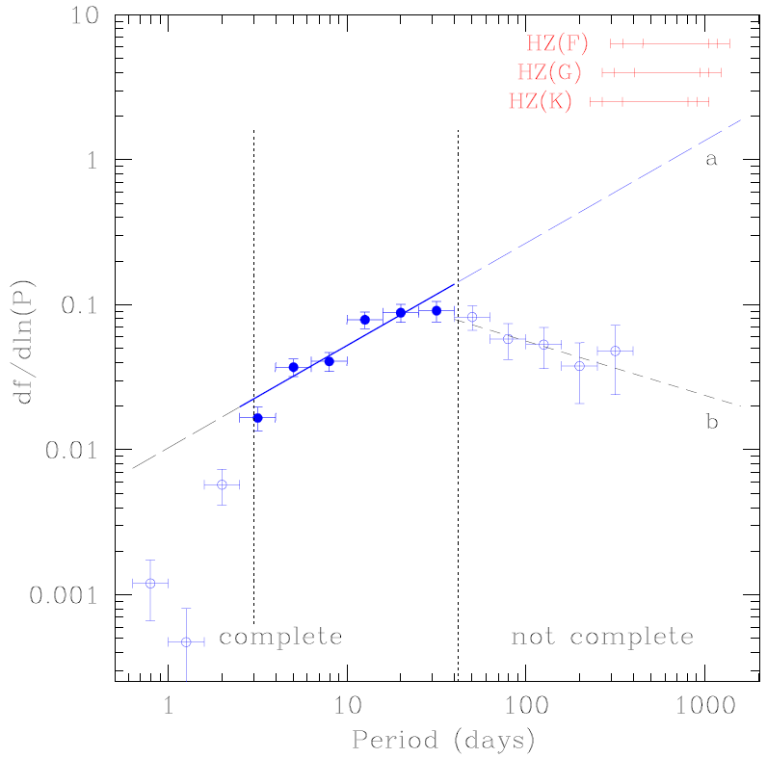
Basis of my previous η⊕ estimate (Traub, 2012)
η⊕ = 32%
With new data added, &
with a better appreciation
of possible
measurement bias,
does this estimate
still hold up?

Slide 5
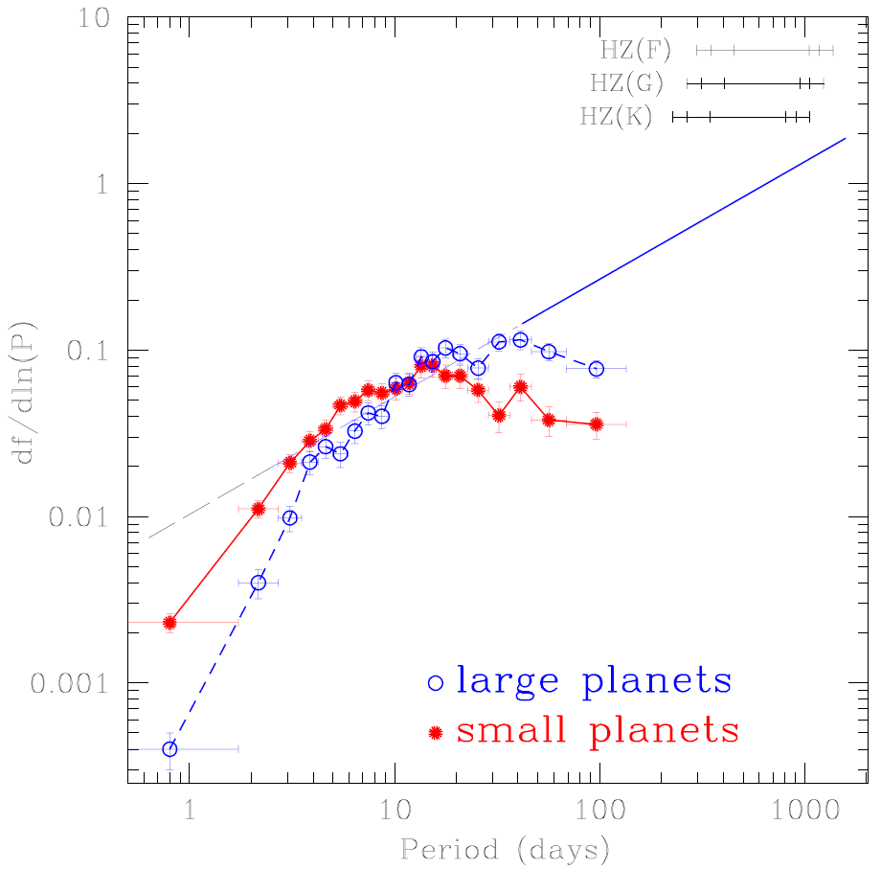
Strong bias for P > 30 days
Additional data (Jan 2013)
here shows same trends,
and fall-off at longer
periods, plus greater
fall-off for small planets
Are these fall-offs
caused by Nature or
instrument bias?
npunder_18_19_v2 8/8/2012

Slide 6
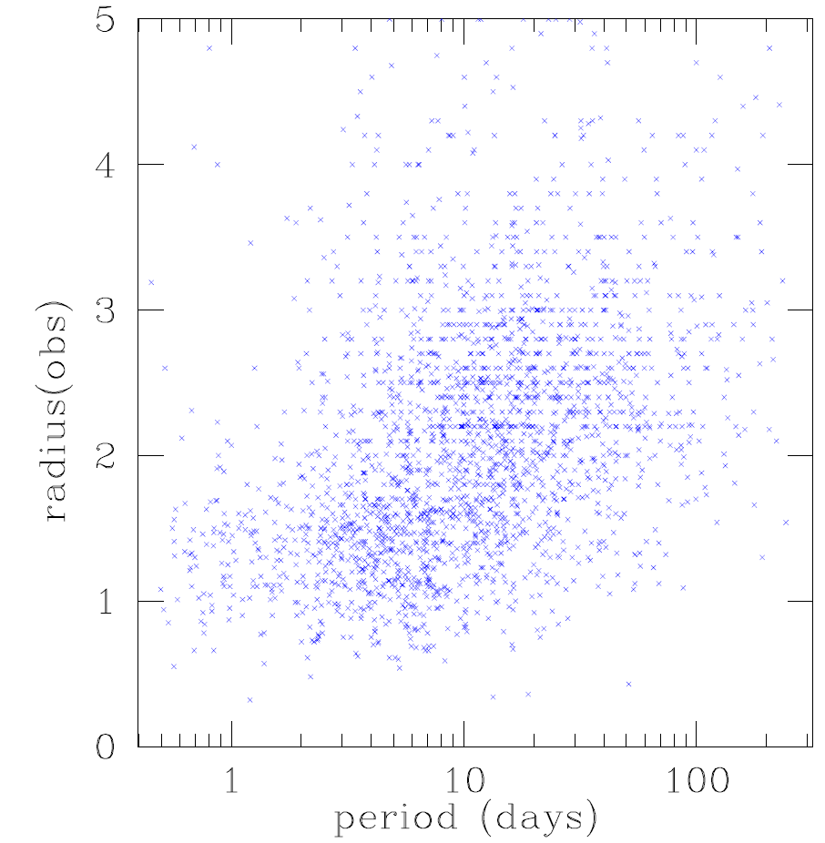
Missing small planets at long periods
Very few small planets
at longer periods:
Nature or Bias?
roc6 7/3/2013

Slide 7
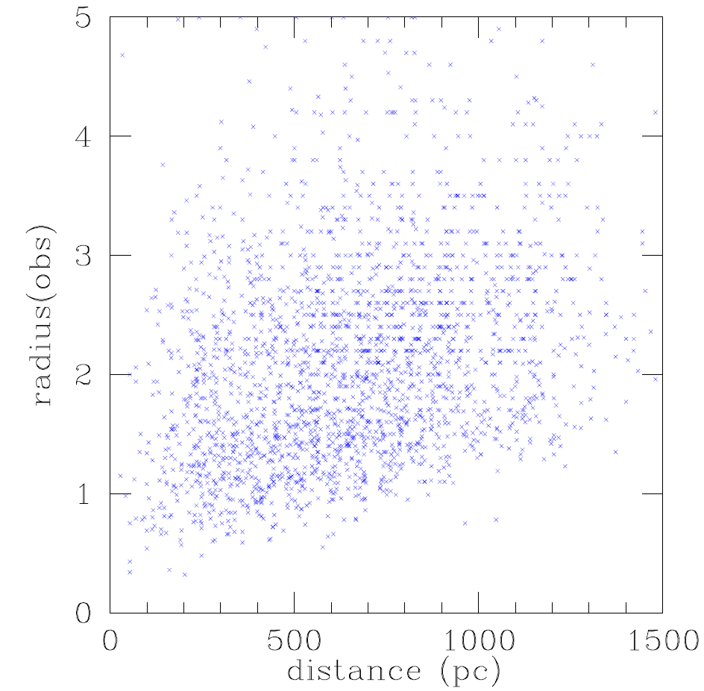
Missing small planets at large distance
Very few small planets
at large distances:
Nature or Bias?
roc5b 4/28/2013

Slide 8
Minimum detectable planet
From first principles,
for SNR = 7 detection criterion,
for T_{mission} = 2 yr & duty cycle = 92%,
& S/N ~ 1/t^{0.32} (not 1/t^{0.50}),
the minimum detectable planet radius is r_{min}:
r_{min}/r⊕ = 0.0389
x (cdpp6_{ppm})^{1/2}
x (r_{star}/r_{sun})^{0.947}
x (P_{days})^{0.197}
x 10^{0.0533 log(g)}
p.264-266, 6/5/2013

Slide 9
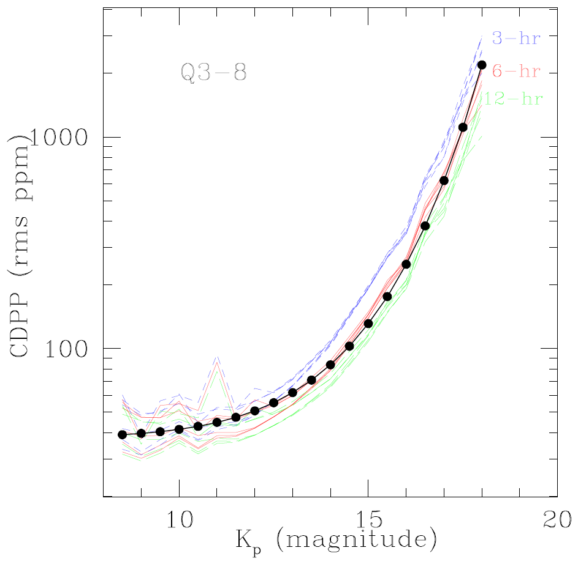
Median noise (CDPP) vs magnitude
CDPP = 30.2
+ 10^{0.377Kp – 3.485}
CDPP is RMS noise per
6-hour observation,
in units of ppm
The middle curve is the
median CDPP for all
stars averaged over
quarters 1 – 8
The best-fit curve is a
simple function of
Kepler magnitude
cdpp, p.216 4/14,28/2013

Slide 10
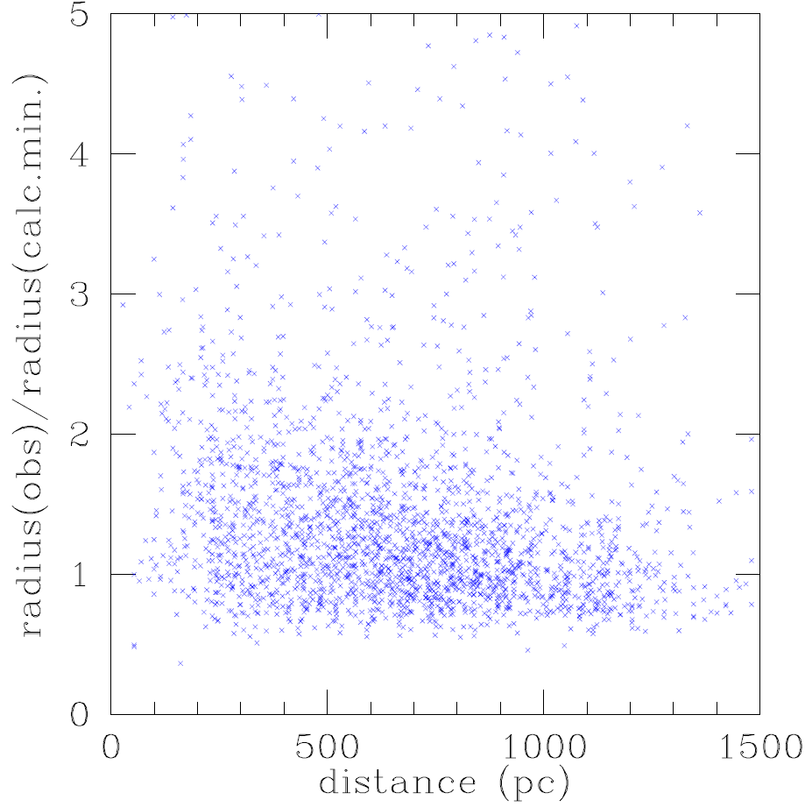
No distance bias when minimum observable radius considered
Scaling the observed radii
by the minimum radius
removes the bias factor
in near vs distant targets
This suggests that the
missing planets are
caused by bias,
not Nature
(A plot vs period
is similar)
roc5a 4/28/2013

Slide 11
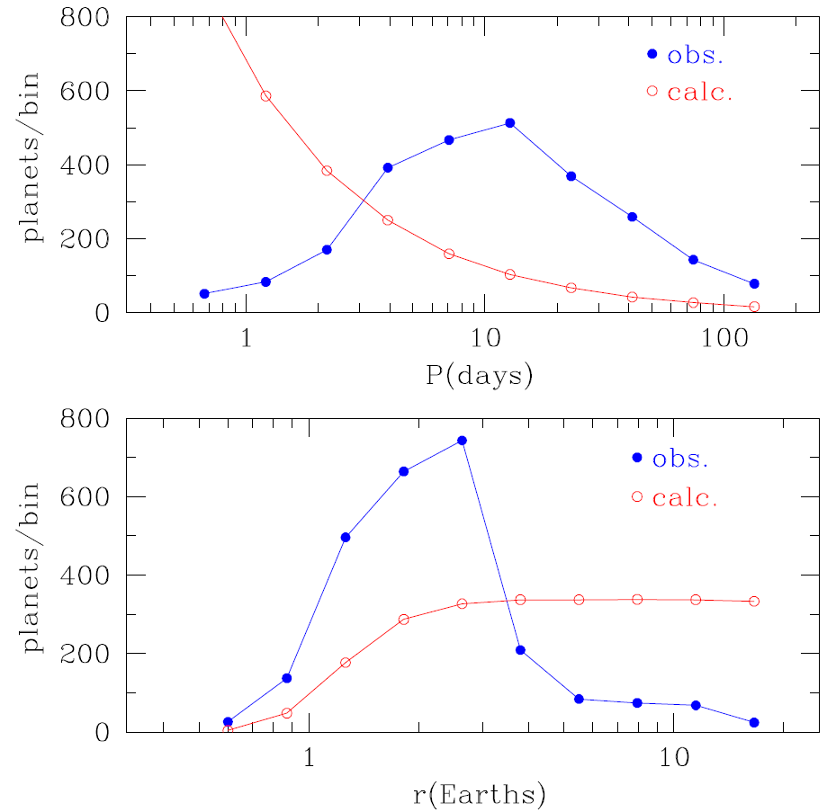
O vs C: f ~ r⁰ P⁰ per bin, poor fit
Generate simulated data:
For each Kepler star,
assign a random planet
radius and period,
using power laws in r & P
If radius is greater than the
minimum, then
“detect” the planet,
otherwise reject it.
Compare observed data
with simulated data.
In this case (flat power laws)
the fits are not good.
comp57 6/22/2013

Slide 12
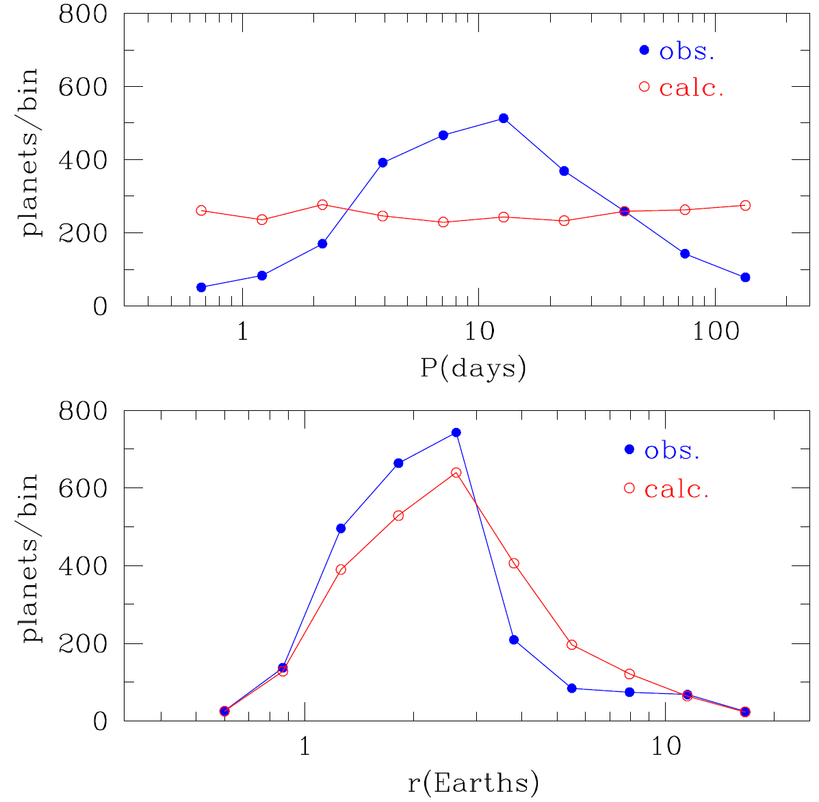
O vs C: f ~ r^{-2.0} P^{+1.1} per bin, a better fit, still not great
Same procedure, but here
with better-fitting
exponents
The well-observed lack of
planets at short periods
has not yet been factored
into the simulation here
When that is done,
the period fit will
improve dramatically
comp58 ,72 6/22,29/2013

Slide 13
Backup charts

Slide 14
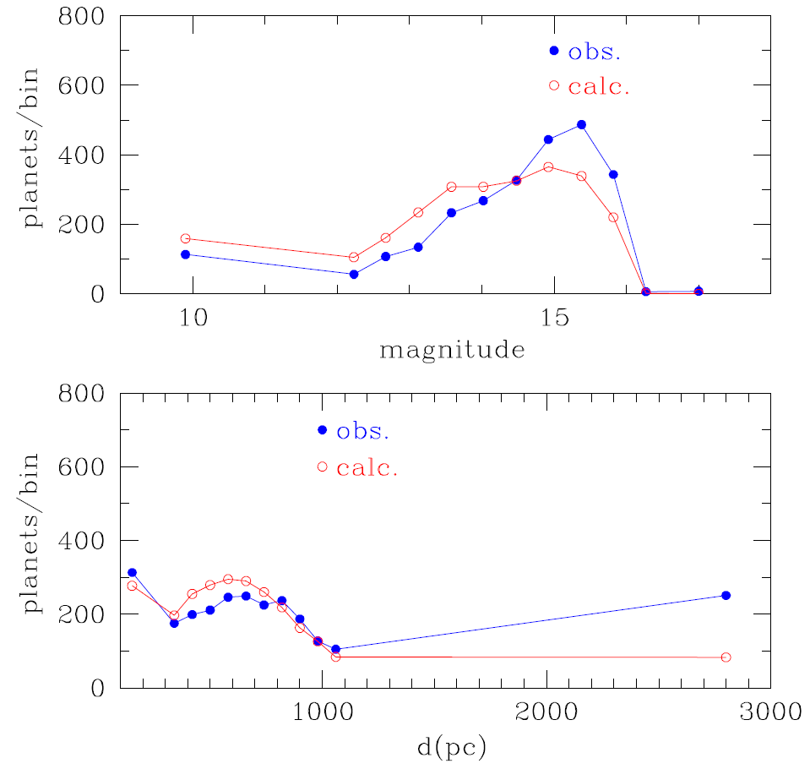
O vs C: f ~ r^{-2.0} P^{+1.1} per bin, vs magnitude & distance
comp67_2 6/28/2013

Slide 15
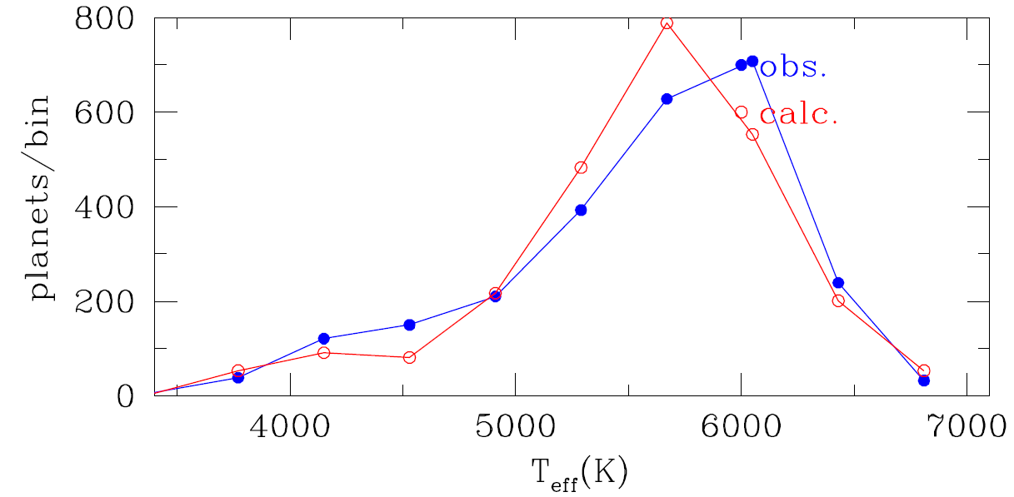
O vs C: f ~ r^{-2.0} P^{+1.1} per bin, vs T_{eff}
comp67_3 6/28/2013

