Slide 1
AFTA-C Introduction and Update
Tom Greene and Wes Traub
ExoPAG-8 Meeting, Denver CO
5 October 2013
© 2013 California Institute of Technology. Government sponsorship acknowledged.

Slide 2
The AFTA Mission
The 2010 Decadal Survey recommended WFIRST, a wide-field infrared survey telescope, for dark energy and exoplanets (gravitational microlensing)
The WFIRST SDT delivered its report in summer 2012
The NRO offered a 2.4-m telescope to NASA in early 2012
NASA requested the SDT to study the 2.4-m for WFIRST, with an optional coronagraph
The SDT delivered its report on WFIRST-AFTA in May 2013.
C. Bolden approved continuing to study AFTA in May 2013, with a coronagraph included (but descopeable)
The SDT continues to study the mission, with a goal of a new start in FY17 and a launch in 2024
AFTA is still a study, not an approved mission; there are options for smaller missions should AFTA not be selected
Meanwhile, GSFC leads the study, JPL leads the telescope and coronagraph elements, and ExEP has started a selection process for the coronagraph

Slide 3
Coronagraph Science Goals
Exoplanet abundances, clouds, temperatures as functions of orbit, stellar mass, metallicity, and planet mass
Example 1: NH₃ clouds will evaporate and H₂O clouds will dominate around 4 AU, and inside that distance H₂O band will start to show up, giving the abundance of C and O
Example 2: Inside 1 AU we lose H₂O clouds and start to see Na and K absorption, giving abundances of C, O, Na, K, and maybe N, all a “home run” in terms of exoplanet science

Slide 4
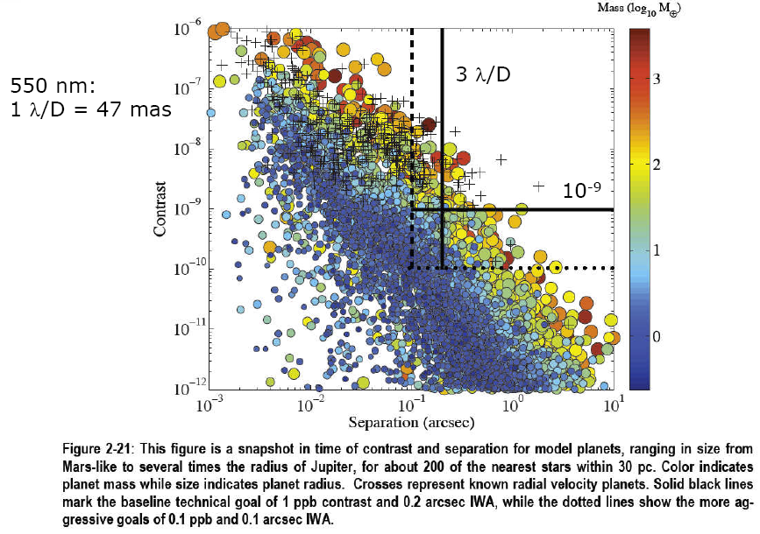
NB: Modeling from Dmitry Savransky

Slide 5
AFTA Giant Planet Survey
About 150 stars can be searched for mature giant planets in reflected visible light over 1 year
Includes time for spectroscopic characterization
Limited sensitivity overlap with ground nIR AO imaging surveys
Worthwhile to see if AFTA can detect some young planets (perhaps HR 8799 ones at red wavelengths)
Similar planet population sampled by RV (and somewhat by microlensing)
Observing RV planets is important and unique: masses constrain atmospheric possibilities
Significant object samples allow statistical comparisons of properties
Some overlap with JWST for 10^8-9 yr gas giant planets
AFTA has much smaller inner working angle

Slide 6
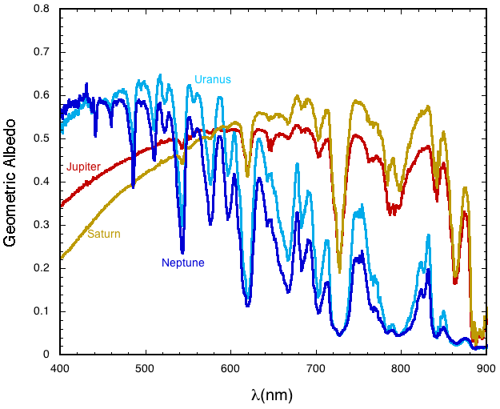
Giant Planet Spectra
• Geometric albedo spectra (Karkoschka 1994) for the solar system giant planets.
• All four planets are darker at all wavelengths than perfect Rayleigh or Lambert scattering spheres.
• Jupiter contrast relative to Sun is 1E-9. This gets better in the mid-IR where thermal emission is up and the star is falling off (JWST imaging sweet spot)
Courtesy of M. Marley & PECO study

Slide 7
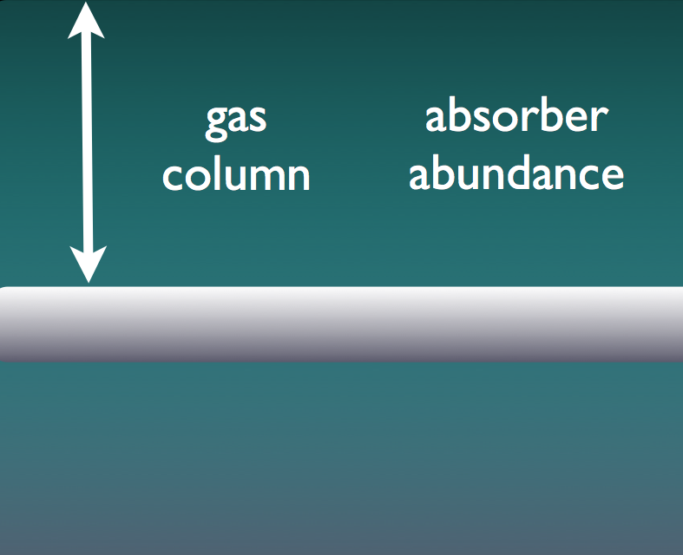
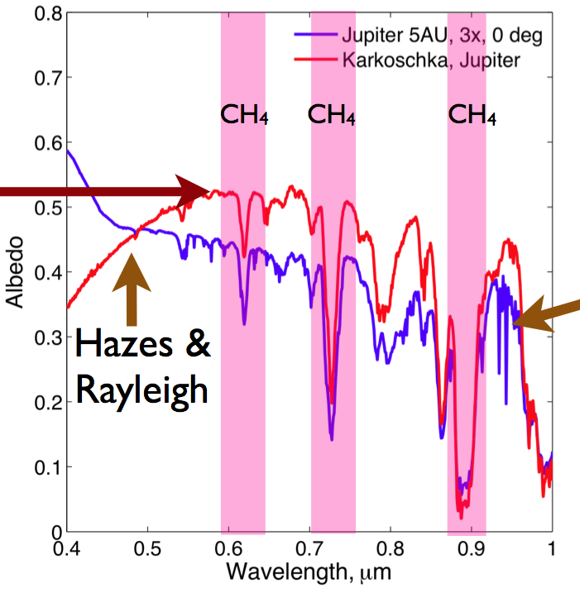
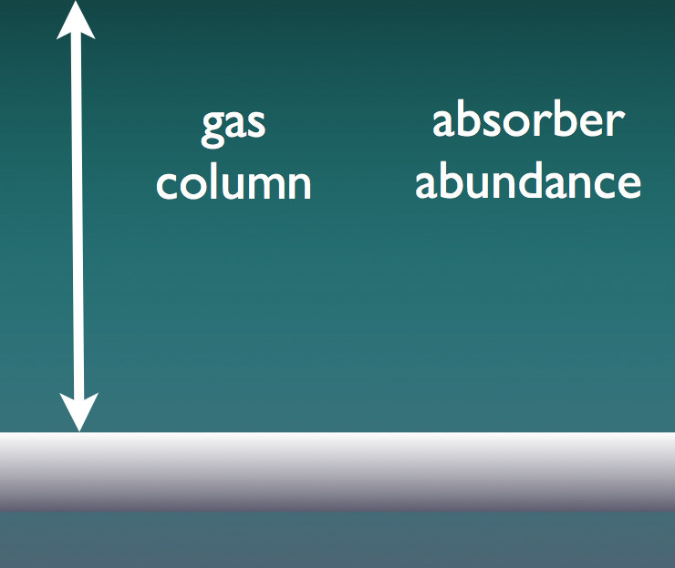
Giant spectra: molecules, clouds, hazes
model
obsv
High Clouds
continuum
H2O
observed but not in model
Low Clouds
Adapted from M. Marley

Slide 8
Giant planet spectra: more than CH4
Atmospheric composition, abundances, and temperatures can be retrieved from spectra
R ~ 50 visible spectroscopy over 0.4 – 1 μm
RV masses add further constraints
Constrain formation scenarios:
Abundances give cluse to accretion
Sample planets within and beyond snow line
Study Brightness changes with orbital phase
Phase gives scattering properties
Statistical studies possible:
Variation of clouds and composition with planetary mass (known RV planets)
Variation of albedo / clouds and molecular features with effective temperature

Slide 9
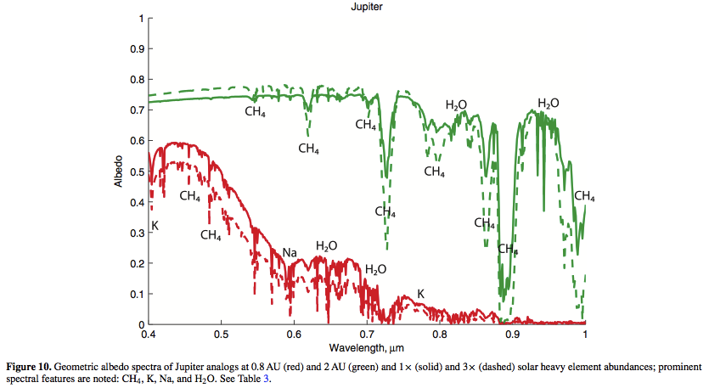
Giant planet albedo with stellar distance
• Strong CH4 absorption in cool giants > 2 AU from Sun: DETECTABLE!
• Clouds disappear and albedo drops as Jupiter moves toward the Sun and heats up.
• Absorption from Alkalis Na and K dominate in visible (Cahoy, Marley & Fortney 2010)

Slide 10
Giant Planet Detection Feasibility
• 3 λ/D IWA is ~ 130 mas V band vs. 700 mas JWST 5 λ/D @ 4.5 μm
• ~33% EE in FWHM PSF (30% obstr+spiders), 50% eff, 1E-9 @IWA
Planet PSF is diluted against star and Exozodiacal light
Solar system twin at 10 pc (1 zodi) has Earth ~ 0.07 (exozodi + star) and Earth is within coronagraph IWA (2.2 vs 3 λ/D)
Look for HZ planets within 10 pc for GV and earlier (some stars)
Solar system twin at 10 pc (1 zodi) has 5 AU Jupiter ~ 1 (exozodi + star) in PSF, depends on contrast profile
• SNR ~ 10 on Jupiter continuum in solar system twin at 10 pc
~25 hr integration time with R~70 IFU (0.18 throughput)
Can detect 30% deep CH4 at SNR > 3
• Expect to be able to detect up to ~10 known RV planets
Masses are a big plus for interpreting spectra
Trick is to catch them at max elongation

Slide 11
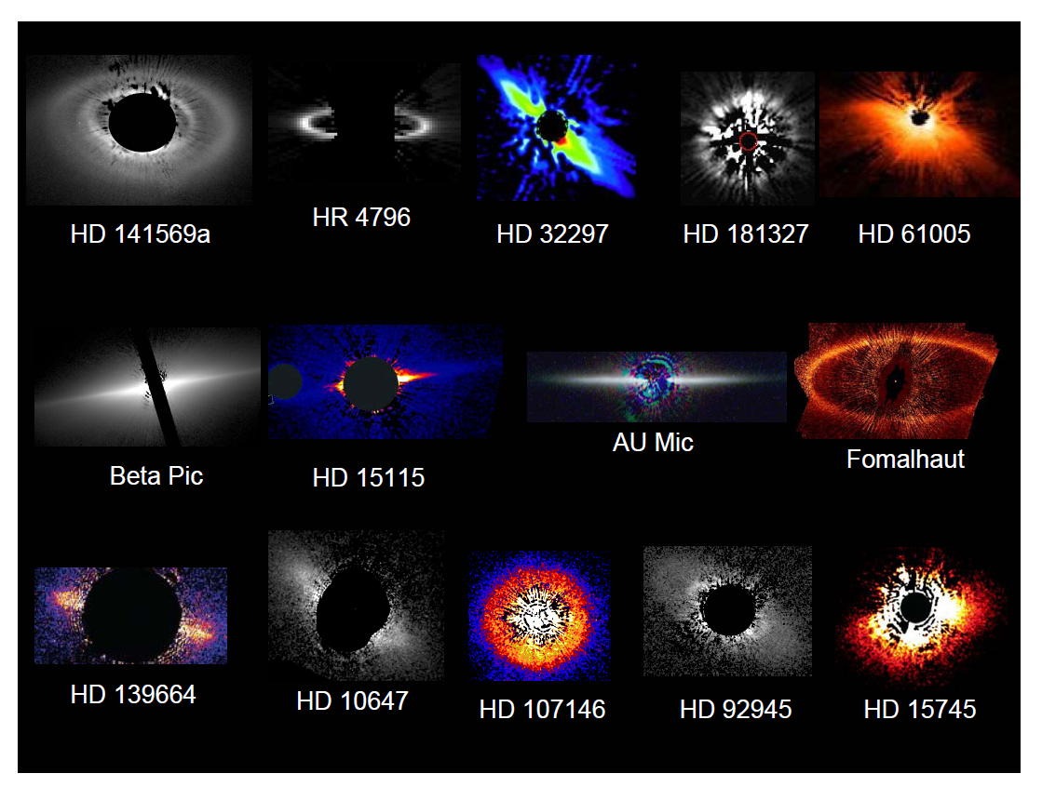
HST has imaged ~2 dozen disks, > 1000 zodi

Slide 12
Unique AFTA-C Disk Science in 2020s: Reflected light imaging of nearby planetary systems
Extremely sensitive, high spatial resolution imaging of zodi and Kuiper disks of nearby, mature stars
Can sample habitable zones of some (10-20) nearby stars
Find signs of un/seen planets and collisions (gaps, belts, shepherding)
Dust data useful for future terrestrial planet imaging
Sensitivity close to LBT-I with better spatial resolution:
AFTA visible + LBT-I MIR yield grain albedos
Image inner regions of ~20 extreme debris disks found with HST
Image transition disks of young stars found in mm or IR (secondary):
How much material is in the inner “clear” regions?
What are particle sizes, and how do disks clear?
Scattered light imaging of well-studied T Tauri disks (secondary)
Study grain albedos and dust distributions during planet formation era

Slide 13
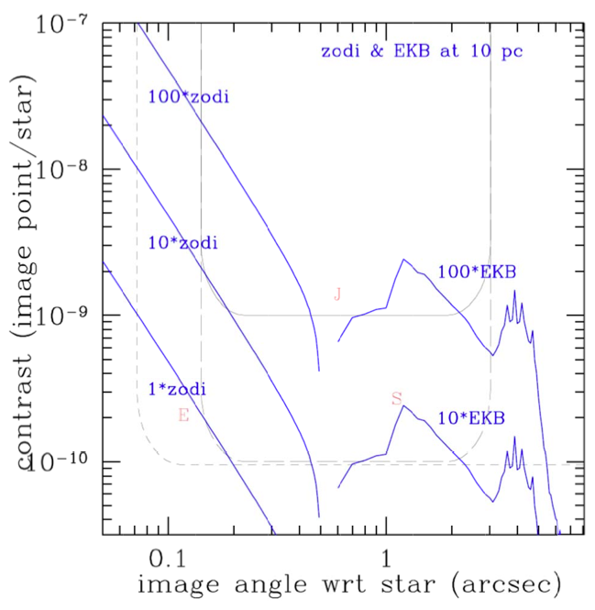
AFTA can detect zodiacal and Kuiper Belts
IWA
OWA
AFTA Niche:
• Small IWA good for zodi
• Current OWA is set by 48 x 48 DMs and is not great
Adapted from Traub (2013), “zodi disk contrast”
& “Edgeworth-Kuiper belt contrast” memos

Slide 14
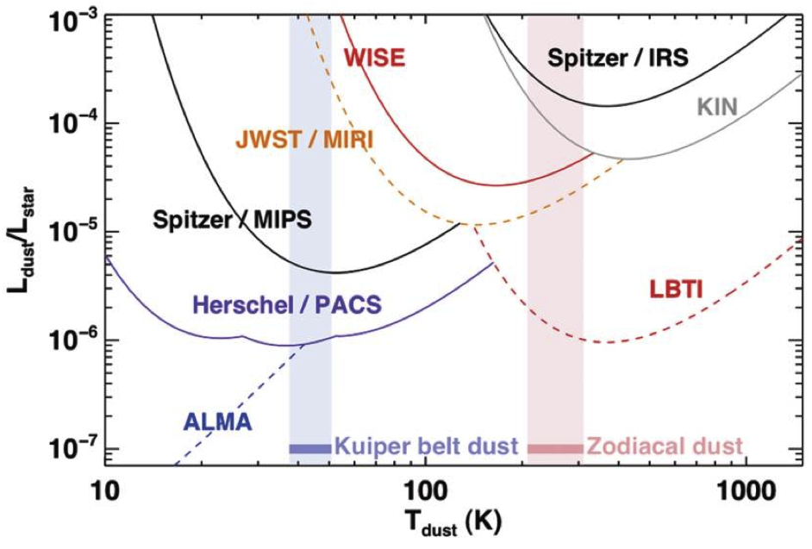
Excellent Exozodi sensitivity
10 Zodi
1 Zodi
AFTA Coronagraph
5 zodi ~ 1E-9 star outer HZ at 10pc
Adapted from Roberge et al. (2012)

Slide 15
Exozodiacal Dust Imaging Feasibility
• Most sensitive visible dust imaging yet and high resolution
• Searching for planets around nearby stars should reveal disks in the same images
• Exozodi sensitivity per res. element is not a strong function of distance due to IWA and r^{-2.x} disk flux dropoff:
5 zodi Exozodi ~ 1E-9 star at 10 pc at 1.6 AU (3.5 λ/D)
• ~10 hr exposure time for SNR ~10, R=10 res el. (5 zodi, 10pc)
- Res. element is 50 mas V band or 0.5 AU at 10 pc
- Trace disks to large radii if you bin azimuthally
• 2x higher spatial resolution than LBT-I: locate the dust!
- LBT-I resolution is ~10 μm / 20-m = 100 mas

Slide 16
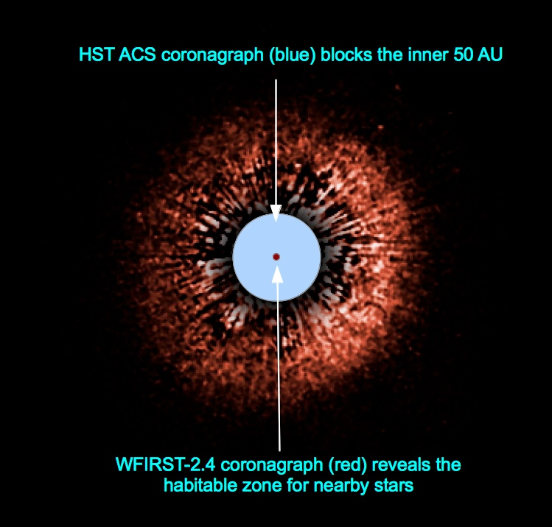
AFTA Debris Disk Imaging
AFTA will:
Measure the amount and distribution of circumstellar dust.
Measure the large scale structure of disks, revealing the presence of asteroid belts and gaps due to unseen planets.
Measure the size and distribution of dust grains.
Provide measurements of the zodiacal cloud in other systems.
Debris disk around the young (~100 Myr), nearby (28 pc) sun-like (G2 V0) star HD 107146 (Ardila et al. 2004)
http://hubblesite.org/newscenter/archive/releases/2004/33/image/c/

Slide 18
Exoplanet Science Requirements
The coronagraph will operate from 430 to 980 nm in >10% bandpasses. The imager will provide at least five 10% filters at roughly 450, 550,650, 800, 950 nm and to image separately or simultaneously in two polarization channels. The spectrograph will provide R~70 from 600 to 950 nm in at least 10% coverage per setting
With these parameters, it will require 5 spectrograph exposures for full coverage
It is a strong goal to cover at least 15% bandpass in a single coronagraphic setup to allow a broad absorption line and surrounding continuum to be measured in a single exposure, and reduce number of needed exposures to 4
It is recognized that the residual speckle halo may be polarized, the requirement is only to potentially measure polarization of bright debris disks that are significantly above the residual halo
AFTA will be capable of spectroscopically characterizing at SNR=10 per resolution element from 600-850 nm at least 6 previously-known Doppler planets in 3 months of mission time (assuming orbits are known and observations are targeted to the most favorable observing conditions) distributed over the full 6 year mission, assuming grey planetary albedo of 0.1 and attenuation of speckle noise by 1/10
Note that there’s no explicit requirement on spectra of previously-unknown planets, though models indicate that a subset of the discoveries will be characterisable
18

Slide 19
Exoplanet science requirements continued
AFTA shall achieve a total search depth for objects from r1=4 RE to r2=13 RE and 1.5<a<5 of 130 over a survey of 200 stars observing at 550 nm with one visit per star and a total survey time of up to 2 months
We probably need to specify an albedo (critical) and eccentricity (not as critical), recommend 0.2
For a reasonable Kepler-like radius distribution extrapolated out to 5 AU, this lets the mission find >10 giant planets for most smooth depth of search functions
These values need to be verified by a Monte Carlo crosscheck
Savransky and Macintosh will evaluate these quantities for several toy coronagraphs.
AFTA shall achieve a total search depth for objects of r<4RE of 5 over a survey of 200 stars observing at 550 nm with four visits per star and a total survey time of up to 2 months
For the Kepler distribution this would discover ~4 sub-neptune planets
Total search depth for objects of r<2RE is a important ‘extra’ science capability for selection, with a desirable value being >4
19

Slide 20
Disk Science Requirements
Threshold requirement: AFTA will be capable of detecting a disk of 100x our solar system’s zodiacal level at SNR=5 per resolution element at 2 AU separation around a star 8 pc away at 450 and 800 nm
In Traub calculation (see next page) this is a contrast of 6.4e-9 per resolution element; assuming x10 suppression of the speckle halo that requires 1.3e-8 raw contrast
This corresponds to a IWA of 0.25 arcseconds.
Baseline requirement: AFTA will be capable of detecting a disk of 10x our solar system’s zodiacal level at SNR=5 per resolution element at 1 AU at 450 nm at 8 pc
In Traub calculation (see next page) this is a contrast of 3e-9 per resolution element; assuming x10 suppression of the speckle halo that requires 6e-9 raw contrast
This corresponds to a very challenging IWA of 0.13 arcseconds
This does not have to be achieved over a full 360 degree field of view, could be achieved in multiple coronagraph or spacecraft orientations
September 23, 2013
AFTA Disk Science Requirements
20

Slide 21
AFTA can detect zodiacal and Kuiper Belts
IWA
OWA
AFTA Niche:
• Small IWA good for zodi
• Current OWA is set by 48 x 48 DMs and is not great
Adapted from Traub (2013), “zodi disk contrast”
& “Edgeworth-Kuiper belt contrast” memos

Slide 22
Science FOMs for each coronagraph
Calculate “detection” of model planets, spectra, & disks, based on photon-limited noise, plus attenuated speckle noise, and a TBD-sigma criterion (10 charts, not shown here ).
Calculate cumulative number vs time in mission, and also a total-depth criterion, to give 10 FOM values:
known RV planets: (1) detections, (2) colors, (3) spectra
new planets : (4) detections, (5) colors, (6) spectra
zodi disks: (7) images, (8) colors
Kuiper belts: (9) images, (10) colors
Balance these modes to maximize a TBD aspect of science for the mission, using a common rule for all coronagraphs if possible

Slide 23
Backup

Slide 24
Exolanet Science L1 Requirements
AFTA imaging channel will operate from 450 to 950 nm (goal 400 to 1000 nm) and support five filters of 10% bandwidth at roughly 450, 550,650, 800, 950 nm
The AFTA spectroscopic channel will operate from 600 – 950 nm microns at R~70 with the coronagraph operating over 10% bandpass at any single setup.
It is a strong goal to cover at least 15% bandpass in a single coronagraphic setup to allow a broad absorption line and surrounding continuum to be measured in a single exposure
AFTA will be capable of spectroscopically characterizing at SNR=10 per resolution element from 600-850 nm at least 6 previously-known Doppler planets in a total of 3 months of mission time (assuming orbits are known and observations are targeted to the most favorable observing conditions) distributed over the full 5 year mission, assuming grey planetary albedo of 0.1
Note that there’s no explicit requirement on spectra of previously-unknown planets, though models indicate that a subset of the discoveries will be characterisable

Slide 25
Exolanet Science L1 Requirements
AFTA shall achieve a total imaging completeness for objects from r1=0.3 rj to r2=1.1 rj and 0.1<a<5 of 200 over a survey of 200 stars observing at 550 nm with total survey time of 3 months distributed over the 5 year mission
We probably need to specify an albedo (critical) and eccentricity (not as critical), recommend 0.2
For a fiducial jupiter-radius planet at 3 au, 10 pc, G0 star, AFTA shall be capable of measuring the planet to star contrast ratio at all five bands with a precision of 5x10⁻¹⁰
AFTA will achieve a total imaging completeness for objects of r<4re over all semi-major axes of 10 observing at 550 nm with a total survey time of 3 months distributed over the 5 year mission. It is a strong goal to achieve a completeness of 4 for r<2 re at 800 nm
This also needs an albedo, recommend 0.2

Slide 26
Exolanet Science L1 Requirements
AFTA will be capable of astrometrically measuring the position of discovered planet relative to the parent star with a accuracy in each axis of 5 mas for a SNR=20 detection
There will be subsequent requirements on frequency and span of these measurements but since we’re focused on the coronagraph right now they’re not being defined.
Threshold: AFTA will be capable of obtaining <1000 nm photometry on self-luminous planets of 5 MJ at an age of 100 Myr around a G type star at 10 pc at 5 AU separation (or tie to real objects or GPI models?)

