Slide 1
Starshade and Coronagraph Technology Gaps and Paths to Close Them
Peter Lawson and Nick Siegler
Jet Propulsion Laboratory, Caltech
NASA Exoplanet Exploration Program Analysis Group Meeting (ExoPAG) 8
Denver, Colorado
6 October 2013
CL#13-4458

Slide 2
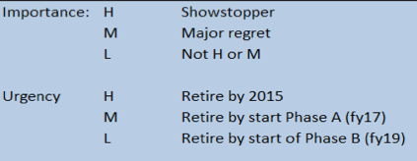
Starshade Technology Gaps
High Relative Gap and Urgency
  System engineering, I&T Verification and Validation (SG-1)
  Control of scattered light from petal edges (SG-5)
Medium Relative Gap and High Urgency
  Starshade deployment demonstration (SG-3)
Medium Relative Gap and Medium Urgency
  Validation of starshade models (SG-4)
  Thermal and dynamic stability under flight conditions (SG-9)
Technologies with Lower Relative Gap
  Formation sensing for a dedicated telescope (SG-7)
  Thruster technology for slew and science observations (SG-10)
  Guidance, Navigation and Control for retargeting (SG-6)
  Petal manufacturing (SG-2)

Slide 3
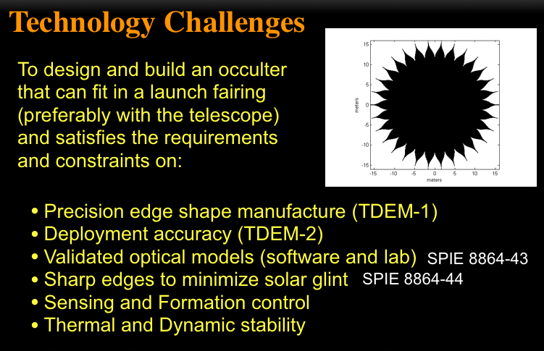
Starshade Technology
Kasdin et al. “Verifying occulter deployment tolerances…” SPIE (2013)

Slide 4
AFTA Coronagraph Technology Gaps
High Relative Gap and Urgency
  Architecture design (CG-1a)
  Key component fabrication (CG-1b)
  Contrast demonstrations (CG-6)
  Low-order wavefront demonstrations (CG-2)
Medium Relative Gap and Urgency
  Flight readiness of DM and Fast Steering Mirror (CG-7)
  Two-DM performance demonstration (CG-3)
  End-to-end dynamic modeling (CG-5)
Less Urgent Gaps
  Post-processing of data (CG-4)
  IFS pixel cross talk (CG-8)
  Flight readiness of IFS detector (CG-9)
  Demonstrations in a flight-like environment (CG-10)

Slide 5
Closing Technology Gaps for Flight Coronagraphs

Slide 6
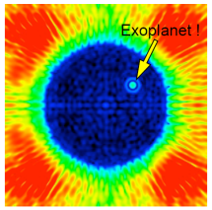
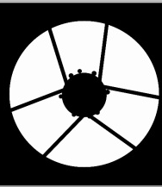
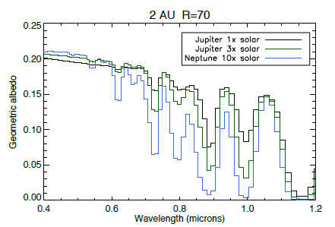
Classical Lyot Coronagraph Design
high–order wavefront control loop
(WF aberrations due to imperfections in optics)
Imaging FPA
Post-processing
Simulated light from star and planet
DM #1 with FSM
DM #2
Coronagraph
(masks/apodizers)
Flip Mirror
AFTA pupil
LOWFS
FPA
IFS
IFS FPA
low-order wavefront control loop
(WF aberrations due to thermal changes)
jitter correction loop
(pointing stability)
Optics
Control
Detector

Slide 7
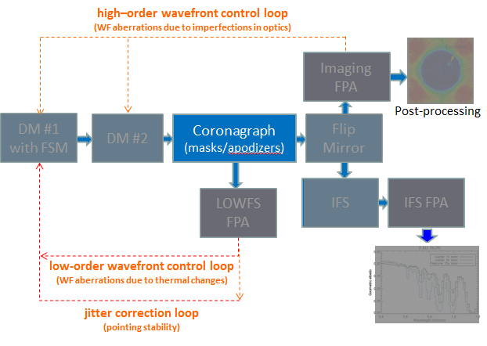
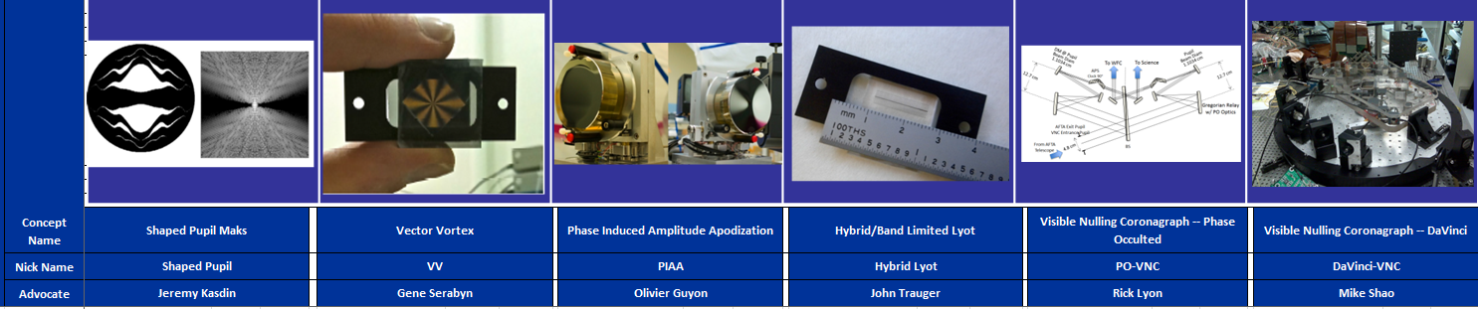
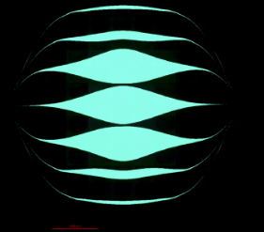
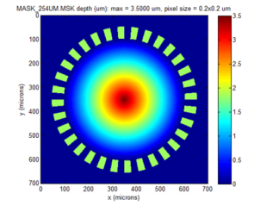

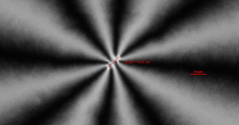
Coronagraph Architectures and Fabrication
Possible Path to Closing Gap
Selection process underway from six AFTA candidate coronagraph architectures to two.
  Primary and backup
Fabricate sets of each mask/apodizers
Demonstrate performance in the two HCITs
  Mask/apodizer iterations likely
Radiation testing (if necessary)
  Some of the masks may have dielectrics or liquid crystal polymers
Downselection to one
Notes:
Identify challenges and then timeline

Slide 8
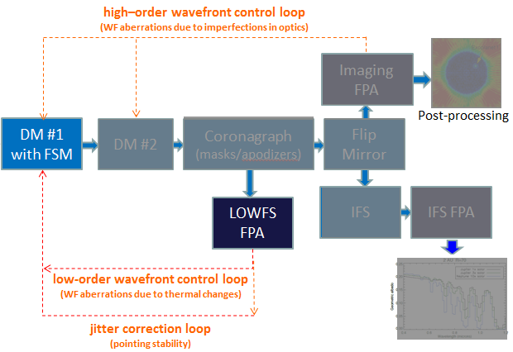
Low-Order Wavefront Sensing and Control (LOWFS/C)
Possible Path to Closing Gap
Upon AFTA coronagraph selection and receiving telescope jitter and WF drift inputs, baseline LOWFS/C rqmts for each coronagraph.
Select from multiple LOWFS/C techniques one or two.
  Each of the down selected coronagraphs may have different sensitivities to low-order WF aberrations.
Develop LOWFS/C algorithms using modeling
Build and demonstrate LOWFS/C closed-loop performance in an independent vacuum testbed.
Deliver and integrate to HCITs
Knife Edge
Use image morphology from a slightly defocused PSF to sense WF
Detector near image plane
Can sense tilt
Zernike WFS
Point diffraction interf.
Sense WF by interfering the WF with a reference WF created by a spatial filter
Detector at pupil plane
Can sense tilt
Phase Retrieval
Use FT and slightly defocused image to sense the WF
Detector near image plane
Can sense tilt
Shack-Hartmann
Use SH subaperture image centroid to measure local WF tilt
Detector at pupil plane
Can sense tilt
Fast WF Jitter
PSF centroid or quad cell / pyramid APD for line of sight at high rate
WF tilt only
Notes:
Identify challenges and then timeline

Slide 9
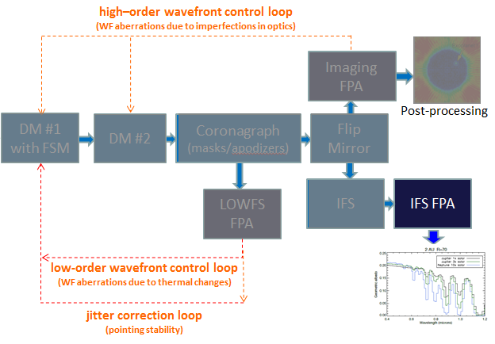
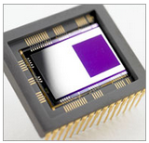
IFS Ultra-Low Noise Detector
Possible Path to Closing Gap
Understand science operational scenarios and camera modes; derive preliminary detector requirements.
  < 0.1 e/pix read noise
  ~0.0001 e/pix/s dark current
  QE > 80% in the visible
Survey existing detector and read-out electronics technologies
  recommend a device that meets requirements.
    Acquire and test performance of available low-noise detector or camera system under realistic operational scenarios
      Includes low-noise electronics
Select a baseline detector and read-out electronics design.
Perform radiation testing of the selected detector; before and after characterization.
Design, build, and test flight-like electronics boards.
e2V Electron Multiplying CCD
(a candidate device)
Notes:
Identify challenges and then timeline

Slide 10
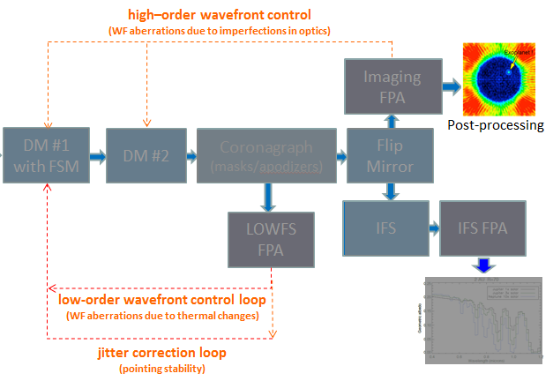
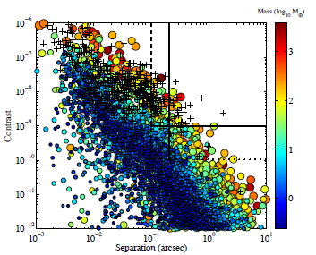
Post-Data Processing
Possible Path to Closing Gap
Assess the performance of current state-of-the-art post-processing algorithms using existing HCIT data and simulated multiwavelength IFS data
  evaluate the regime where contrast in no longer dominated by phase errors.
Understand telescope/instrument temporal behavior and assess possible operational scenarios and observation strategies
Develop simulations of realistic AFTA coronagraphic PSFs including thermal modeling, LOWFS, temporal variations.
Develop simulated PSF library from actual HCIT data with AFTA pupil.
Demonstrate algorithm by retrieving simulated planet through PSF subtraction.
Contrast Ratio vs Planet/Star Separation
AFTA-WFIRST Study Report (2013)
Notes:
Identify challenges and then timeline

Slide 11
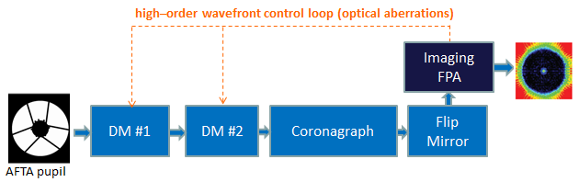
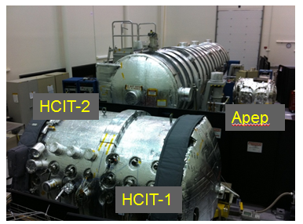
Static Wavefront Systems-Level Testbed Demonstration
Possible Path to Closing Gap
Demonstrate static wavefront performance in fully-assembled coronagraph vacuum testbed with simulated AFTA-WFIRST telescope pupil.
Simulated light from star
Key Demonstration Objectives
Coronagraph masks/apodizers for AFTA-WFIRST obscured pupil
Two-DM configuration
Wavefront control algorithms developed
Static wavefront performance:
  1e-8 contrast
  2% → 10% BW (in 500-600 nm window)
Notes:
Identify challenges and then timeline

Slide 12
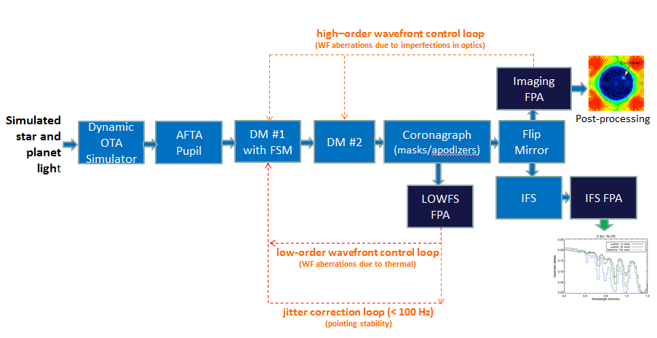


Dynamic Wavefront Systems-Level Testbed Demonstration
Possible Path to Closing Gap
Demonstrate dynamic wavefront performance in fully-assembled coronagraph vacuum testbed with simulated AFTA-WFIRST telescope pupil in a dynamic env’t.
Key Demonstration Objectives (TRL 5)
Dynamic OTA simulator
DM/FSM integrated assembly
LOWFS/C and algorithms developed
Dynamic wavefront performance:
  1e-8 raw contrast
  1e-9 detection contrast
  2% → 10% BW (in 500-600 nm window)
  IFS (R>70 TBD)
Planet simulation and extraction
Notes:
Identify challenges and then timeline

Slide 13
AFTA-WFIRST Coronagraph Tech Dev
Top Level Schedule
Preliminary

Slide 14
Acknowledgements
The work of PL and NS was carried out at the Jet Propulsion Laboratory, California Institute of Technology, under a contract with the National Aeronautics and Space Administration.
© 2013. California Institute of Technology. Government sponsorship acknowledged.

Slide 15
Backup:
Detail of Starshade Technology Gaps

Slide 16
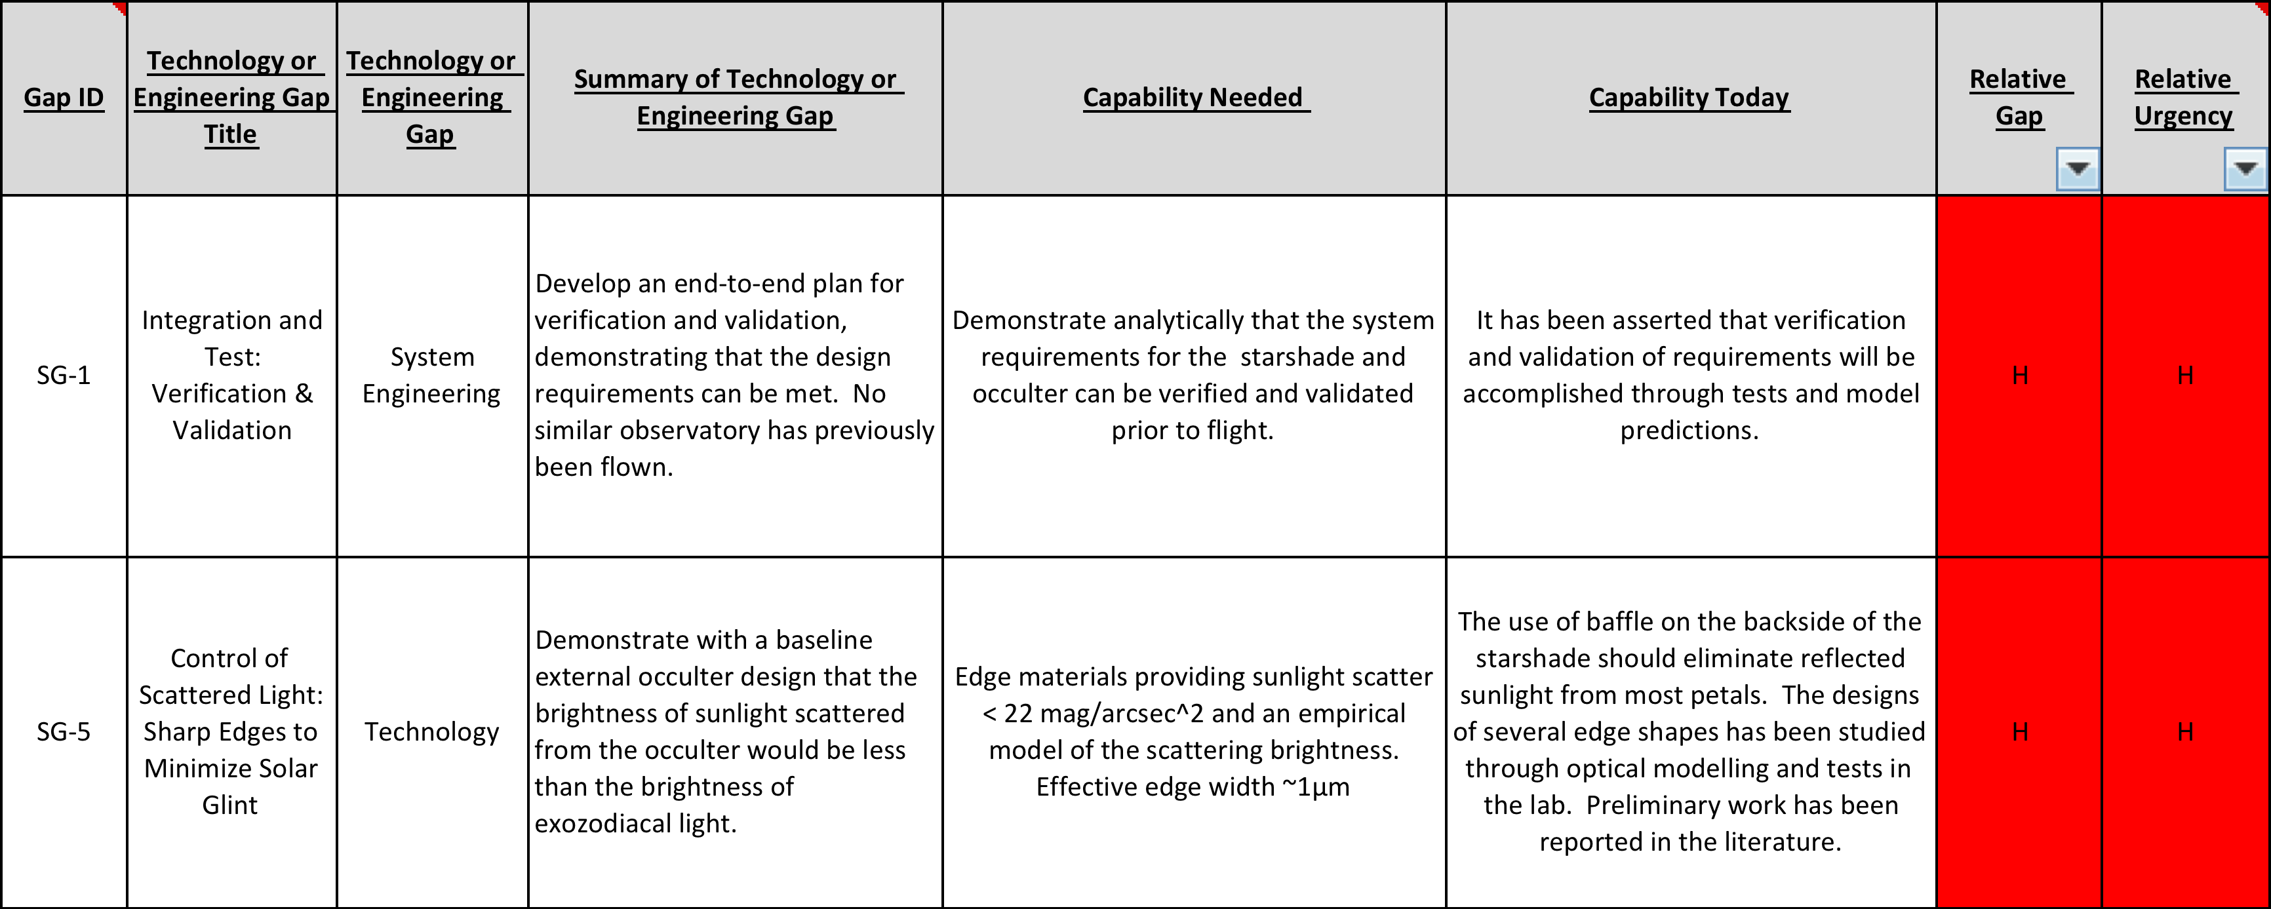
Starshade Technology Gaps (1/3)

Slide 17
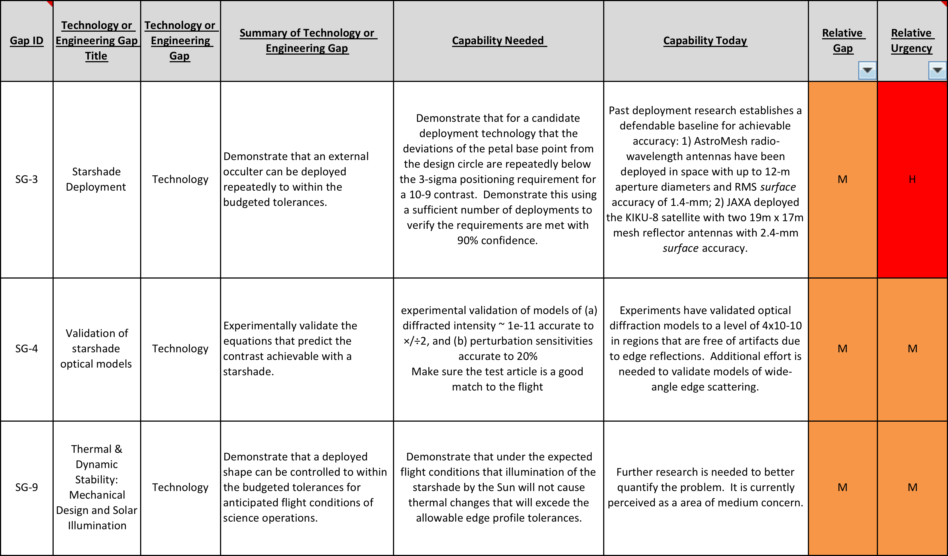
Starshade Technology Gaps (2/3)

Slide 18
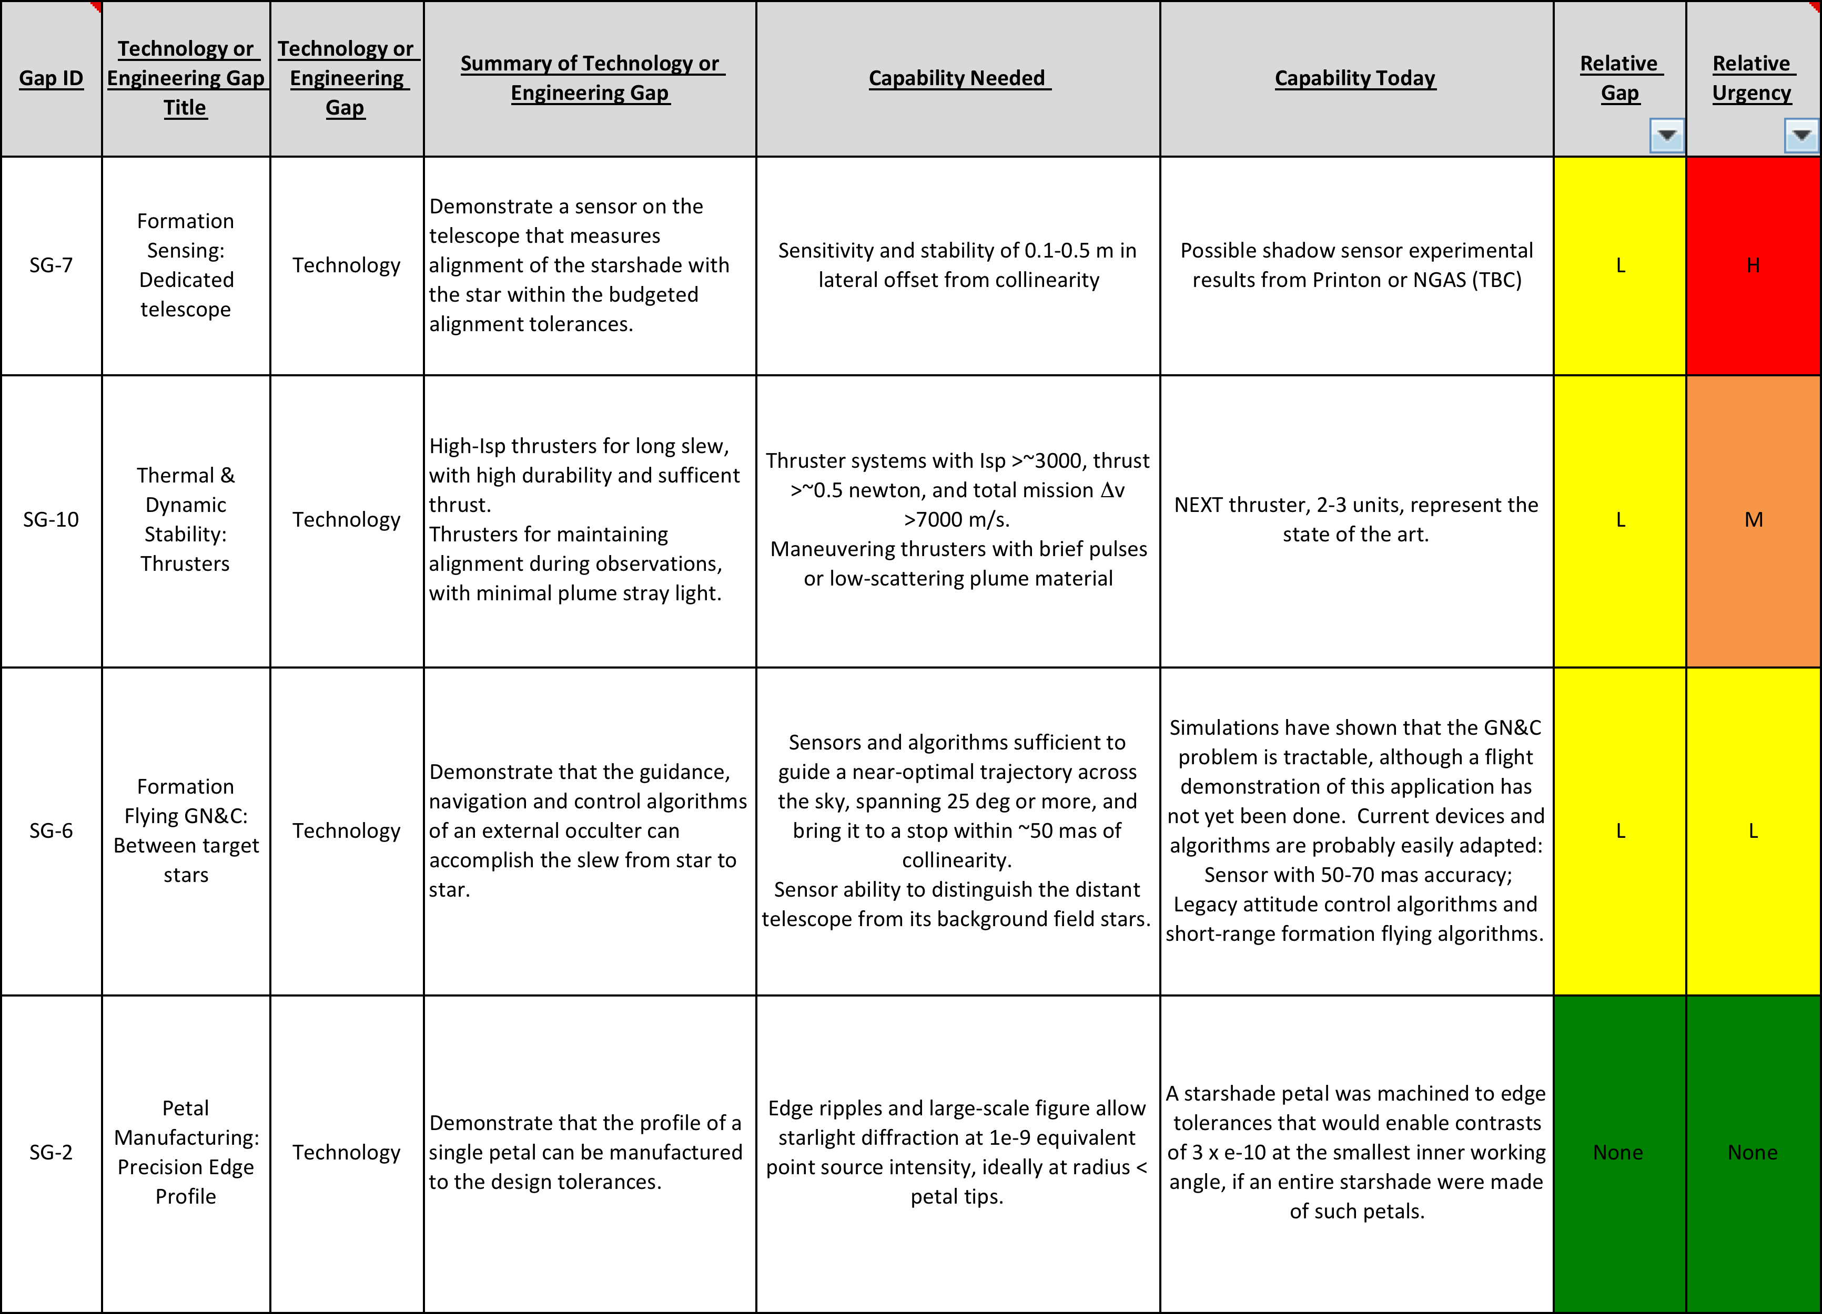
Starshade Technology Gaps (3/3)

Slide 19
Backup:
Detail of AFTA Coronagraph Technology Gaps

Slide 20
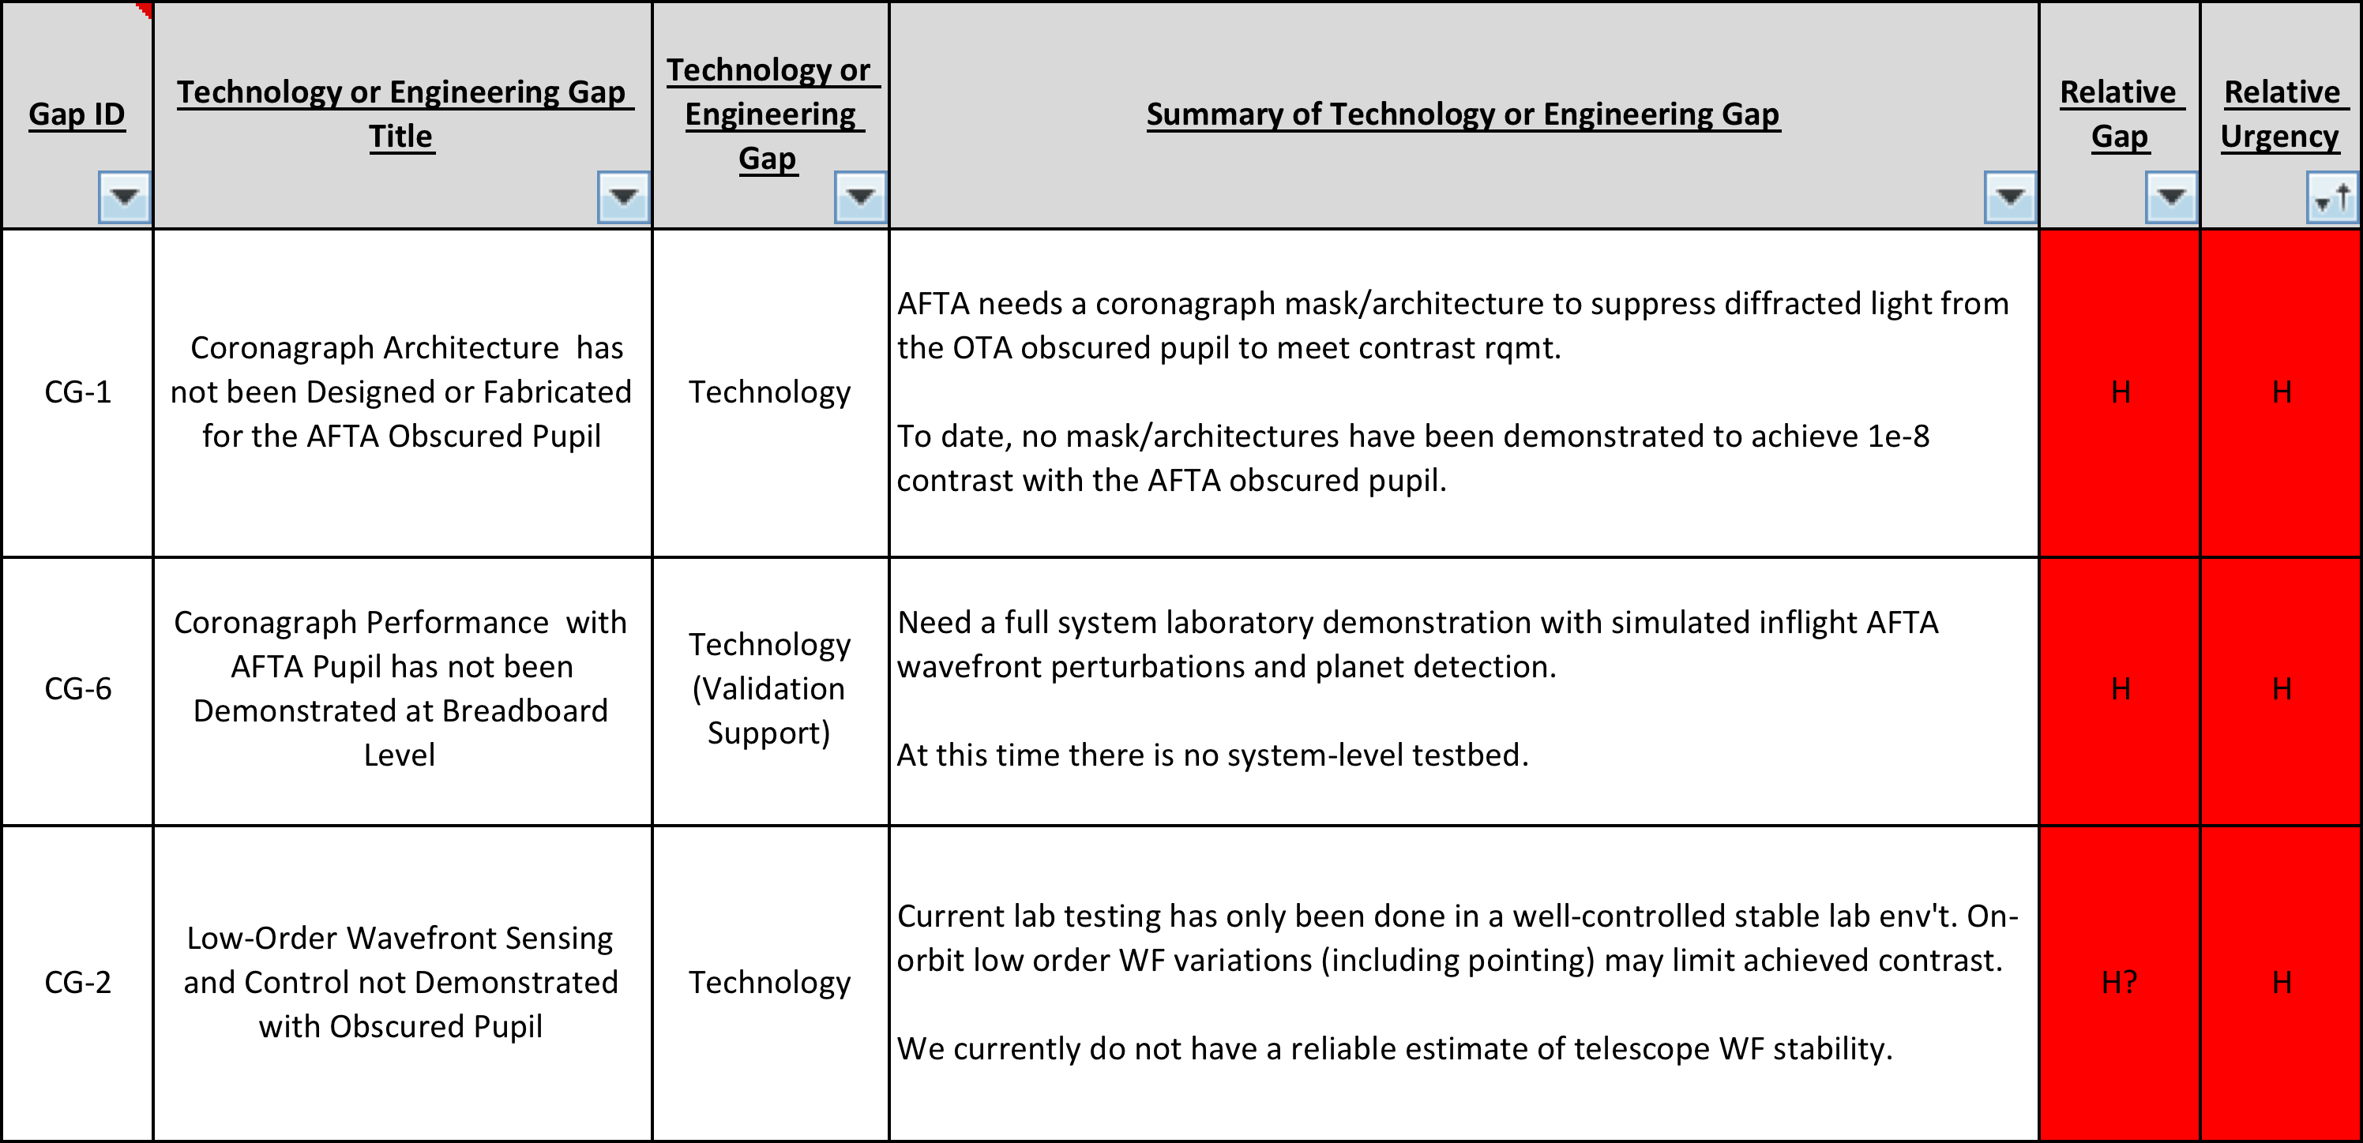
AFTA Coronagraph Technology Gaps (1/3)

Slide 21
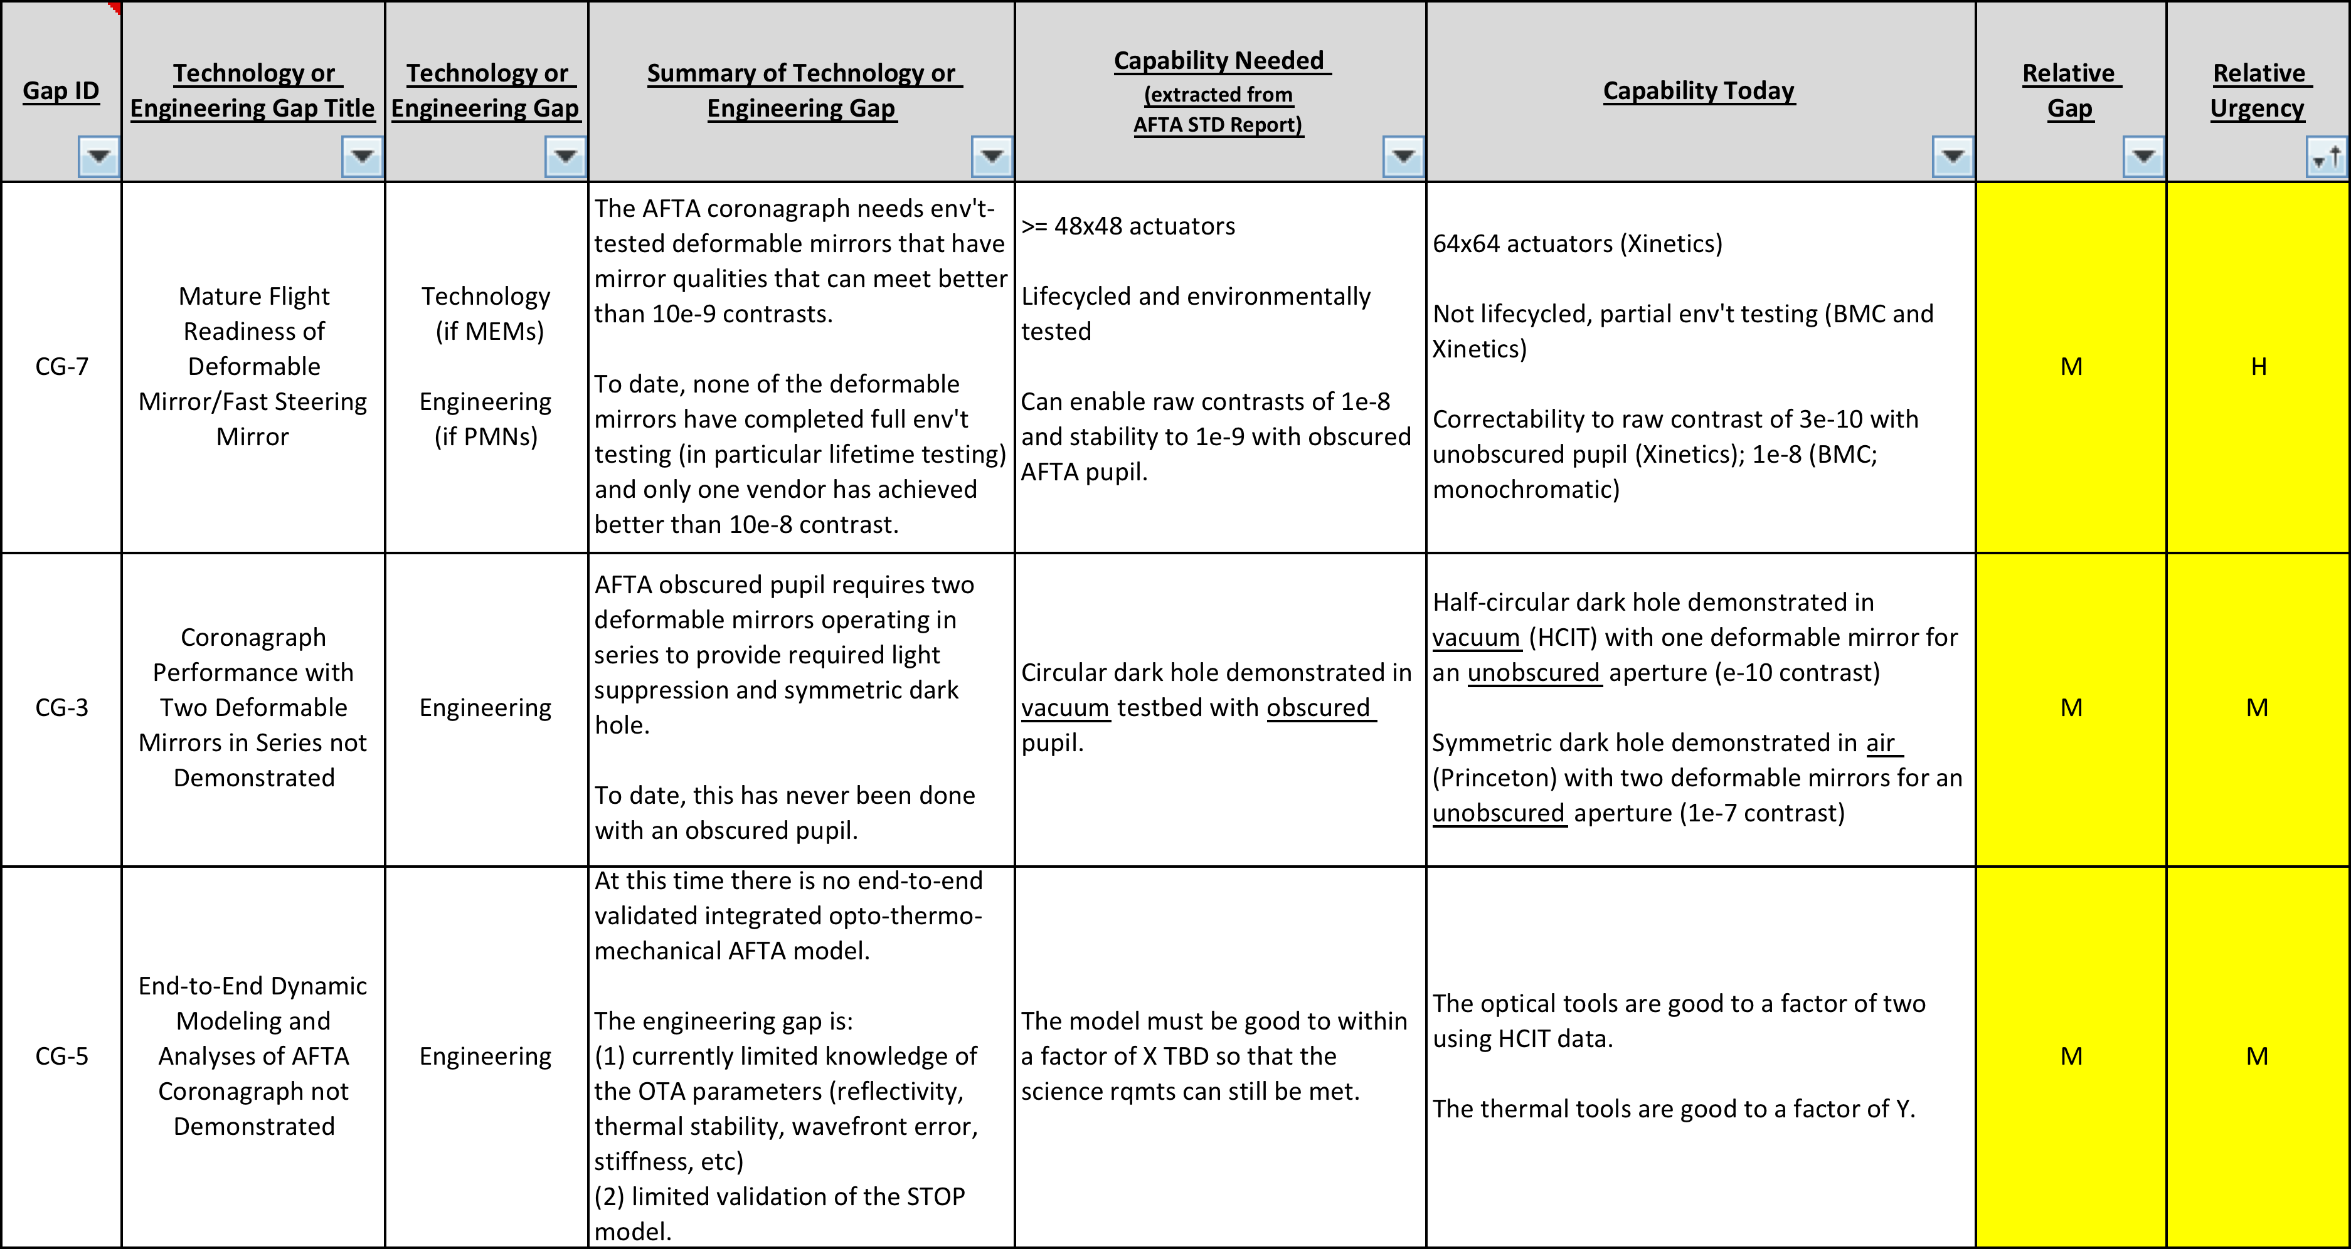

Slide 22
