Slide 1
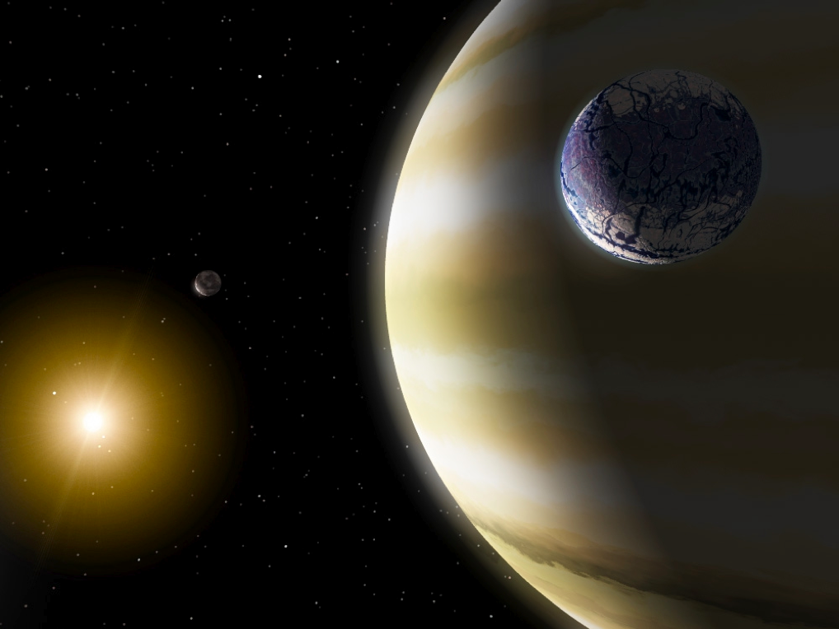
Prospects for measuring
η-Earth from RV
David W. Latham
Harvard-Smithsonian Center for Astrophysics
5 Octoberber 2013

Slide 2
Definitions of η-Earth
Frequency of true Earth twins
1 Earth mass in 1 year orbit around G2 dwarf
1998 Kepler step 1 proposal (predates η-Earth terminology)
Frequency of potentially habitable planets that can be imaged and characterized with a future large space mission
2013 Sep 27 - Scott Gaudi email
Occurrence of rocky planets in the Habitable Zone
2013 Oct 5 - this presentation
planet radius alone is not enough (yet)

Slide 3
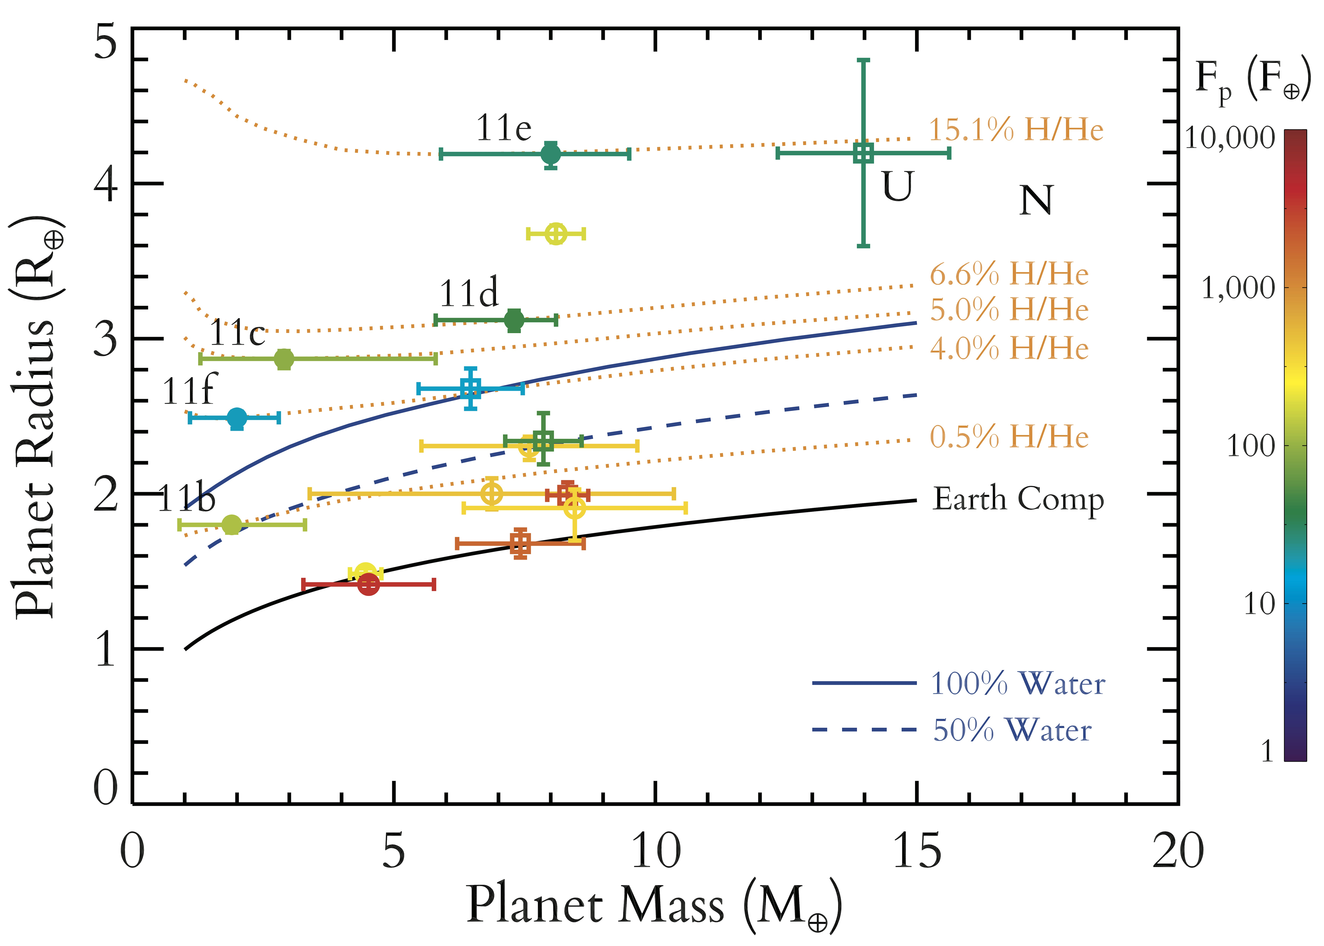
Eric Lopez website

Slide 4
Astrophysical Limitations
Α Cen Bb illustrates the present state of the art
Orbital motion with other objects in the system
Almost any other stable period; any amplitude
Shifts as a function of the magnetic activity cycle
Several years; one to several m/s
Shifts due to spots on a rotating star
Days to months; one to several m/s
Shifts due to granulation
Few hours; about one m/s
Shifts due to acoustic oscillations
Few minutes; about one m/s

Slide 5
α Centauri Bb
Orbital semi-amplitude ~ 50 cm/s
Minimum mass ~ 1.1 M_{Earth}
Residuals of binned velocities ~ 20 cm/s
500 HARPS observations over four seasons
Period = 3.2 days

Slide 6
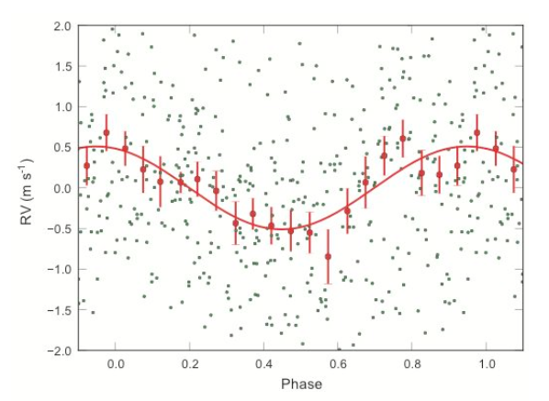
α Centauri Bb
P = 3.23 days, M₂ sin i = 1.13 M_{Earth}, Nobs = 459
RMS of binned points from orbital fit = 0.20 m/s

Slide 7
α Centauri Bb
Orbital semi-amplitude ~ 50 cm/s
Minimum mass ~ 1.1 M_{earth}
Residuals of binned velocities ~ 20 cm/s
500 HARPS observations over four seasons
Perio = 3.2 days
Not the highest peak in the power spectrum
Controversial, no confirmation yet
Advantages of transiting planets
Photometric ephemeris can confirm the RV period
Planet size and mass yield bulk density – is it rocky?

Slide 8
Spectrometer Performance
Present state of the art
HIRES iodine calibration good to about 1 m/s
HARPS about 80 cm/s over 10 years
Green laser comb on HARPS-N about 5 cm/s over days

Slide 9
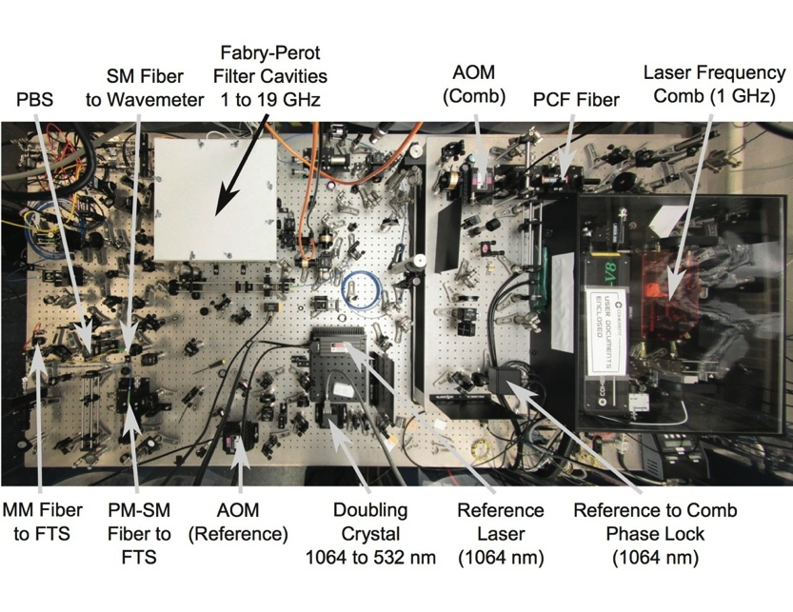

Slide 10
Spectrometer Performance
Present state of the art
HIRES iodine calibration good to about 1 m/s
HARPS about 80 cm/s over 10 years
Laser comb on HARPS-N about 5 cm/s over days
Future state of the art: few cm/s long term
ESPRESSO on the VLT – 2014 launch?
G-CLEF on the Giant Magellan Telescope

Slide 11
ESPRESSO on One Unit Telescope
1 hour
1 min

Slide 12
PRV Telescope Time Use
α Cen Bb
~ a month of HARPS
HARPS (only instrument on ESO 3.6m, Chile)
1000 GTO nights in first 10 years to Geneva-led team
~300 nights per year now for PRV
HARPS-N (on TNG 3.6m, La Palma)
80 GTO nights per year over 5 years
45 Kepler follow up, 35 Rocky Planet Search
Semester A28 (now, third since start)
GTO=40, GAPS=43, Comm=39; 122 of 183 nights
HIRES (on Keck 10m)
88 in 2012, 69 in 2013

Slide 13
Closing Thoughts
PRV Surveys best on 4-m class telescopes
Many nights available on dedicated facilities
Ultimate follow up on next generation giant telescopes
Next generation of super PRV instruments
TESS gives key targets for super PRV follow up
30 to 100 times brighter than KOIs
True Earth twins orbiting Sun-like stars still a dream
Will require years, hundreds of observations.
Systems of planets will require MANY more visits.
Will have to learn how to correct for stellar jitter

Slide 14
Resources Needed for …
Theoretical and observational studies for how to correct for activity
Development of more stable spectrometers with better calibration
Access to much more telescope time
Identification of nearest transiting systems
Characterization of host stars

