Slide 1
Exoplanet Exploration Program Analysis Group #8 Kepler Mission Status
Kepler Mission Manager: Ingolf Heinrichsen
Kepler Deputy Project Scientist: Nick Gautier
Oct 6, 2013

Slide 2
Kepler Flight System Status
Performed series of reaction wheel tests during the month of August to attempt reactivation of the damaged wheels. Final attempt to control flight system caused freeze-up of wheel and subsequently all attempts to resume the original Kepler mission were abandoned.
Flight system was placed into safe “point rest” state, with low fuel consumption and remains stable.
All data show good performance and low friction on two remaining wheels.
BATC and the project developed pointing scheme using two wheels and thrusters
In September started series of tests on the flight system to evaluate performance in 2-wheel mode:
Completed initial pointing and maneuver tests successfully, results are encouraging
Planning to perform Ka-downlink, ecliptic pointing test and photometric test in October

Slide 3
Status on Plans for Future Two-Wheel Mission
ExoPlanet Exploration Program
The project received direction from Director, Astrophysics Division, Paul Hertz dated 7/24/13 “Timeline and deliverables for the development of a “two-wheel” Kepler mission”. The memo requests three deliverables:
a) a study of the engineering modifications that would be required to conduct science operations with the observatory using only the two remaining healthy reaction wheels for spacecraft attitude control
b) a study of the science opportunities for a two-wheel Kepler mission
c) a closeout plan for the mission
An interim report on item a) and b) is due on 9/27 the final report on all three items on 11/1.
Presentation of results to SMD was planned for 10/1, delayed due to government shutdown
Released “Call for White Papers: Soliciting Community Input for Alternate Science Investigations for the Kepler Spacecraft” The purpose of this call for white papers is to solicit community input for alternate science investigations that may be performed using Kepler and are consistent with its probable two-wheel performance.

Slide 4
White Papers
42 white papers submitted, WPs are not proprietary – all public (available at NASA SMD)
Several placed in secondary category:
Not relevant
Spacecraft operation ideas
Solar System in nature
Focal plane / enhance photometry (technical assessment)
Four papers required outside expert review (Neptune and 3 Extra-Galactic)
Demography
Observed Fields:
Observe the nominal Kepler field of view
Observe in the Ecliptic
Observe elsewhere – either single target(s) or many (single) targets
Major Themes:
Exoplanets – Star Clusters – Seismology – Stellar Age (Young stars) – Low-Mass, cool stars - Extra-Gal

Slide 5
Decision Process
Two White Paper Assessment Teams
Science Assessment Team (Lead, Howell ex-officio)
Alex Brown, Steve Kawaler, Chas Beichman, Bill Cochran, Bill Chaplin, Martin Still, Nick Gautier, Michael Haas, Jason Rowe
Technical Assessment Team (Lead, Sobeck ex-officio)
Marcie Smith, Rob Nevitt, Jon Jenkins, Doug Caldwell, Dwight Sanderfer, John Troeltzsch, Dennis Ebbets, Neil Dennehy, Ken Lebsock
Assessment Team Criteria
Science Assessment Team
Hi-Impact Science
Community readiness / data products
SMD astrophysics
Technical Assessment Team
Likelihood of success
Operational Complexity
Cost
Review was intended to broadly discriminate among options, not to pick a “winner”, but find mission strategy that maximizes overall science, while meeting technical and programmatic constraints. - Coarse binning: Easy, Medium, Hard

Slide 6
Two-wheel Mission Design
Technical review has found no show stoppers for implementation of a two-wheel mission
Two-wheel pointing system modifications promise adequate performance for high quality science
Need to be careful with observation design to not drive planning and data reduction costs
The Kepler Project will recommend the results of the decision process to SMD
Final mission scheme is expected to contain a scientifically solid core mission and broad open time component to allow white paper submitters and the whole community to participate in science return
SMD will decide whether or not to direct the Kepler Project to propose a two-wheel mission to the Senior Review of Operating Missions next year.

Slide 7
Plans for Close-out of Original Kepler Mission and Heritage Archive
The original Kepler mission is not over, lots remains to be done!
The project is in the process to define the scope and budget for the close-out mission, either stand-alone or in parallel with potential 2-wheel extended mission, including:
Finish pipeline development, decide on final upgrades
Define final processing schedule and related efforts
Define set of heritage products for the Kepler mission to allow maximum scientific exploitation for both exo-planets and astrophysics research
Release and document best and final calibration data for the mission
Prepare and maintain the archive sites at MAST and NExScI

Slide 8
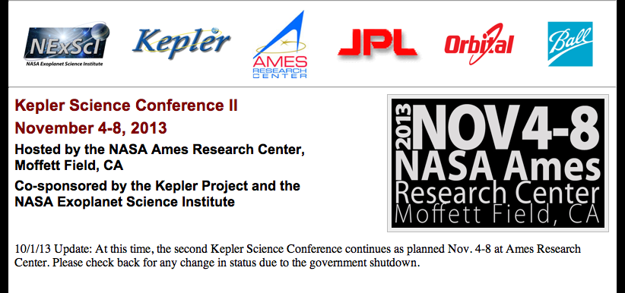
Kepler Science Conference II
Conference was threatened by NASA rules for conferences under sequestration. A waiver for the Kepler Science Conference was granted by NASA OCFO in August.
Reminder: Registration will close on Oct. 18th
Hope to see you all there!

