Slide 1
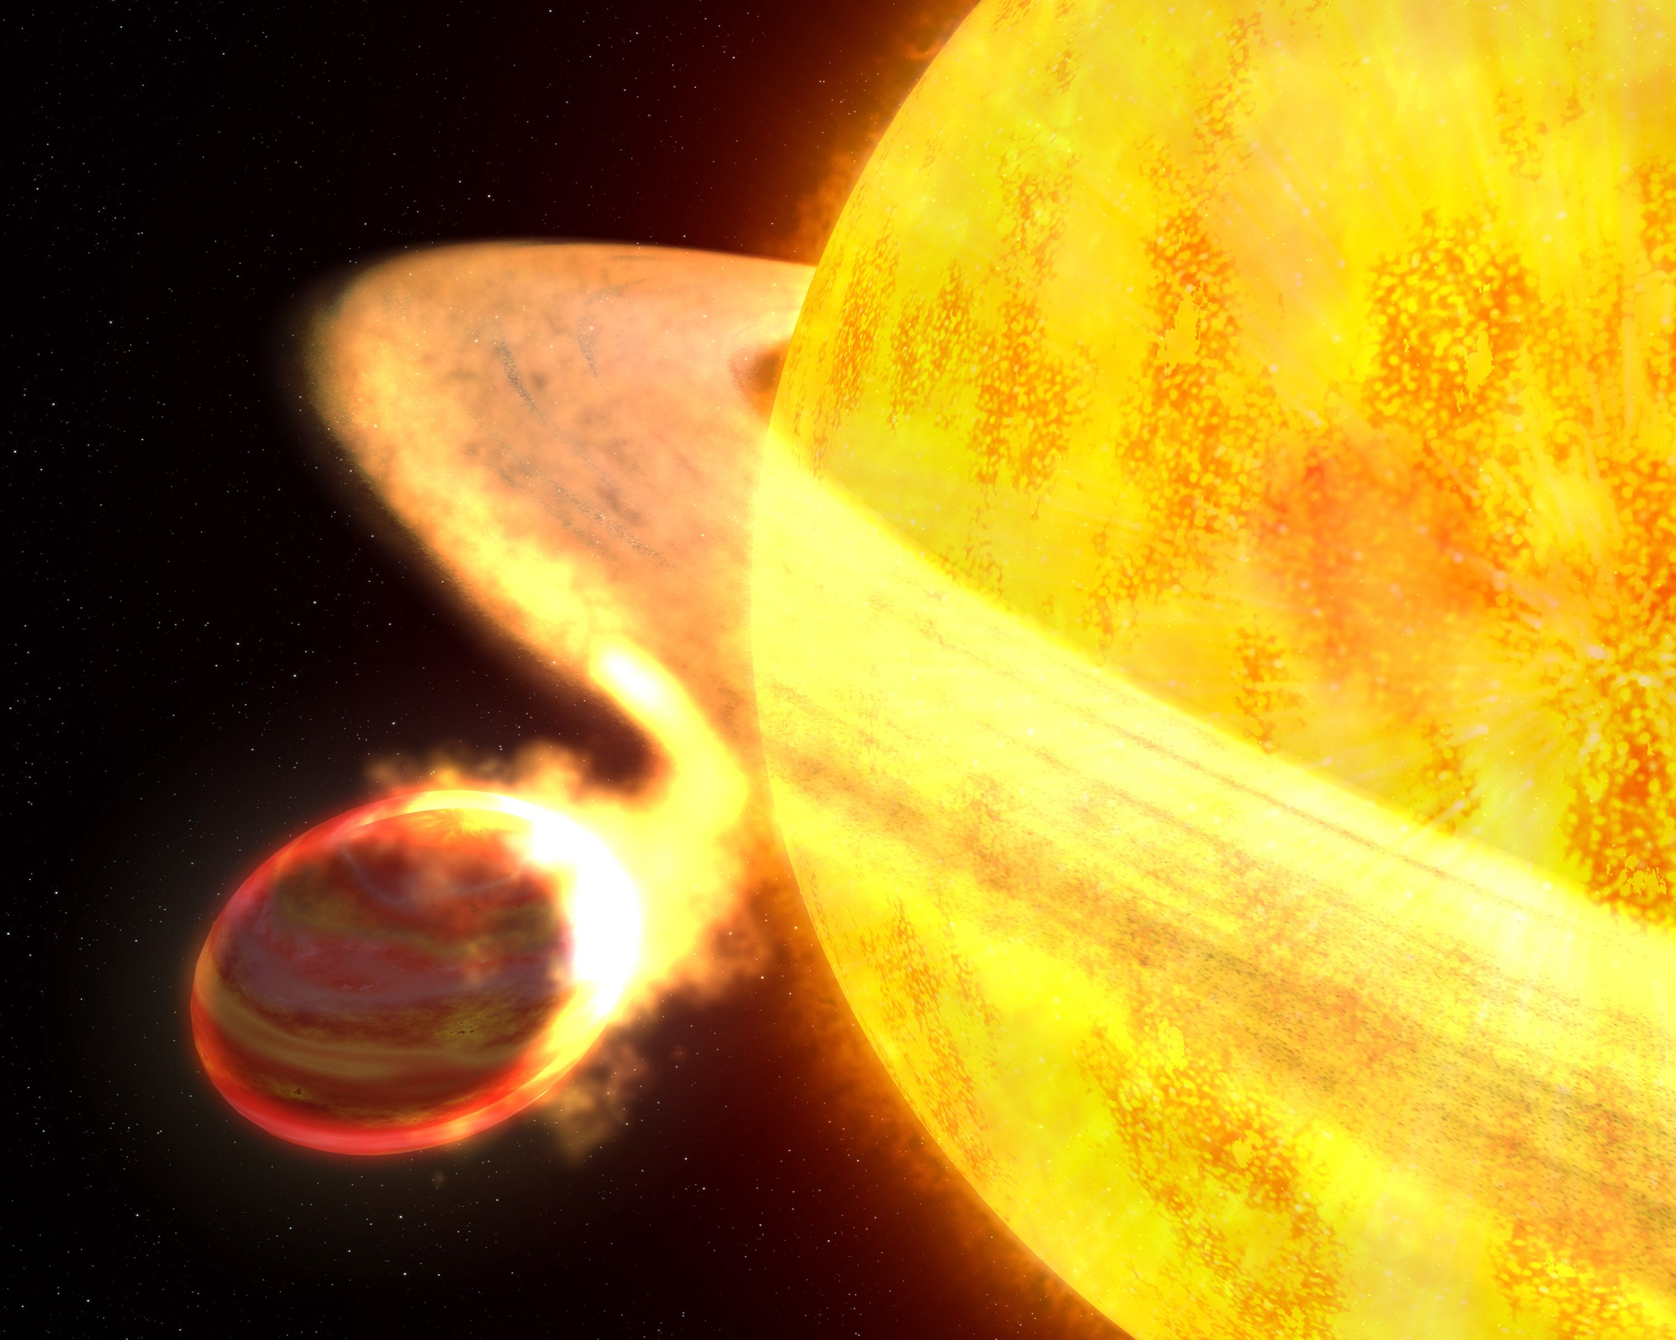
SAG X Giant Exoplanet Climate; What NASA Can Do About It
Nick Cowan
(Northwestern)

Slide 2
Game Plan
Where this SAG Fits In
Hot Jupiter Characterization
Outstanding Questions

Slide 3
Who Cares About Gas/Ice Giants?
“JWST is gonna spend all its [exoplanet] time hammering on habitable super-Earths orbiting nearby M-Dwarfs!” -NBC
It hasn’t been demonstrated that JWST can do compelling HZ science (SAG 4 should tell us)
We know we’ll be able to do giant planet science, and learn about their atmospheres

Slide 4
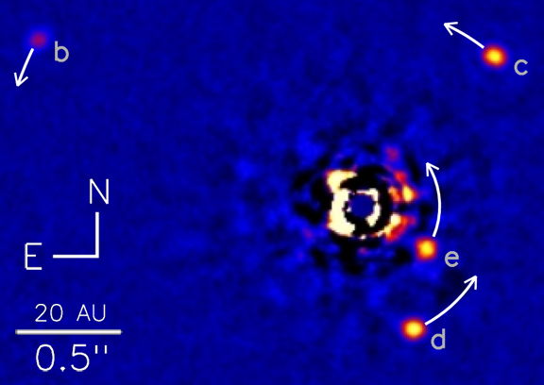
Direct Imaging (covered by SAG 9, WFIRST/AFTA, 2xSTDT)

Slide 6
Transit

Slide 7
“Light Curve” = brightness vs. time
Brightness
Transit Depth = fraction of starlight
blocked by planet
= (R_{p}/R*)²
100%
Transit
99%
Transit depth is different
at different wavelengths
Time

Slide 8
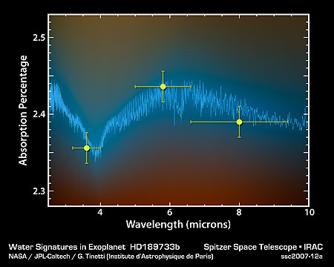
Transit Spectroscopy

Slide 9
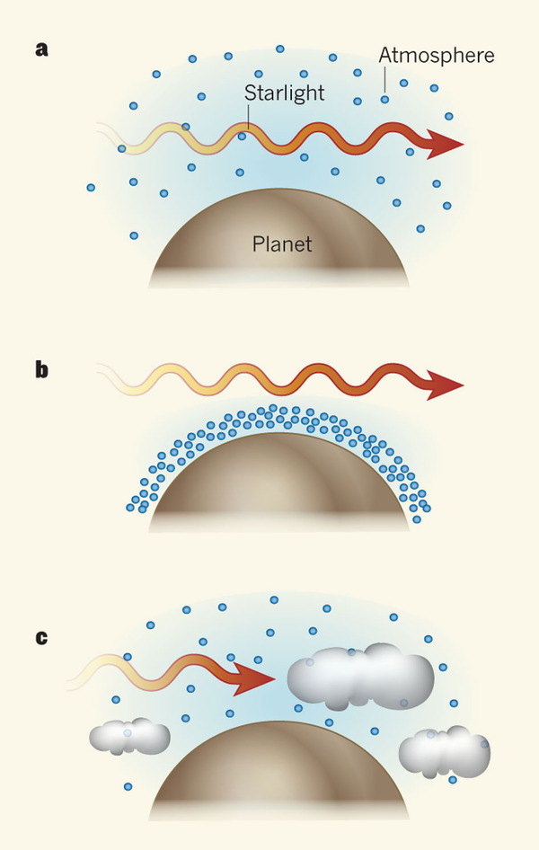
Hazes & Clouds: - Light gets blocked by clouds - No water features in spectrum
Puffy Atmosphere:
Light Interacts with Water Vapor
Water Absorption Lines
Compact Atmosphere:
Not much light passes through water vapor
No water features in spectrum

Slide 10
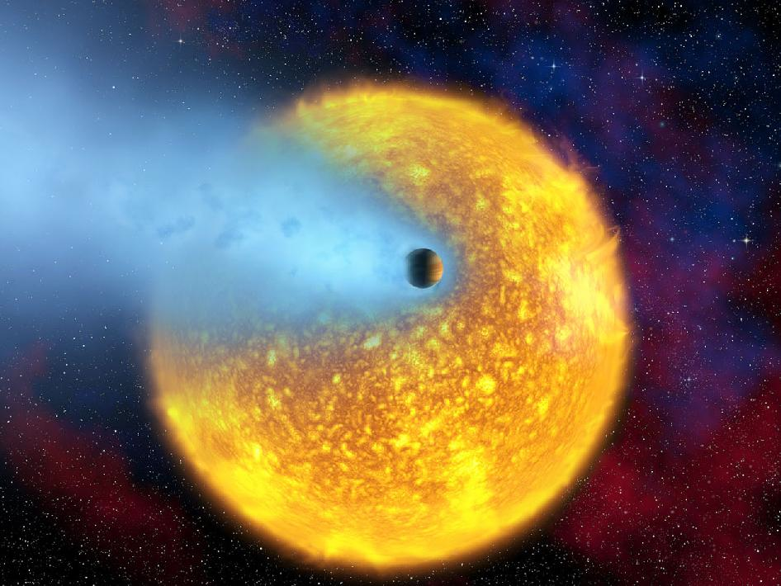
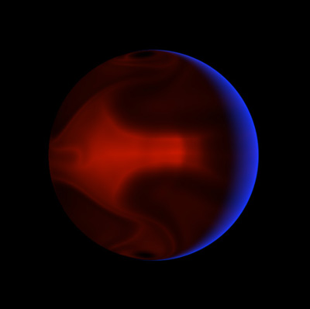
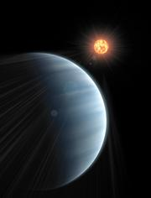
Wavelength Coverage
UV
(Exosphere)
IR
(Molecules
& Heat)
Optical
(Hazes)

Slide 11
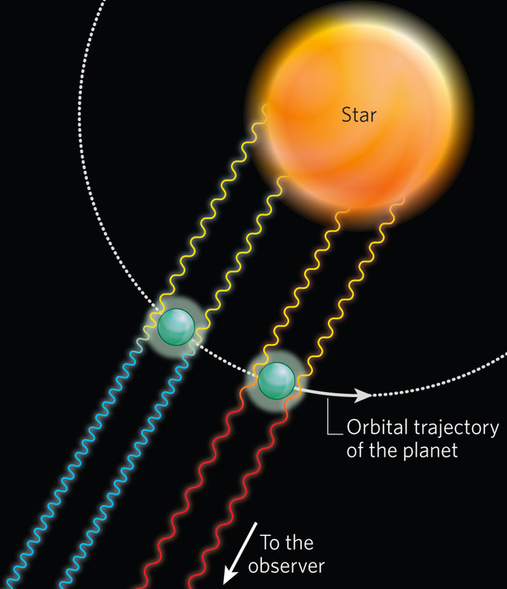
Doppler Shift:
Planet’s orbit
High Altitude Winds

Slide 12
Eclipse

Slide 13
Infrared Light Curve
Brightness
Star + Planet
Star
100.3%
100%
Eclipse
Eclipse Depth = Planet Brightness
Star Brightness
99%
Transit
Time

Slide 14
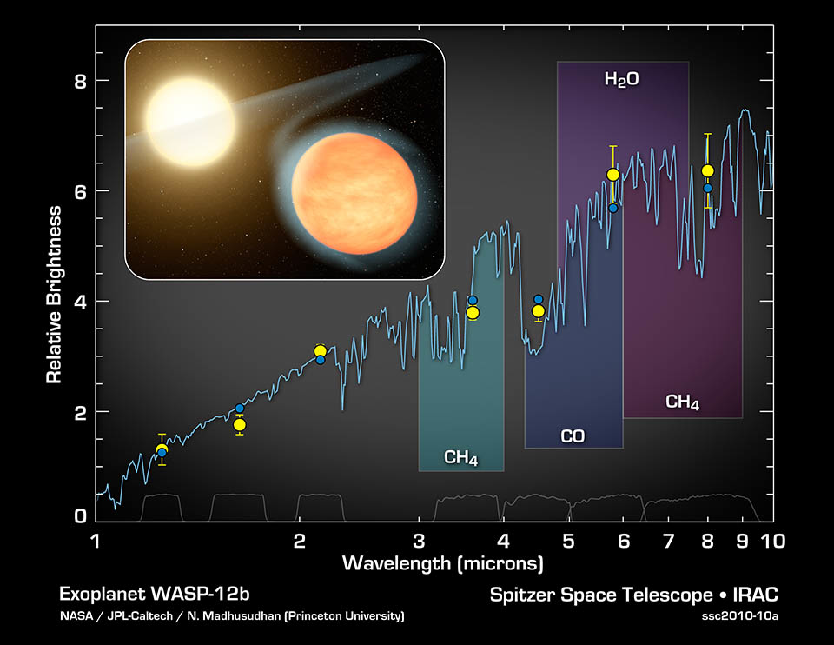
Thermal Spectrum

Slide 15
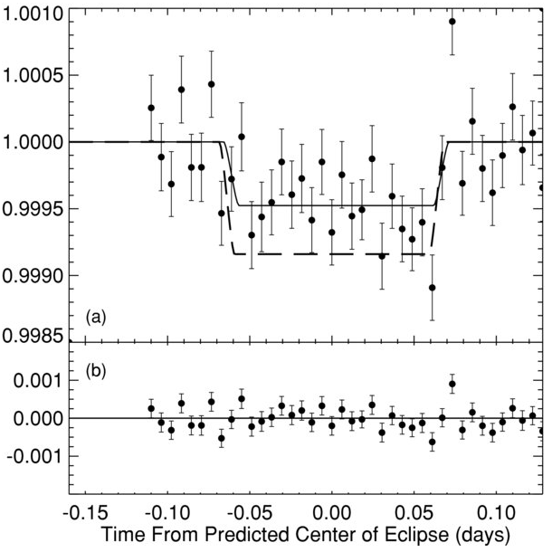
Repeatability is Key
Knutson+(2009)

Slide 16
Hot Jupiters ➔ Earth Analogs
More SED Separation (T⁻¹)
Less Flux (T¹⁻⁵)
Smaller Scale Height (T)
Hot Jupiters
Size
Less Flux (R²)
Smaller Annulus (R)
Earth Analogs
Separation

Slide 17
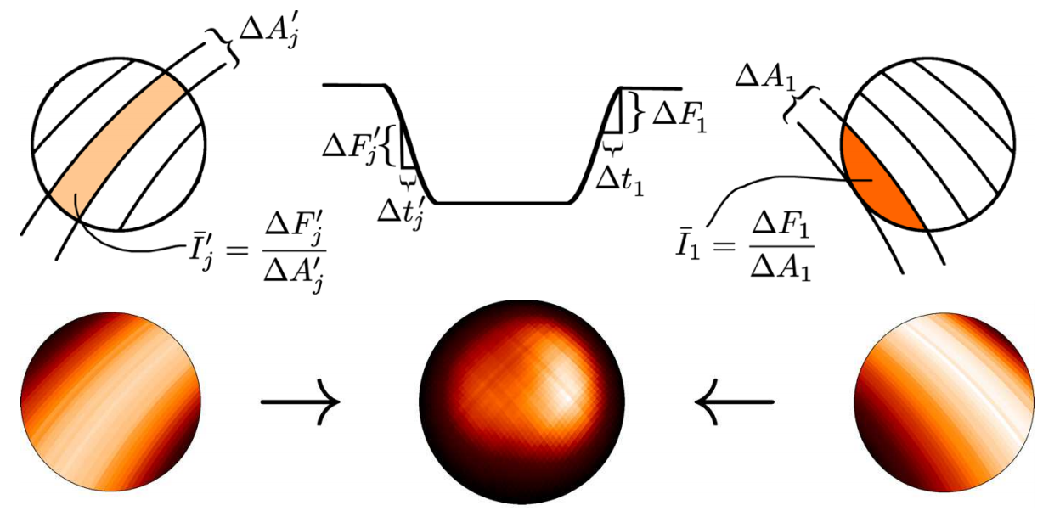
Eclipse Mapping
Majeau+(2012)

Slide 18
Thermal Phase Variations

Slide 19
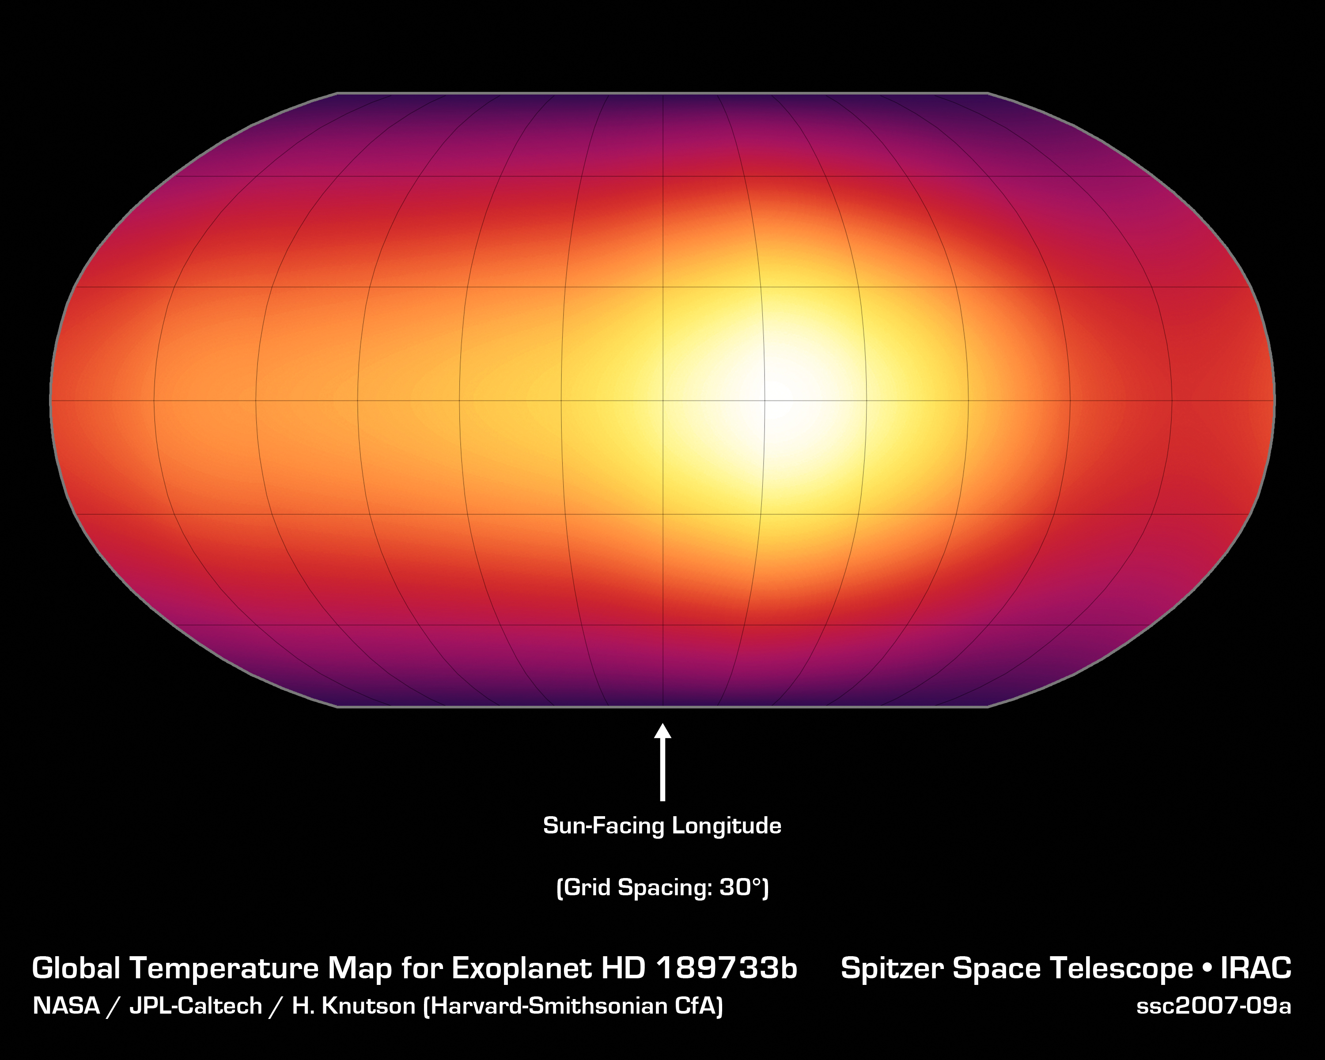

Slide 20
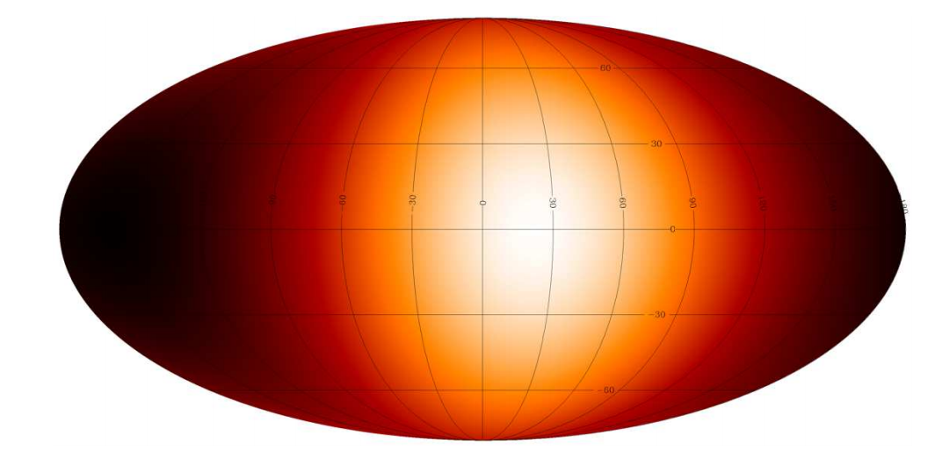
Phase + Eclipse Mapping
Majeau+(2012)

Slide 21
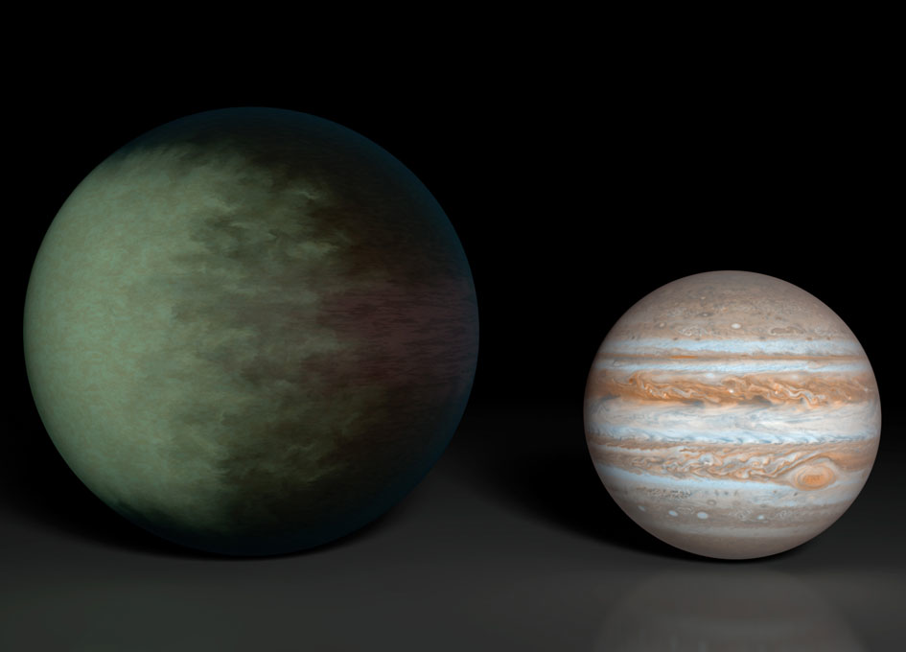
Demory+(2013)

Slide 22
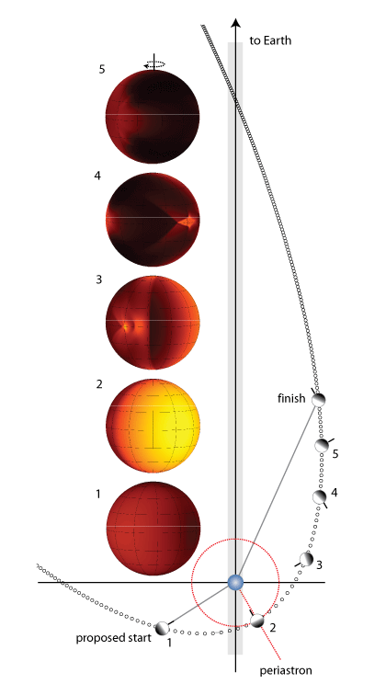
Eccentricity Seasons

Slide 23
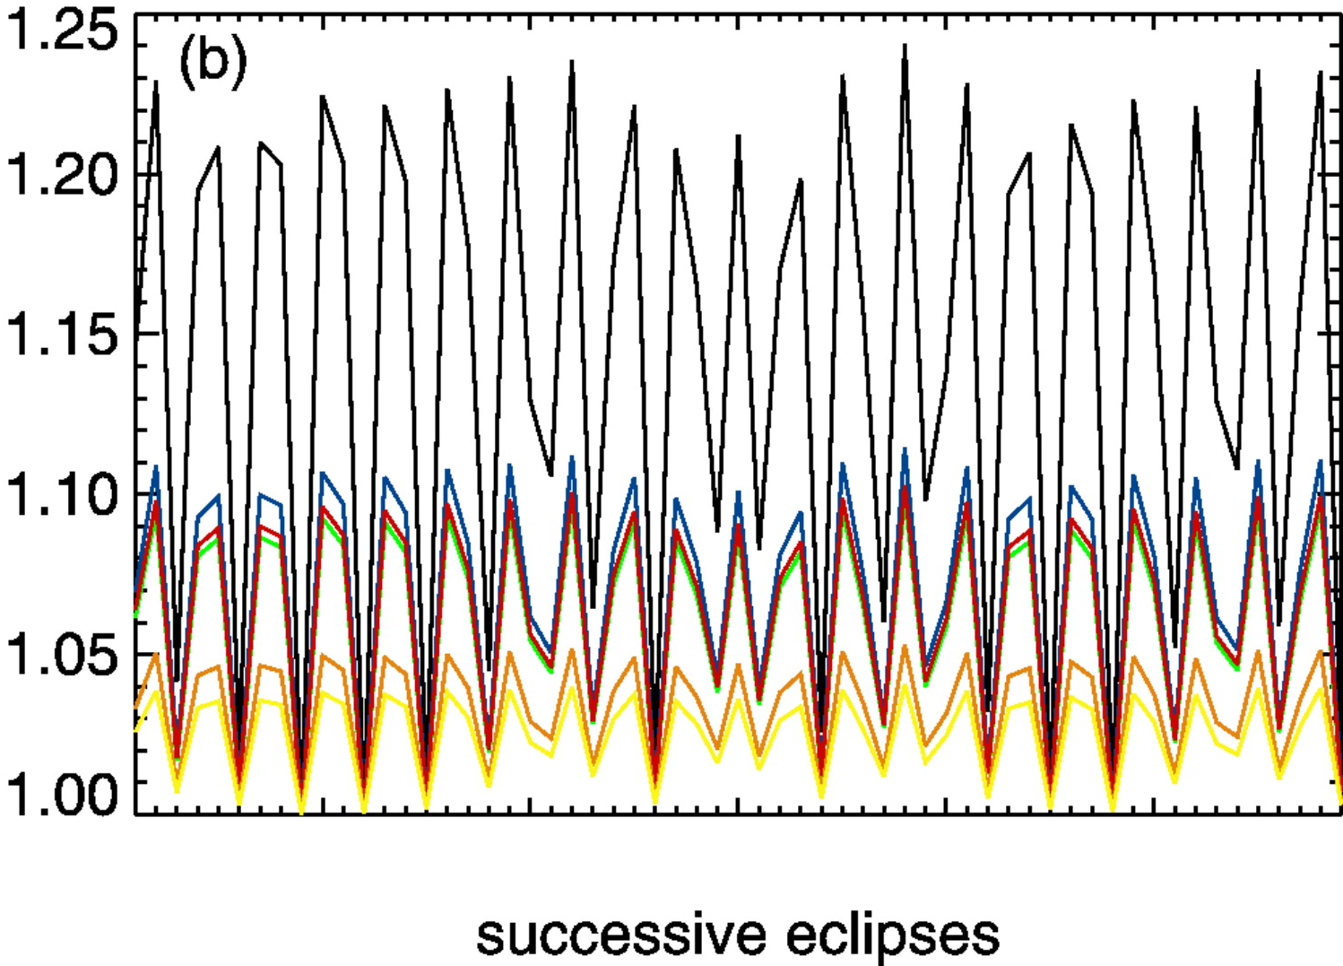
Weather
Relative Eclipse Depth
Rauscher+(2007)

Slide 24
JWST Methods Summary
Transmission Spectroscopy (at transit)
Atmospheric Opacity & Scale Height
Low pressures near terminator
East vs. West terminator
Emission Spectroscopy (throughout orbit)
Brightness Temperature (Opacity & T-P profile)
Modest pressures at tropical latitudes
2D dayside, 1D nightside map
Variability
Seasons
Weather

Slide 25
If Exoplanets Are Cloudy/Hazy Then Also Need:
UV-Vis Reflectance Spectrum (at all phases)
Characterize cloud morphology
Identify cloud particles
High-Res IR Spectroscopy (at all phases)
Line cores probe low-pressures above clouds
(JWST Can’t Deliver these things)

Slide 26
Outstanding Questions (what SAG X will ponder)
Quantify JWST transiting planet capabilities
Will it have enough time to do it right?
What Can’t JWST Do?
High-Res Spectroscopy
UV-Vis transit/eclipse/phase
What Else Should NASA be Considering?
(Formalize this in a SAG X Charter by November)

Slide 27
SAG X Plans
ExoPAG 9 (at 2014 AAS meeting in DC)
Presentations from JWST instrument teams
Presentation from EChO team?
10-15 page report by mid-2014
In time for mid-decadal review

Slide 28
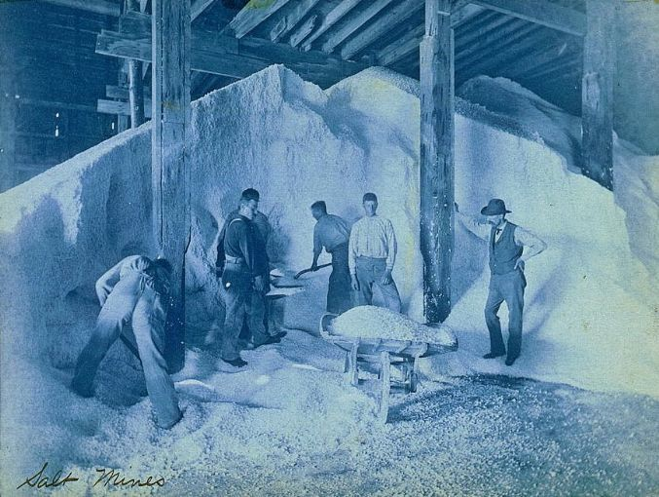
SAG X Needs You!
Talk to Nick (don’t worry: no commitment!)
n-cowan@northwestern.edu
www.nickcowan.com

