Slide 1
Overlap of Direct Imaging and Radial Velocity Searches
Nick Cowan, SAG 9
(Northwestern University)

Slide 2
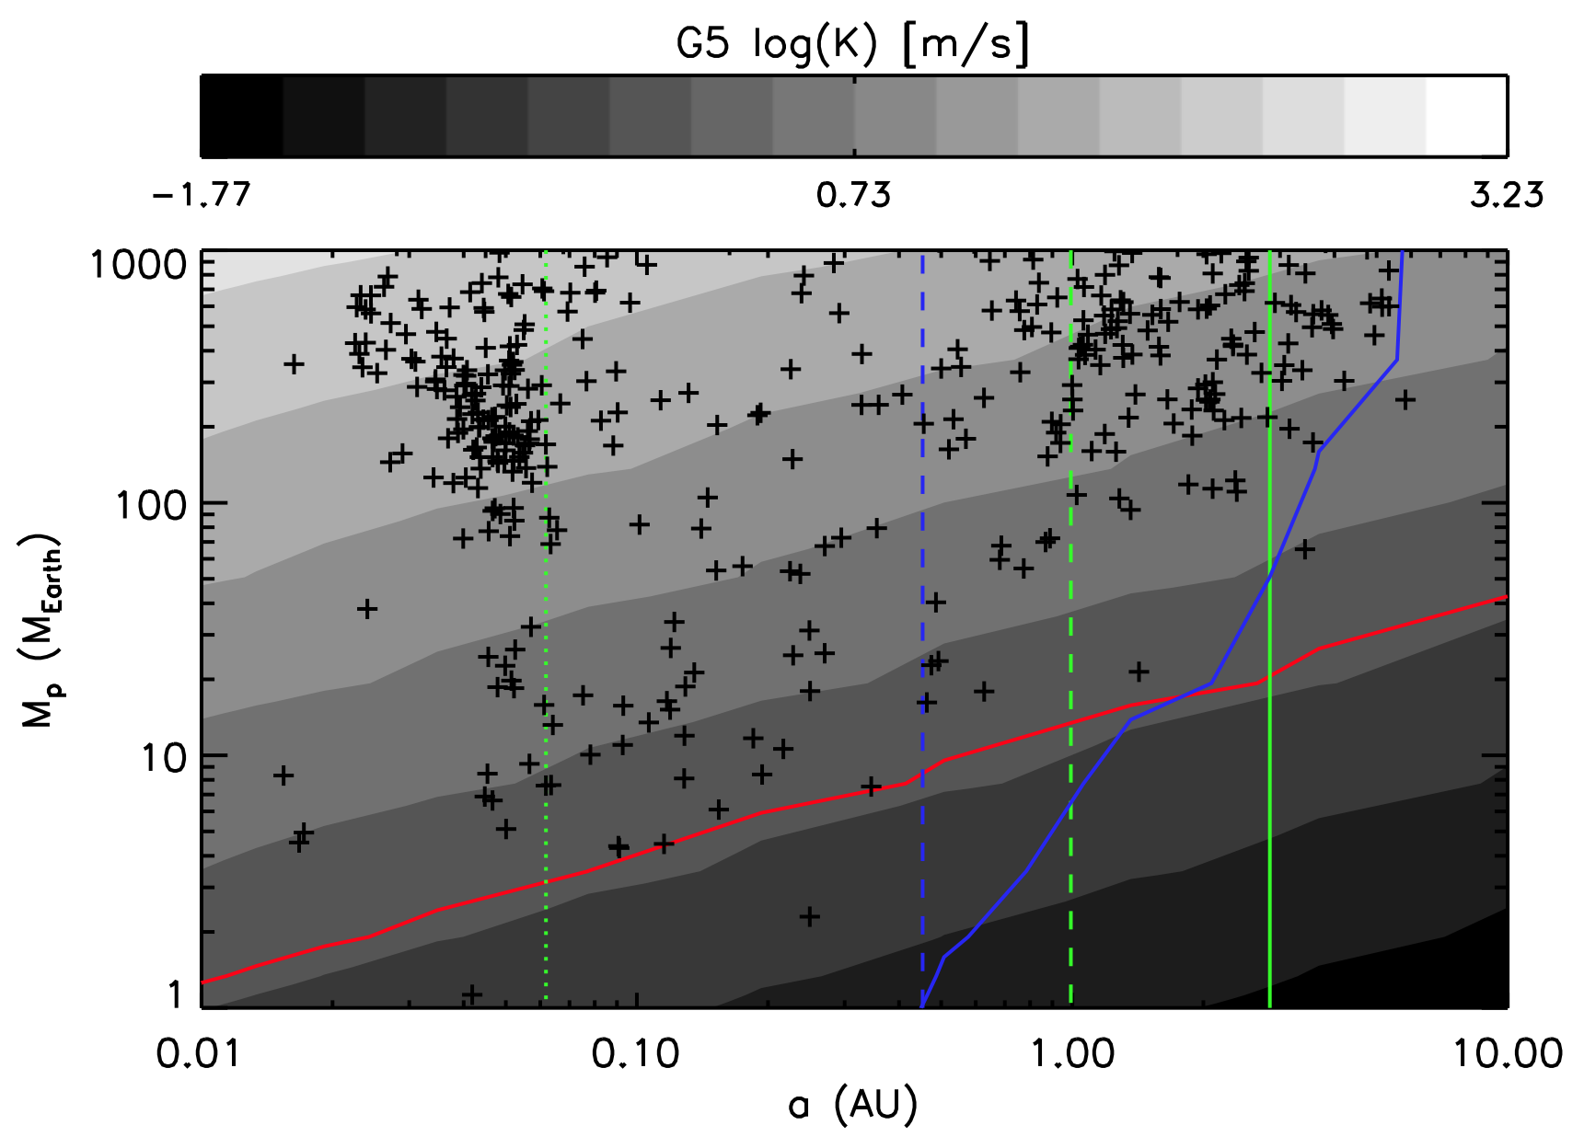
IWA = 100 mas
Contrast = 10⁻⁹
known
planets
RV = 1 m/s
T = 140 K
T = 1000 K
T = 255 K
Notes:
Inner Working Angle for tenth-nearest G-star.
Temperatures are Emitting temperatures for 30% Albedo
Contrast Ratios Assuming median M-R relation and 30% Albedo

Slide 3
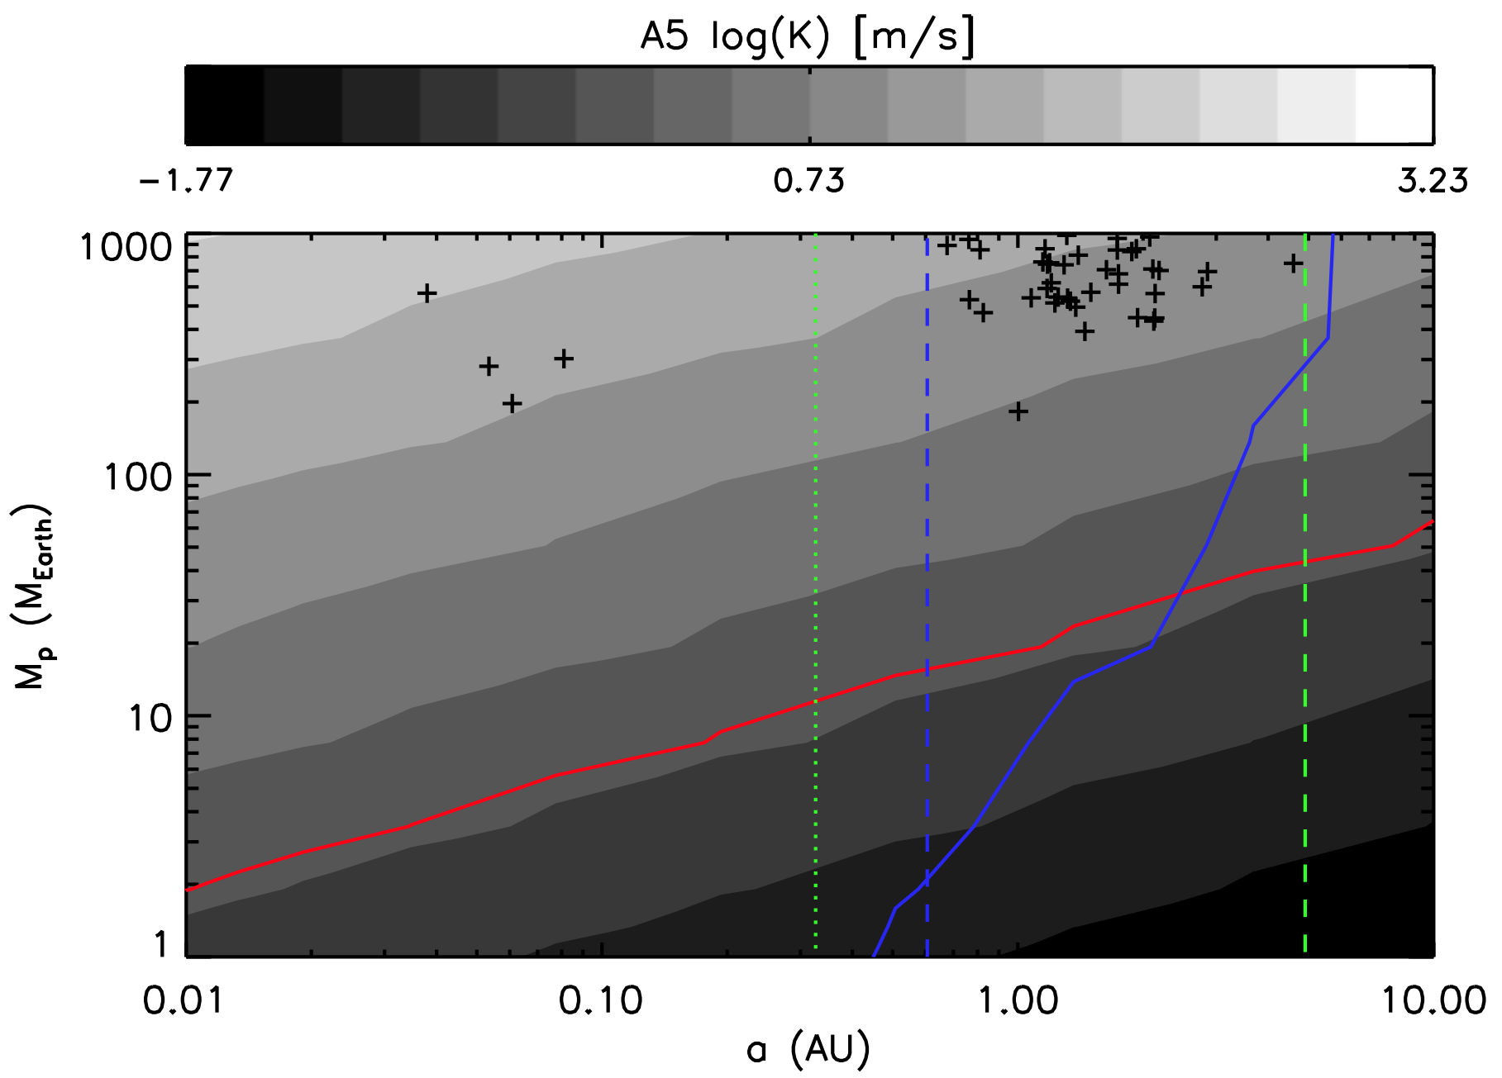

Slide 4
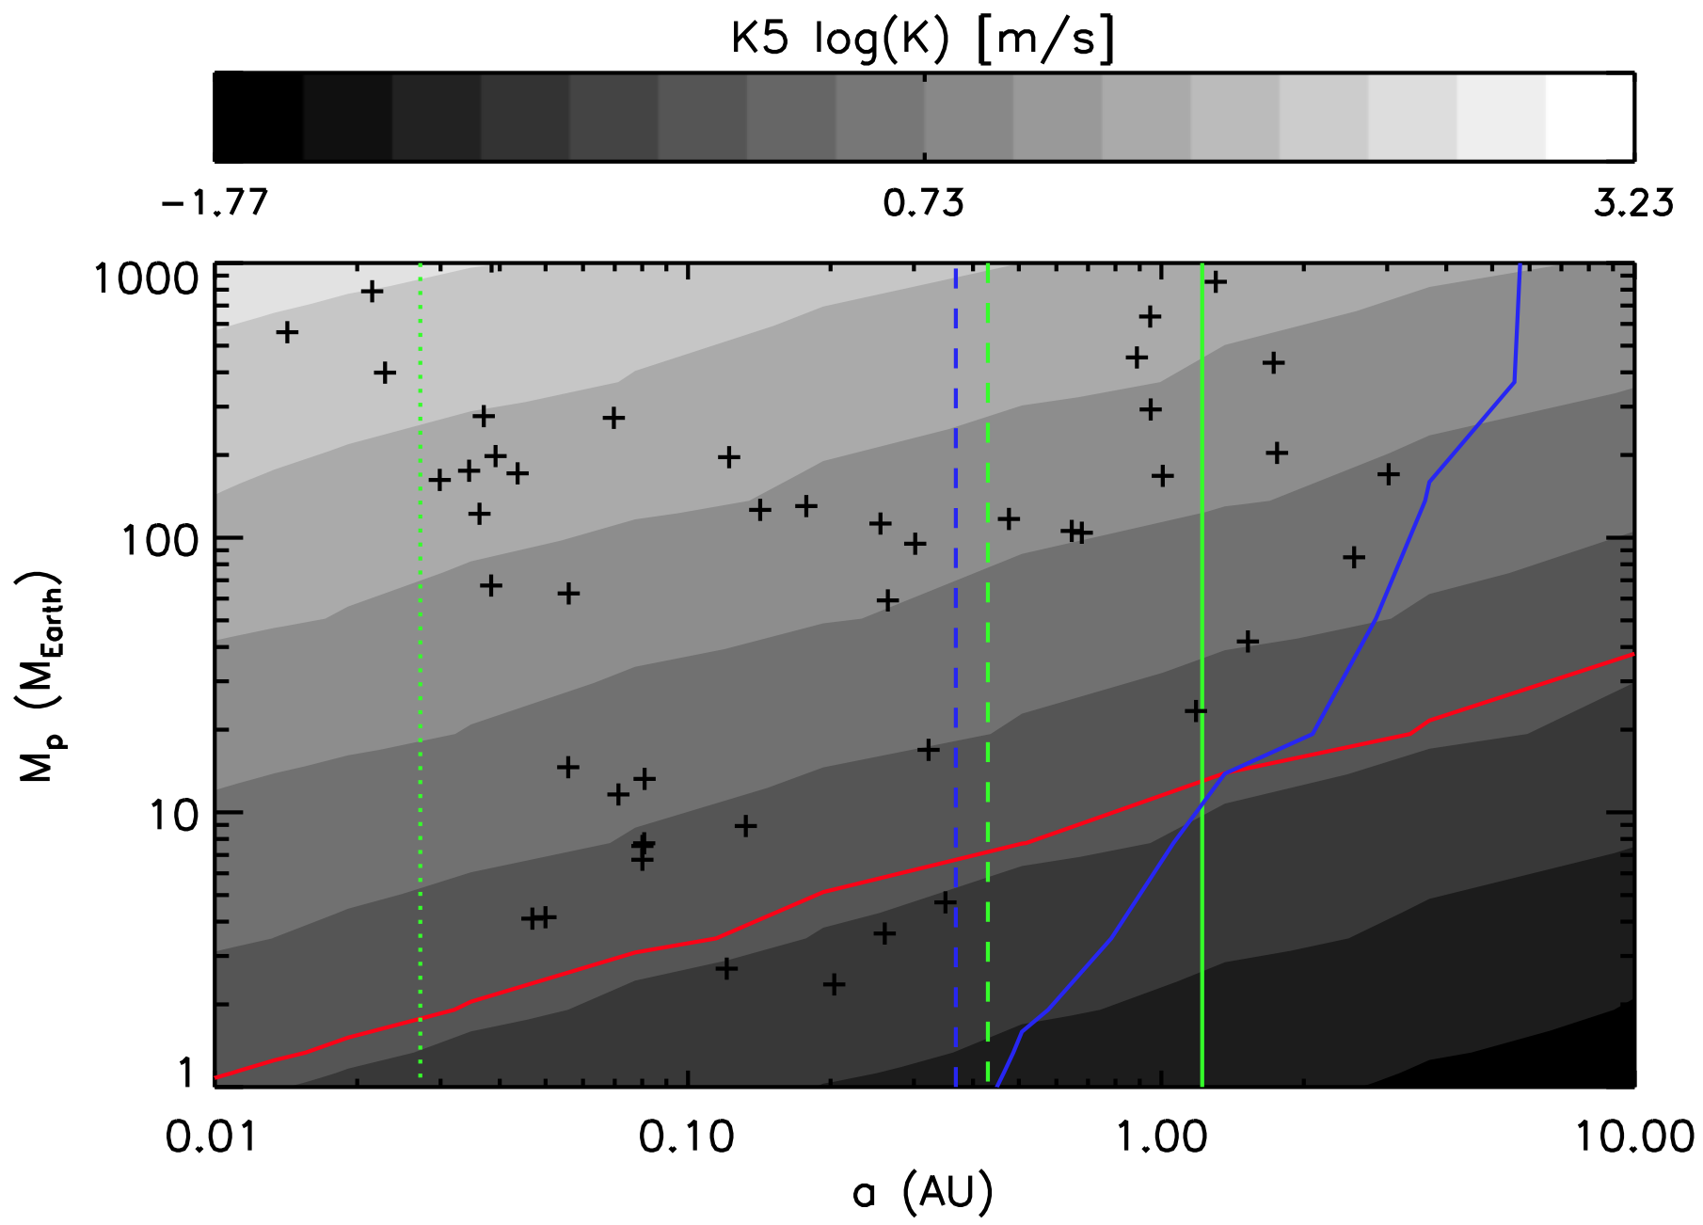
Virgin Territory

Slide 5
Is Overlap a GOOD THING?
Pros:
Know which stars to observe
Know where and when to observe given stars
Know planetary mass
Cons:
Not probing new parameter space

Slide 6
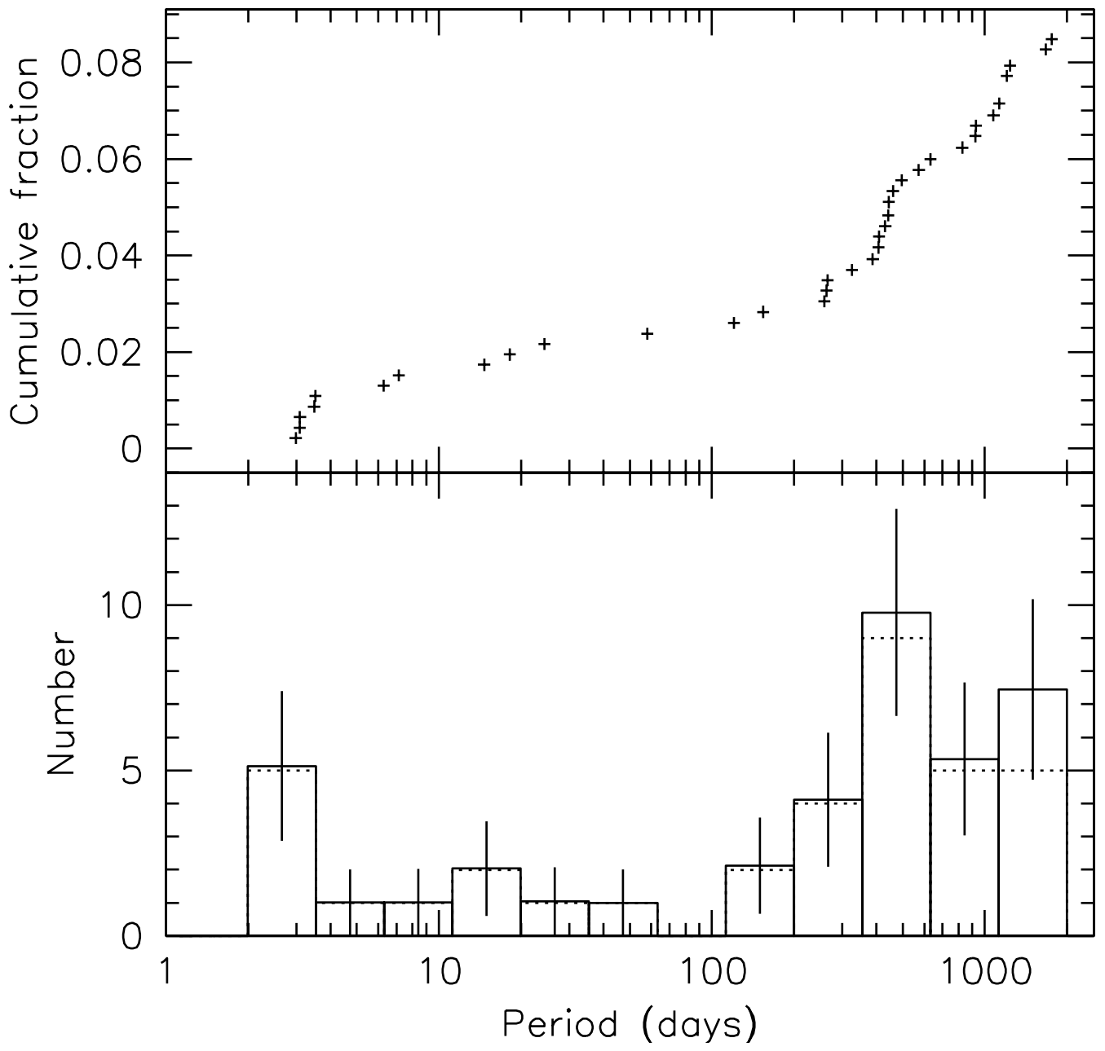
20% of FGK Stars Have Gas Giant within 20 AU (better odds for smaller planets)
Cumming+(2008)

Slide 7
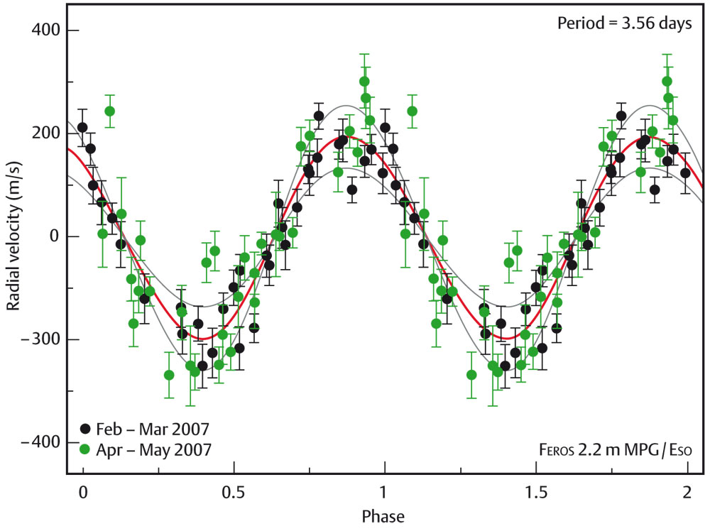
Knowing When/Where to Look

Slide 8
Knowing When/Where to Look

Slide 9
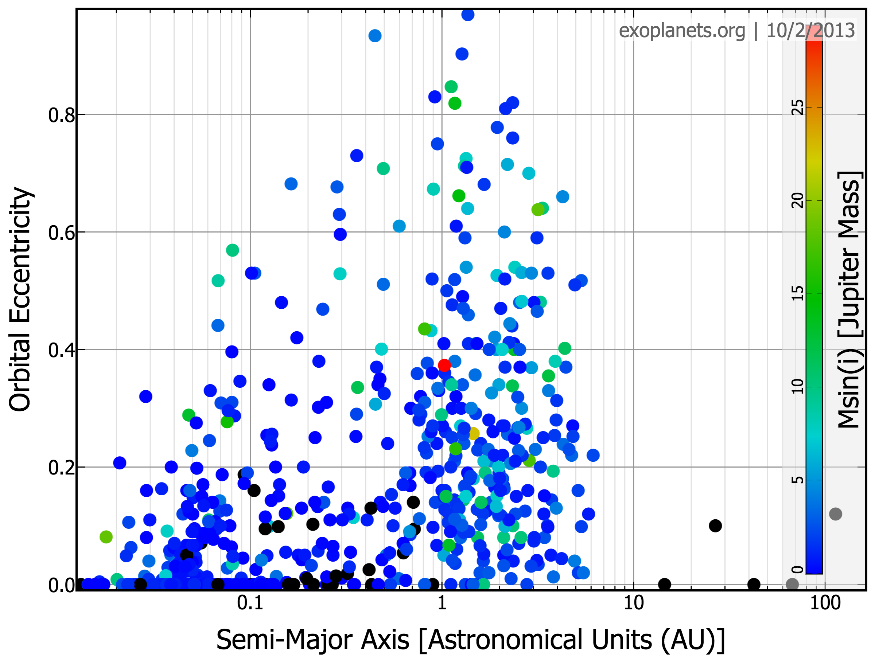

Slide 10
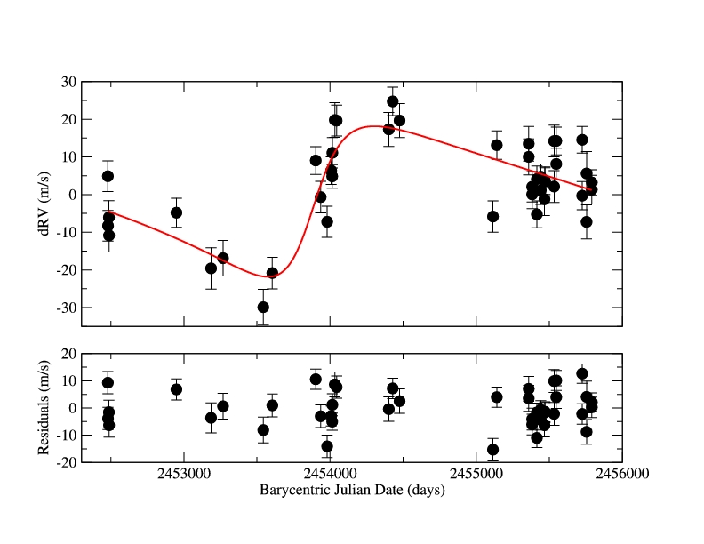
Knowing When/Where to Look
Non-Zero Eccentricity
Unkown Inclination

Slide 11
Good News: we know e and ω
Blind Search
|esin(ω)|
No Problem
Only One Max-Elong
|ecos(ω)|

Slide 12
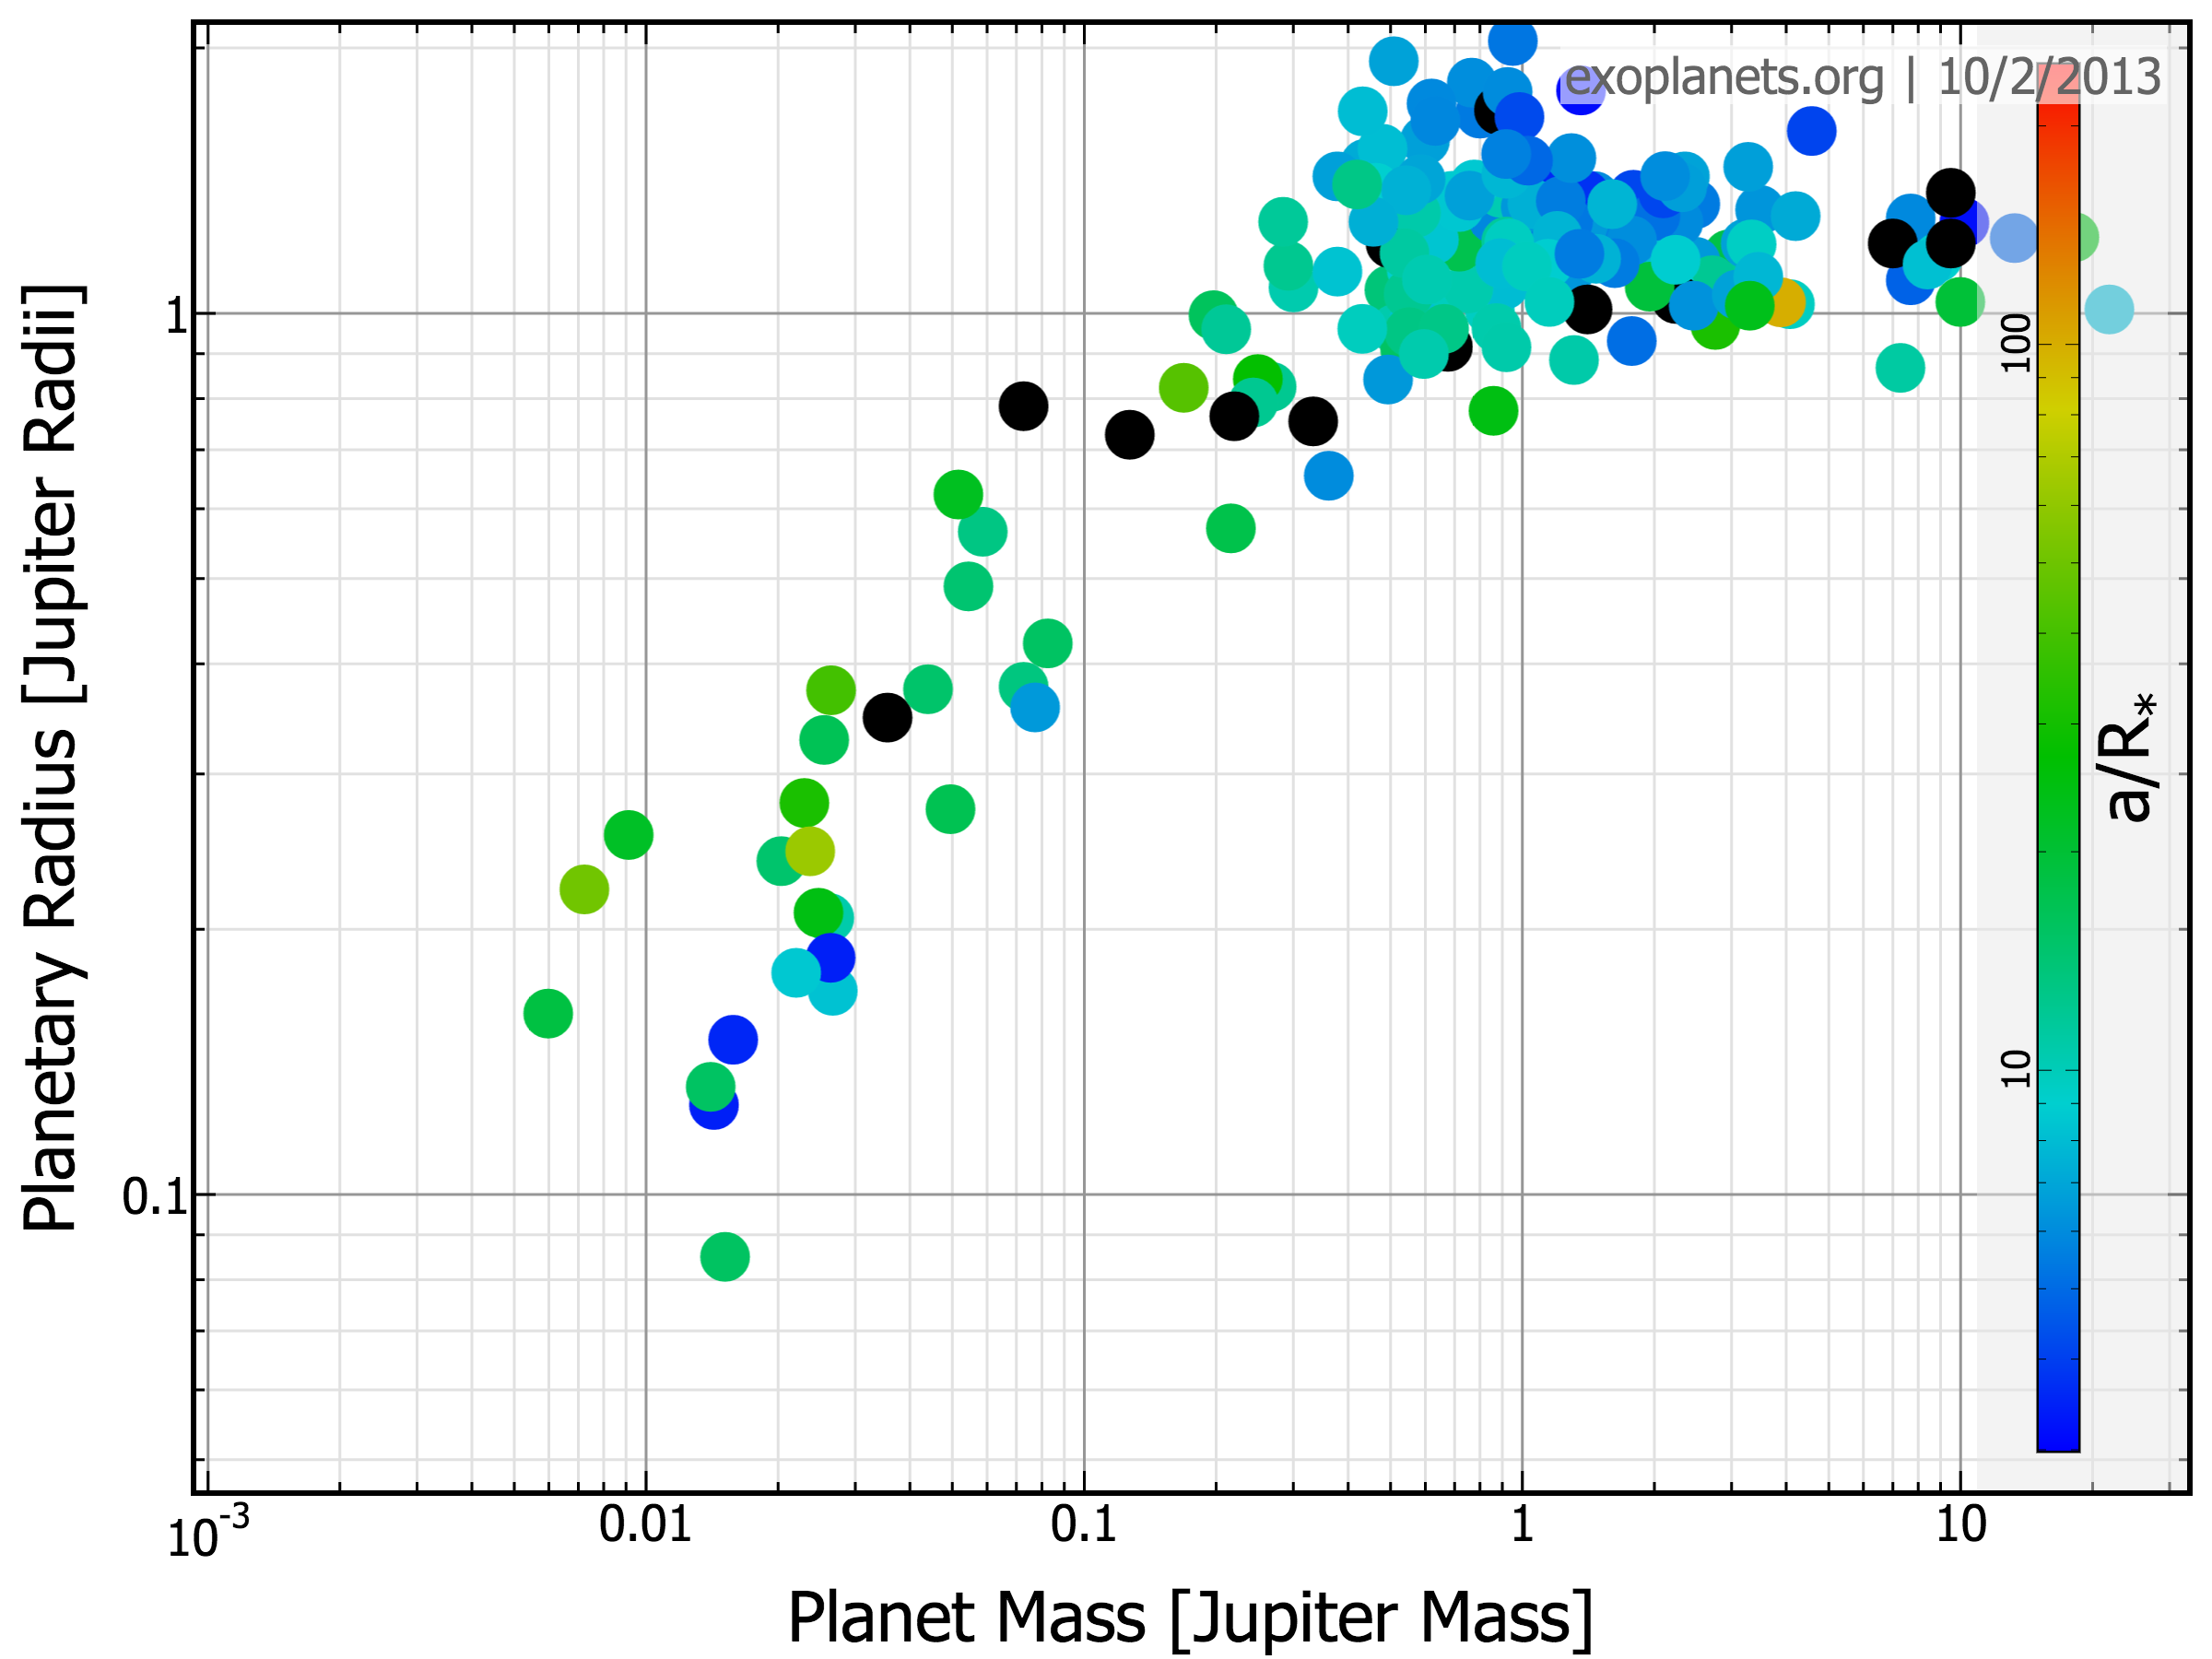

Slide 13
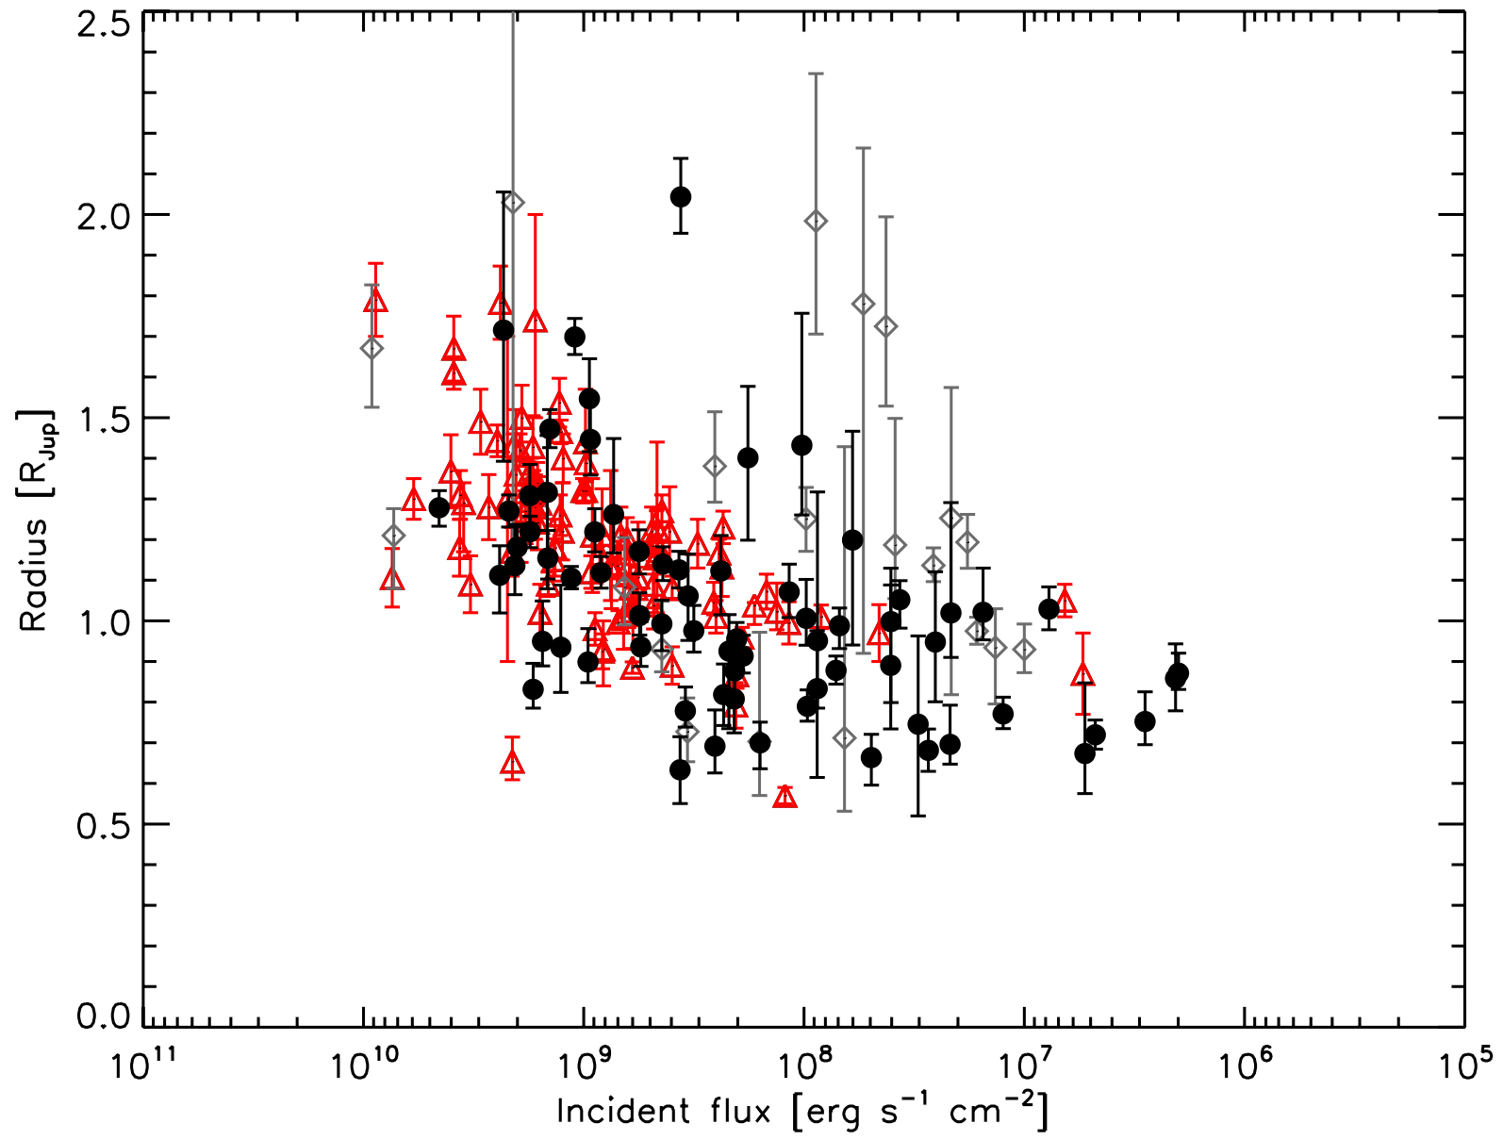
Demory & Seager (2011)

Slide 14
Overlap is a GOOD THING
Pros:
Know which stars to observe
(5x improvement)
Know where and when to observe stars
(roughly 2x improvement)
Know planetary mass
(convert brightness to albedo)
10x improvement in efficiency of finding planets

Slide 15
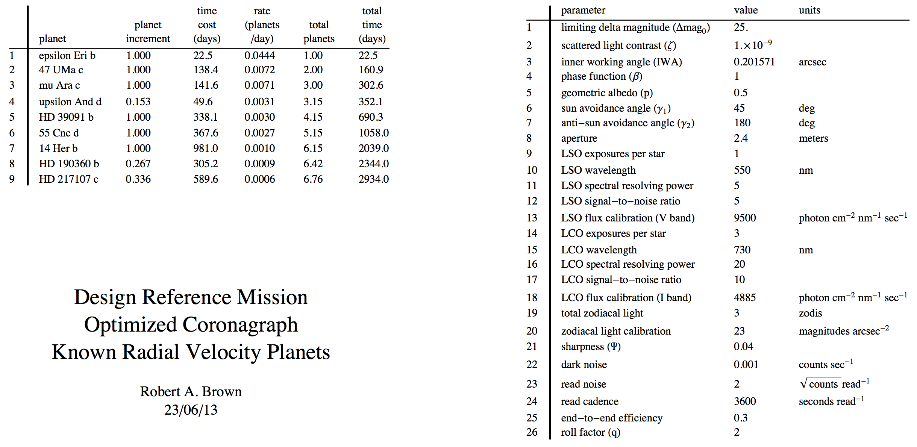
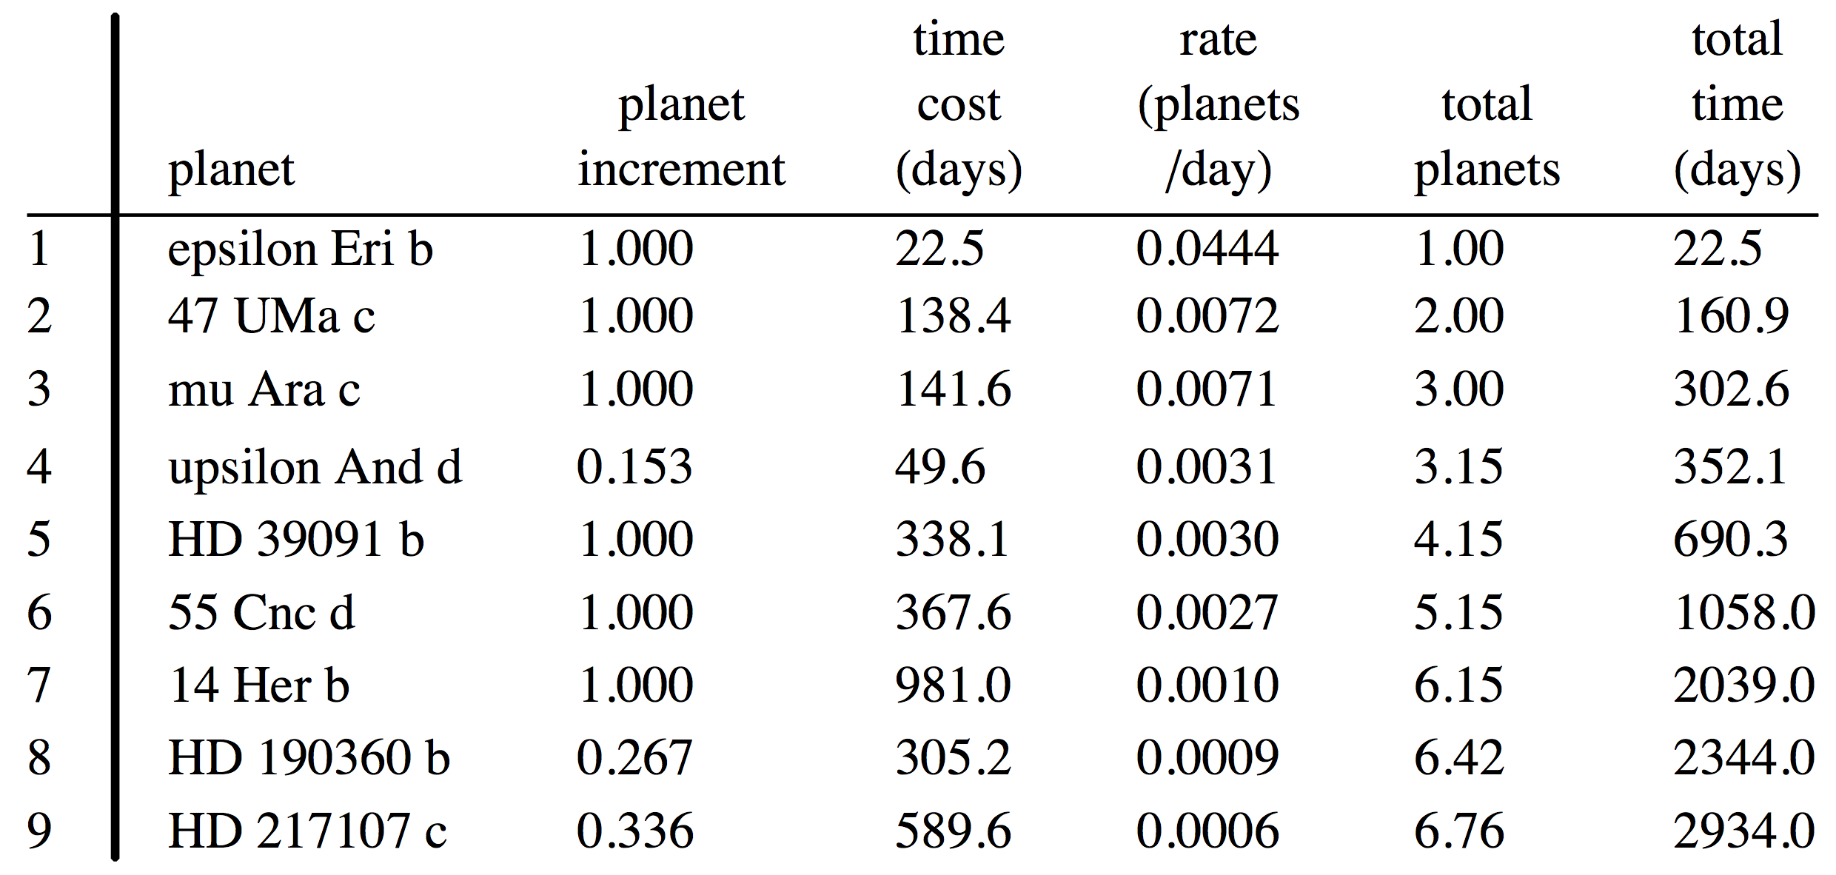
Which Known RV Planets could a Notional DI Mission Detect?
R. Brown (pers. com.)

