Slide 1
Douglas Hudgins
Exoplanet Exploration Program Scientist
Presentation to ExoPAG#8, Denver Colorado
October 5, 2013

Slide 2
Astrophysics Budget Strategy
The goal is to be prepared to start a new strategic Astrophysics mission to follow JWST as soon as funding becomes available, while continuing to advance Decadal Survey science during the interim.
Use the scientific priorities of the 2010 Decadal Survey to guide strategy and inform choices.
In order to prepare for a new mission, a near term program of science definition teams, mission concept studies and technology development is being undertaken with the goal of informing a mid-decade decision on which mission will begin formulation starting as early as FY17
Moderate missions (“probes”) are being studied, in addition to a large mission (WFIRST), to be prepared for a mid-decade decision.
Mission concepts studied derive from the science objectives of the prioritized missions and recommendations in the Decadal Survey.
AFTA-WFIRST (WFIRST using existing 2.4m telescopes)
WFIRST (2 design reference missions already studied, including WFIRST-probe)
Exoplanet Probes (moderate missions using internal or external occulters)
X-ray Astrophysics Probe (moderate mission addressing IXO science)

Slide 3
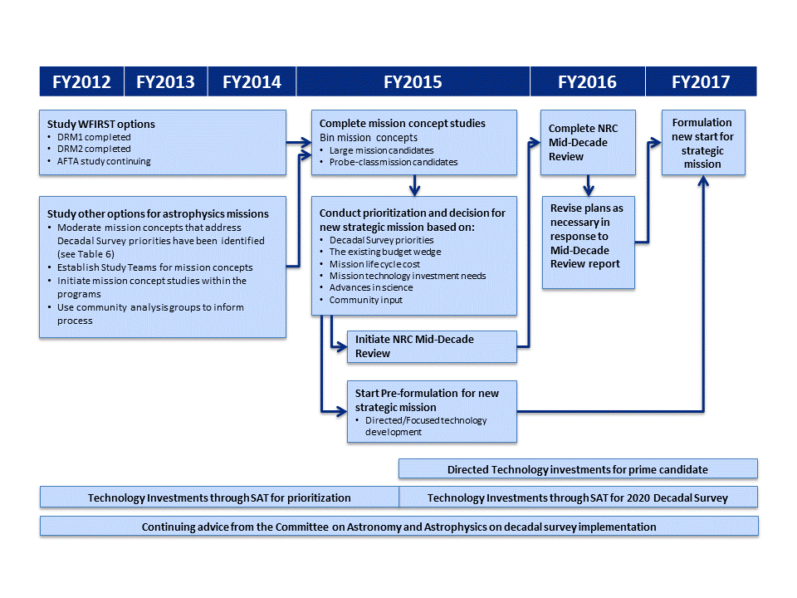
Preparing the next strategic mission
Spring 2013: Begin AFTA preformulation following Administrator’s decision
Winter 2015: Final SDT reports to NASA and CAA; CATE on each
Identified SDT studies:
Versions of WFIRST (2012) Exoplanet probe(s) (2013)
X-ray probe (2013)
Spring 2015: CAA study of all SDT reports resulting in a NRC letter report
Spring 2014: Interim SDT reports to NASA and CAA
Astrophysics Implementation Plan (CY2012)
Astrophysics Roadmap (CY2013)
ESA’s L2/L3 process
Notes:
Redraw this chart

Slide 4
The Role of the AFTA Coronagraph Workshops
The addition of a coronagraph to the AFTA-WFIRST mission concept
Very exciting to the NASA Administrator who explicitly approved continued study of a coronagraph for an AFTA-WFIRST mission.
NASA also interested in this as a way to realize direct imaging exoplanet science much earlier than anticipated in the decadal survey.
Prompt prioritization of possible coronagraph architectures will allow necessary focusing of limited resources on development of a primary and a backup coronagraph design.
Exoplanet Program Office at JPL, AFTA Study Office at GSFC coordinating efforts to support Astrophysics’ primary objective to be prepared to start a strategic mission after JWST.
Decision of primary and backup coronagraph architectures fn AFTA-WFIRST mission will be made by the Astrophysics Division Director based on recommendations from the AFTA Study Office and the Exoplanet Exploration Program Office.
AFTA Study Office/Exoplanet Exploration Program Office Recommendations will be based on the analyses provided by the AFTA Coronagraph Workshops.

Slide 5
FY13 Appropriation
Congress appropriated $659M for Astrophysics and $628M for JWST.
Astrophysics appropriation is $10M over FY13 PBR, earmarked for WFIRST.
JWST appropriation is what was requested.
Rescission (~1.8%), Sequester (~5%), and other budget adjustments resulted in an FY13 Astrophysics budget significantly lower.
Astrophysics ended up at $617M and JWST ended up at $628M for FY13.
Includes $7M for AFTA studies.
Astrophysics made reductions totaling $42M (6.4%) in the following areas.
Reduced carry-over for operating missions, includes rephasing of GO funds.
Rephased unneeded FY13 reserves for developing missions.
Rephased R&A funding until FY14 for some PIs, reduced selections.
Slowed down development of current and future Explorers.
Postponed needed upgrades in infrastructure programs.
Downstream impacts will include.
Lowered R&A selection rates in 2013 (for FY14 funding).
Delays in future Explorer AOs.
Other reductions in FY14 where funding requirements were deferred.

Slide 6
Astrophysics FY14 Budget Request Features
What’s changed (since the President’s FY13 budget request in 2/12)
A new Explorer mission (TESS) and a new Explorer Mission of Opportunity (NICER) downselected for development leading to flight.
New Euclid project created in PCOS program to fund hardware procurement and US science team.
Spitzer, Planck, Chandra, Fermi, XMM, Kepler, Swift, and Suzaku extended per the recommendation of the 2012 Senior Review.
Efficiencies in Fermi mission operations implemented in FY14, ahead of schedule and resulting in a significant reduction of operating costs, plus reduced GI selections for one year.
Budget does not support selections for the 2012 Astrophysics Explorer Mission of Opportunity AO.
What’s the same
JWST funded to maintain progress toward 2018 launch.
Hubble, SOFIA, NuSTAR, Astro-H, ST-7, Balloons, Sounding Rockets, R&A, Archives.
Budget for large decadal survey mission begins to grow in FY17.

Slide 8
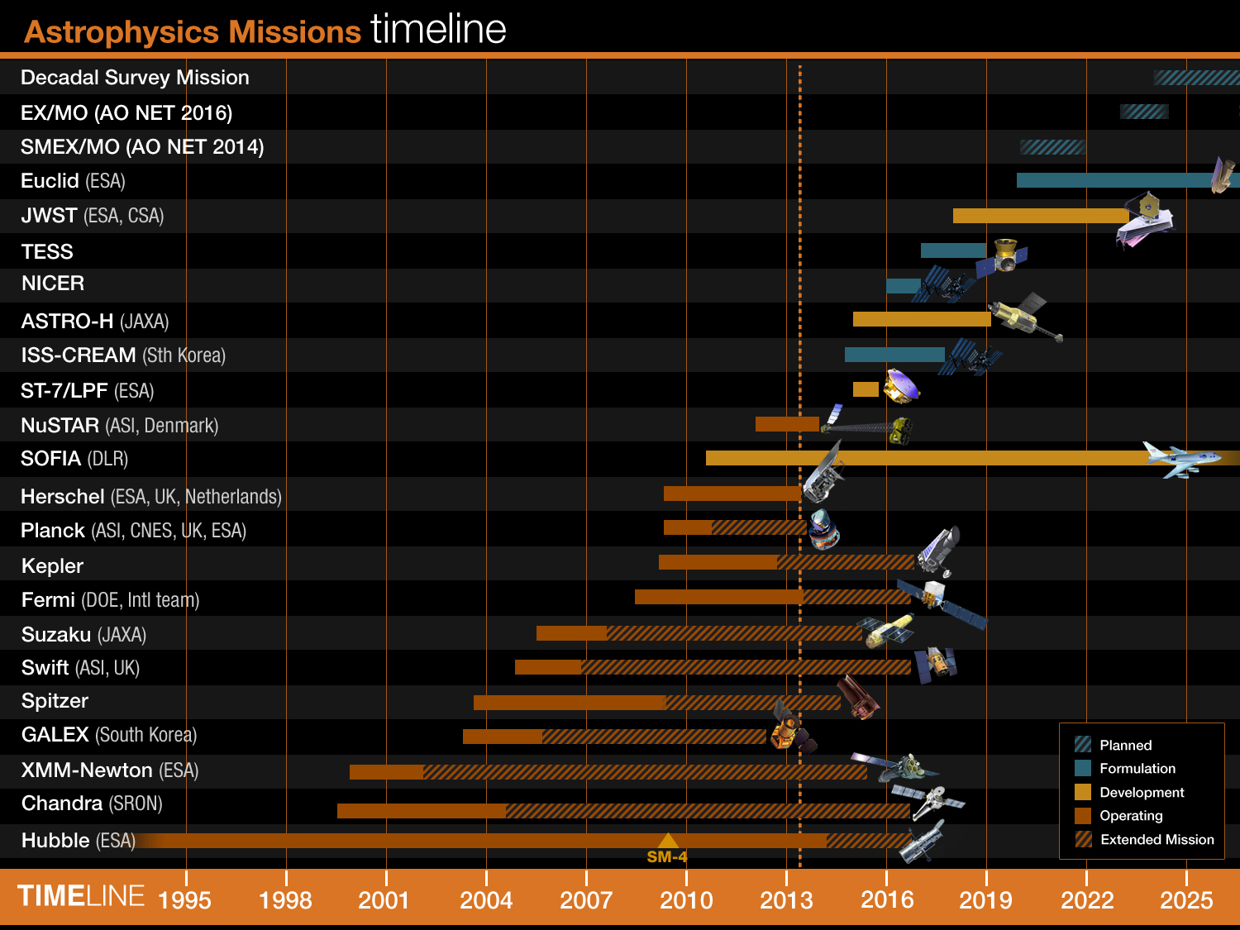
Last updated: April 15, 2013
Launch in 2020
Launch in 2018
Launch in 2017
Launch in 2016
Launch in 2015
Launch in 2014
Launch in 2015
Herschel cryogen depleted in April 2013
GALEX NASA science mission ended February 2012. Caltech mission May 2012- April 2013, Decommission in June 2013.

