Slide 1
EXOPLANET EXPLORATION PROGRAM ANALYSIS GROUP #8, Denver CO
Exoplanet Exploration Program
Overview
Gary Blackwood, Exoplanet Exploration Program Manager
Jet Propulsion Laboratory, California Institute of Technology
October 5, 2013
Copyright 2013 California Institute of Technology. Government sponsorship acknowledged

Slide 2
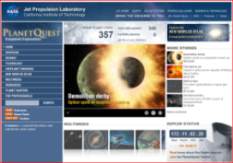
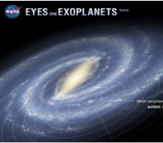
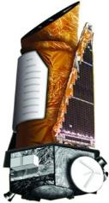
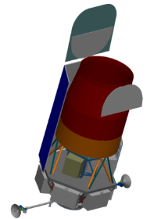
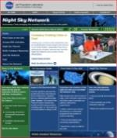
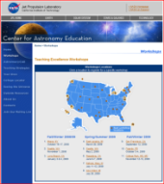
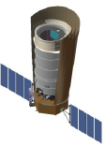
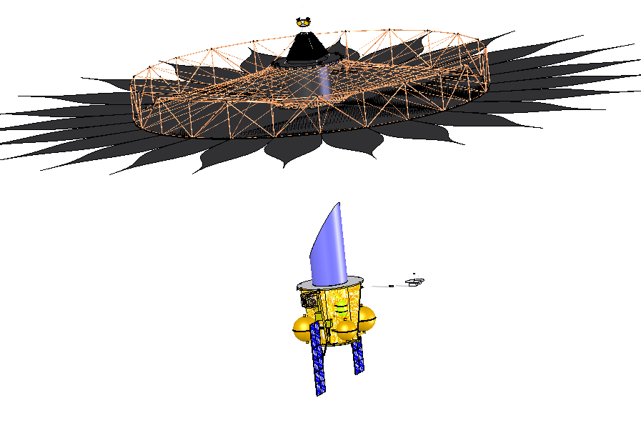
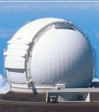
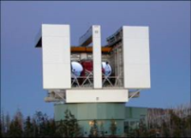

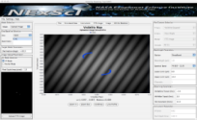
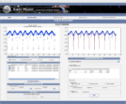
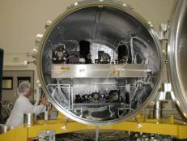
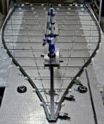

The Exoplanet Exploration Program:
Exploring New Worlds
Exploring How the Universe Works
Discovering and Characterizing Exoplanets
Searching for Signs of Life in the Galaxy
Space Missions and Mission Studies
Public Engagement
Probe-Scale:
Kepler
External Occulter (Starshade)
AFTA
Coronagraph
Supporting Research & Technology
Key Sustaining Research
Archives, Tools & Professional Education
Technology Development
Keck Single Aperture
Imaging and RV
Large Binocular
Telescope Interferometer
High Contrast
Imaging
Deployable
Star Shades
NASA Exoplanet Science Institute
2

Slide 3
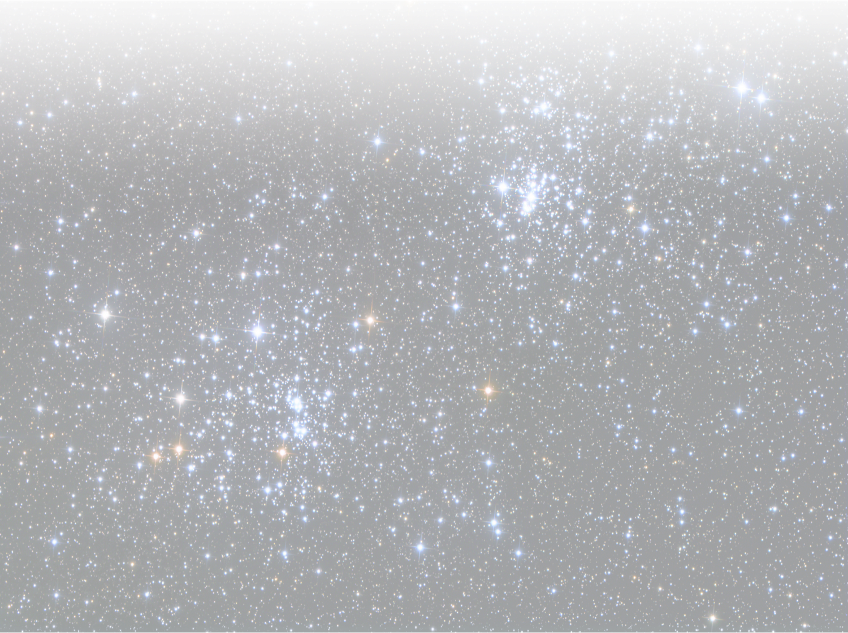
Exoplanet Exploration: A Decade Horizon
NASA-sponsored efforts
Fiscal Year
2013 | 2014 | 2015 | 2016 | 2017 | 2018 | 2019 | 2020 | 2021 | 2022 | 2023 | 2024
Kepler
Extended Mission Science
Keck
Single Aperture Science
Great
Observatories
Spitzer HST
Explorer Science
TESS
JWST Science
MIRI, NIRCAM
LBTI
ORR
ExoZodiacal Science
GO Program
Mid-decade
Review
2020 Decadal
Survey
AFTA +Coronagraph
AFTA
Pre Ph A
Formulation
Implementation
Concept
Report
LRD
Technology
SAT+Directed
SAT+Directed
NWNH Mission-Focused
Exoplanet
New Worlds
Mission
Concept
Report
TRL 5
TRL 6
Coronagraph Probe
Exoplanet Decadal Preparation
NWNH Exoplanet Mission
Starshade Probe
Concept
Report
Program defines Success as three compelling, viable mission concept reports by 1/31/15 with CATE by 2/28/15

Slide 4
Exoplanet Exploration Program
Organization Chart
Astrophysics Division, NASA HQ
Director – Dr. P. Hertz
Deputy Director/Program Director – A. Razzaghi
Astronomy Physics & Space Technology Directorate, JPL
Director for – D. Gallagher
Deputy Director for – Dr. D. Coulter
Exoplanet Prog. Exec. – Dr. A. Carro
Exoplanet Prog. Sci. – Dr. D. Hudgins
730
Exoplanet Exploration Program Office
Program Manager – Dr. G. Blackwood
Deputy Program Manager - Vacant
Program Chief Scientist – Dr. W. Traub (3200)
Program Technologist – Dr. P. Lawson (3800)
AFTA Program Executive – L. LaPiana
AFTA Program Scientist – Dr. D. Benford
AFTA Dpy Prog Scientist – Dr. D. Hudgins
Kepler Program Executive – Dr. A. Carro
Kepler Program Scientist – Dr. D. Hudgins
NExScI, LBTI Prog. Exec. – Dr. M. Perez
NExScI, LBTI Prog. Sci. – Dr. H. Hasan
ExoPlanet TAC¹
Alan Boss
Carnegie Mellon
7301
Program Science Office
Dr. S. Unwin (312)
AFTA – Dr. D. Stern (326)
AFTA - TBD
7303
Program Engineering Office
Manager - Vacant
Exoplanet Probe
STDT - Starshade¹
Prof. S. Seager, MIT
7304
Program Business Office
Manager – Vacant
Resource Analyst – L. Scott (252)
Export Tech Lia. – Dr. A. Abramovici (383)
Administrator – O. Pananyan (720)
Project Schedule Analyst – TBD
Staff Assistant – K. Miller (730)
Staff Assistant – M. Rubio (730)
Exoplanet Probe
Study Manager
K. Warfield (312)
Exoplanet Probe
STDT - Coronagraph¹
Dr. K. Stapelfeldt, GSFC
Mission Managers / Scientists
Kepler Mission Mgr – I. Heinrichsen (734)
Kepler Mission Sci – Dr. N. Gautier (326)
WFIRST Mission Mgr – I. Heinrichsen (730)
WFIRST Mission Sci – Dr. S. Unwin (312)
790
NASA Exoplanet Science Institute (Caltech)
Exec. Director –
Dr. C. Beichman (790)
Deputy Director – Dr. R. Akeson
Manager – Dr. D. Imel
Kepler (ARC)
Project Manager (Phase E) – R. Hunter
Project Scientist (Phase E) – Dr. S. Howell
Science PI – Dr. W. Borucki
7320
LBTI (Univ. of Arizona)
Manager – B. Parvin (730)
Principal Investigator – Dr. P. Hinz, U of A
Project Scientist – Dr. R. Milan-Gabet
7330
Program Technology (JPL)
Manager – Dr. N. Siegler (383)
AFTA Study Office (GSFC)
Study Manager – K. Grady
Study Scientist – Dr. N. Gehrels
AFTA SDT¹
Prof D. Spergel
Princeton U.
Dr. N. Gehrels
GSFC
7302
Program Education &
Public Outreach (JPL)
EPO Manager – M. Greene (183)
Web Manager – R. Jackson
Web Editor – J. Rodriguez
EPO Coordinator – A. Biferno
AFTA TAC
Alan Boss
Carnegie Mellon
Ground Observatories & Suborbital Activity
Manager – Dr. D. Imel
Keck Project Scientist –
Dr. R. Akeson
AFTA Study Office (JPL)
Telescope – Dr. J. Dooley (740)
Coronagraph – Dr. F. Zhao (383)
Technology – Dr. N. Siegler (383)
September 11, 2013
G. Blackwood
Exoplanet Exploration Program
¹Reports to HQs APD

Slide 5
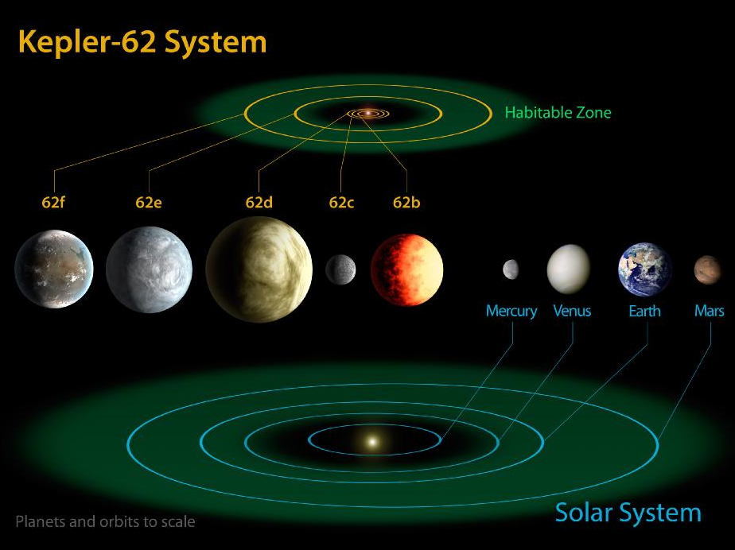
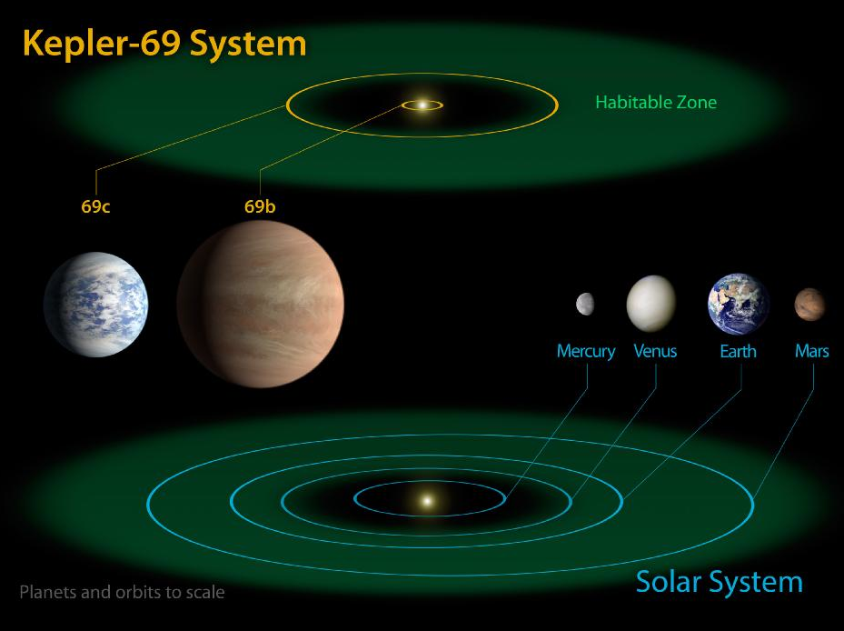
Major Program Events since ExoPAG7
Exoplanet Observatory abstract – 51 contributors
Kepler 62e, 62f, 69c – habitable zone
Kepler wheel failure ended science collection – 2 wheel science considered
Capitol Hill hearing on exoplanets
AFTA final report and strategic guidance
AFTA Coronagraph Working Group
LBTI – commissioning progress, secondary AO failure and recovery
Probe STDTs announced and active
TDEM-12’s selected and notified
Eyes on Exoplanets debut
ExoCat released – star database to 30 parsec

Slide 6
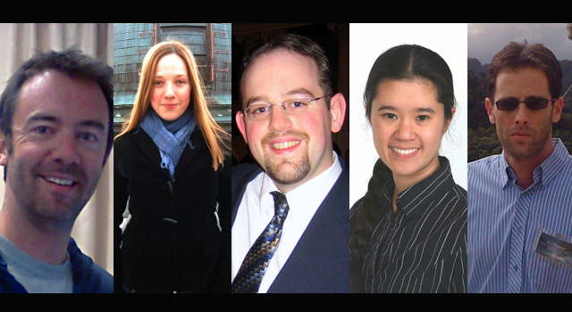
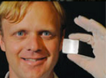
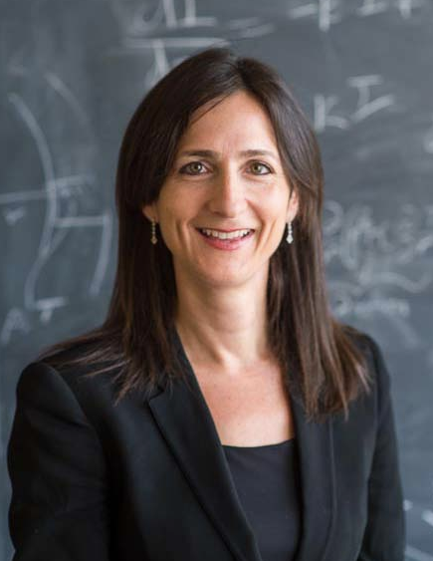
Special Recognition
Five newest Sagan Fellows:
  Jared Males, University of Arizona
  Katja Poppenhaeger, Harvard Smithsonian Center for Astrophysics
  Jacob Simon, Southwest Research Institute
  Jennifer Yee, Harvard Smithsonian Center for Astrophysics
  Avi Shporer, NASA JPL
Mike McElwain (GSFC) awarded NASA Roman Technology Fellowship - Integral Field Spectrometer
Sara Seager awarded MacArthur Grant

Slide 7
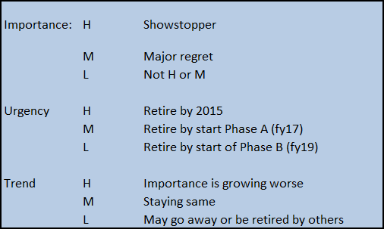
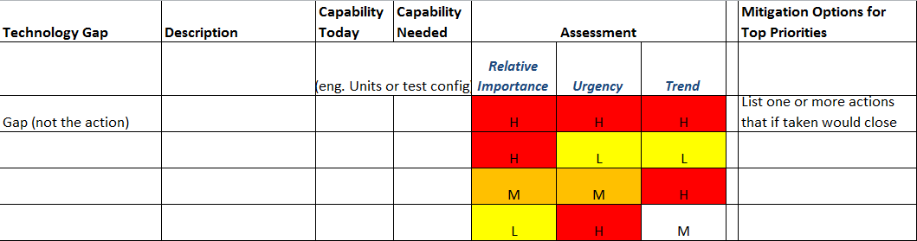
Recent Program Emphasis
Trades:
  Clarity on success criteria
  Account for Musts, Wants and Risk
  Encourages design options
Technology Concerns Prioritization:
  Account for Importance (Gap), Urgency and Trend
  Use for consistent communication
  Guide investments to retire top concerns

Slide 8
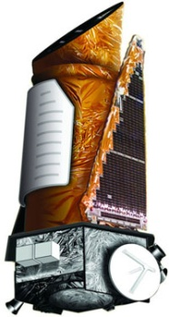

Kepler
Her X-1
August: attempted reactivation of the damaged wheels; Final attempt to control flight system caused freeze-up, all attempts to resume the original Kepler mission were abandoned.
The flight system is now behaving nominally in Point Rest State
SOC 9.2 remains on schedule, for a release on 10/18.
The Call for White Papers: “Soliciting Community Input for Alternate Science Investigations for the Kepler Spacecraft” resulted in 42 submitted papers.
  Peer-reviewed and ranked papers are ready for presentation to HQs as of 10/1.
The project developed a close-out plan for the mission, ready for presentation to HQs as of 10/1
September: started series of tests on two-wheel flight system:
  Initial pointing and maneuver tests encouraging
  Ka-downlink, ecliptic pointing and photometric test in Oct
Kepler Science Conference at NASA Ames Research Center from November 4 to 8, 2013.
Her X-1
Kepler
space
telescope

Slide 9
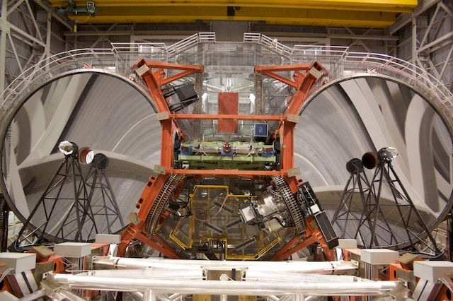
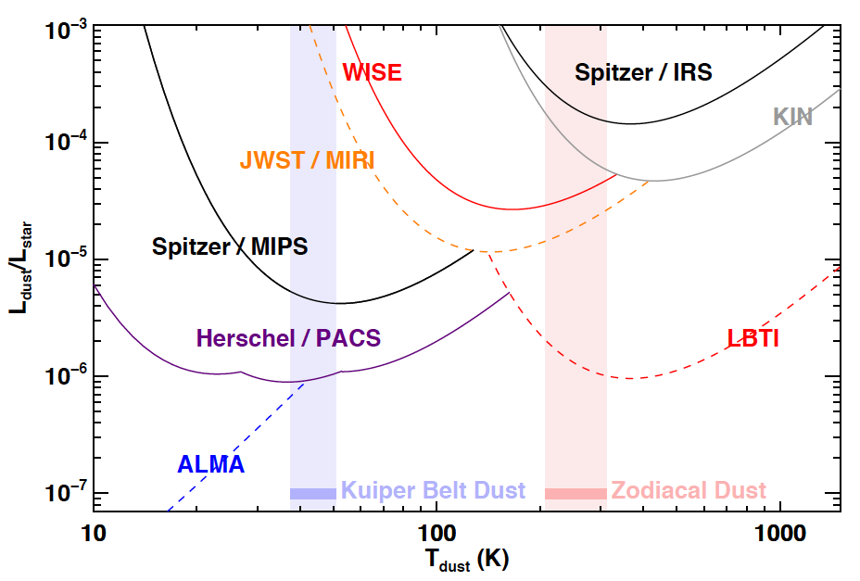
Large Binocular Telescope Interferometer (LBTI)
University of Arizona
Instrument Status:
    All subsystems finalized and demonstrated on-sky.
    Achieved open loop nulls on the sky.
Commissioning Status & Plans:
    Spring 2013 observing runs postponed due to failure of LBT adaptive secondary. Spare now ready.
    Finalize commissioning during Fall 2013 (3 runs, 6 nights):
      On-sky nulling with closed phase loop.
      Optimized & automated data sequences.
      First science demonstration data.
      ORR planned for Jan 2014.
NExScI Archive:
    Level 0 data archive v 1.0: operational since Jul 2012.
    Development plan:
      L1 v 1.0: Dec 2013.
      L2 v 1.0: Apr 2014.
      L0 v 2.0: Jun 2014.
Science Team: very active with data pipeline dev, definition of exozodi survey and target list, dev of observable modelling tools (leak ➔ zodis).
Science Capabilities: LBTI will enable characterization of exo-solar planetary systems
Survey 50 nearby stars for exozodiacal dust, at levels of 3-6 times(1σ) the dust in our own planetary system.

Slide 10
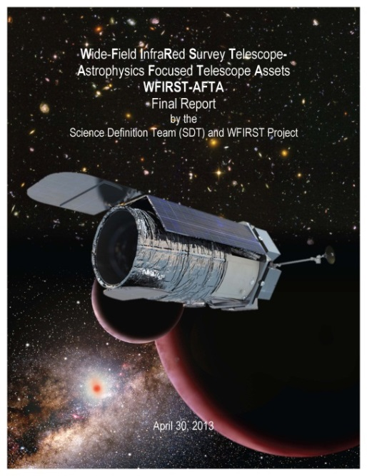
AFTA
May 30: Agency strategic guidance provided to proceed with pre-formulation studies for WFIRST science (dark energy, IR survey, exoplanet microlensing), and exoplanet direct imaging using coronagraph (now baseline)
Planning underway for Study Office, Detector Technology, Coronagraph Technology
Science Definition Team (SDT) reconvened; met September 9-10 to consider direct-imaging requirements
Technical Analysis Committee (TAC) formed; five coronagraph members added, will add IR detector membership later
Underway now: AFTA Coronagraph Working Group. Six architectures under consideration, for prioritization by December to focus near-term investments in design and technology

Slide 11
Exoplanet Probe STDTs
Exoplanet Probe Science and Technology Definition Teams (STDTs) chartered, membership selected
  Probe-class Starshade: Exo-S
  Probe-class Coronagraph: Exo-C
Purposes of Probe Studies per Charter:
  Potential alternatives to AFTA for strategic mission, 2017 new start
  Guide technology investments for latter part of decade
  Informs 2020 Decadal for habitable exoplanet imaging mission consideration
Success criteria include: compelling science, viable technology, $1B life cycle cost ($FY15)
STDT meetings (held jointly)
  July 1-2, GSFC
  September 11-12, MIT
  November 14-15, JPL
Mission concept reports and CATE due 1/31/15 and 2/28/15, respectively

Slide 12
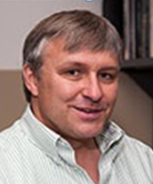
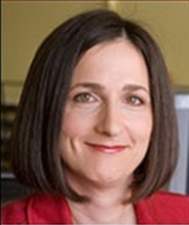
STDT Membership
Last | First | Organization
* Stapelfeldt | Karl | NASA Goddard Space Flight Center
Belikov | Rus | NASA Ames Research Center
Bryden | Geoff | Jet Propulsion Laboratory
Cahoy | Kerri | Massachusetts Inst. of Technology
Chakrabarti | Supriya | Univ. of Massachusetts, Lowell
Marley | Mark | NASA Ames Research Center
McElwain | Michael | NASA Goddard Space Flight Center
Meadows | Vikki | Univ. of Washington
Serabyn | Gene | Jet Propulsion Laboratory
Trauger | John | Jet Propulsion Laboratory
* Chair
Last | First | Organization
* Seager | Sara | Massachusetts Inst. of Technology
Cash | Webster | Univ. of Colorado
Domagal-Goldman | Shawn | NASA Goddard Space Flight Center
Kasdin | N. Jeremy | Princeton Univ.
Kuchner | Marc | NASA Goddard Space Flight Center
Roberge | Aki | NASA Goddard Space Flight Center
Shaklan | Stuart | Jet Propulsion Laboratory
Sparks | William | Space Telescope Science Institute
Thomson | Mark | Jet Propulsion Laboratory
Turnbull | Margaret | Global Science Institute
* Chair
Karl Stapelfeldt
GSFC Chairperson
Sara Seager
MIT
Chairperson

Slide 13
Exoplanet Probe Study Office
One Study Office, two coordinated design teams: fully staffed
  Study Office Manager: Keith Warfield
  Starshade Design Team Lead: Doug Lisman
  Coronagraph Design Team Lead: Michael Brenner
  Each has a full time team Leader and about 10 part time discipline experts
Completed initial Team X studies of both configurations
  Initial concepts for both probes designed and costed by JPL’s Team X
  Team X design and cost models (and a Team X engineer) have been delivered to both design teams for quick mission-level trade studies
Design trades are underway on both Design Teams
  Error budgets, Mission-level trades
  An initial telescope optical design established for the coronagraph STDT
  Mechanical configuration work is underway on both teams
An initial CATE meeting was held Sept. 3 with Aerospace Corp.
  Aerospace presented and answered questions on the CATE process
  STDT and Design Team members presented materials on the state of coronagraph and starshade technology development
Preliminary prioritized technology needs delivered by both STDTs
Probe
Starshade
Probe
Coronagraph

Slide 14
Coronagraph Technology: Recent TDEM results
Best contrast to date using two deformable mirrors in HCIT-1:
  Jeremy Kasdin’s demonstrated raw contrast ratio of 3.8e-9 between working angles of 5-9 λ/D in monochromatic light. The pupil was unobscured and the coronagraph mask was a shaped pupil.
  The deformable mirrors were Xinetics continuous surface sheet, z-directional PMNs.
Phase Induced Amplitude Apodization (PIAA) coronagraph (Olivier Guyon/UA) operated at broadband (10% ) and reached approximately 2e-8 raw contrast ratio over 2-4 λ/D working angles (unobscured pupil).

Slide 15
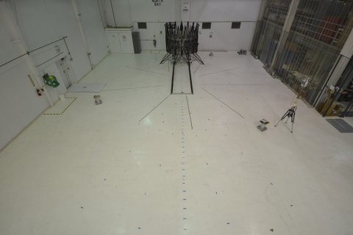
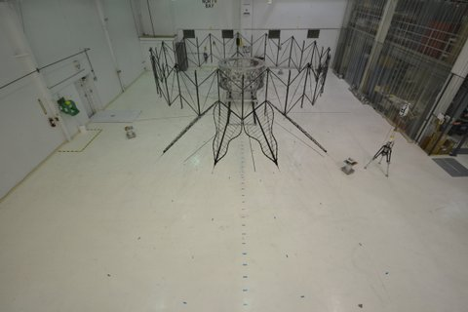
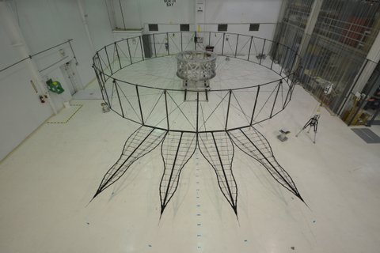
Starshade Technology
Starshade technology TDEM led by PI Jeremy Kasdin: a first look test at deployment repeatability from a partially stowed position easily met 500 um deployment requirement
  Four JPL-built starshade petals were integrated with a NGAS-Astro built inner disk structure and central hub at the Astro facility in Goleta, CA.
  Integrated system successfully deployed multiple times with metrology of the deployed shape after each deployment.

Slide 16
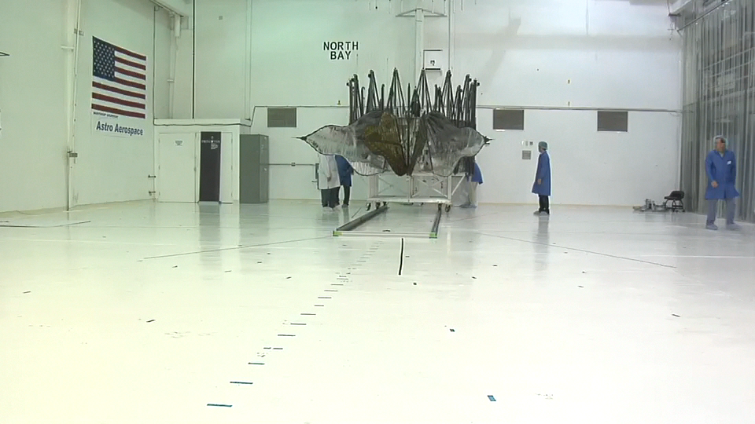
Starshade Deployment
Northrup Grumman's Goleta Facility

Slide 17
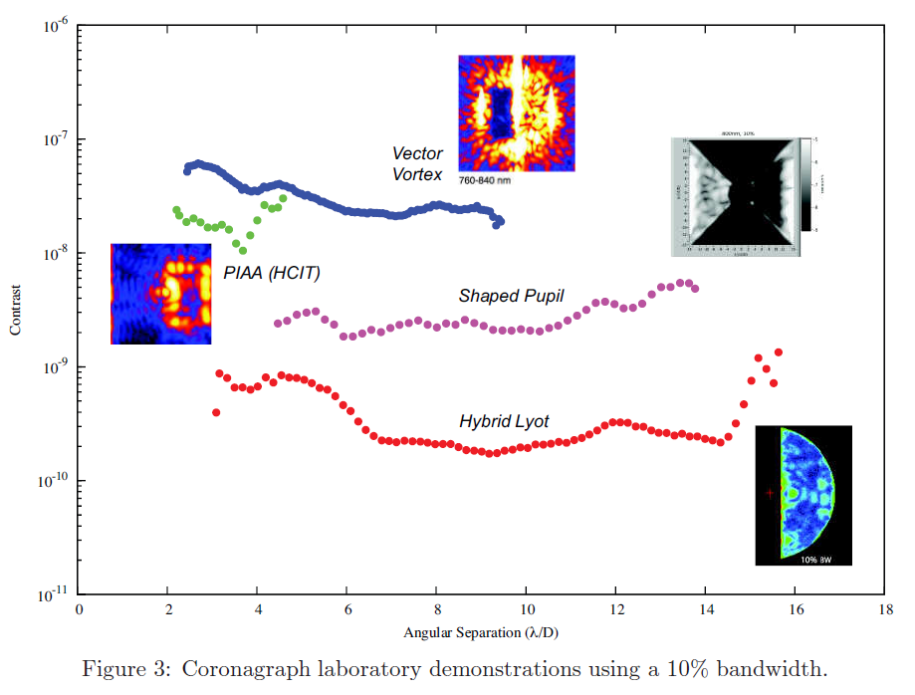
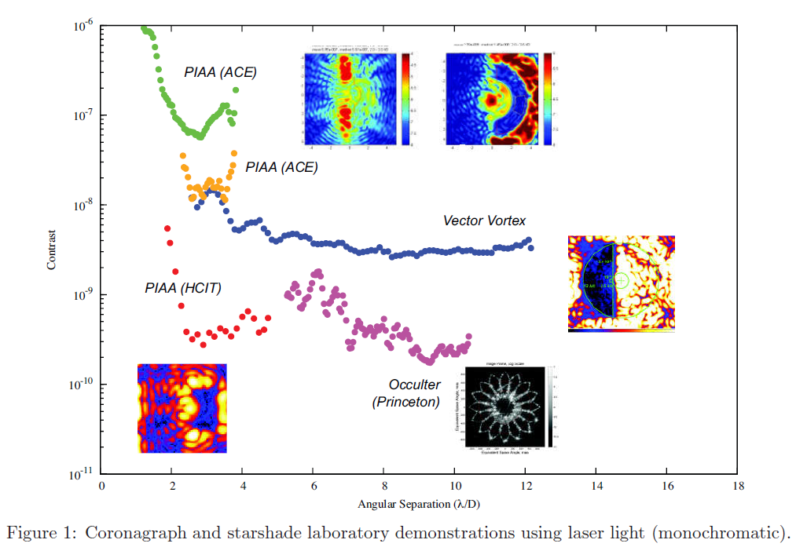
High Contrast Results
Lawson et al, SPIE 8864-50 (2013)
Internal Coronagraph,
10% bandwidth
Monochromatic Contrast
Internal and External Occulters

Slide 18
NASA Exoplanet Science Institute (NExScI)
Keck Single Aperture: very strong response to call for NASA Keck 2014A Observing Time
Call active for next Sagan Fellows (due Nov 7)
Sagan Fellow Poppenhaeger is the lead author on a paper with the first X-ray observations of an exoplanet transit.
Continued data archiving and Community Follow Up Program for Kepler
  Q16 Kepler light curves now available, along with new planet and planet-host data columns.

Slide 19
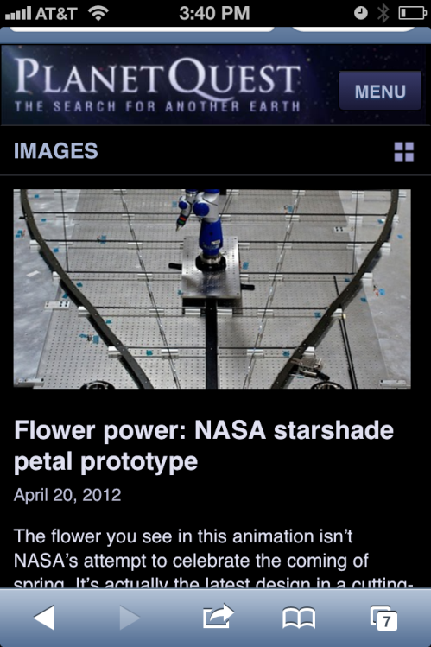
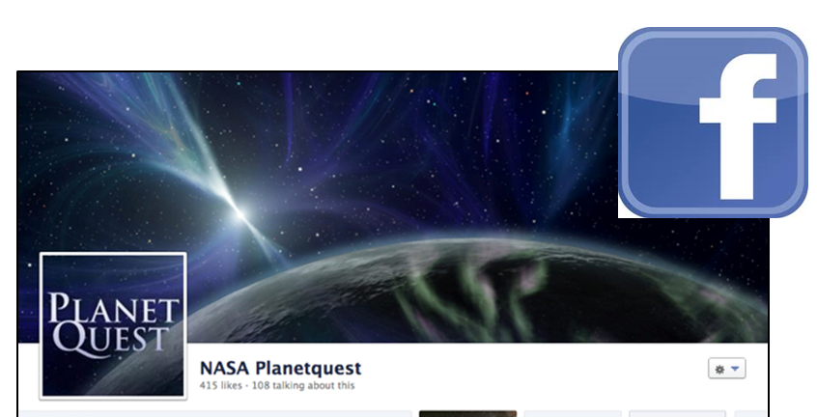
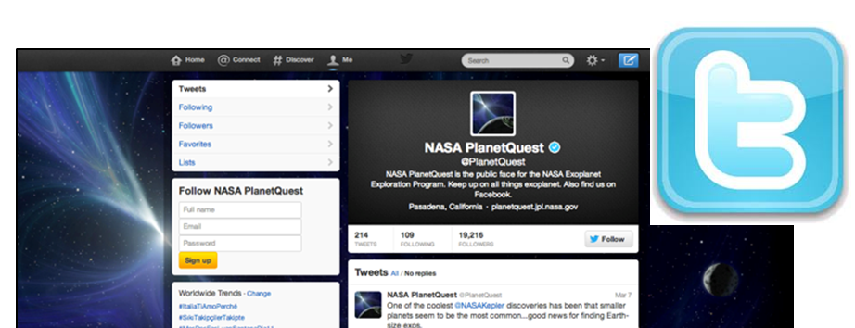
PlanetQuest
PlanetQuest has gone mobile
Find PlanetQuest on Facebook
Follow PlanetQuest on Twitter
Check out Program website
  Exep.jpl.nasa.gov
Check out Eyes on Exoplanets

Slide 20
Acknowledgements
This was carried out at the Jet Propulsion Laboratory, California Institute of Technology under a contract with the National Aeronautics and Space Administration. © 2013. All rights reserved.
Work also carried out by
  NASA Goddard Space Flight Center
  NASA Ames Research Center
Work also carried out by University of Arizona under a contract with the Jet Propulsion Laboratory
Work also carried out by Princeton University, University of Arizona and Northrop Grumman Aerospace Systems under contracts with the National Aeronautics and Space Administration.

